Slide 1
The status for odd-Z and superheavy nuclei
The 7th international workshop DRHBc mass table
July 1 - 4, 2024, Gangneung Green City, Gangneung, Republic of Korea
Peng Guo 郭鹏
School of Physics, Peking University
Notes:
超重核的检验：角动量截断的检验：约束计算
奇Z核：检查过程中遇到的问题

Slide 2
Outline
Introduction
Theoretical framework
Numerical details
Current status for odd-Z nuclei
Results for superheavy nuclei
Summary
Notes:
引言：
理论框架+数值细节：P4，RHB，Legendre+DWS，Blocking，数值细节
奇Z核结果检查与提交进度
结果与讨论：转动修正能问题+超重核数值细节

Slide 3
Introduction
Nuclear mass is one of the most fundamental quantities in atomic nucleus, and is important in not only nuclear physics but also other fields such as particle physics and astrophysics.
Experimentally, more than 3300 nuclides have been discovered, and the masses of about 2500 among them have been measured.
Theoretically, 7000-10000 nuclides are predicted to exist.
In the foreseeable future, the masses of most exotic nuclei far from the stability line still rely on theoretical predictions.
Lunney, Pearson, and Thibault, Rev. Mod. Phys. 75, 1021 (2003)
Meng (Ed.), Relativistic Density Functional for Nuclear Structure (2016)
Thoennessen, Discovery of Nuclides [https://people.nscl.msu.edu/~thoennes/isotopes/]
Wang, Huang, Kondev, Audi, Naimi, Chin. Phys. C 45, 030003 (2021)
Erler, et al., Nature 486, 509 (2012)
Moller, et al., Atom. Data Nucl. Data Tabl. 109-110, 1 (2016)
Xia, et al., Atom. Data Nucl. Data Tabl. 121, 1 (2018)

Slide 4
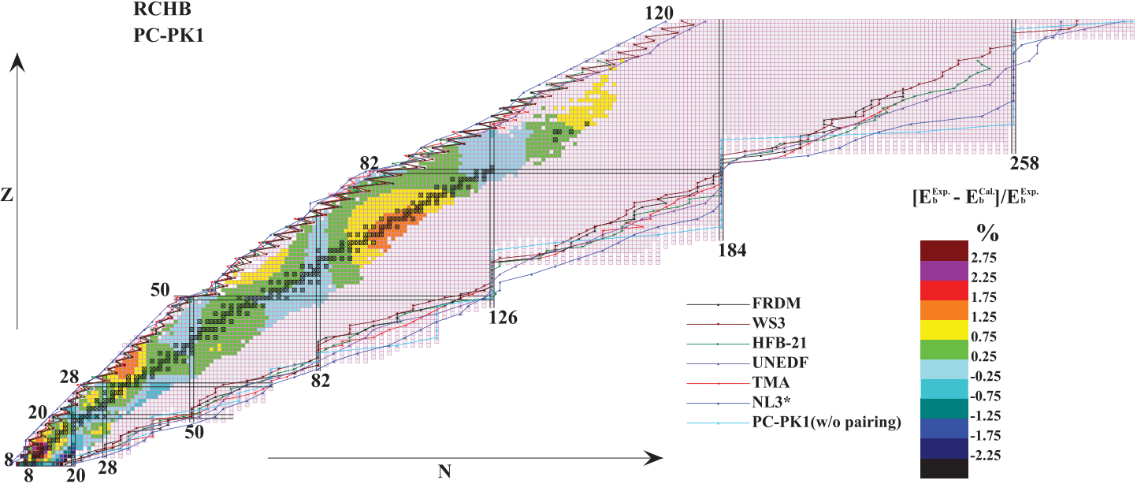
The RCHB mass table
Continuum and pairing correlations play an important role in exotic nuclei near the drip lines.
Meng and Ring, Phys. Rev. Lett. 77, 3963 (1996)
Meng, et al., Prog. Part. Nucl. Phys. 57, 470 (2006)
Based on the spherical relativistic continuum Hartree-Bogoliubov (RCHB) theory, the first nuclear mass table with continuum effects has been constructed.
Xia, et al., Atom. Data Nucl. Data Tabl. 121, 1 (2018)

Slide 5
The DRHBc theory
Except doubly-magic nuclei, most nuclei deviate from spherical shape.
To describe deformed exotic nuclei, the deformed relativistic Hartree-Bogoliubov theory in continuum (DRHBc) was developed, which simultaneously takes into account the effects of deformation, pairing correlations and continuum, and can provide a proper description for exotic nuclei.
Zhou, Meng, Ring, and Zhao, Phys. Rev. C 82, 011301 (2010)
Li, Meng, Ring, Zhao, and Zhou, Phys. Rev. C 85, 024312 (2012)
The DRHBc theory has achieved great success in many studies on exotic nuclei.
Sun, et al., Phys. Lett. B 785, 530 (2018)
Zhang, et al., Phys. Rev. C 100, 034312 (2019)
Sun, et al., Nucl. Phys. A 1003, 122011 (2020)
Sun and Zhou, Sci. Bull. 66, 2072 (2021)
Yang, et al., Phys. Rev. Lett. 126, 082501 (2021)
Sun, Phys. Rev. C 103, 054315 (2021)
Zhang, et al., Phys. Rev. C 107 L041303 (2023)
Zhang, et al., Phys. Lett. B 844, 138122 (2023)
An, et al., Phys. Lett. B 849, 138422 (2024)

Slide 6
The DRHBc mass table collaboration
To construct the relativistic nuclear mass table with the deformation and continuum effects by the DRHBc theory, the DRHBc Mass Table Collaboration was established.

Slide 7
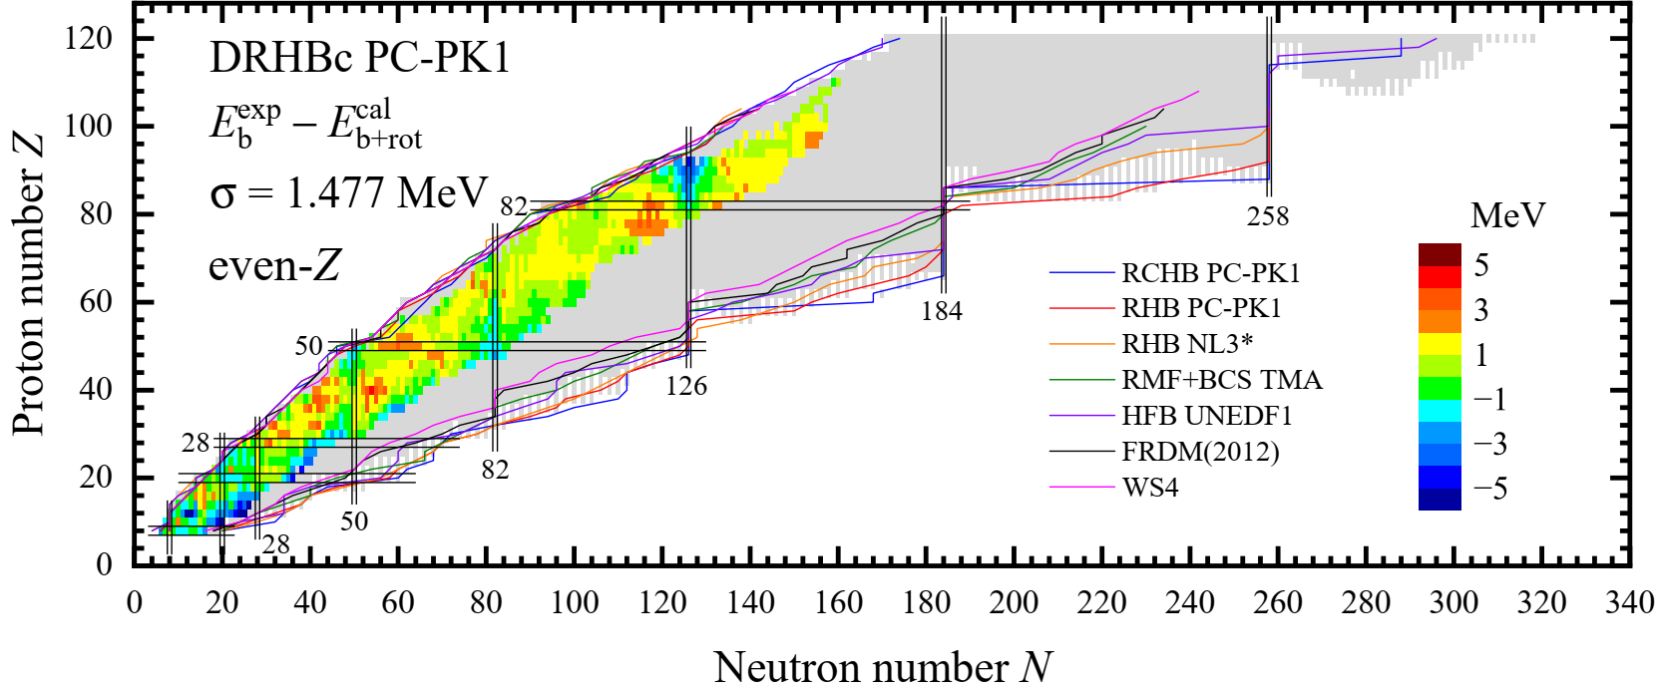
The DRHBc mass table: even-Z nuclei
The DRHBc mass table based on the density functional PC-PK1 has been constructed for even-even nuclei.
Zhang, et al. (DRHBc Mass Table Collaboration), Phys. Rev. C 102, 024314 (2020)
Zhang, et al. (DRHBc Mass Table Collaboration), Atom. Data Nucl. Data Tabl. 144, 101488 (2022)
With the DRHBc theory extended to odd systems, the DRHBc mass table for even-Z nuclei has been constructed.
Pan, et al. (DRHBc Mass Table Collaboration), Phys. Rev. C 106, 014316 (2022)
Guo, et al. (DRHBc Mass Table Collaboration), Atom. Data Nucl. Data Tabl. 158, 101661 (2024)

Slide 8
Recent works based on DRHBc calculations
Year
Evolution of N = 20, 28, and 50 shell closure in the 20 $≤$ Z $≤$ 30 region
Zheng, Sun, Shen, and Geng, Chin. Phys. C 48, 014107 (2024)
The unified description of halo nuclei ³⁷Mg from microscopic structure to reaction observables
An, Zhang, Lu, Zhong, and Zhang, Phys. Lett. B 849, 138422 (2024)
Nuclear mass predictions with the kernel ridge regression
Wu, Pan, Zhang, and Hu, Phys. Rev. C 109, 024310 (2024)
α-decay half-lives for even-even isotopes of W to U
Choi, Lee, Mun, and Choi, Phys. Rev. C 109, 054310 (2024)
Nuclear magnetism in deformed halo nuclei
Pan, Zhang, and Zhang, Phys. Lett. B 855, 138792 (2024)

Slide 9
Next step
The calculations for odd-Z nuclei with 8 $≤$ Z $≤$ 120 have been almost finished and examinations are in progress.
To explore the limit of nuclear landscape and evolution of shell structure, the calculations for superheavy nuclei with 121 $≤$ Z $≤$ 136 are suggested in last workshop.
The project plan has been made and calculations are in progress.
In this talk
The status for odd-Z nuclei is summarized.
The numerical checks and preliminary results for superheavy nuclei are introduced.

Slide 10
Outline
Introduction
Theoretical framework
Numerical details
Current status for odd-Z nuclei
Results for superheavy nuclei
Summary
Notes:
引言：
理论框架+数值细节：P4，RHB，Legendre+DWS，Blocking，数值细节
奇Z核结果检查与提交进度
结果与讨论：转动修正能问题+超重核数值细节

Slide 11
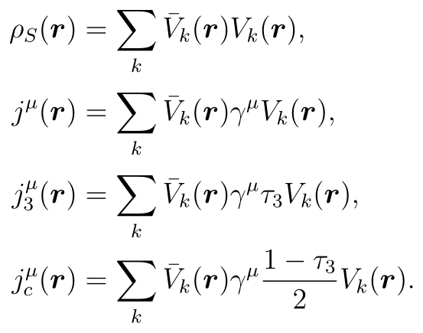
RHB equation
The mean fields and pairing correlations can be treated self-consistently by relativistic Hartree-Bogoliubov (RHB) equation
where h_{D} is Dirac Hamiltonian; Δ is pairing potential; λ_{τ} is Fermi energy; U_{k}, V_{k} are quasiparticle wavefunctions; E_{k} is quasiparticle energy.
In coordinate space, Dirac Hamiltonian reads In the point-coupling framework, the scalar and vector potentials are
Pairing potential reads
Zhou, Meng, Ring, and Zhao, Phys. Rev. C 82, 011301 (2010)
Li, Meng, Ring, Zhao, and Zhou, Phys. Rev. C 85, 024312 (2012)
Zhang, et al. (DRHBc Mass Table Collaboration), Phys. Rev. C 102, 024314 (2020)

Slide 12
Legendre expansion and DWS basis
For an axially deformed nucleus with spatial reflection symmetry, the potentials and densities are expanded in terms of the Legendre polynomials,
Because of the spatial reflection symmetry, λ is only allowed to be even number.
The RHB equations are solved in a spherical Dirac Woods-Saxon (DWS) basis, which is obtained by solving a Dirac equation with a spherical Woods-Saxon potential.
Zhou, Meng and Ring, Phys. Rev. C, 68, 034323 (2003)

Slide 13
Blocking effect
For an odd-A or odd-odd nucleus, the blocking effect of the unpaired nucleon(s) needs to be considered.
The ground state for a system with an unpaired particle can be described by a one-quasiparticle state:
The blocking effect is taken into account by the exchange where the level k_{b} is blocked.
For an odd-A or odd-odd nucleus, the blocked orbital k_{b} breaks the time reversal symmetry and the currents appear. To restore the time-reversal symmetry, the equal filling approximation is adopted.
Ring and Schuck, The Nuclear Many-Body Problem (Springer, 1980)
Perez-Martin and Robledo, Phys. Rev. C 78, 014304 (2008)
Li, Meng, Ring, Zhao, and Zhou, Chin. Phys. Lett. 29, 042101 (2012)
Pan, et al. (DRHBc Mass Table Collaboration), Phys. Rev. C 106, 014316 (2022)

Slide 14
Outline
Introduction
Theoretical framework
Numerical details
Current status for odd-Z nuclei
Results for superheavy nuclei
Summary
Notes:
引言：
理论框架+数值细节：P4，RHB，Legendre+DWS，Blocking，数值细节
奇Z核结果检查与提交进度
结果与讨论：转动修正能问题+超重核数值细节

Slide 15
Numerical details
Relativistic density functional: PC-PK1
Pairing force: Density-dependent zero-range interaction
Pairing strength: −325.0 MeV fm³
Box size: R_{box} = 20 fm
Mesh size: ∆r = 0.1 fm
Energy cutoff: E_{cut} = 300 MeV
Angular momentum cutoff: J_{max} = 23/2 ℏ
Legendre expansion order: λ_{max} = 6 (8 ≤ Z ≤ 70) λ_{max} = 8 (71 ≤ Z ≤ 100) λ_{max} = 10 (101 ≤ Z ≤ 136)
Blocking procedure: The automatic blocking procedure is adopted. If it doesn’t work, the orbital-fixed blocking procedure is used.
Zhao, et al., Phys. Rev. C 82, 054319 (2010)
Zhang, et al. (DRHBc Mass Table Collaboration), Phys. Rev. C 102, 024314 (2020)
Pan, et al. (DRHBc Mass Table Collaboration), Phys. Rev. C 106, 014316 (2022)

Slide 16
Outline
Introduction
Theoretical framework
Numerical details
Current status for odd-Z nuclei
Results for superheavy nuclei
Summary
Notes:
引言：
理论框架+数值细节：P4，RHB，Legendre+DWS，Blocking，数值细节
奇Z核结果检查与提交进度
结果与讨论：转动修正能问题+超重核数值细节

Slide 17
Project plan
Steps: (1) even-even √ (2) even-odd √ (3) odd-Z
For odd-Z nuclei, the nuclear regions and PIs are:
Nuclear region | Team | Principal investigator
F (Z = 9) to K (Z = 19) | RISP, IBS | Panagiota Papakonstantinou
Sc (Z = 21) to Cu (Z = 29) | BUAA | Ruyou Zheng
Ga (Z = 31) to Y (Z = 39) | SICNU | Xuewei Xia
 | AHU | Xiaoyan Zhang
Nb (Z = 41) to In (Z = 49) | CENS, IBS | Qiang Zhao
Sb (Z = 51) to Pr (Z = 59) | PKU / AHNU | Cong Pan
 | SWU | Xiao-Hua Fan
Pm (Z = 61) to Tm (Z = 69) | HKU | Martin Yiu
 | NKU | Jinniu Hu
Lu (Z = 71) to Au (Z = 79) | PNU | Yong-Beom Choi
Tl (Z = 81) to Ac (Z = 89) | SSU | Seong-hyun Kim
 | GZMU | Xiaoying Qu
 | TJU | Ying Zhang
Pa (Z = 91) to Es (Z = 99) | ZZU | Wei Zhang
 | ZZU | Tingting Sun
 | IMP-CAS | Xinle Shang
Md (Z = 101) to Mt (Z = 109) | HUZU | Caiwan Shen
 | NUAA | Jiawei Wu
Rg (Z = 111) to Uue (Z = 119) | PKU / INPC, CAEP | Kaiyuan Zhang
 | SYSU | Yanxin Zhang

Slide 18
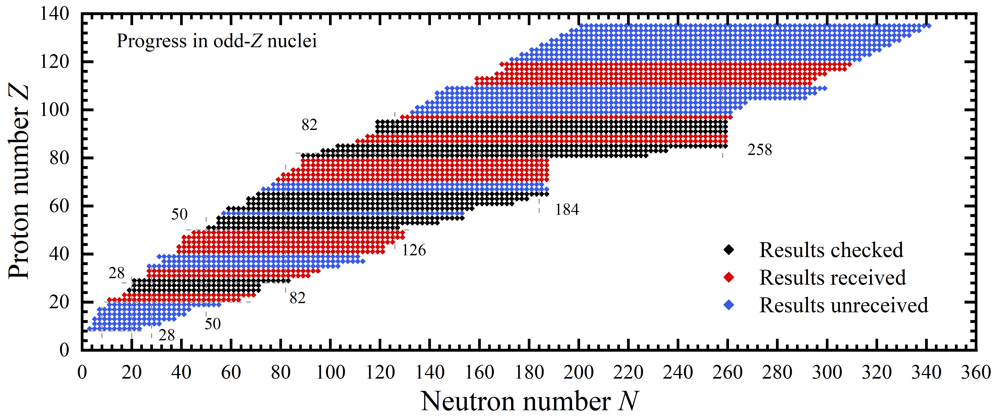
Progress on odd-Z nuclei
For odd-Z nuclei, 38 isotopic chains have been received and 19 isotopic chains have been checked.

Slide 19
Outline
Introduction
Theoretical framework
Numerical details
Current status for odd-Z nuclei
Results for superheavy nuclei
Summary
Notes:
引言：
理论框架+数值细节：P4，RHB，Legendre+DWS，Blocking，数值细节
奇Z核结果检查与提交进度
结果与讨论：转动修正能问题+超重核数值细节

Slide 20
Naming rules
A naming rule for unknown nuclei with 100 $≤Z ≤$ 999
Digit | Root
0 | nil
1 | un
2 | bi
3 | tri
4 | quad
5 | pent
6 | hex
7 | sept
8 | oct
9 | enn
Atomic number:
1
3
2
un
tri
bi
Name:
Untribium
Symbol:
Utb
The root are put together in the order of the digits in the atomic number and terminated by ‘ium’ to spell out the name. The final ‘n’ of ‘enn’ is elided when it occurs before ‘nil’, and the final ‘i’ of ‘bi’ and ‘tri’ when it occurs before ‘ium’.
J. Chatt, Pure and Applied Chemistry, 51, 381 (1979)

Slide 21
Project plan
For nuclei with 121 $≤Z ≤$ 136, the nuclear regions and PIs are:
Nuclear region | Team | Principal investigator
Ubu (Z = 121) to Ubt (Z = 123) | BNU | Jing Peng
 | NCEPU | Zhenhua Zhang Yuanyuan Wang
 | INPC, CAEP | Kaiyuan Zhang
Ubq (Z = 124) to Ubh (Z = 126) | JNU | Lang Liu
 | AHNU | Cong Pan
Ubs (Z = 127) to Ubo (Z = 128) | CIAE | Yingxun Zhang Zhanjiang Lian
 | ITP | Xiao Lu
Ube (Z = 129) to Utu (Z = 131) | HKU | Martin Yiu
 | UTokyo | Haozhao Liang
 | JLU | Jian Li
Utb (Z = 132) to Uth (Z = 136) | PKU | Peng Guo
 | CQU | Sibo Wang
 | FZU | Xinhui Wu

Slide 22
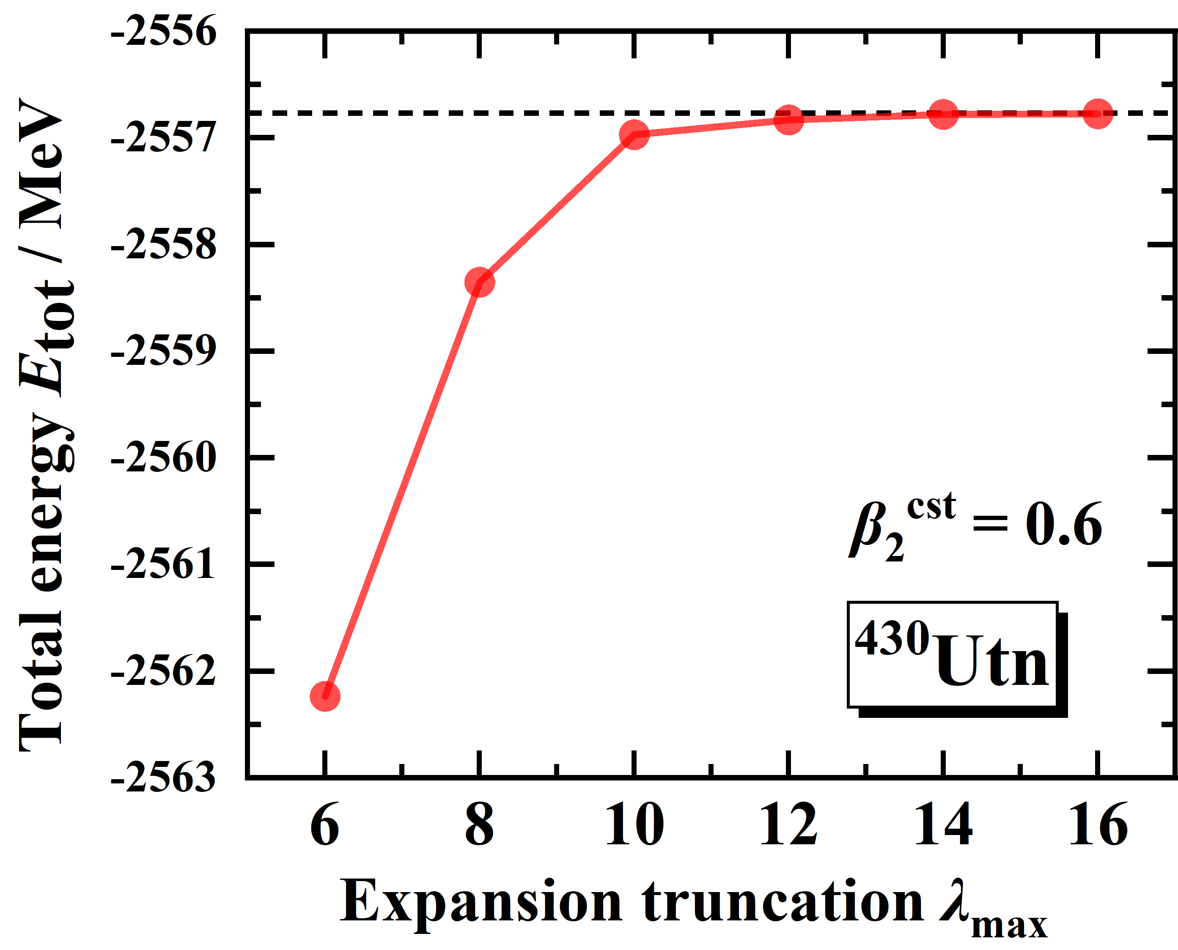
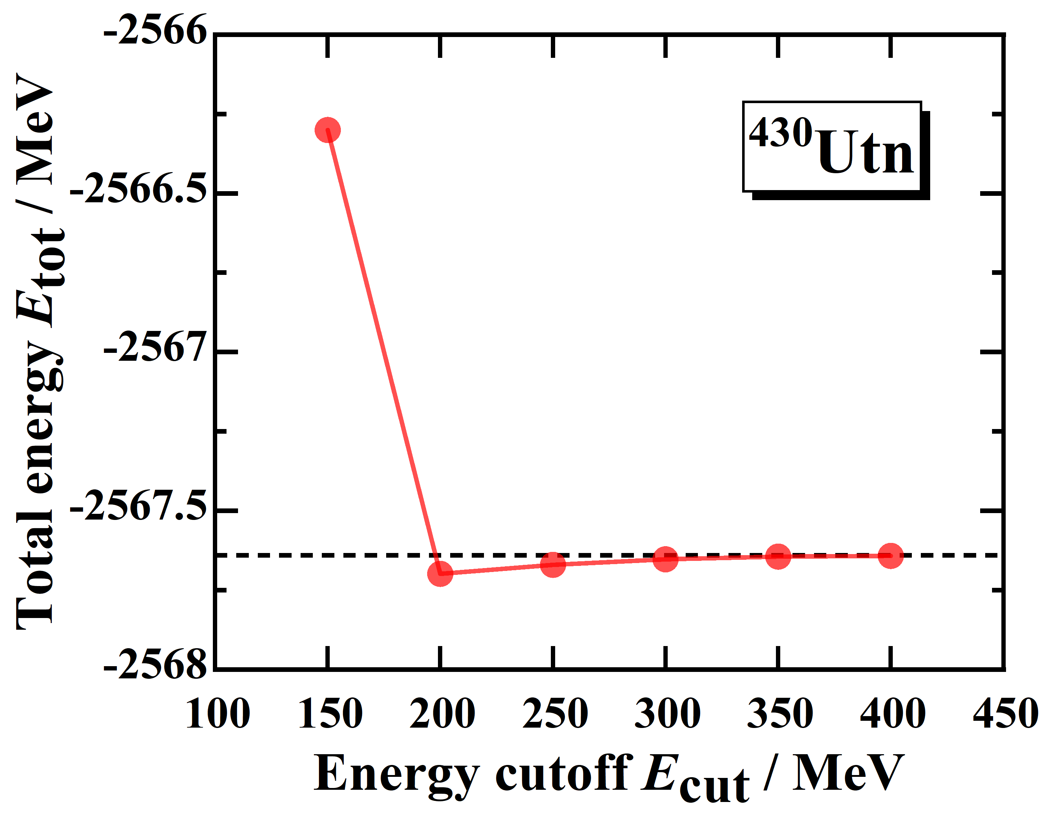
λ_{max} and E_{cut}
Legendre truncation and energy cutoff for nuclei with 101 $≤$ Z $≤$ 120:
λ_{max} = 10, E_{cut} = 300 MeV
are still available for nuclei with 121 $≤$ Z $≤$ 136.

Slide 23
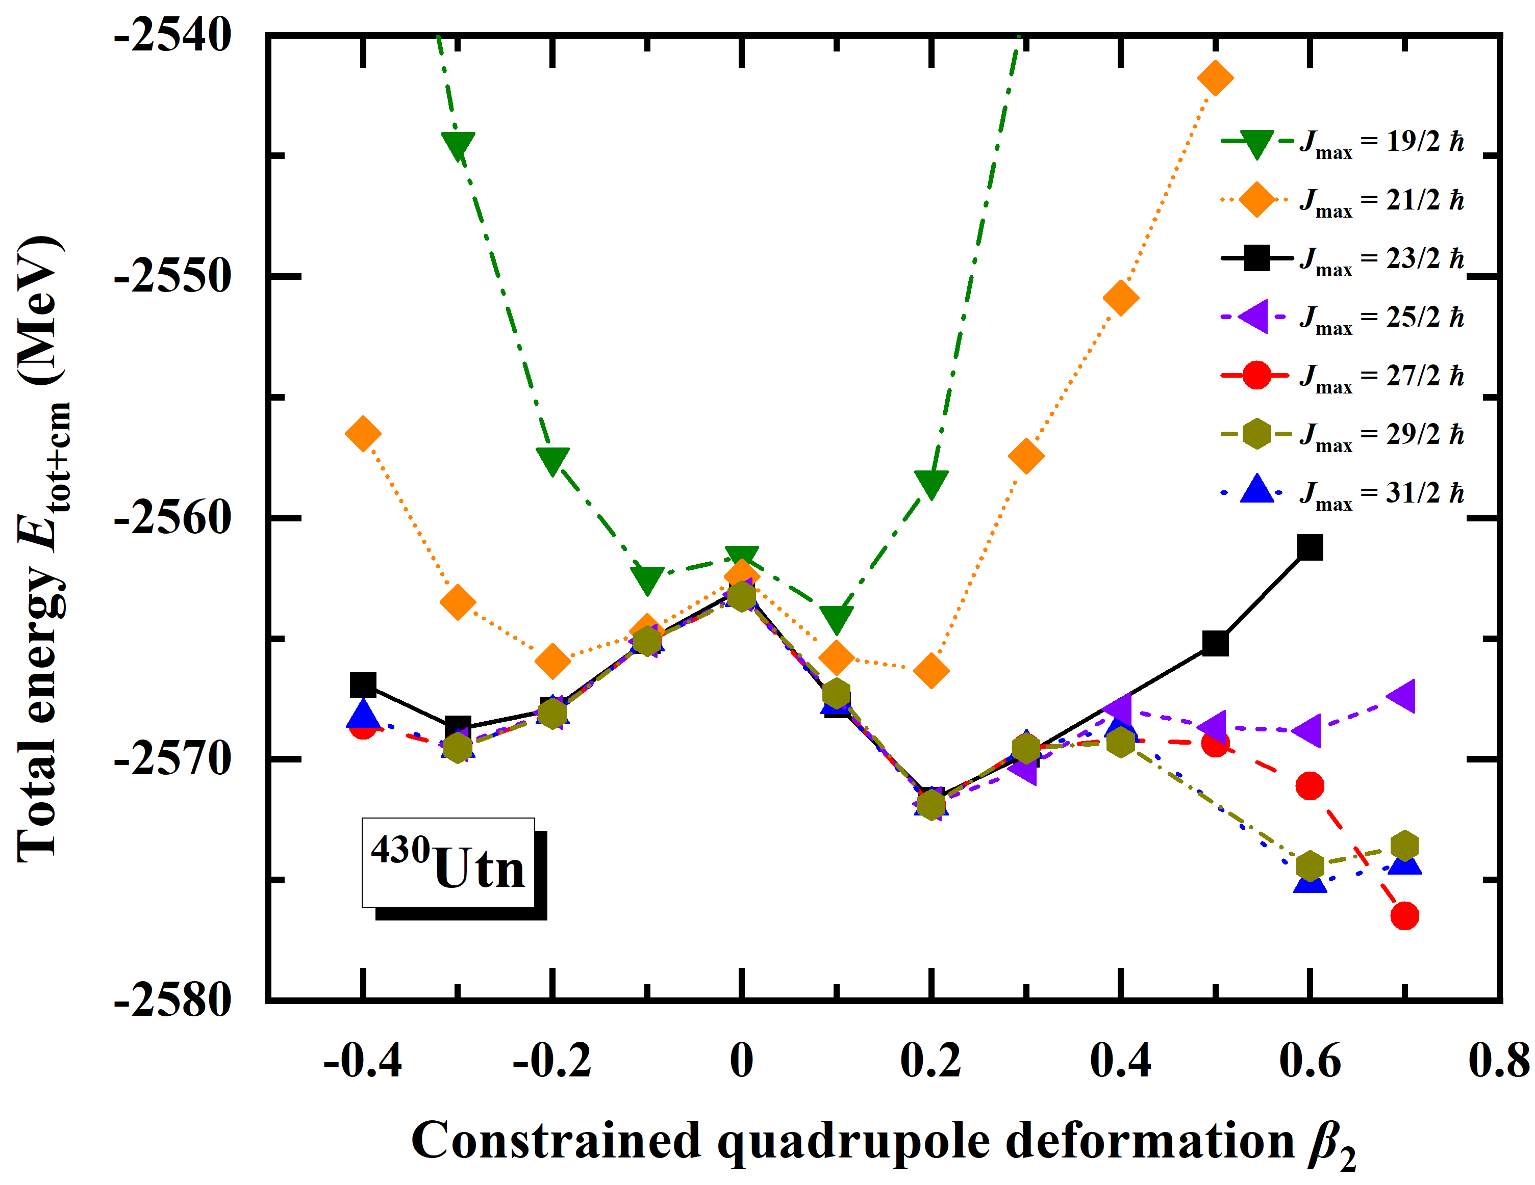
J_{max}
Angular momentum cutoff:
J_{max} = 23/2 $ℏ$,
is available for nuclei with 121 $≤$ Z $≤$ 136 with β₂ $≤$|0.3|.

Slide 24
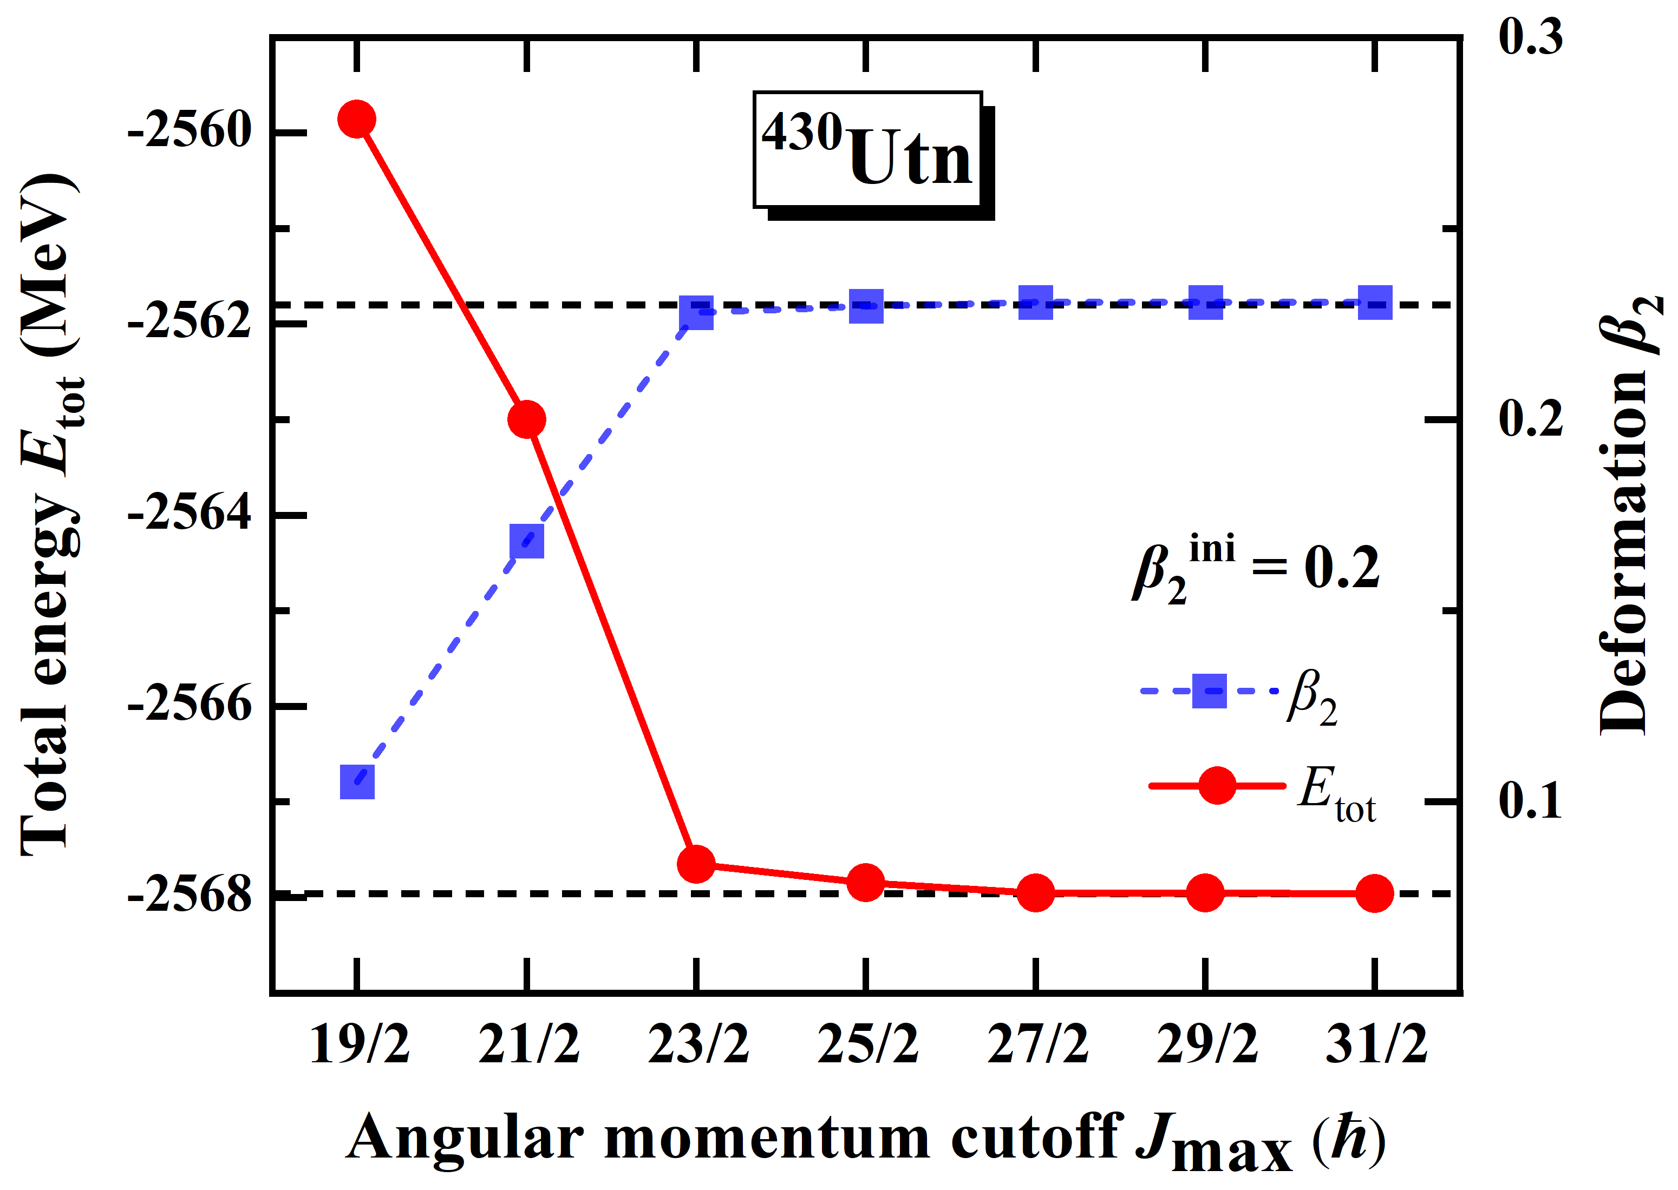
J_{max}
Angular momentum cutoff:
J_{max} = 23/2 $ℏ$,
is available for nuclei with 121 $≤$ Z $≤$ 136 with β₂ $≤$|0.3|.

Slide 25
Numerical details for superheavy nuclei
For nuclei with 121 $≤Z ≤$ 136, numerical details are suggested to be:
Energy cutoff: E_{cut} = 300 MeV
Angular momentum cutoff: J_{max} = 23/2 ℏ
Legendre expansion order: λ_{max} = 10
To confirm the ground state, the following strategy is suggested:
Constrained calculations with -0.4 $≤$ β₂ $≤$ 0.6 for PEC
Unconstrained calculations around minima of PEC
Constrained calculations under larger J_{max} (31/2 ℏ, V_{pair} = $−$300 MeV) are necessary to confirm whether a minimum at |β₂| $≥$ 0.3 is ground state.

Slide 26
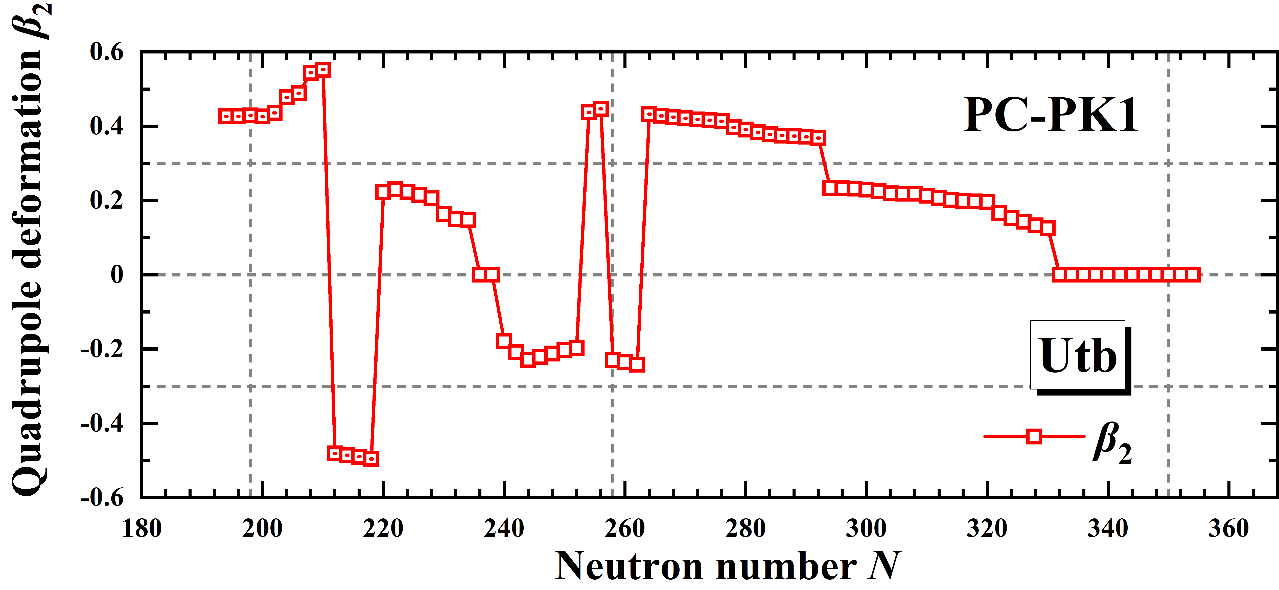
Results for even-even Utb isotopes: β₂
The predicted neutron magic number N = 258 vanishes.
Spherical shape around N = 350 indicate possible shell closure.
Calculations at larger numerical condition is needed for N < 220.

Slide 27
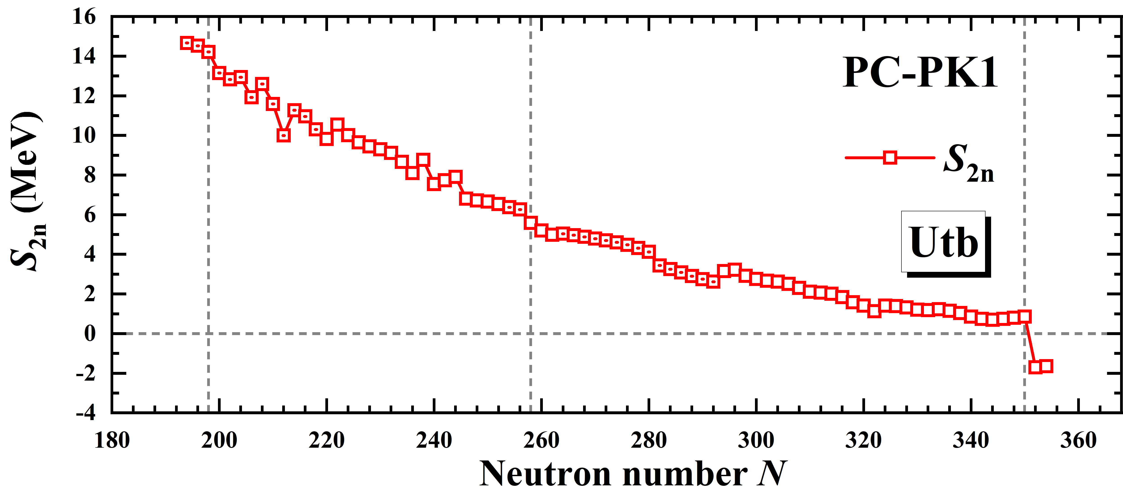
Results for even-even Utb isotopes: S_{2n}
Two-neutron drip line: N = 350
The predicted neutron magic number N = 258 vanishes
Sudden change at N = 350 indicate possible shell closure

Slide 28
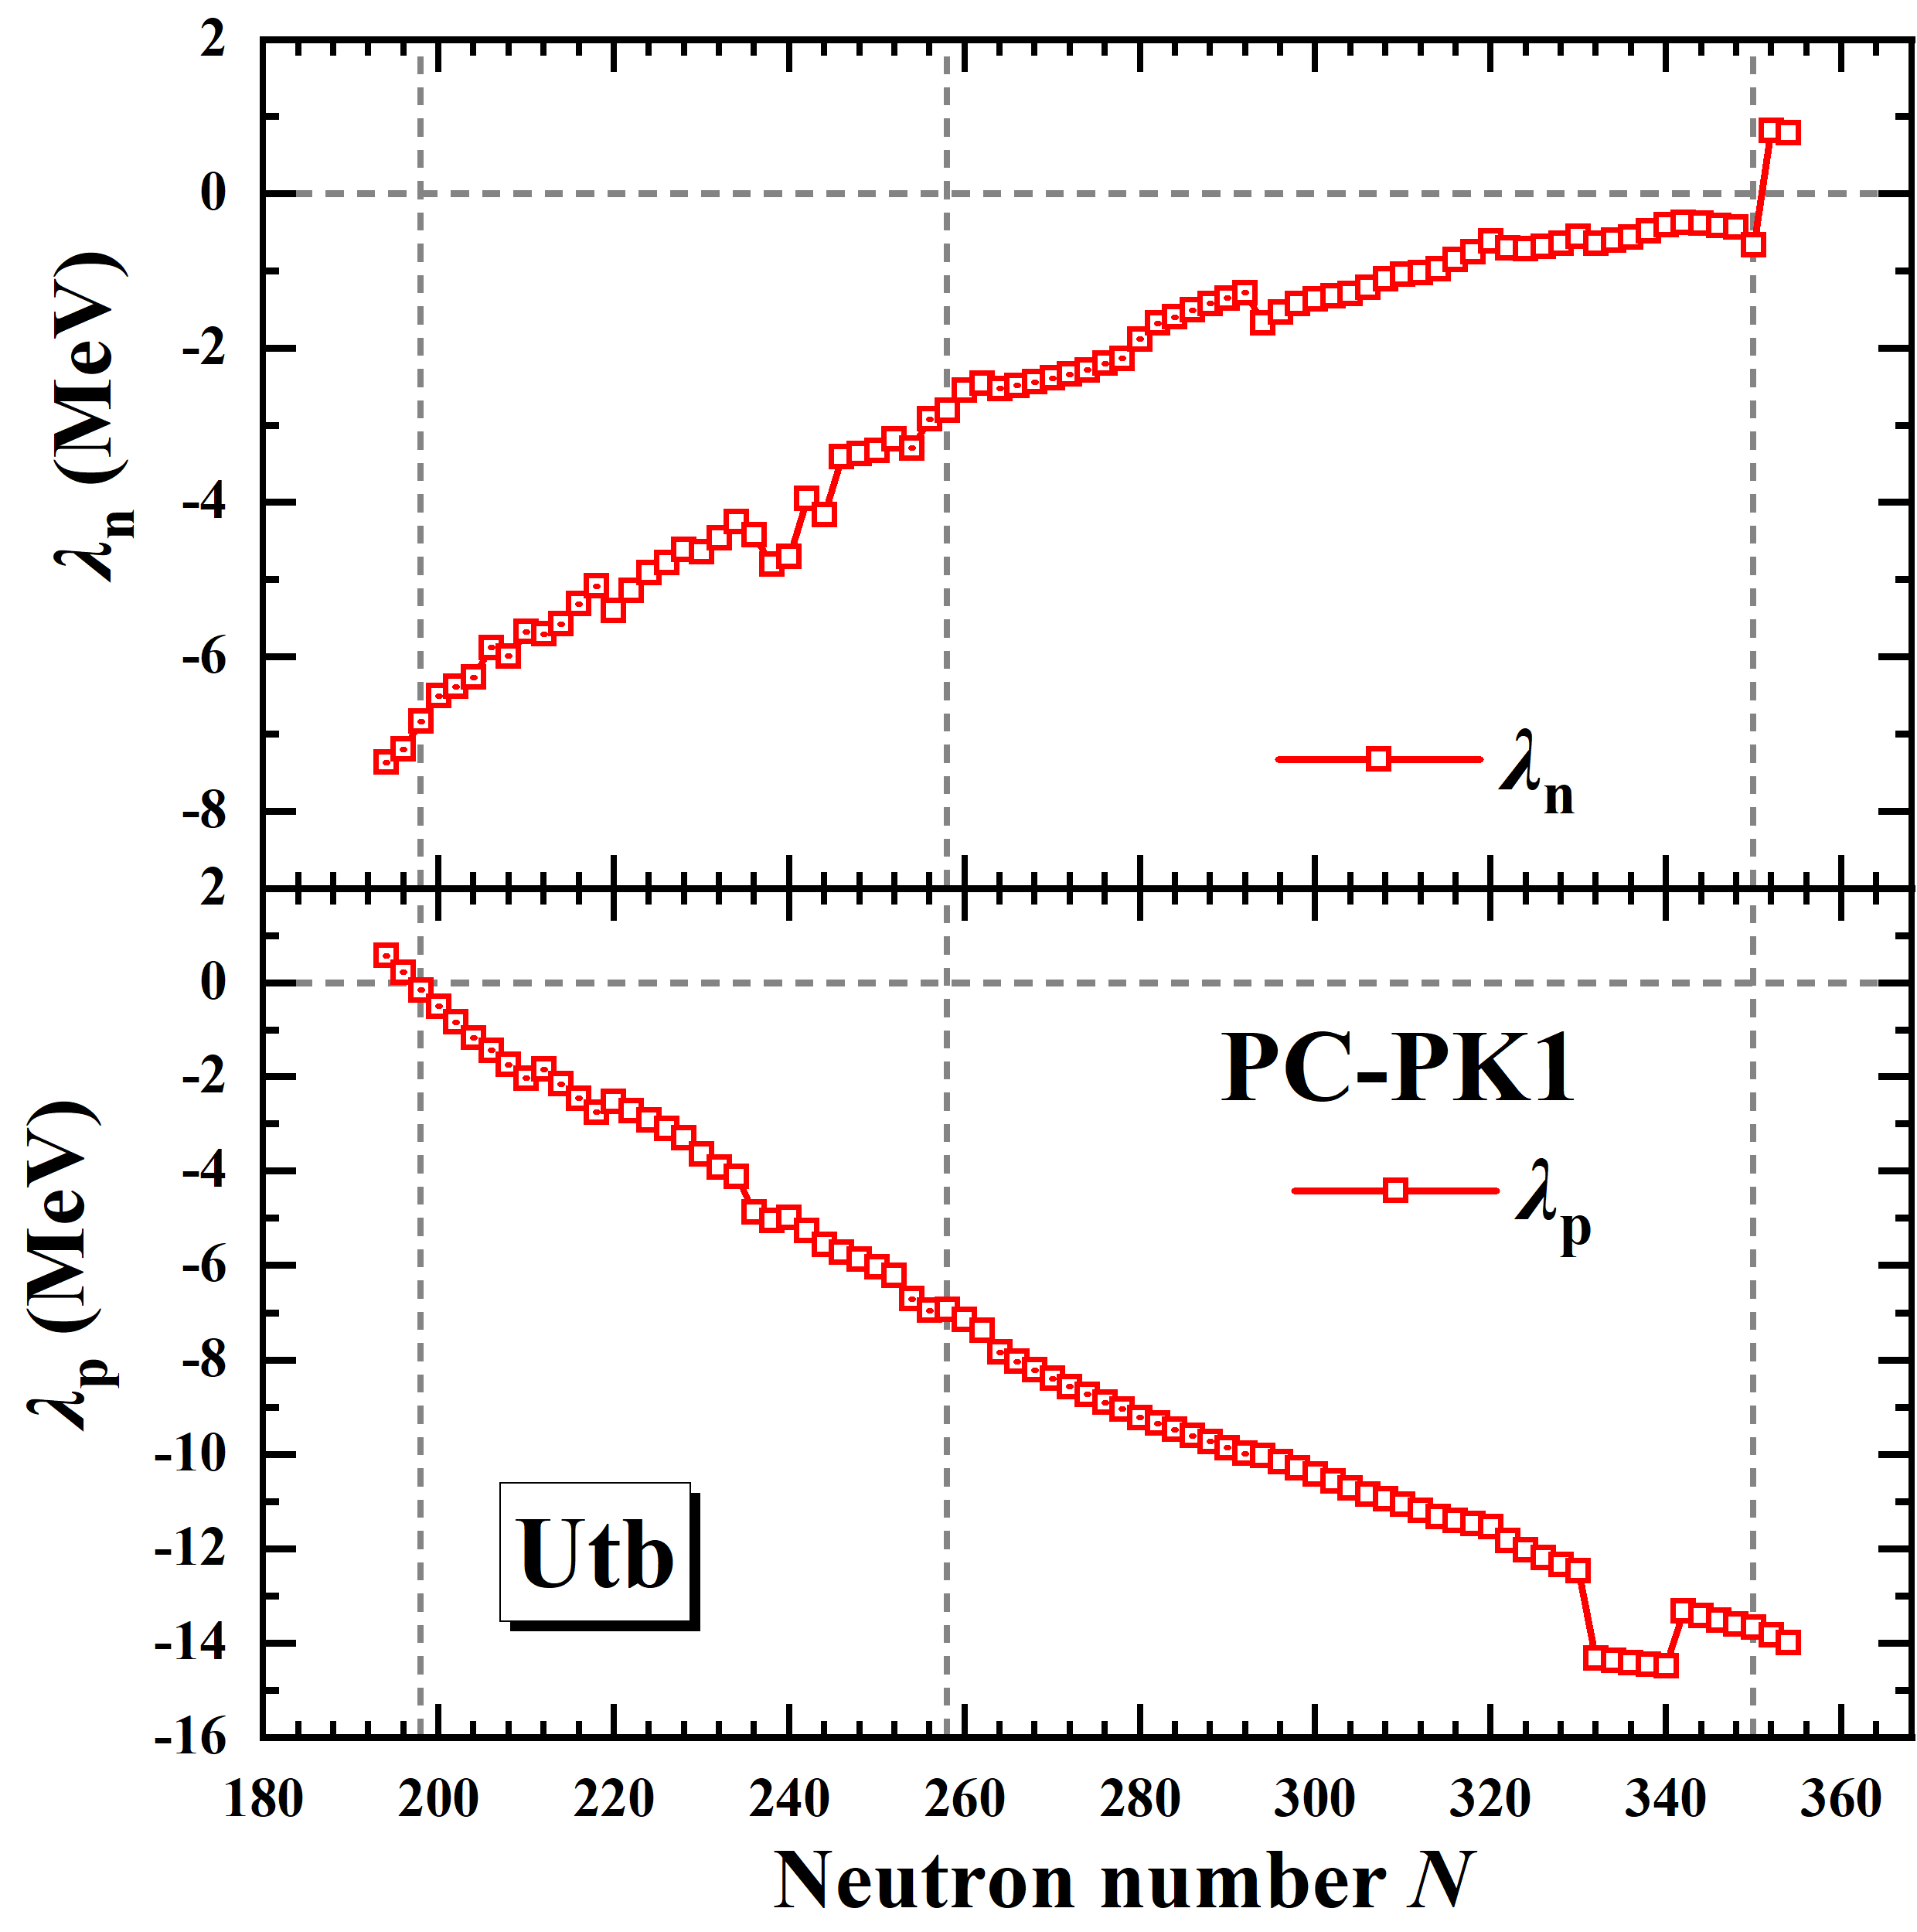
Results for even-even Utn isotopes: λ
Proton drip line: N = 198; neutron drip line: N = 350.
Sudden change around N = 340 comes from pairing collapse.

Slide 29
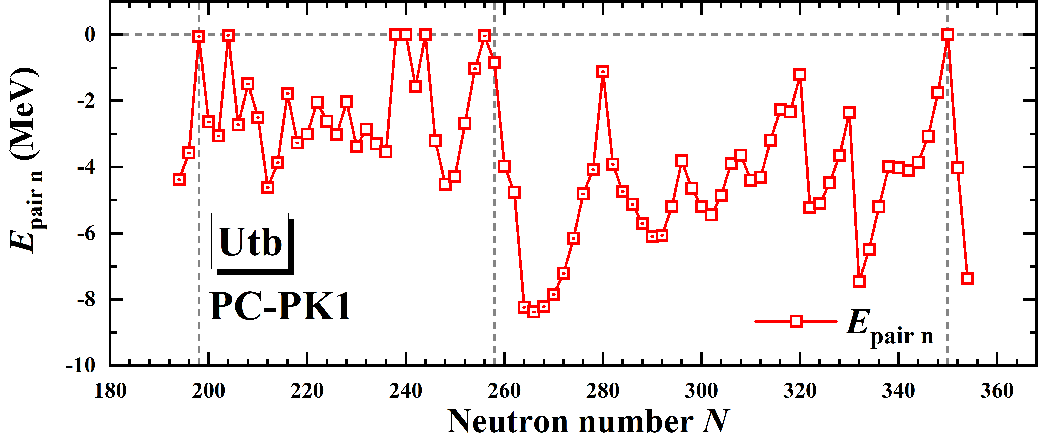
New predicted magic number: N = 350
Most nuclei have not small neutron pairing energies.
Vanished neutron pairing energy at N = 350 support possible shell closure.

Slide 30
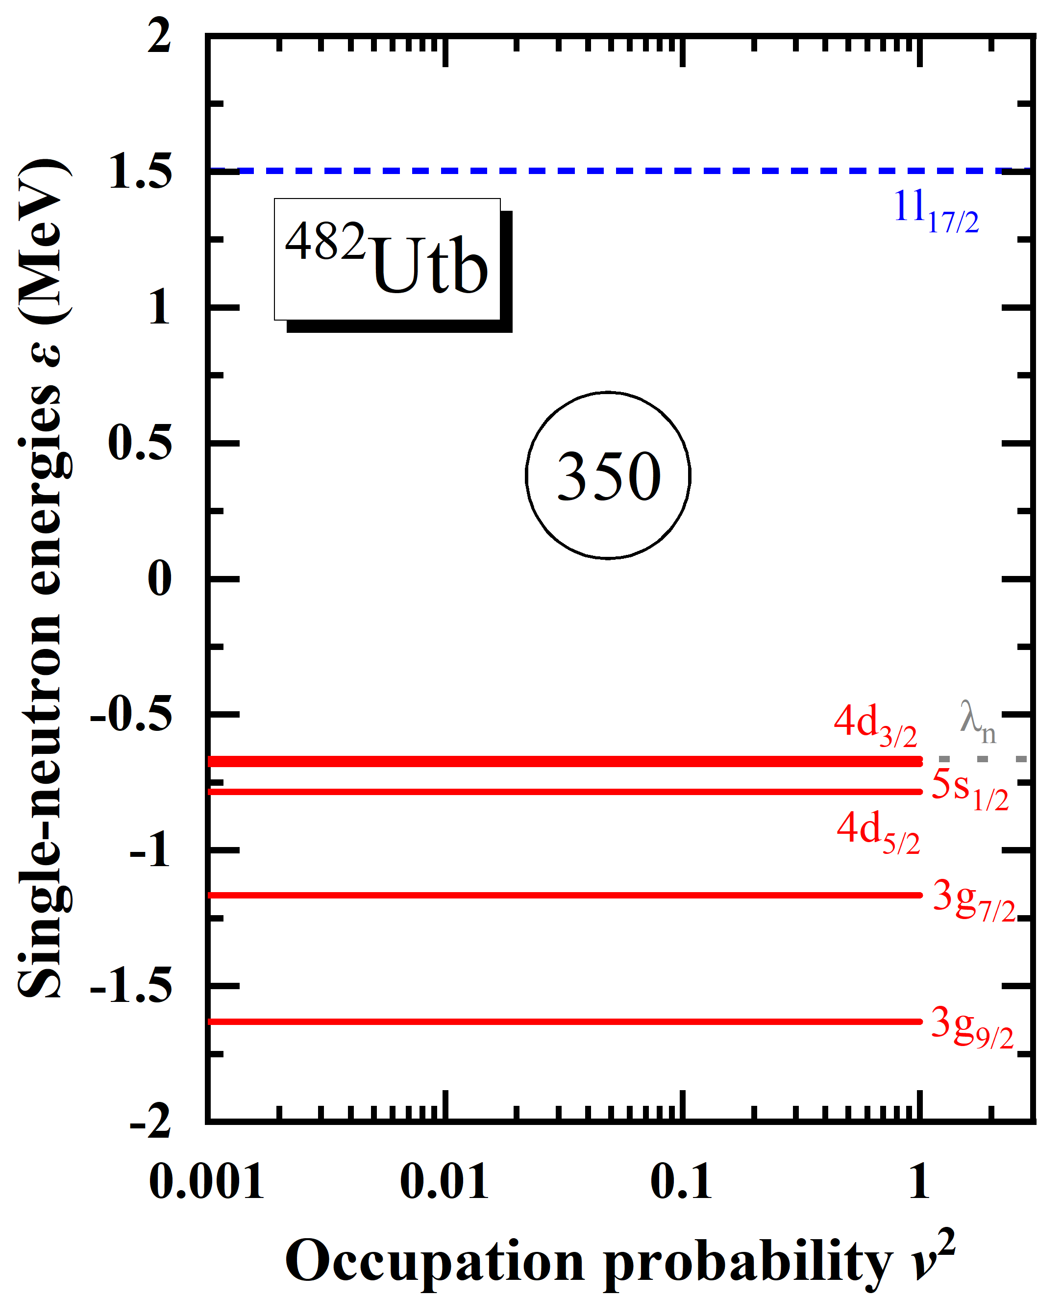
New predicted magic number: N = 350
The neutron orbitals around the Fermi surface are 4d_{3/2}, 5s_{1/2}, and 4d_{5/2}.
The last occupied orbital is 4d_{3/2}.
A pronounced energy gap can be found at N = 350 between the orbital 4d_{3/2} and 1l_{17/2}.

Slide 31
Summary
Most results for odd-Z nuclei with 8 $≤$ Z $≤$ 120 have been submitted and the examination is in progress.
The numerical details for nuclei with 121 $≤$ Z $≤$ 136:
Energy cutoff: E_{cut} = 300 MeV
Angular momentum cutoff: J_{max} = 23/2 ℏ
Legendre expansion order: λ_{max} = 10
The suggested calculation strategy for nuclei with 121 $≤$ Z $≤$ 136:
Constrained calculations with -0.4 $≤$ β₂ $≤$ 0.6 for PEC
Unconstrained calculations around minima of PEC
Constrained calculations under larger J_{max} (31/2 ℏ, V_{pair} = -300 MeV) are necessary to confirm whether a minimum at |β₂| $≥$ 0.3 is ground state
Results of even-even Utn isotopes are introduced:
Proton and neutron drip line is predicted at N = 198 and N = 350, respectively
Magic number N = 258 vanishes and N = 350 is predicted to be next magic number

Slide 32
Thanks for your attention!

Slide 33
Appendix

Slide 34
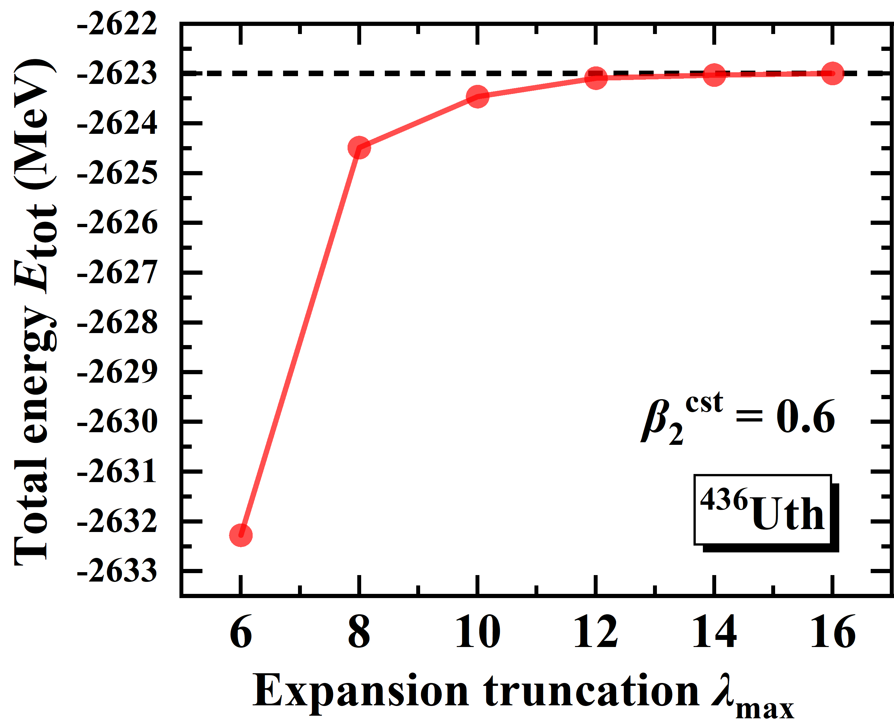
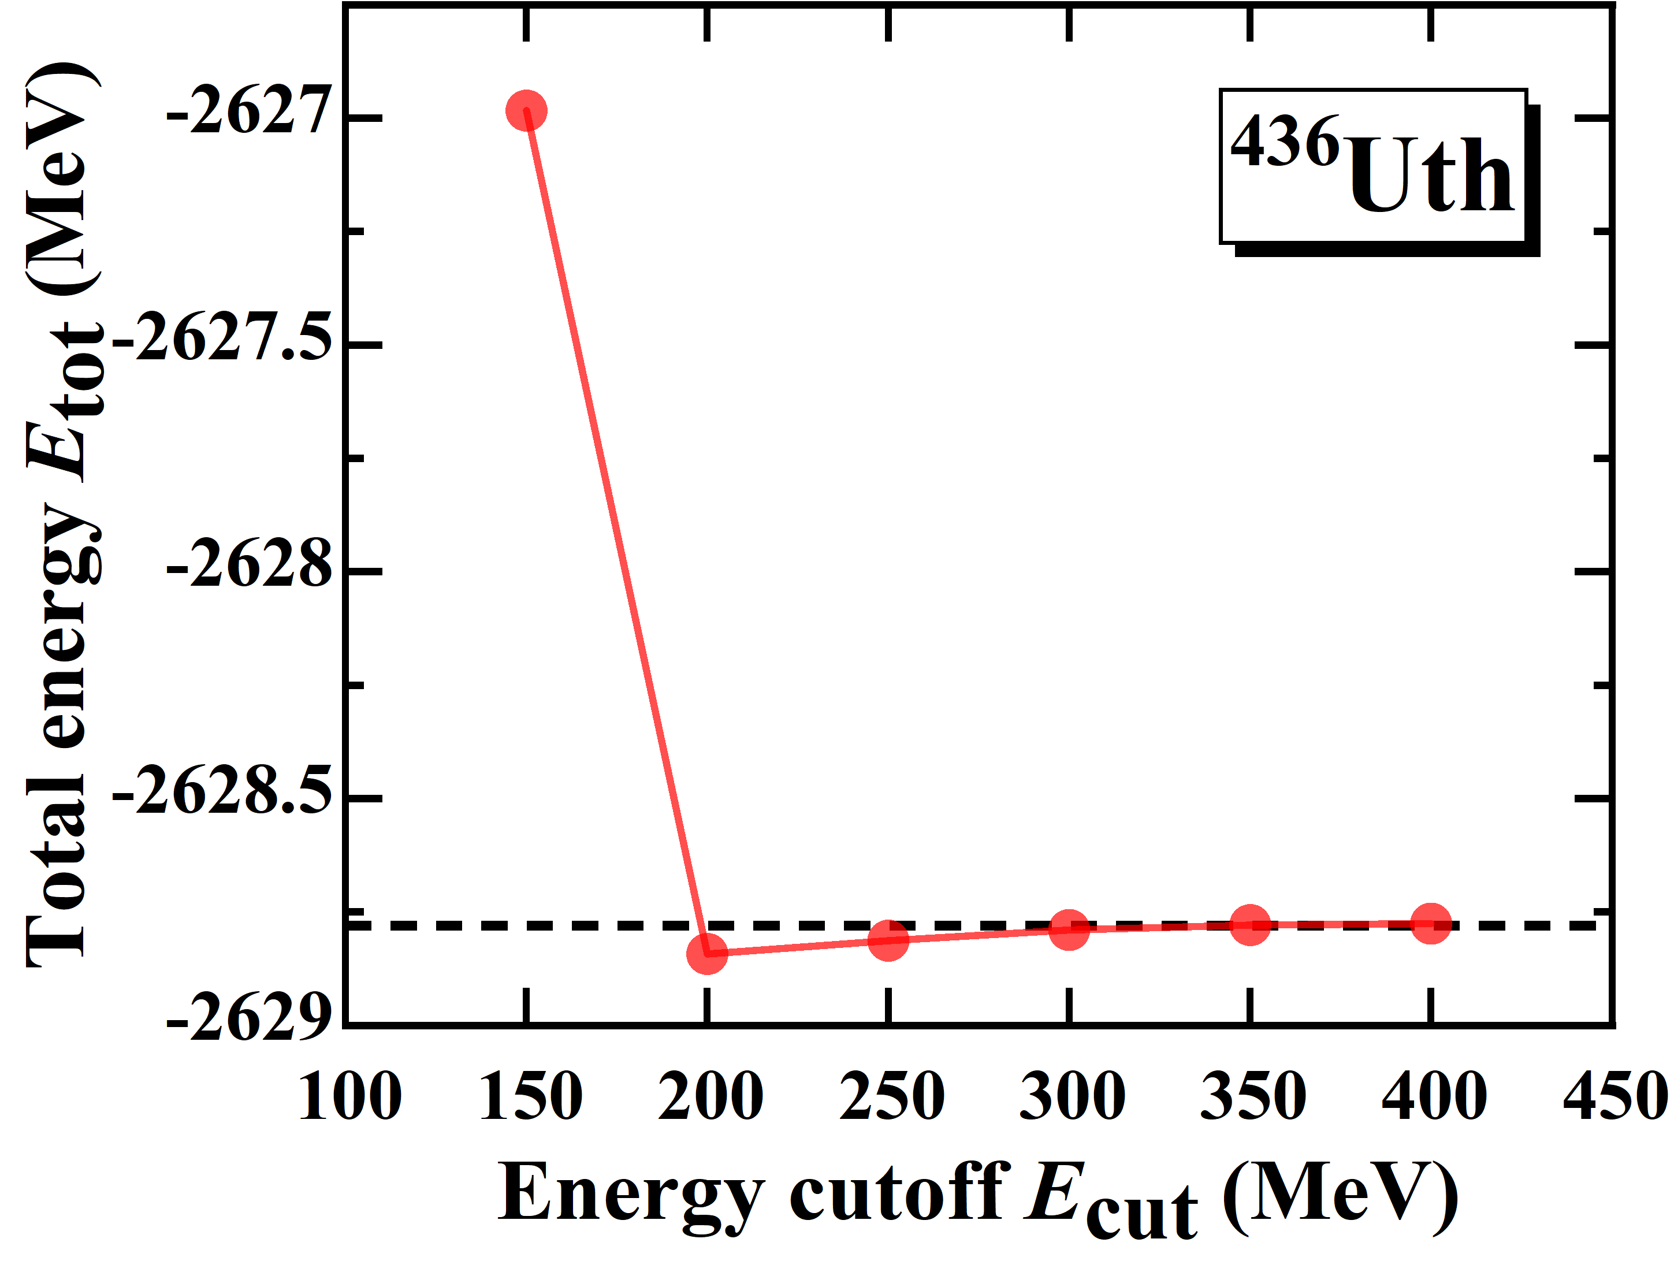
λ_{max} and E_{cut}
Legendre truncation and energy cutoff for nuclei with 101 $≤$ Z $≤$ 120:
λ_{max} = 10, E_{cut} = 300 MeV
are still available for nuclei with 121 $≤$ Z $≤$ 136.

Slide 35
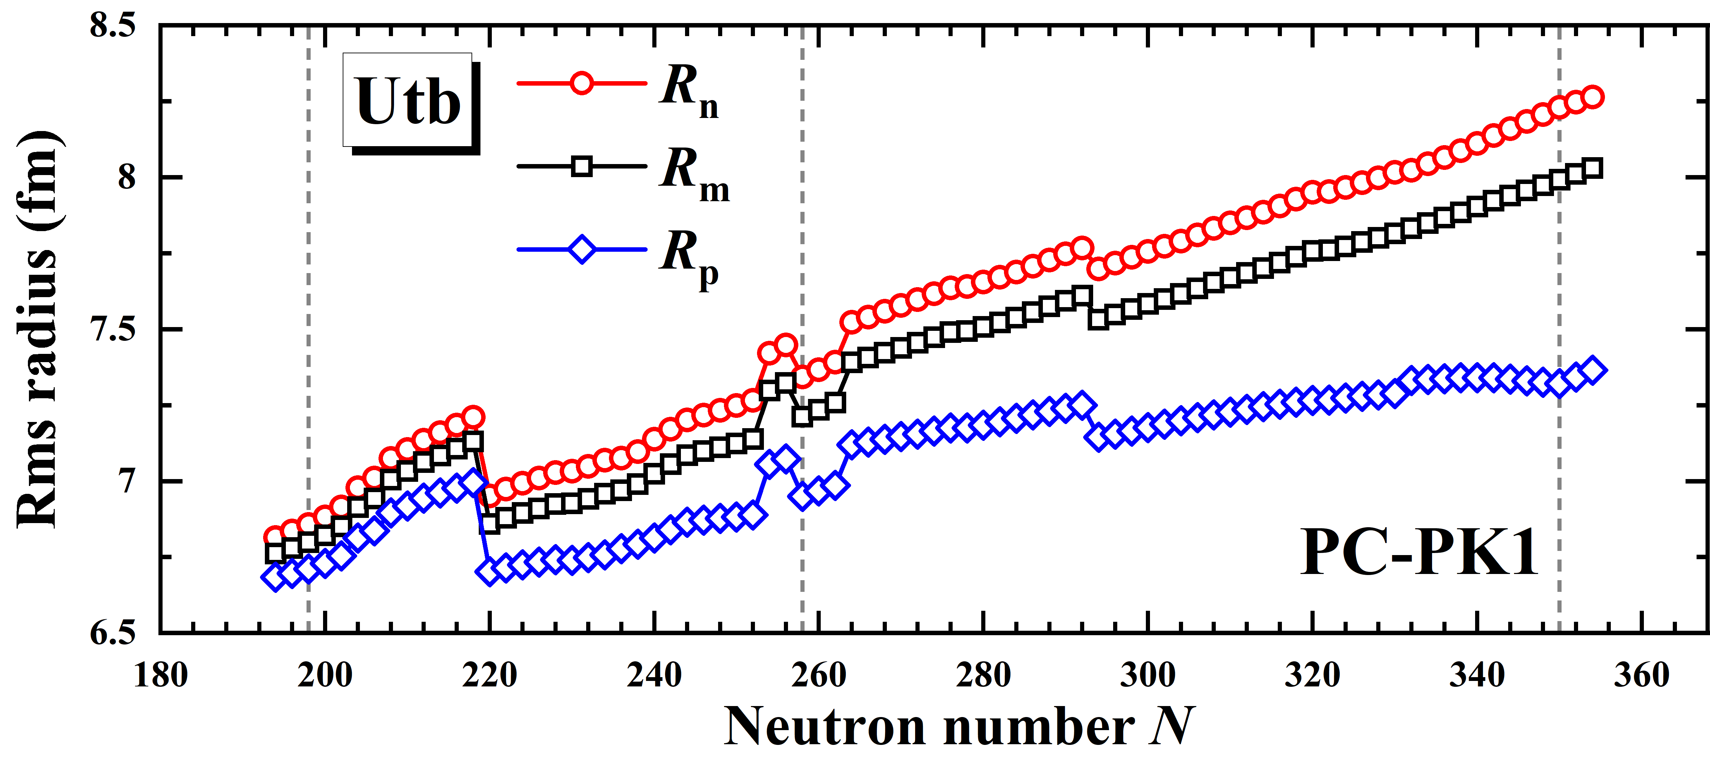
Results for even-even Utn isotopes: R

Slide 36
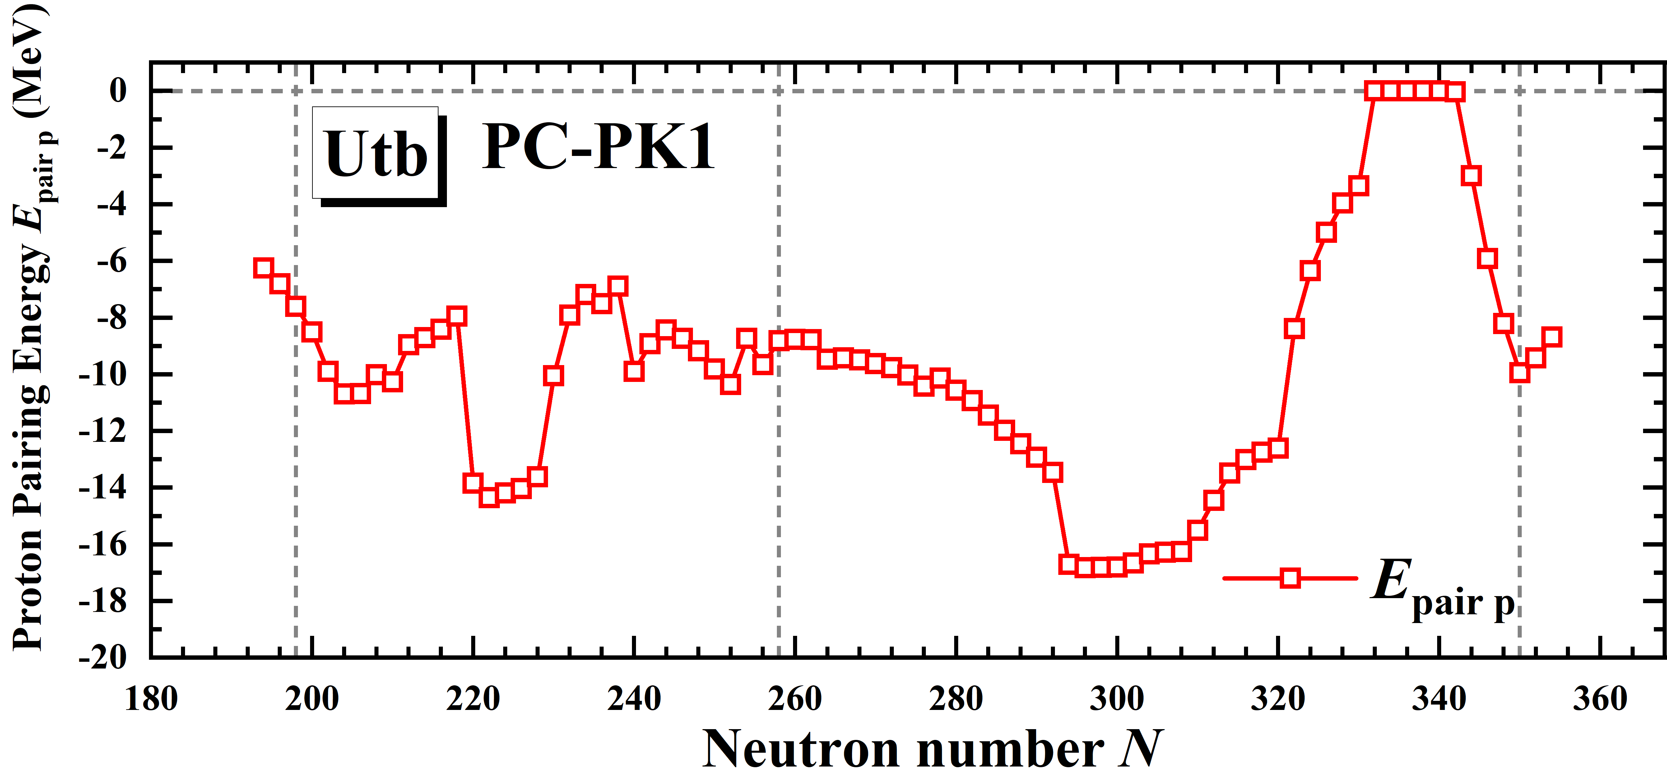
Results for even-even Utn isotopes: E_{pair p}
Most nuclei have pronounced proton magic number, possibly due to more larger single-particle level densities

Slide 37
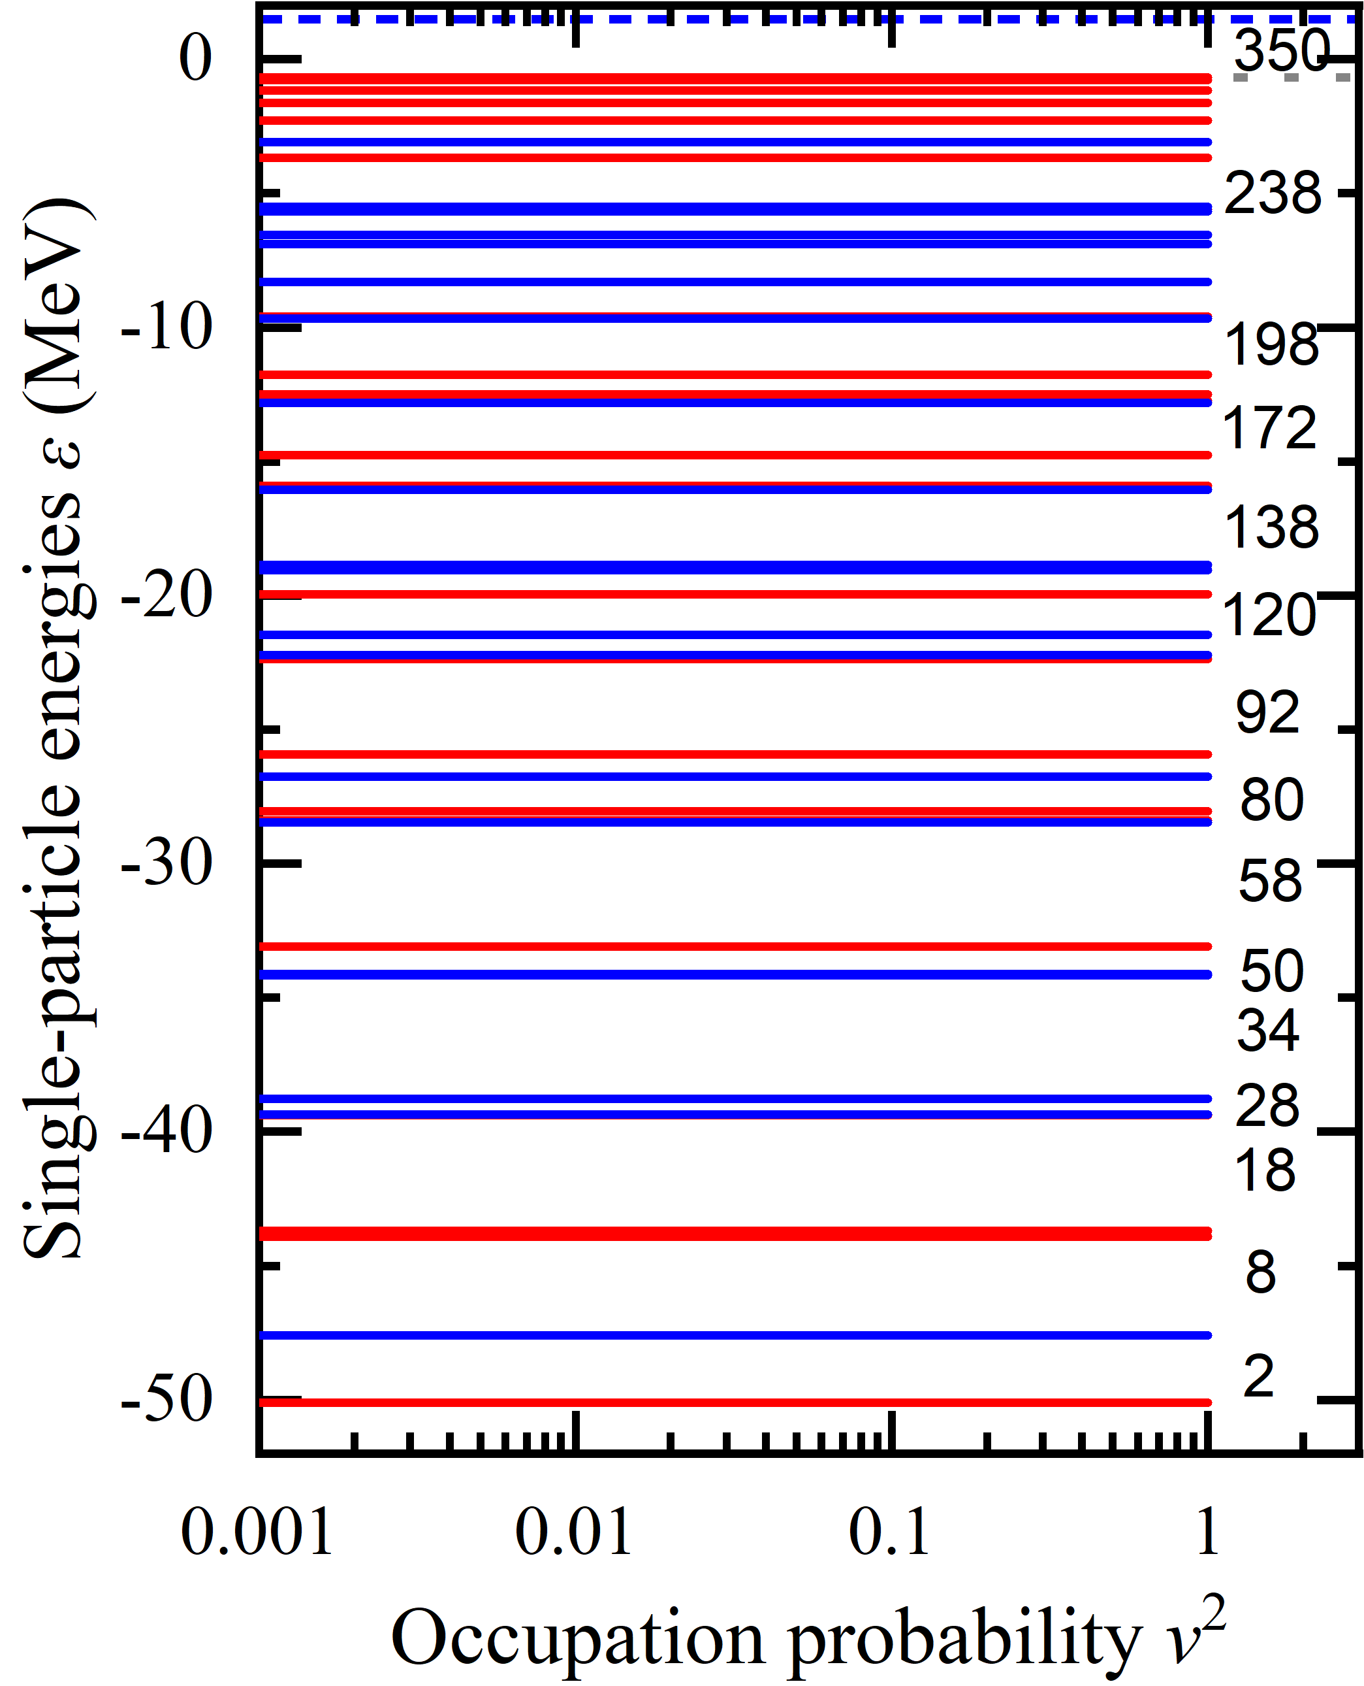
New predicted magic number

