Slide 1





7th Workshop on Nuclear Mass Table with DRHBc Theory
Gangneung Green City Experience Center, July 1-4, 2024
Progress on $41≤Z≤50$ Region
Qiang ZHAO
Center for Exotic Nuclear Studies, Institute for Basic Science
Research Center for Nuclear Physics, Osaka University

Slide 2
Content
Numerical Details
Determination of the Ground state and Driplines
Results and discussions
Summary

Slide 3
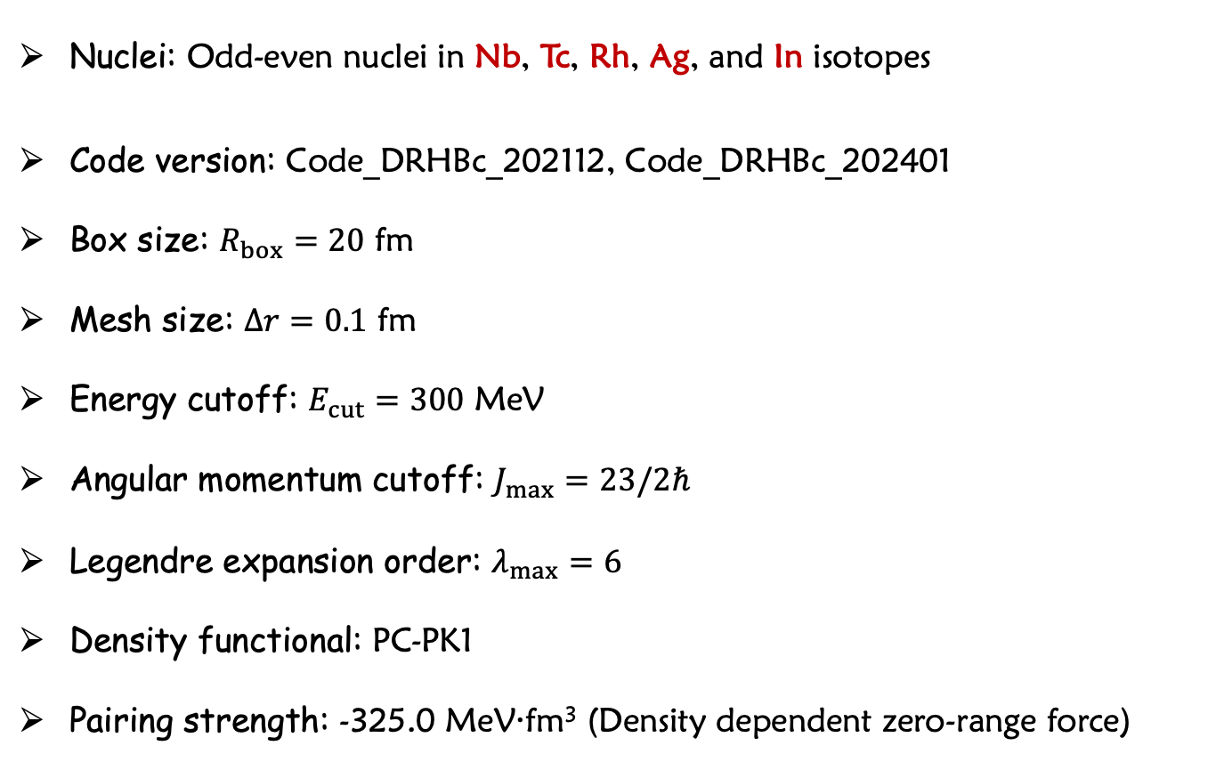
Numerical Details
  Nuclei: Odd-even nuclei in Nb, Tc, Rh, Ag, and In isotopes
  Code version: Code_DRHBc_202112, Code_DRHBc_202401
  Box size: $R_{box}=20$ fm
  Mesh size: $Δr=0.1$ fm
  Energy cutoff: $E_{cut}=300$ MeV
  Angular momentum cutoff: $J_{max}=23/2ℏ$
  Legendre expansion order: $λ_{max}=6$
  Density functional: PC-PK1
  Pairing strength: -325.0 MeV·fm³ (Density dependent zero-range force)
IBS High Performance Computing Resources

Slide 4
Content
Numerical Details
Determination of the Ground state and Driplines
Results and discussions
Summary

Slide 5
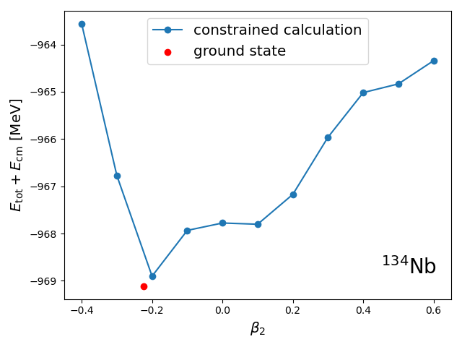
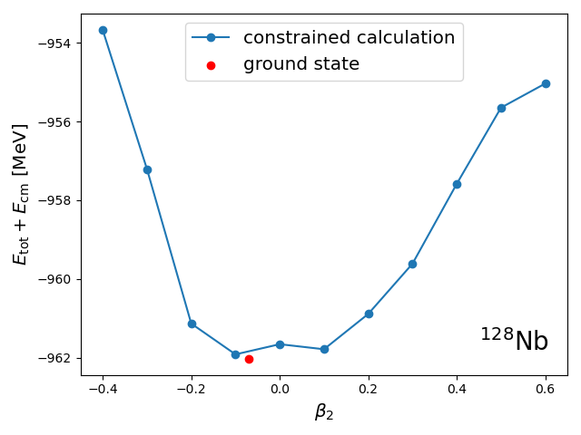
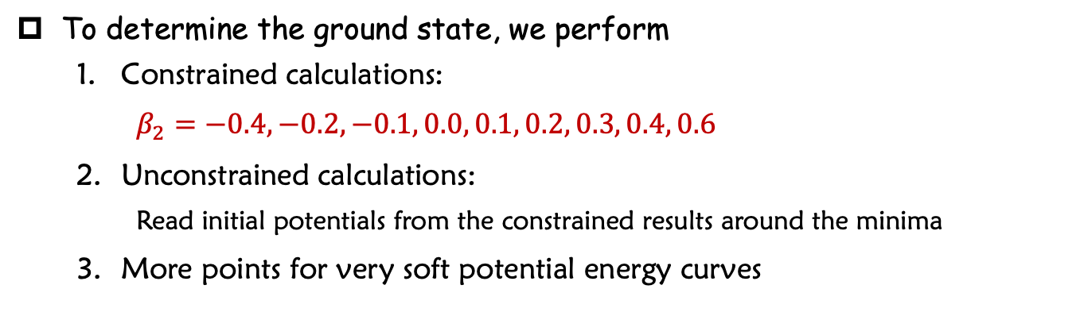
Determination of Ground State
To determine the ground state, we perform
  Constrained calculations:
  $β_{2}=−0.4, −0.2, −0.1, 0.0, 0.1, 0.2, 0.3, 0.4, 0.6$
  Unconstrained calculations:
    Read initial potentials from the constrained results around the minima
  More points for very soft potential energy curves

Slide 6
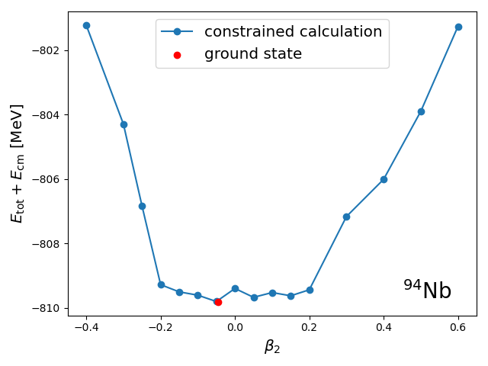
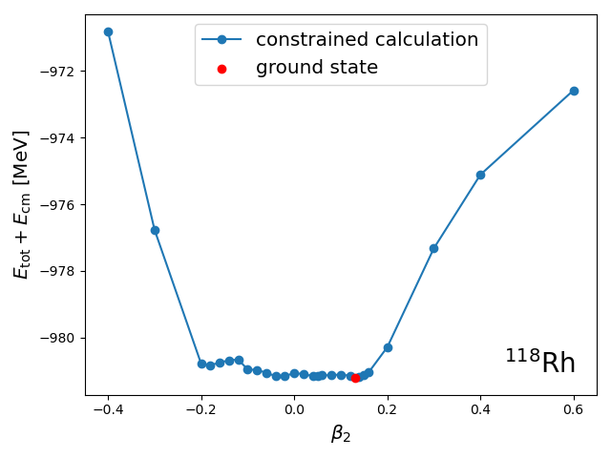
Determination of Ground State
To determine the ground state, we perform
  Constrained calculations:
  $β_{2}=−0.4, −0.2, −0.1, 0.0, 0.1, 0.2, 0.3, 0.4, 0.6$
  Unconstrained calculations:
    Read initial potentials from the constrained results around the minima
  More points for very soft potential energy curves

Slide 7
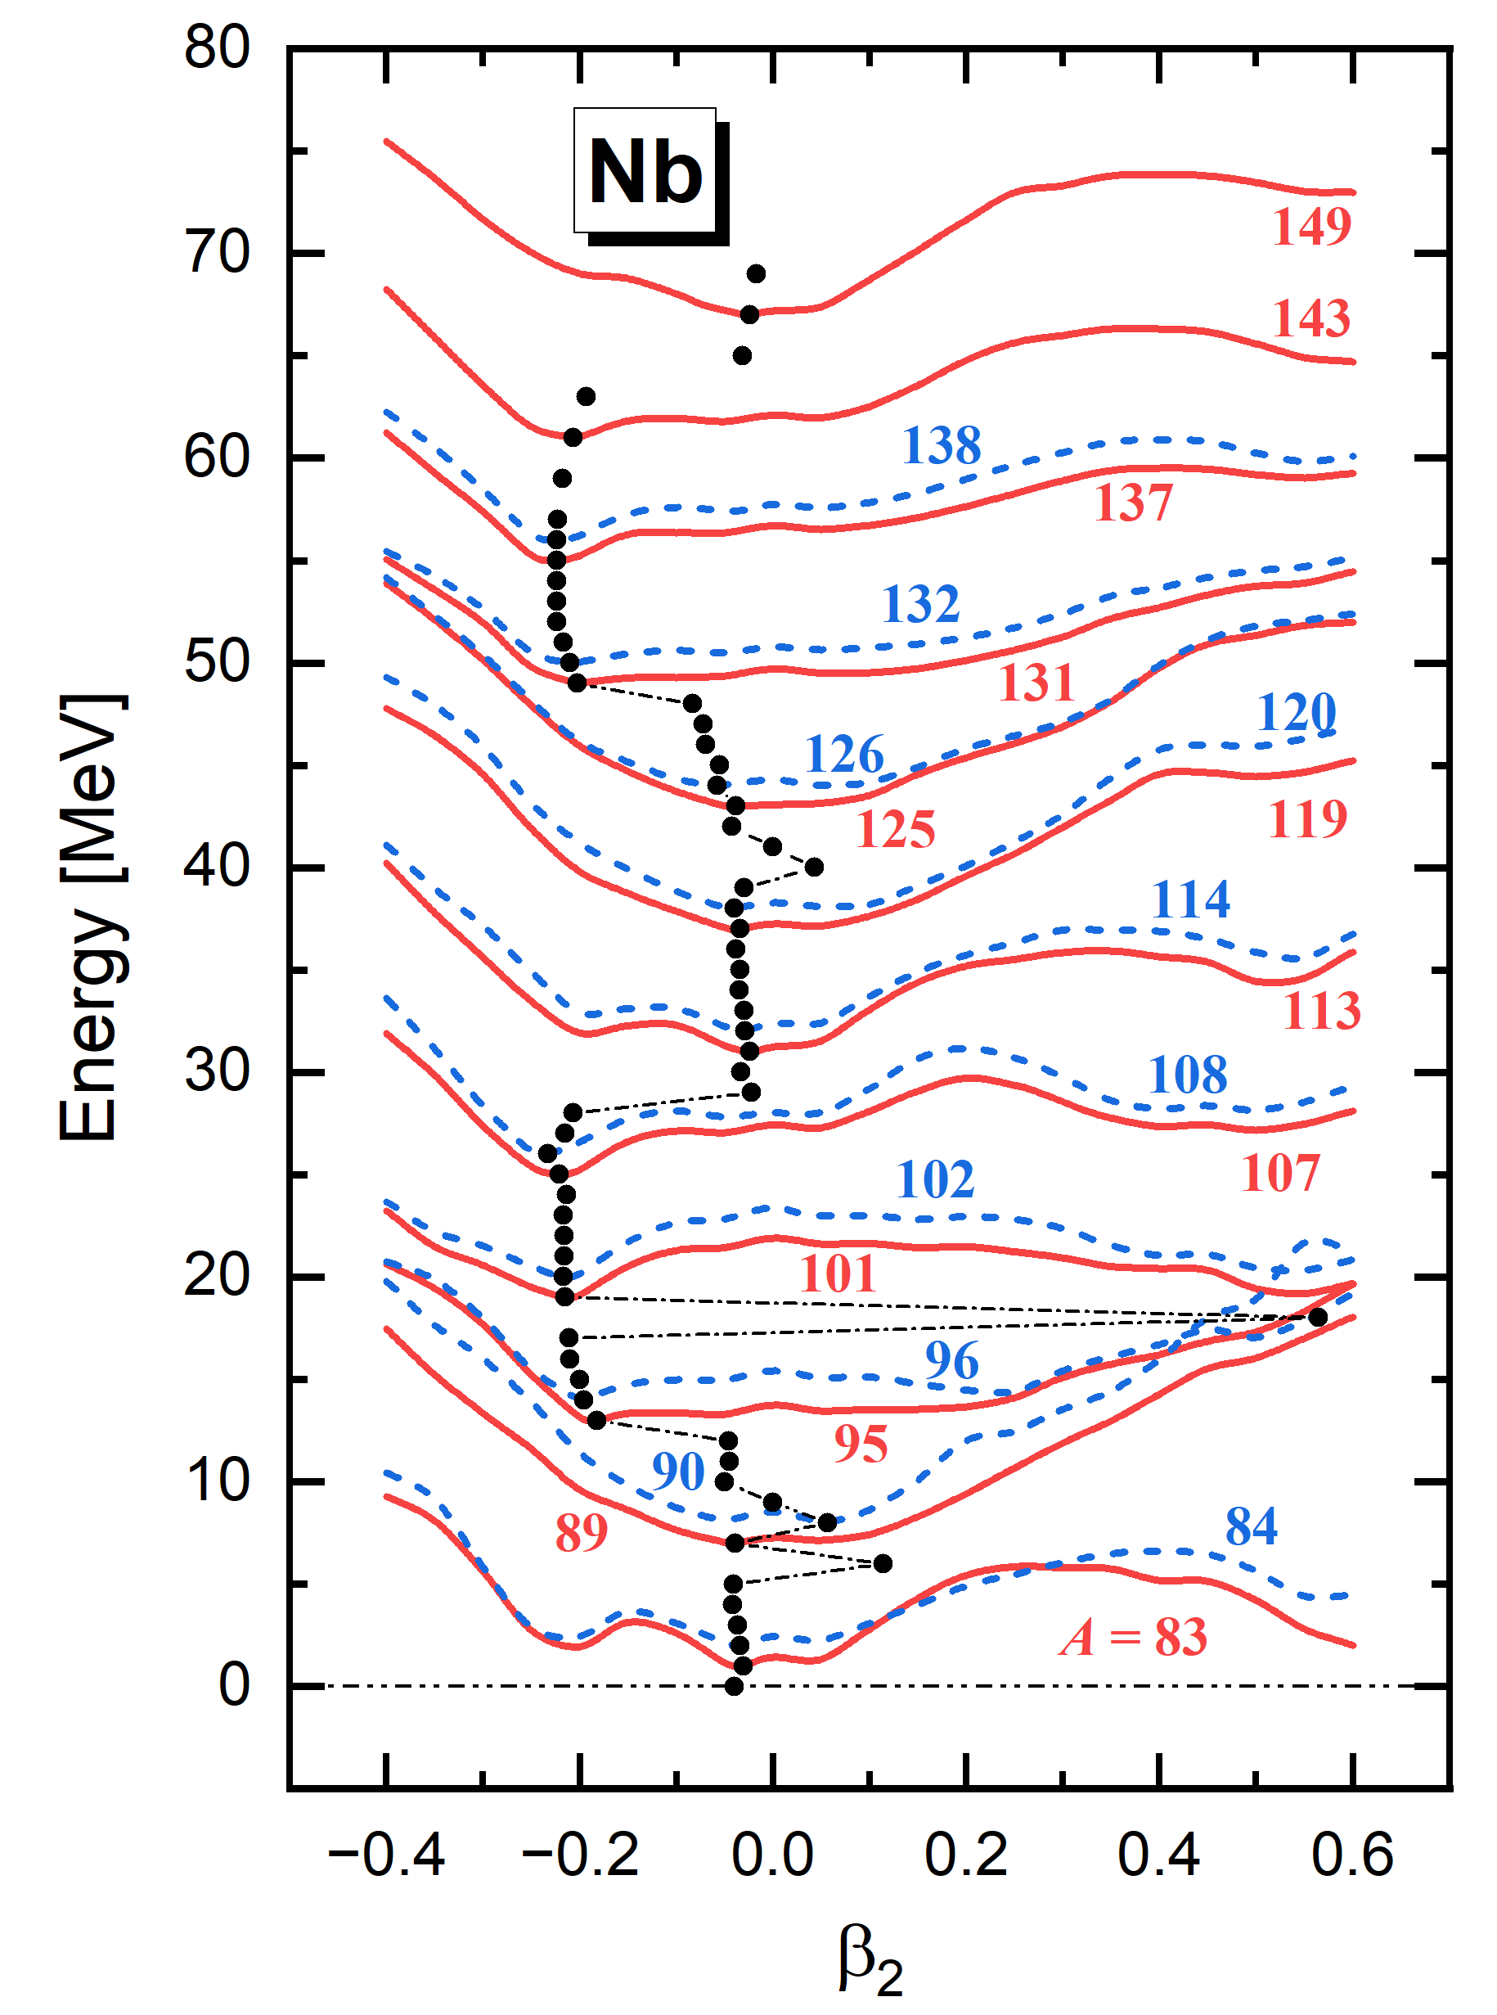
Determination of Ground State
Potential energy curves
The ground state given by unconstrained calculations are consistent with the results of constrained calculations.

Slide 8
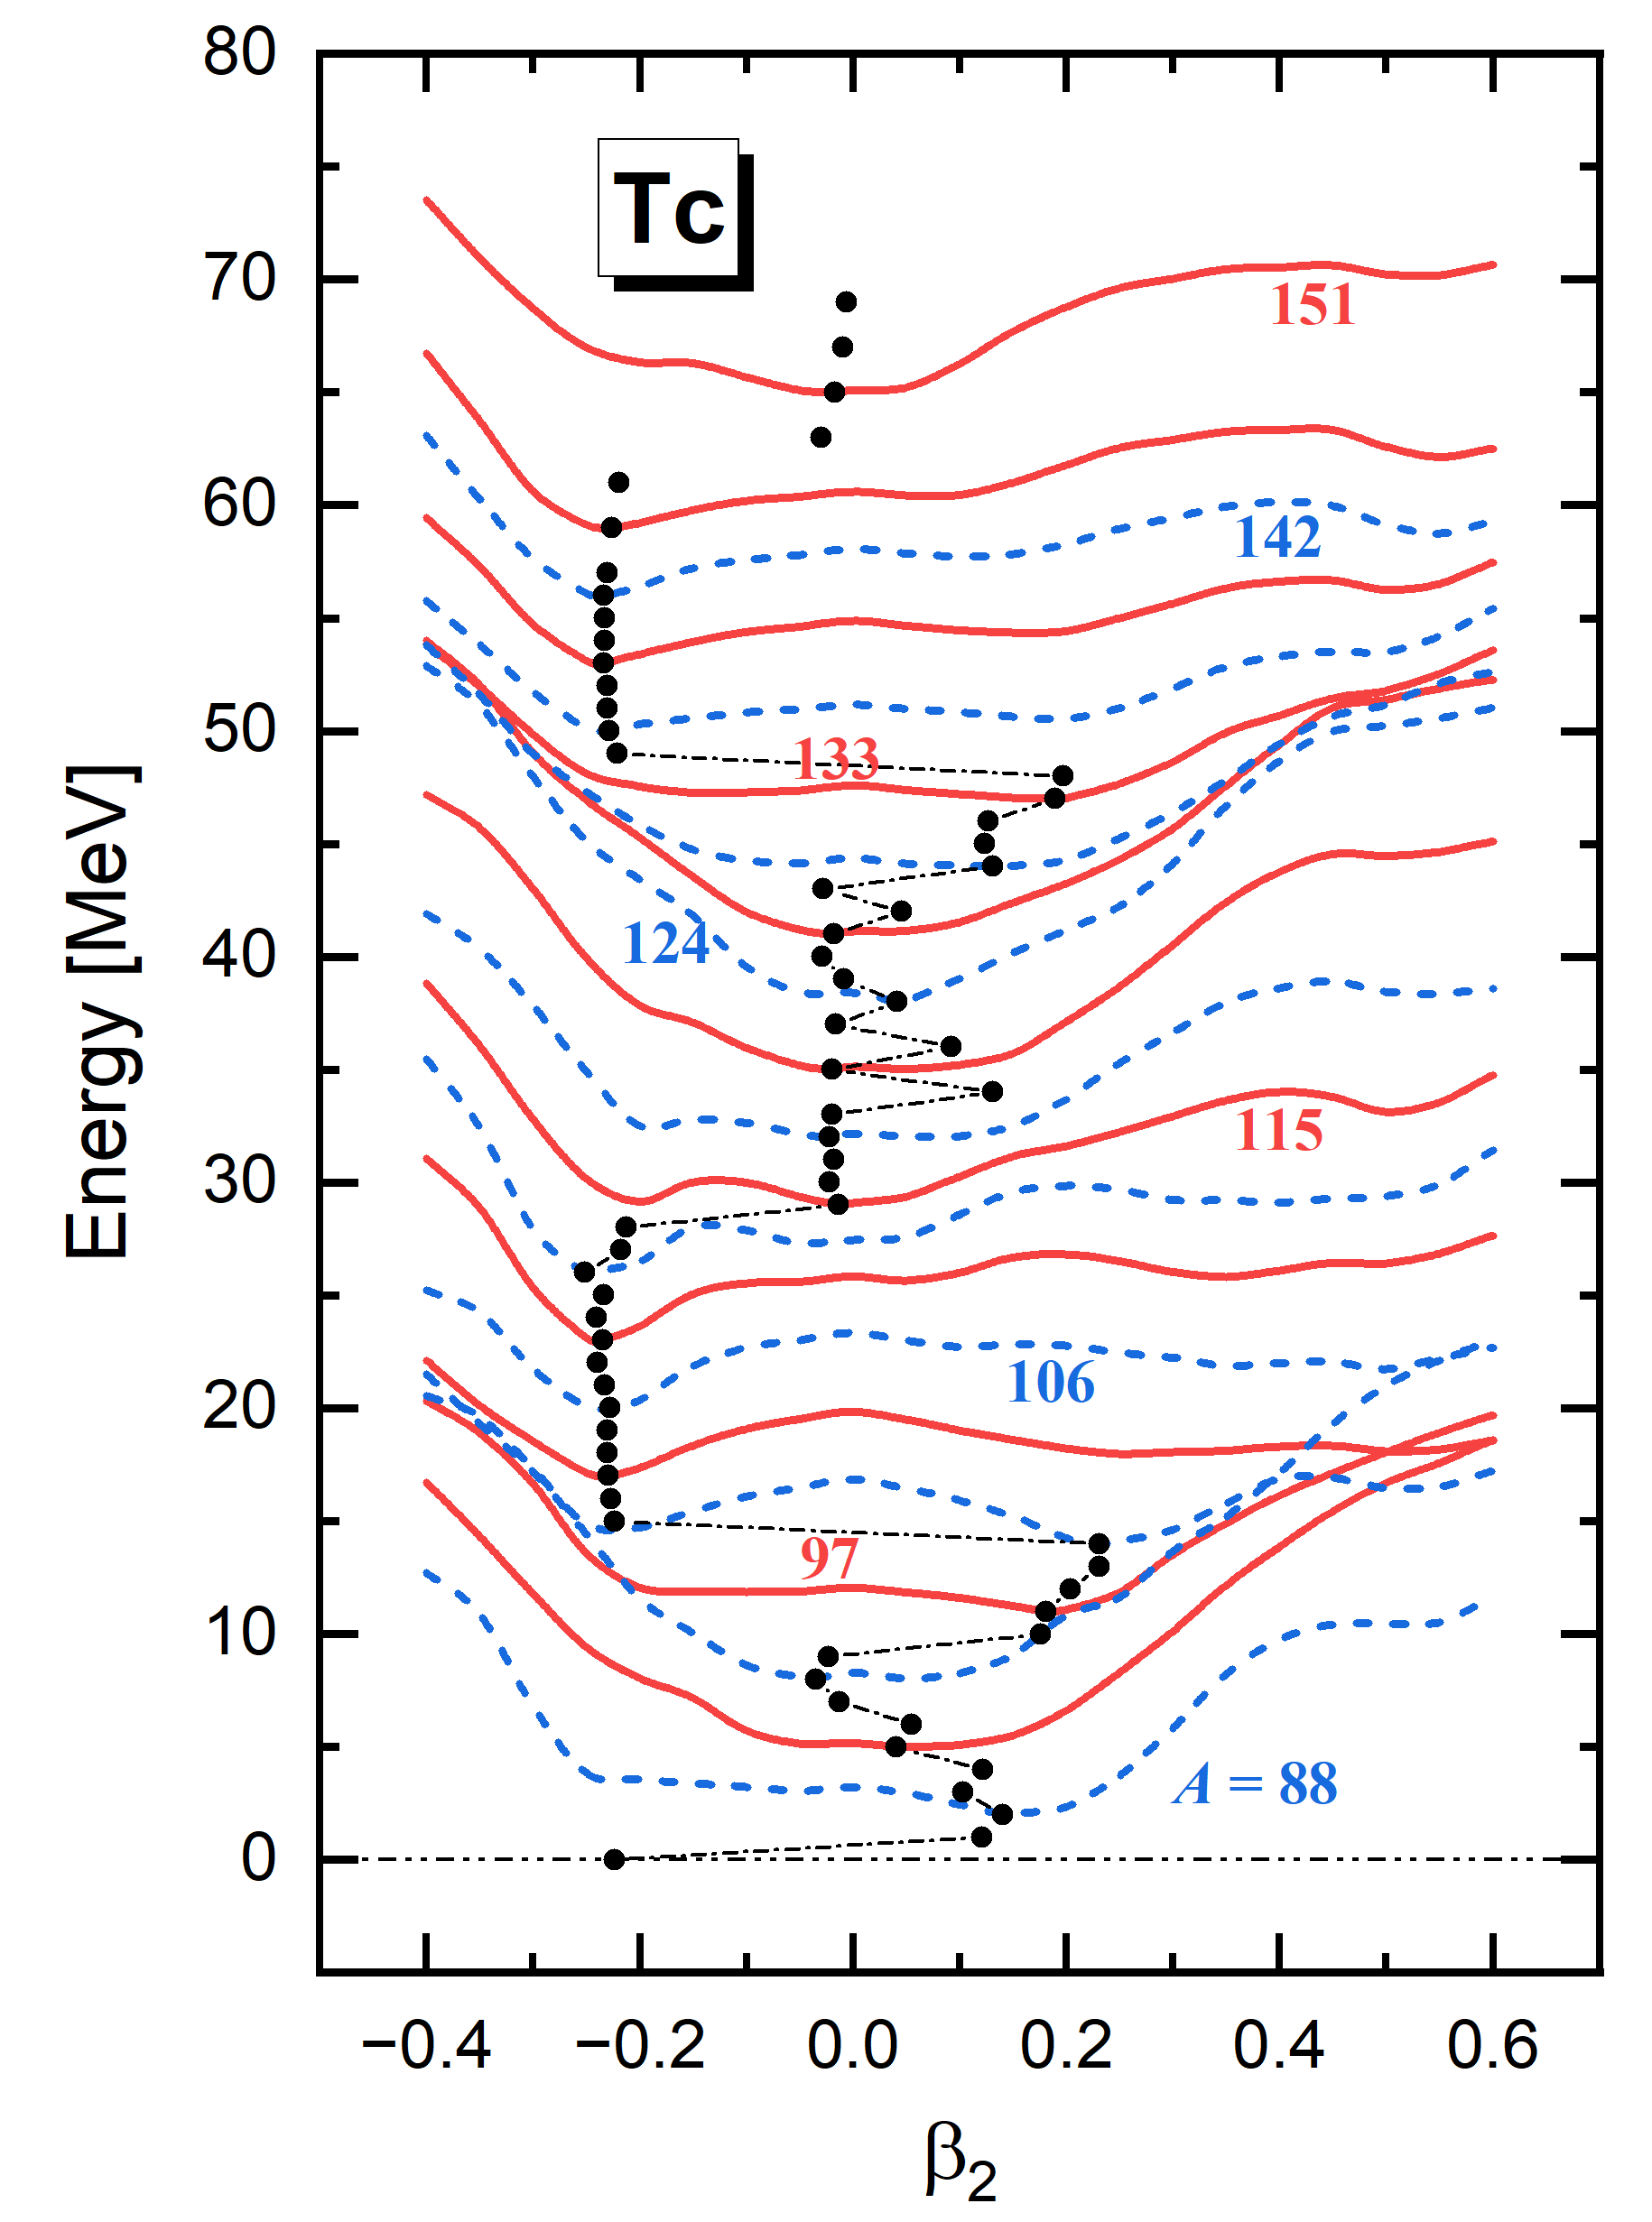
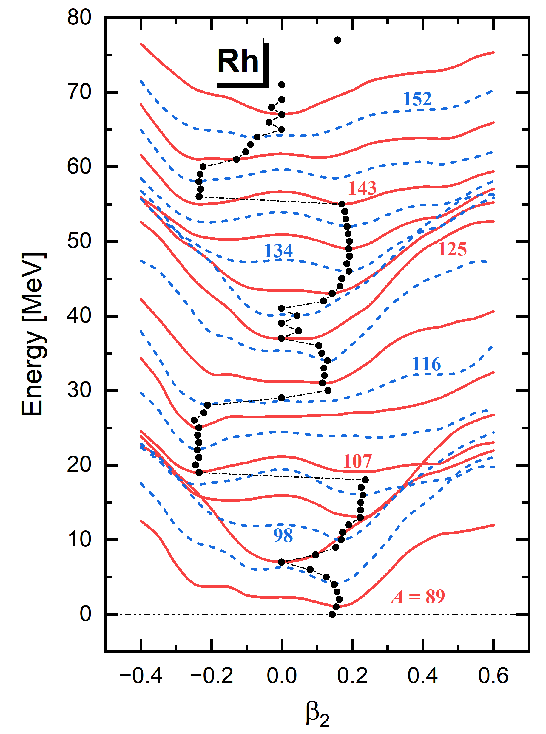
Determination of Ground State
Potential energy curves

Slide 9
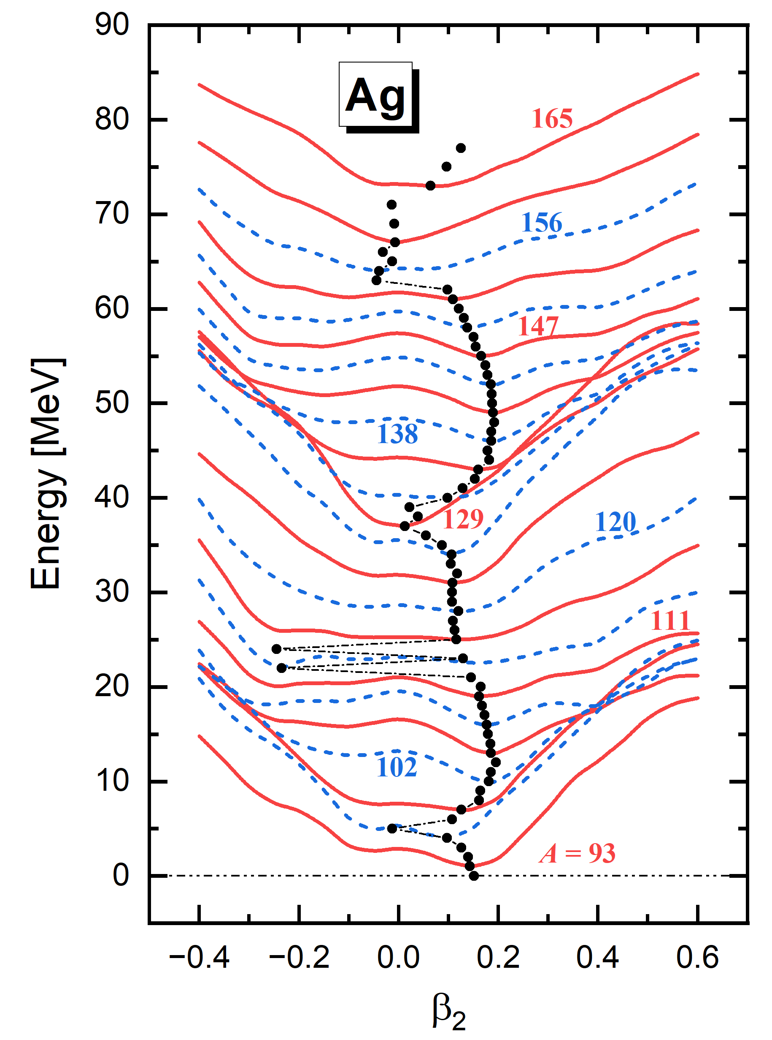
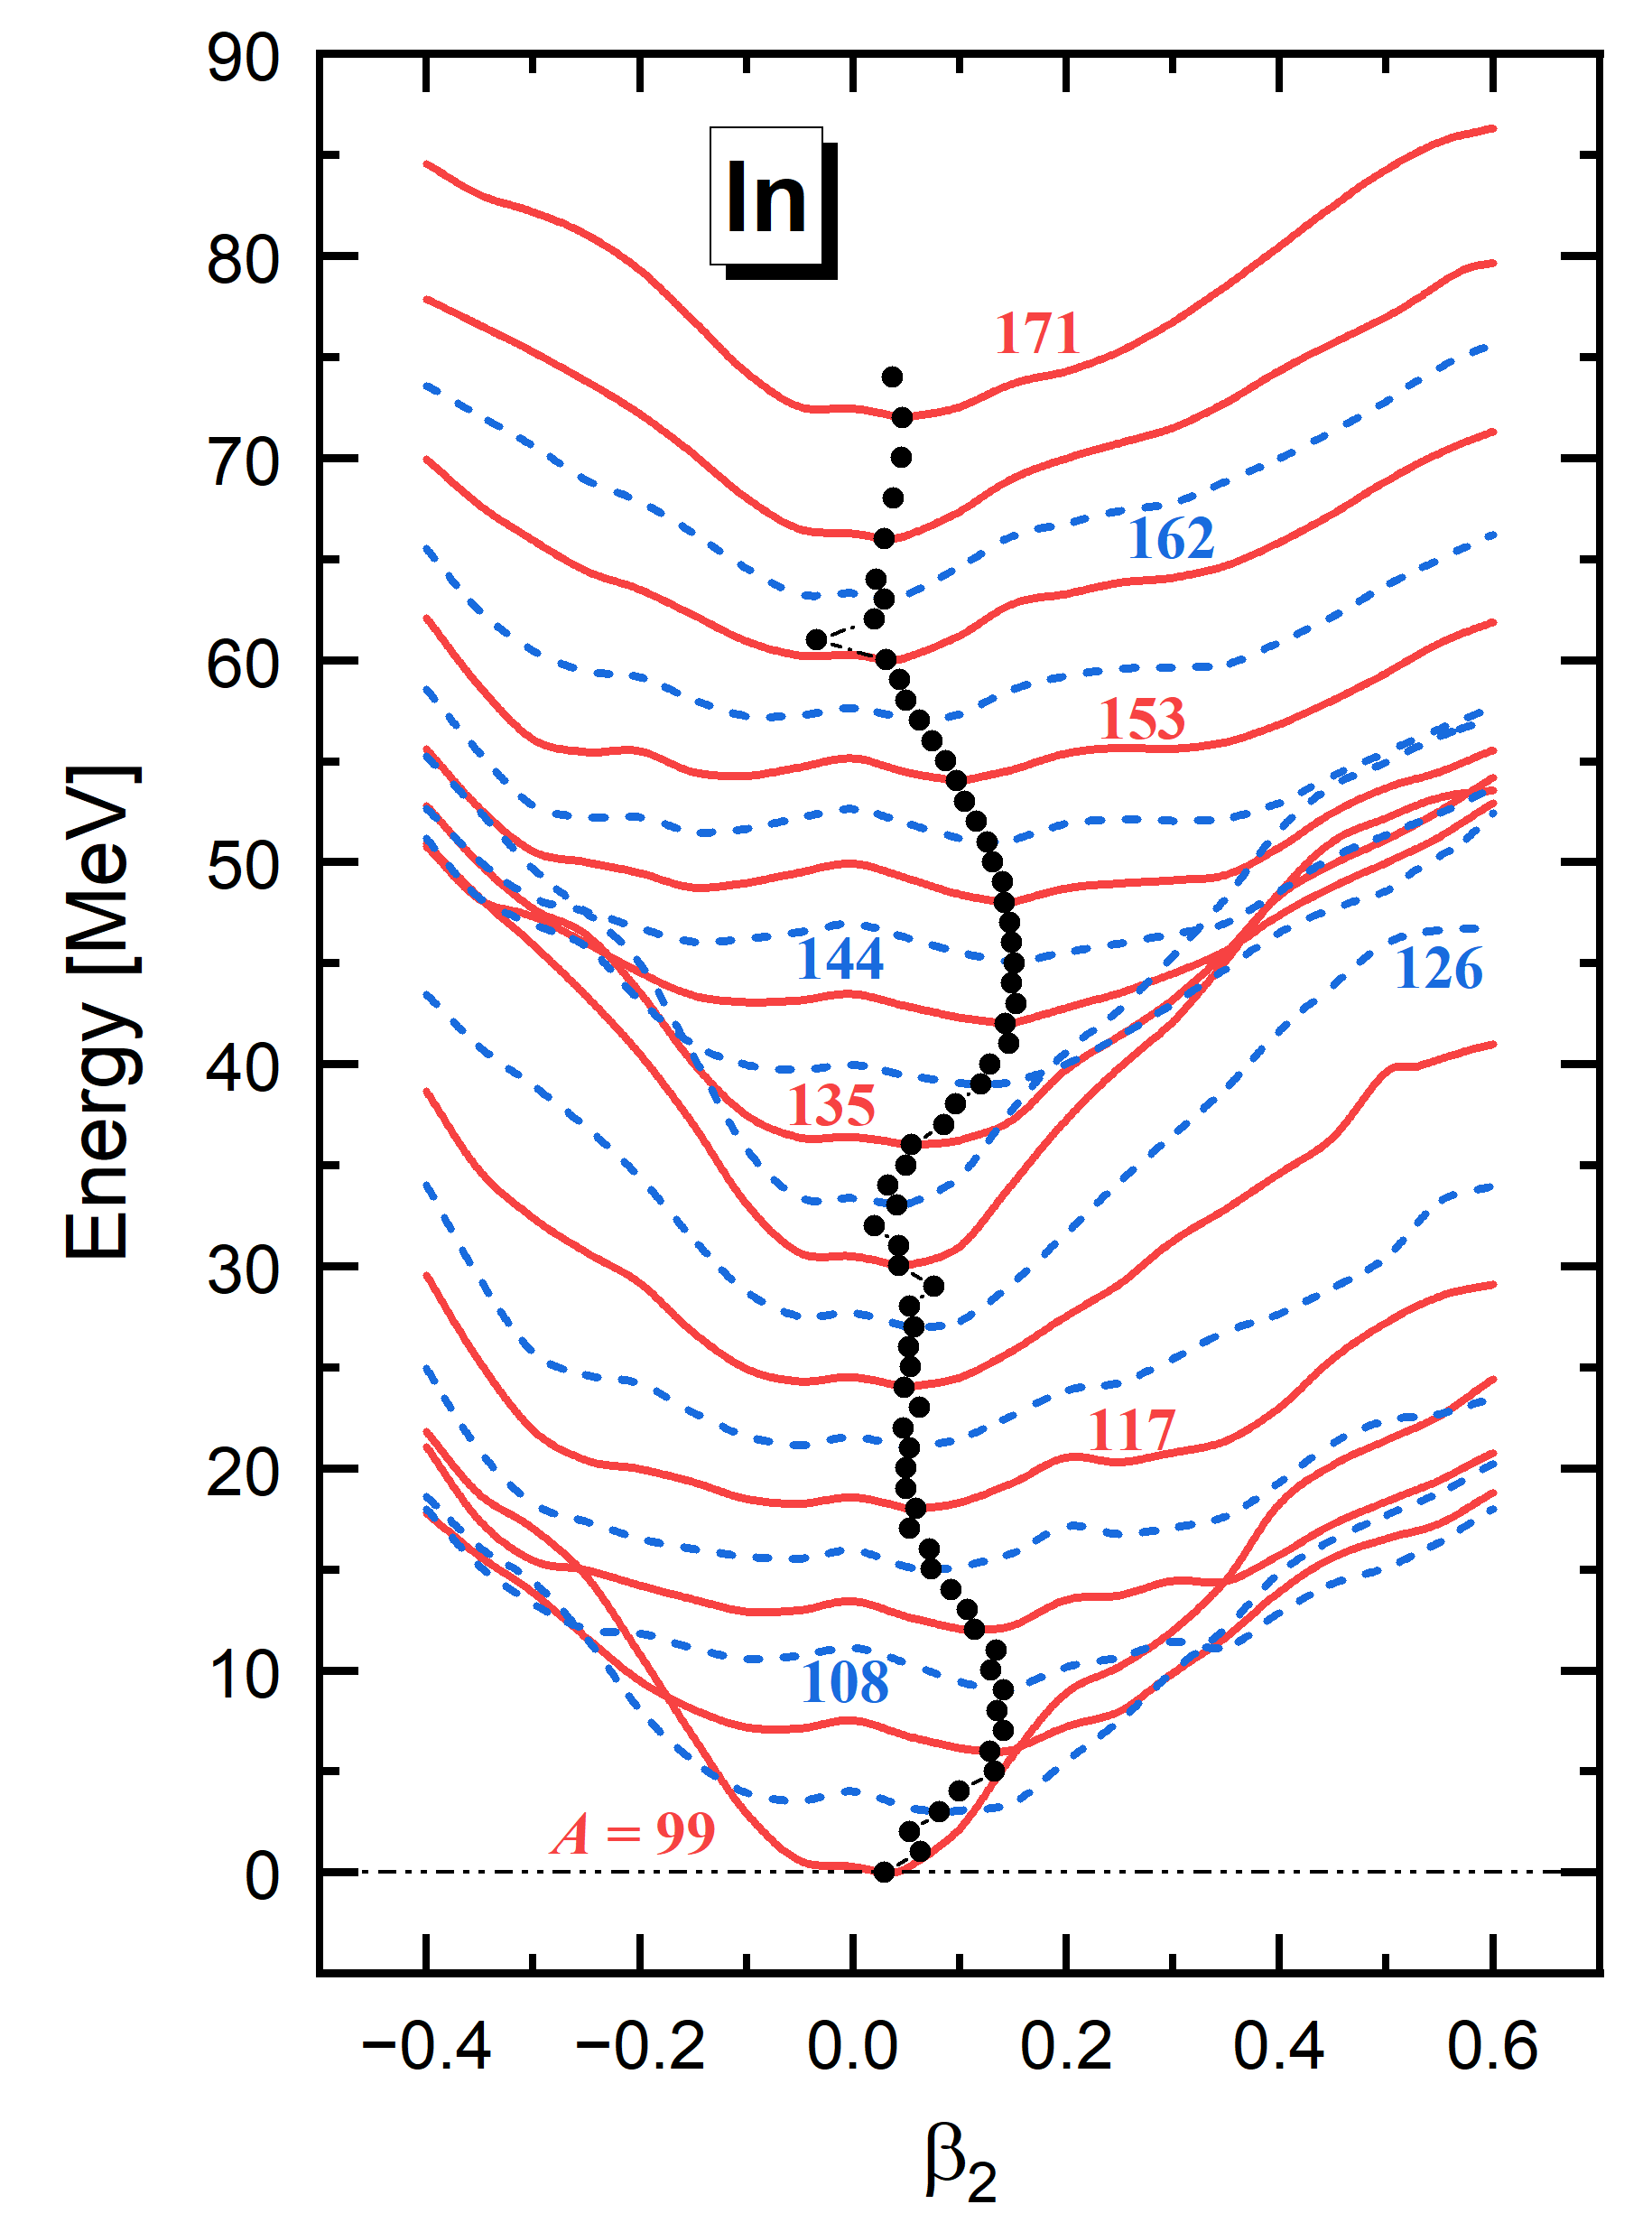
Determination of Ground State
Potential energy curves

Slide 10
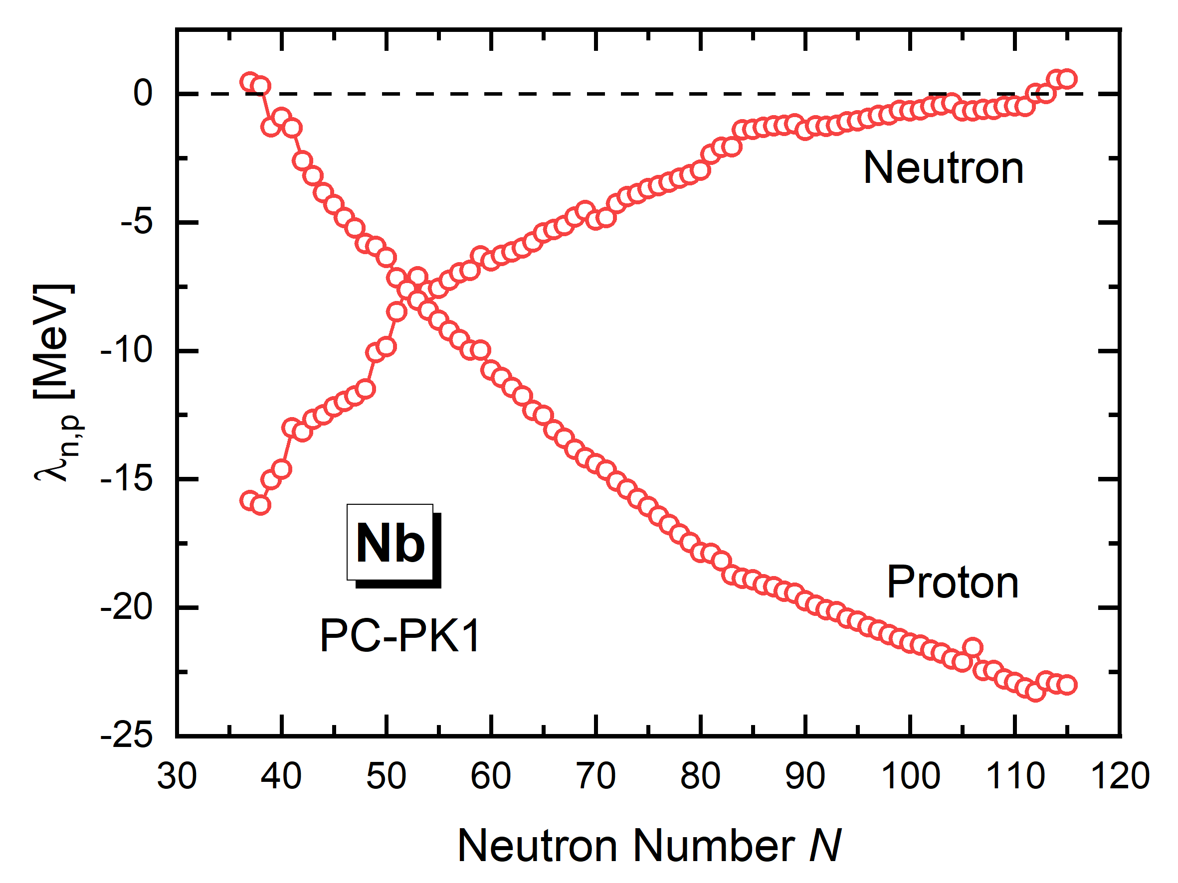
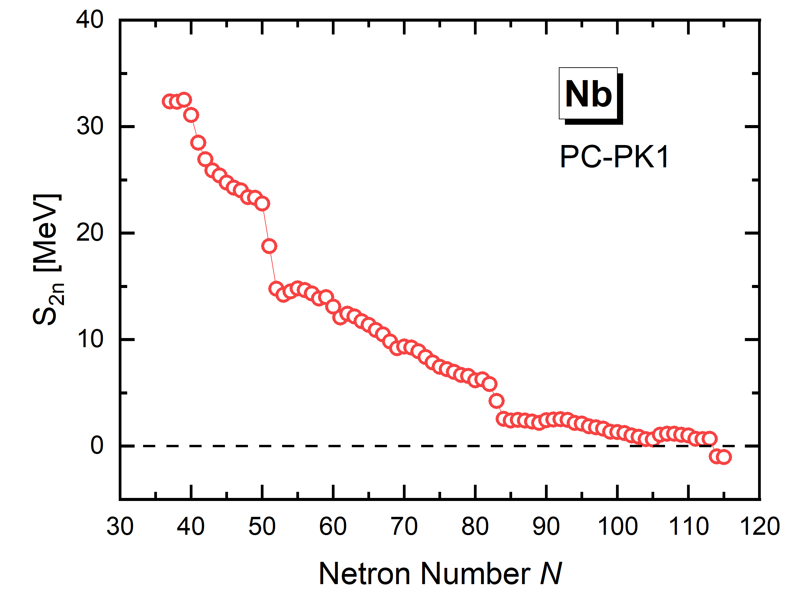
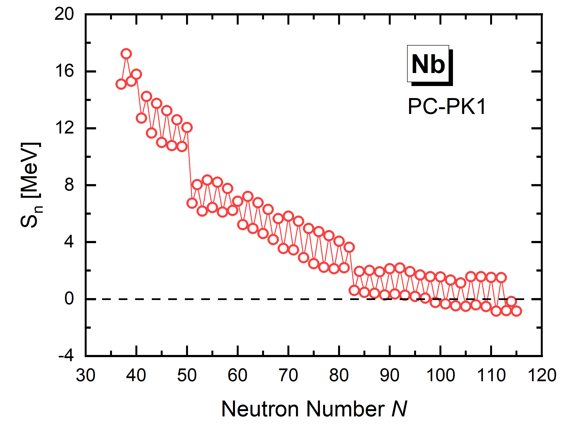
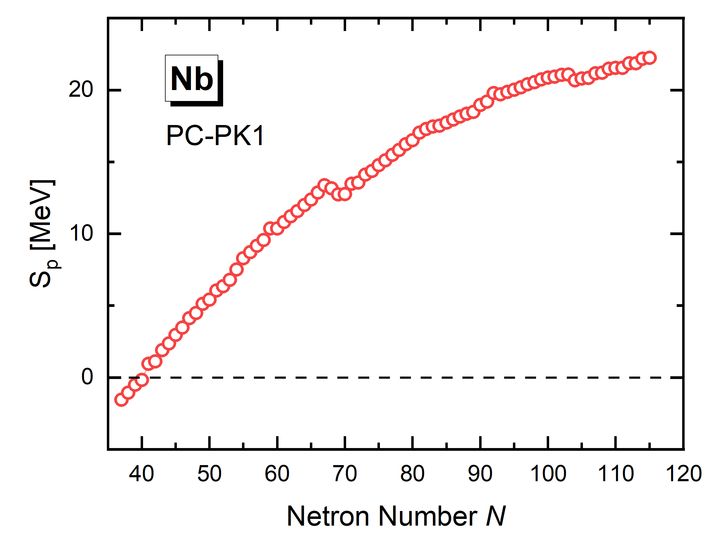
Determination of Driplines
The neutron and proton driplines are determined according to:
  Fermi energy, two-nucleon separation energy, single-nucleon separation energy
Fermi Energy
Two-neutron
separation energy
Single-neutron
separation energy
Single-proton
separation energy

Slide 11
Content
Numerical Details
Determination of the Ground state and Driplines
Results and discussions
Summary

Slide 12
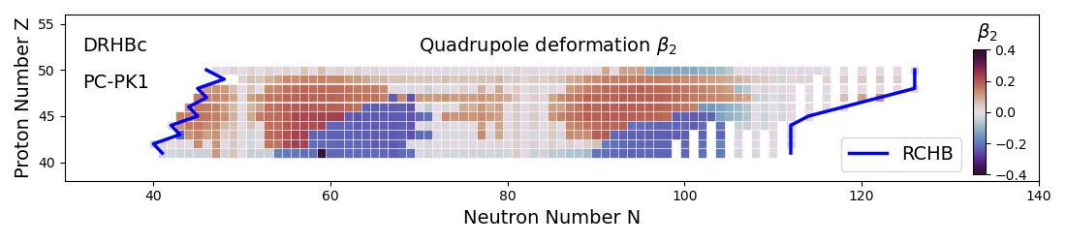
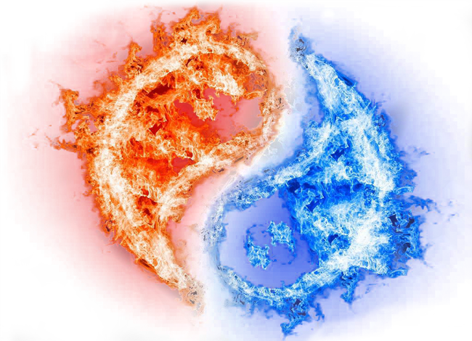
Quadrupole Deformation
Driplines and quadrupole deformation ($41≤Z≤50$)
 | Proton Dripline | Neutron Dripline | Number of isotopes
Nb | ⁸²Nb₄₁ | ¹⁵¹Nb₁₁₀ | 64
Tc | ⁸⁶Tc₄₃ | ¹⁵⁵Tc₁₁₂ | 64
Rh | ⁸⁸Rh₄₃ | ¹⁵⁹Rh₁₁₄ | 71
Ag | ⁹²Ag₄₅ | ¹⁶⁹Ag₁₂₂ | 73
In | ⁹⁹In₅₀ | ¹⁷³In₁₂₄ | 70
The driplines are almost same as the ones given by RCHB
The calculated quardupole deformations are consistent with the results of Even Z nuclei

Slide 13
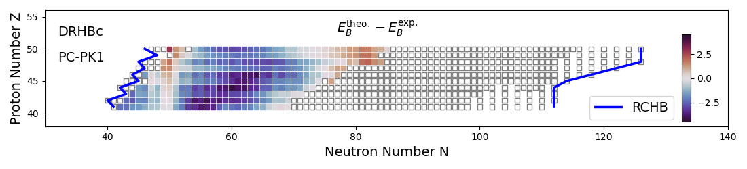
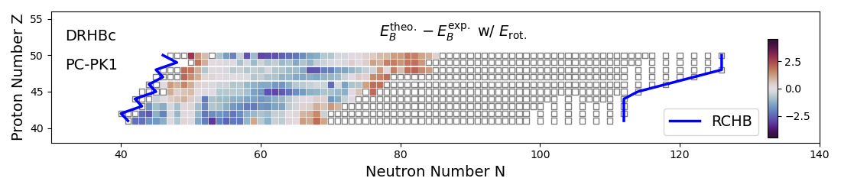
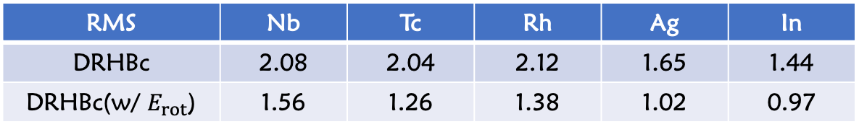
Binding Energy
Binding energy
Exp from Wang et al., CPC 45, 030003 (2021)
RMS | Nb | Tc | Rh | Ag | In
DRHBc | 2.08 | 2.04 | 2.12 | 1.65 | 1.44
DRHBc(w/ $E_{rot}$) | 1.56 | 1.26 | 1.38 | 1.02 | 0.97
Unit: MeV

Slide 14
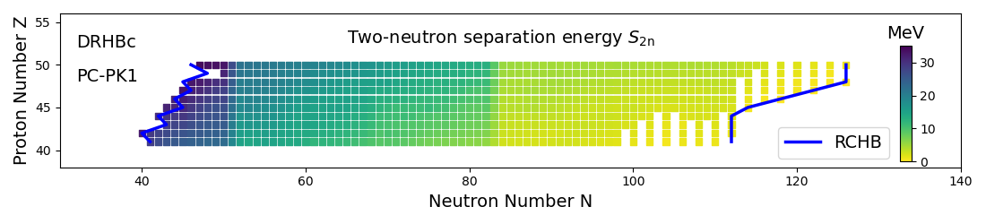
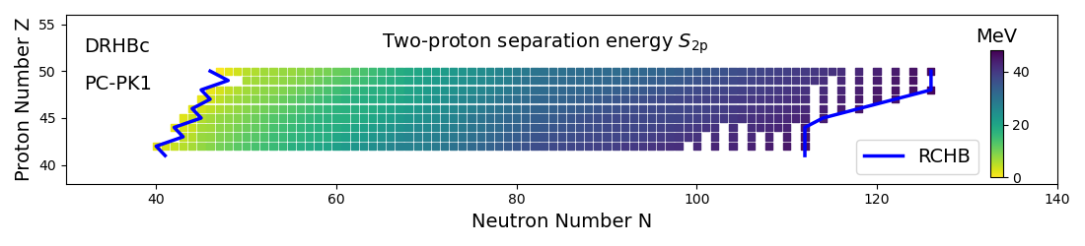
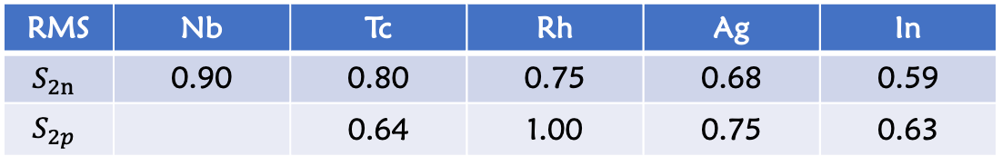
Two-Nucleon Separation Energy
Two-nucleon separation energy
Exp from Wang et al., CPC 45, 030003 (2021)
RMS | Nb | Tc | Rh | Ag | In
$$S_{2n}$$ | 0.90 | 0.80 | 0.75 | 0.68 | 0.59
$$S_{2p}$$ |  | 0.64 | 1.00 | 0.75 | 0.63
Unit: MeV

Slide 15

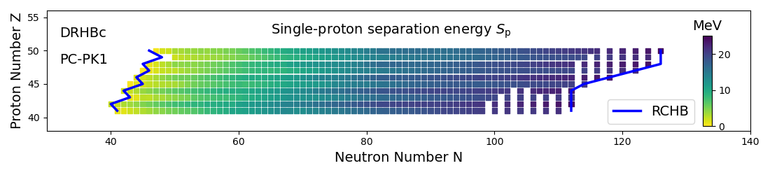
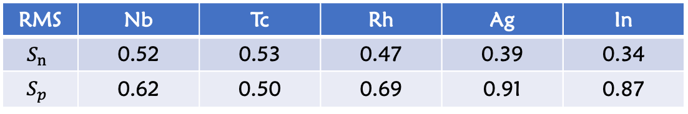
Single-Nucleon Separation Energy
Two-nucleon separation energy
Exp from Wang et al., CPC 45, 030003 (2021)
RMS | Nb | Tc | Rh | Ag | In
$$S_{n}$$ | 0.52 | 0.53 | 0.47 | 0.39 | 0.34
$$S_{p}$$ | 0.62 | 0.50 | 0.69 | 0.91 | 0.87
Unit: MeV

Slide 16
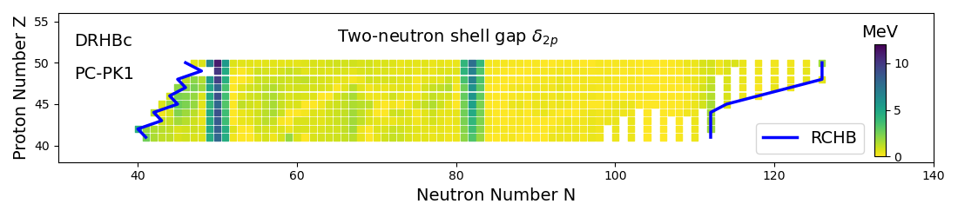
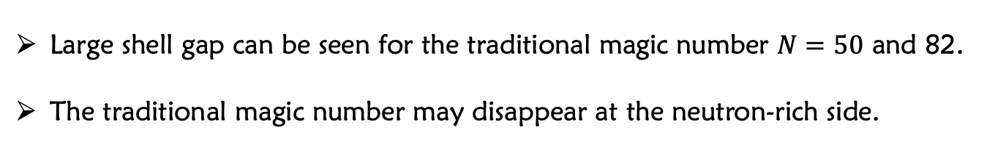
Two-Neutron Shell Gap
Two-neutron shell gap
Exp from Wang et al., CPC 45, 030003 (2021)
Large shell gap can be seen for the traditional magic number $N=50$ and 82.
The traditional magic number may disappear at the neutron-rich side.

Slide 17
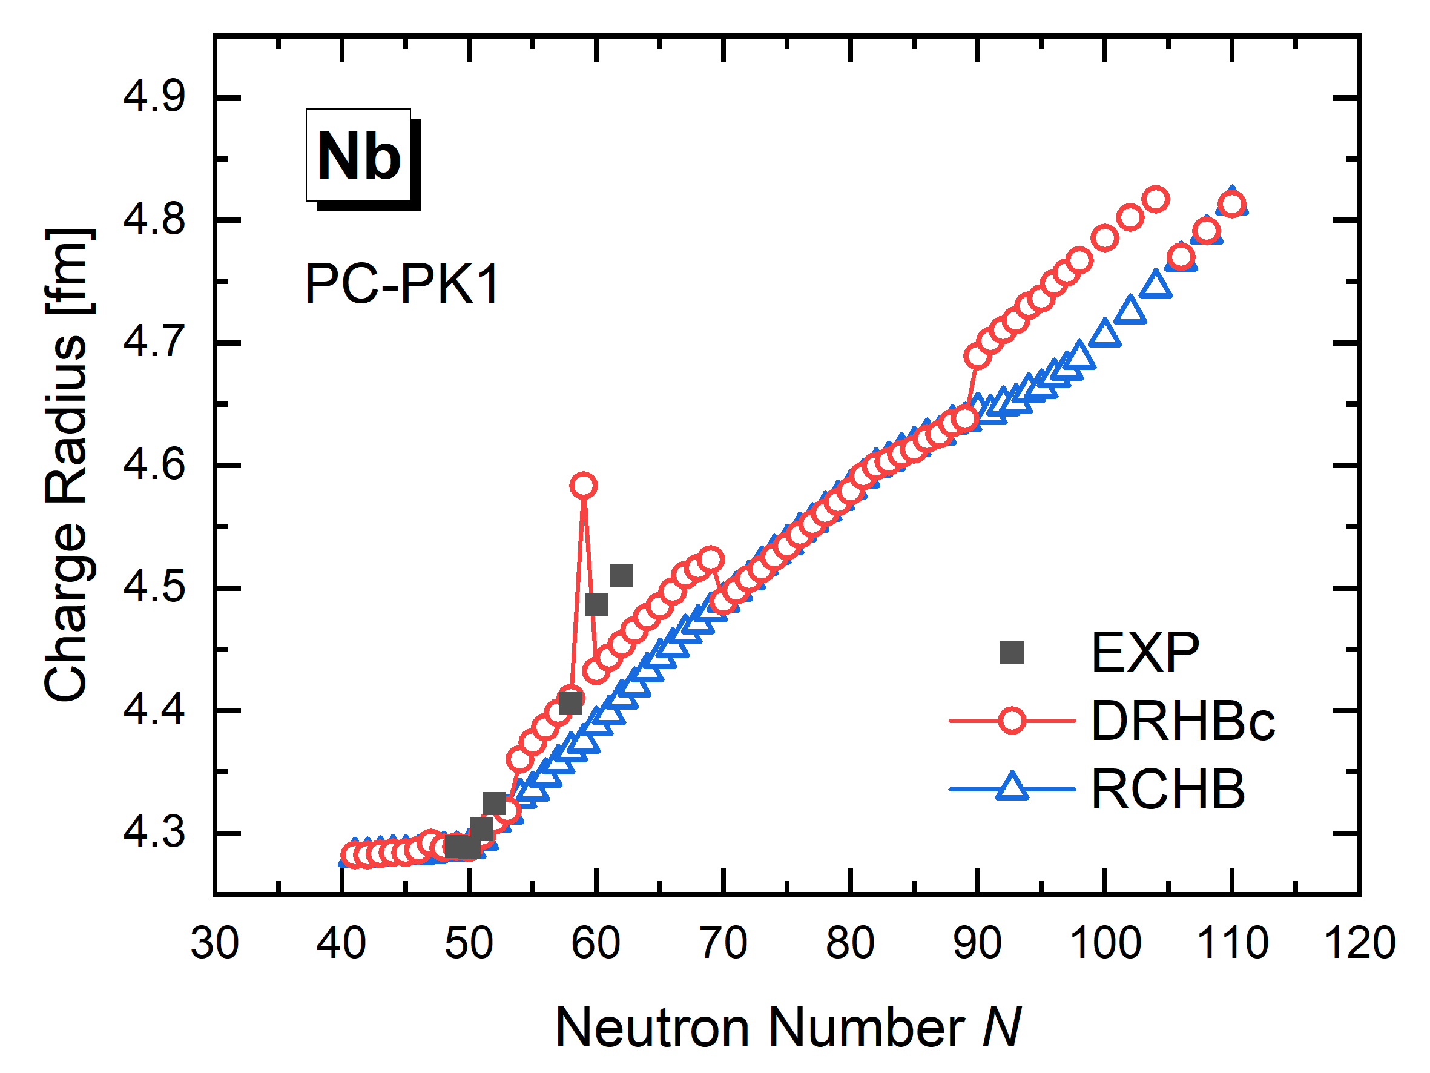
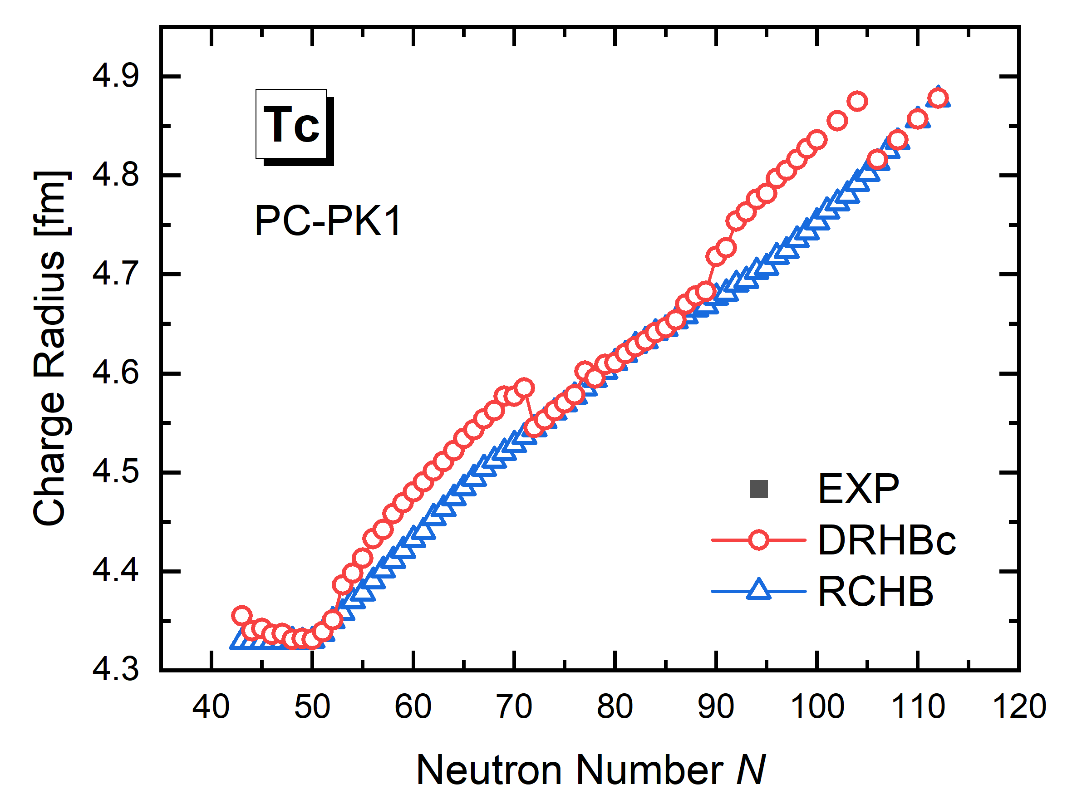
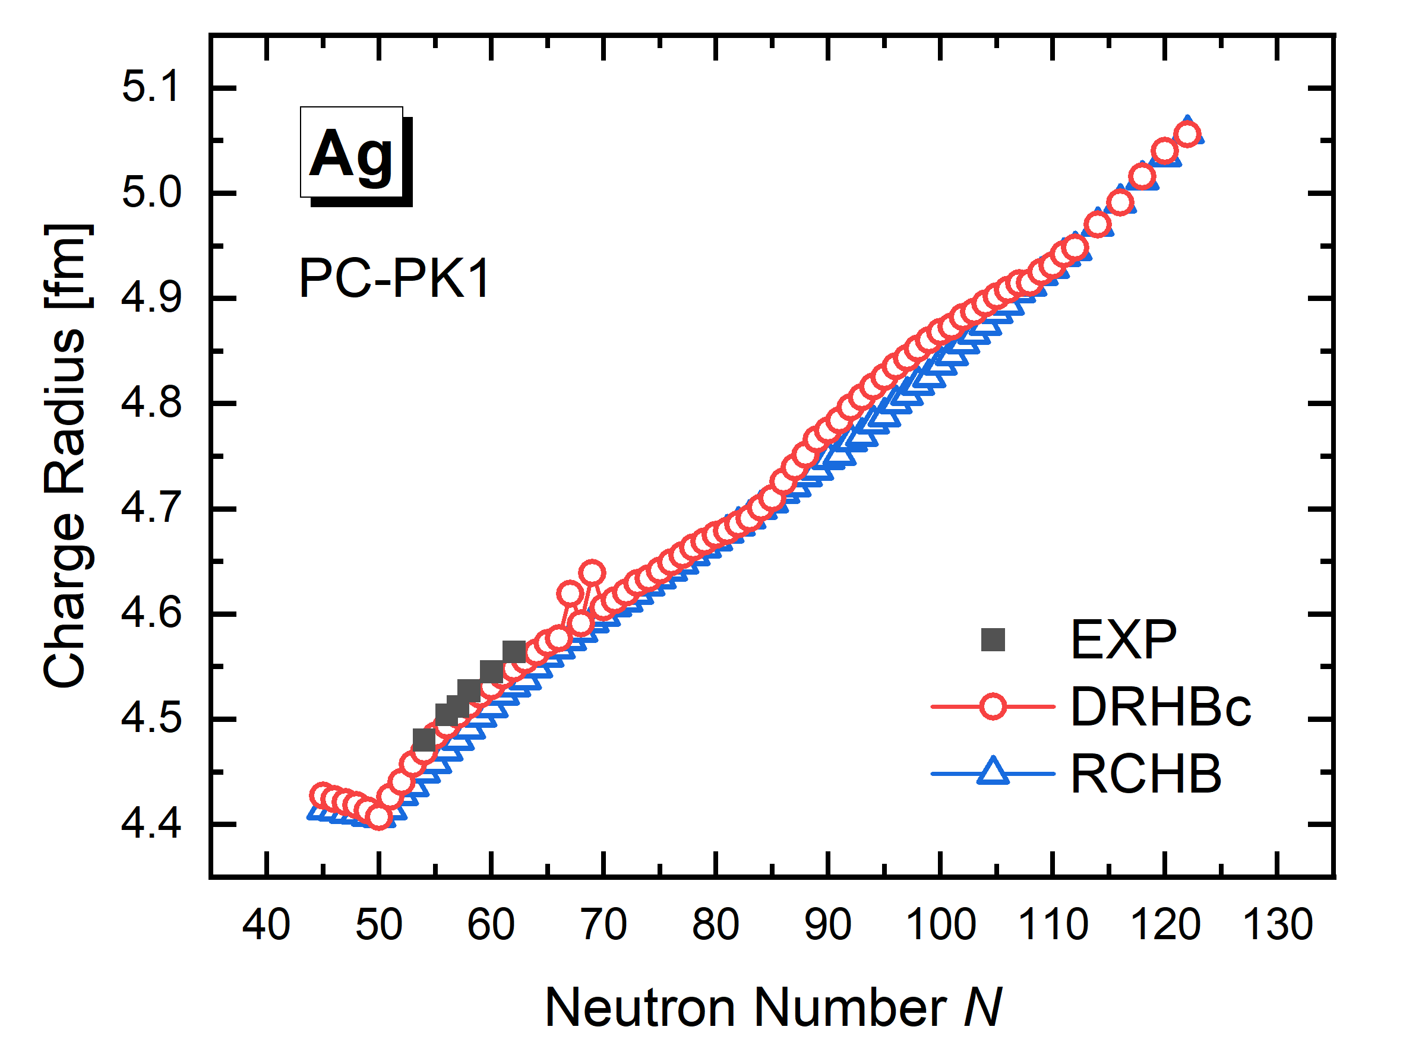
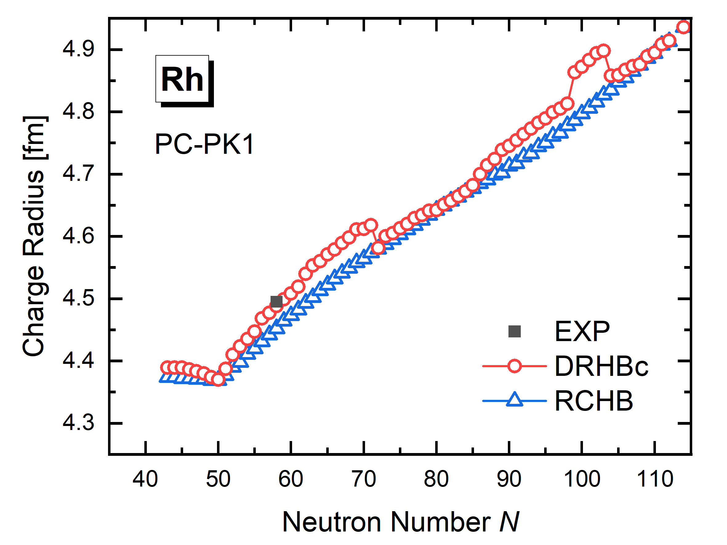
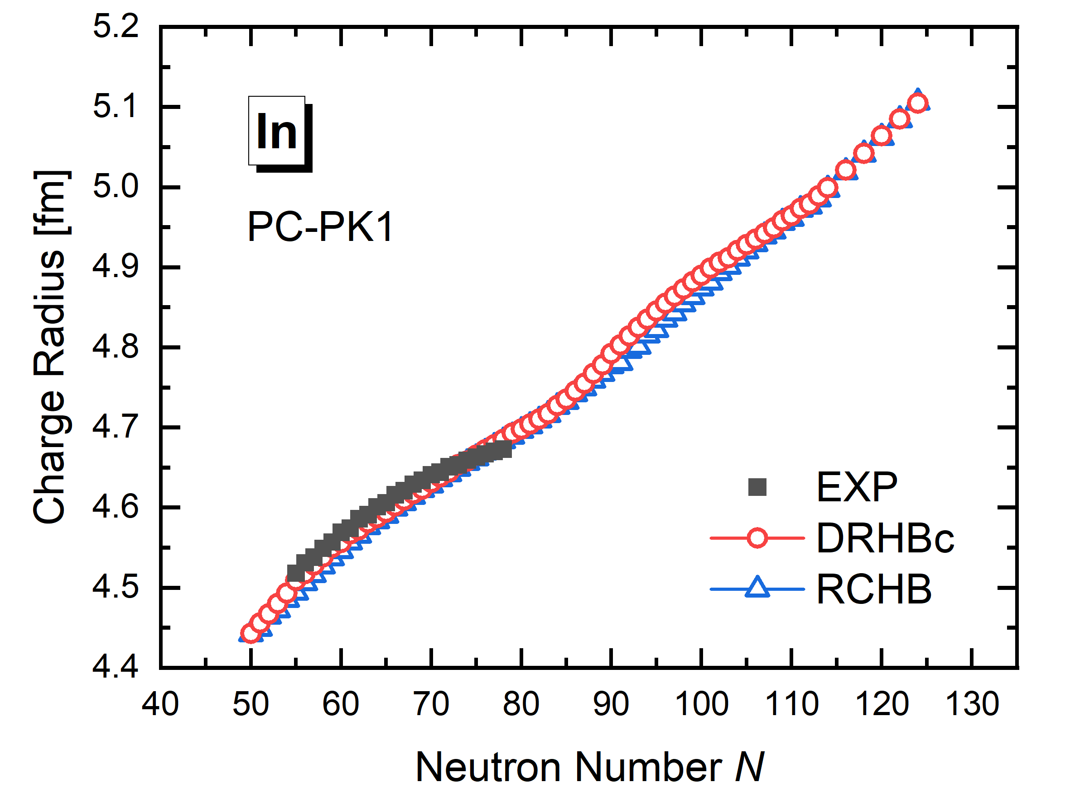
Charge radii
The calculated charge radius
The calculated charge radii are in good agreement with the experimental data

Slide 18
Content
Numerical Details
Determination of the Ground state and Driplines
Results and discussions
Summary

Slide 19
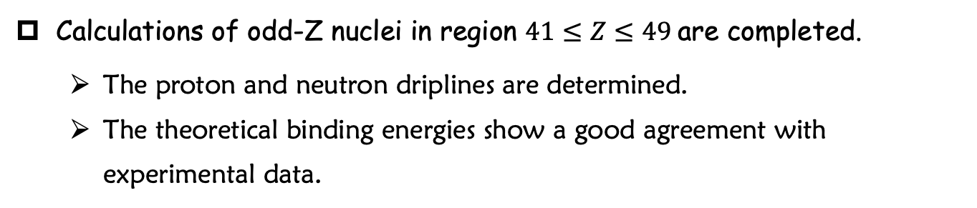
Summary
Calculations of odd-Z nuclei in region $41≤Z≤49$are completed.
  The proton and neutron driplines are determined.
  The theoretical binding energies show a good agreement with experimental data.
Thank you!

Slide 20
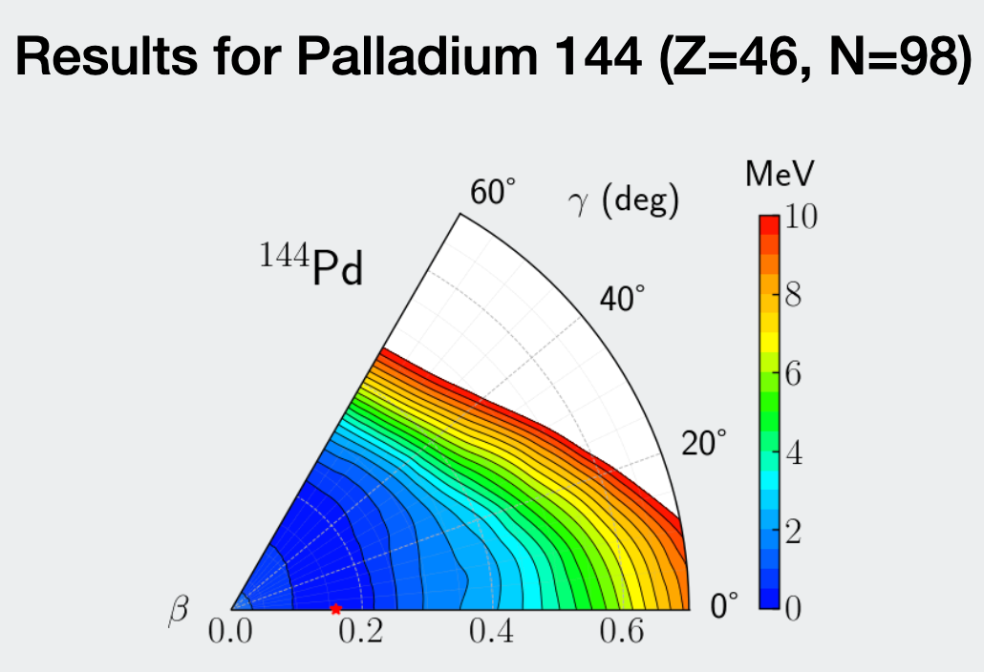
0.53 MeV
0.60 MeV
0.60 MeV
1.04 MeV
0.62 MeV
0.75 MeV
1.10 MeV
0.64 MeV

