Slide 1
Progress Report for nuclear regions with (G5) 51 ≤ Z ≤ 59 & (G13) 124 ≤ Z ≤ 126
The 7th Workshop on nuclear mass table with DRHBc theory
Jul 1 - 4, 2024, Gangneung, Korea
Cong Pan (潘琮)
School of Physics and Electronic Information, Anhui Normal University, China
Center for Exotic Nuclear Studies, Institute for Basic Science, South Korea
Collaborators: Xiao-Hua Fan (范小华), Southwest University Lang Liu (刘朗), Jiangnan University

Slide 2
Outline
Introduction
Progress in 51 ≤ Z ≤ 60 (G5)
Progress in 124 ≤ Z ≤ 126 (G13)
Summary

Slide 3
Introduction
Nuclear mass is one of the most important quantities in nuclear physics and nuclear astrophysics.
The masses of most nuclei will still rely on theoretical predictions in the foreseeable future.
Deformed relativistic Hartree-Bogoliubov theory in continuum (DRHBc) can provide a proper description for both stable and exotic nuclei.
The DRHBc mass table for even-Z nuclei has been finished.
Lunney, Pearson, and Thibault, RMP 75, 1021 (2003)
Meng (Ed.), Relativistic Density Functional for Nuclear Structure (2016)
Thoennessen, Discovery of Nuclides [https://people.nscl.msu.edu/~thoennes/isotopes/]
Wang, et al., CPC 45, 030003 (2021)
Zhou, et al., PRC 82, 011301 (2010)
Li, et al., PRC 85, 024312 (2012)
DRHBc Mass Table Collaboration, ADNDT 144, 101488 (2022)
DRHBc Mass Table Collaboration, ADNDT 158, 101661 (2024)
See P. Guo’s talk

Slide 4
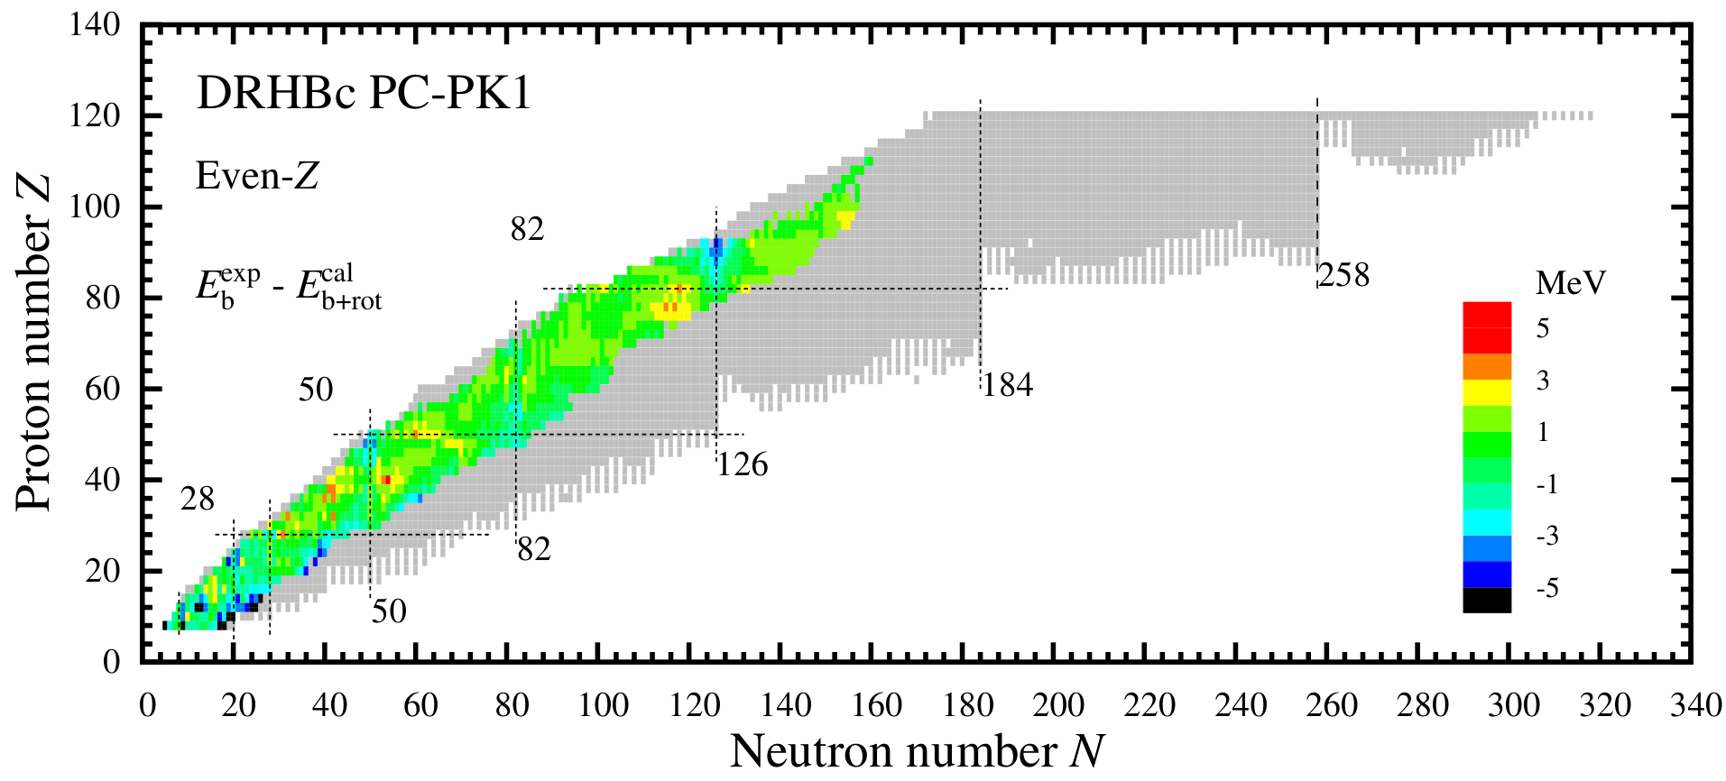
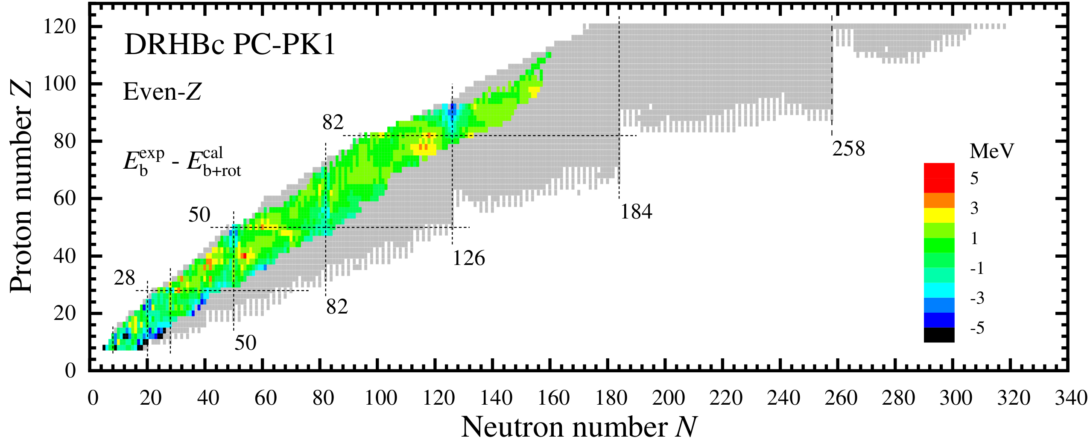
Nuclear regions: G5 and G13
G13: Z = 125,126 (AHNU)
Z = 124 (JNU)
G5: Z = 51,53,55,59 (AHNU)
Z = 57 (SWU)
DRHBc Mass Table Collaboration, ADNDT 158, 101661 (2024)

Slide 5
Outline
Introduction
Progress in 51 ≤ Z ≤ 60 (G5)
Numerical details
Nuclear landscape
Potential energy curves
Progress in 124 ≤ Z ≤ 126 (G13)
Summary
Collaborators: Xiao-Hua Fan (SWU)

Slide 6
Numerical details
Nuclides: ₅₁Sb, ₅₃I, ₅₅Cs, ₅₇La, ₅₉Pr isotopes
Version: Code_DRHBc_202405
Box size: R_{box} = 20 fm
Mesh size: Δr = 0.1 fm
Energy cutoff: E_{cut} = 300 MeV
Angular momentum cutoff: J_{max} = 23/2 ћ
Legendre expansion order: λ_{max} = 6
Relativistic density functional: PC-PK1
Pairing strength: -325 MeV fm³
Blocking treatment: Automatic blocking procedure
DRHBc Mass Table Collaboration, PRC 102, 024314 (2020)
DRHBc Mass Table Collaboration, PRC 106, 014316 (2022)

Slide 7
Progress for odd-Z nuclei with 51 ≤ Z ≤ 60
In the 6th DRHBc workshop, the preliminary unconstrained results for the odd-Z nuclei with 51 ≤ Z ≤ 60 have been presented.
90% of the unconstrained calculations reached convergence.
In order to confirm the ground states, I calculated the potential energy curves (PECs) for the even-N isotopes with ΔN = 8. The constrained deformations are β^{cst} = -0.40, -0.35, -0.30, … 0.50.
In constrained calculations, 96% reached convergence.
Results | Number
Total | 783
Converged in auto. blocking | 678 (86%)
Converged in orbit-fixed blocking | 75 (10%)
No convergence | 30 ( 4%)

Slide 8
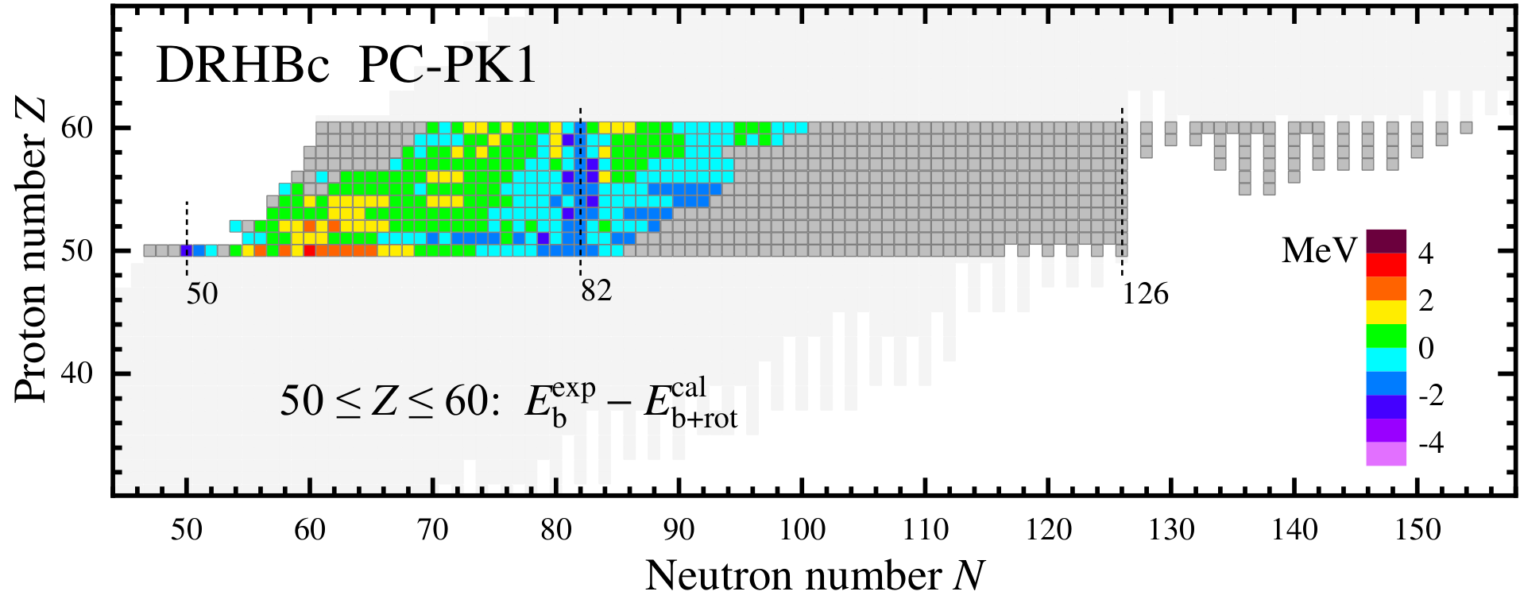
Nuclear landscape in 51 ≤ Z ≤ 60
Exp: AME2020
[Wang, et al., CPC 45, 030003 (2021)]
Exp: AME2020
196 (odd-even) + 171 (odd-odd) = 367 nuclei are bound in DRHBc, which is larger than the number 339 in RCHB.
The rms deviation of binding energy from data is 0.89 MeV, showing significant improvement from 6.12 MeV in RCHB.

Slide 9
Nuclear landscape in 51 ≤ Z ≤ 60
Exp: AME2020
Exp: AME2020
The proton drip line of Z = 51 is less extended than those of Z = 50, 52.
Near the neutron drip line, a zigzag pattern appears.
In the “peninsula” beyond N = 126, no odd-odd nucleus exists.
—— Influence of the odd-even effects.

Slide 10
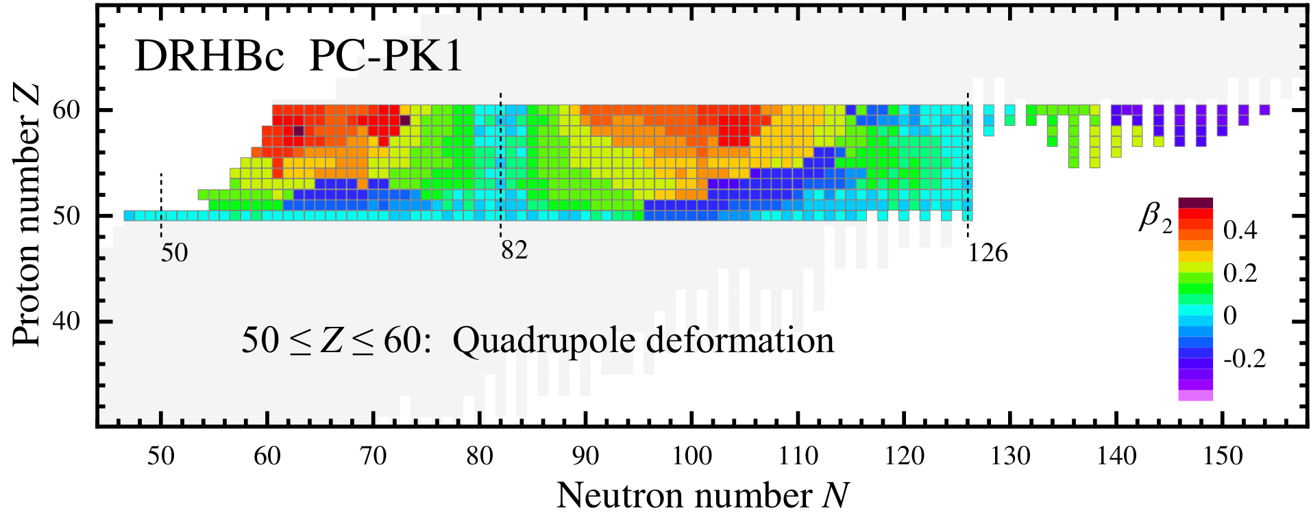
Quadrupole deformation β₂
The evolution of deformation is almost smooth. An odd-Z nucleus has similar shape with neighboring even-Z ones.
Potential energy curves (PECs) for odd-Z nuclei are constructed to confirm the results.

Slide 11
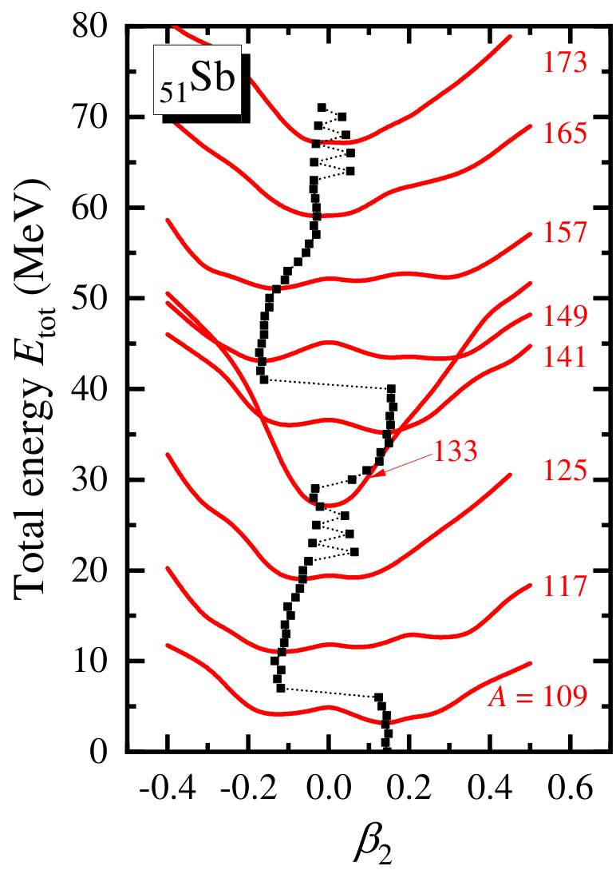
PECs for ₅₁Sb (Antimony)
The PECs for odd-even ₅₁Sb isotopes with ΔN = 8 are calculated. The PECs support the evolution of ground-state deformation.
The deformation near a magic number is close to zero, while significant deformation appears at mid shell. There is no spherical ₅₁Sb isotope, due to the blocking effect.
The PECs for odd-odd isotopes are in progress.
(N=82)
Notes:
N = 82: Proton block 7/2+

Slide 12
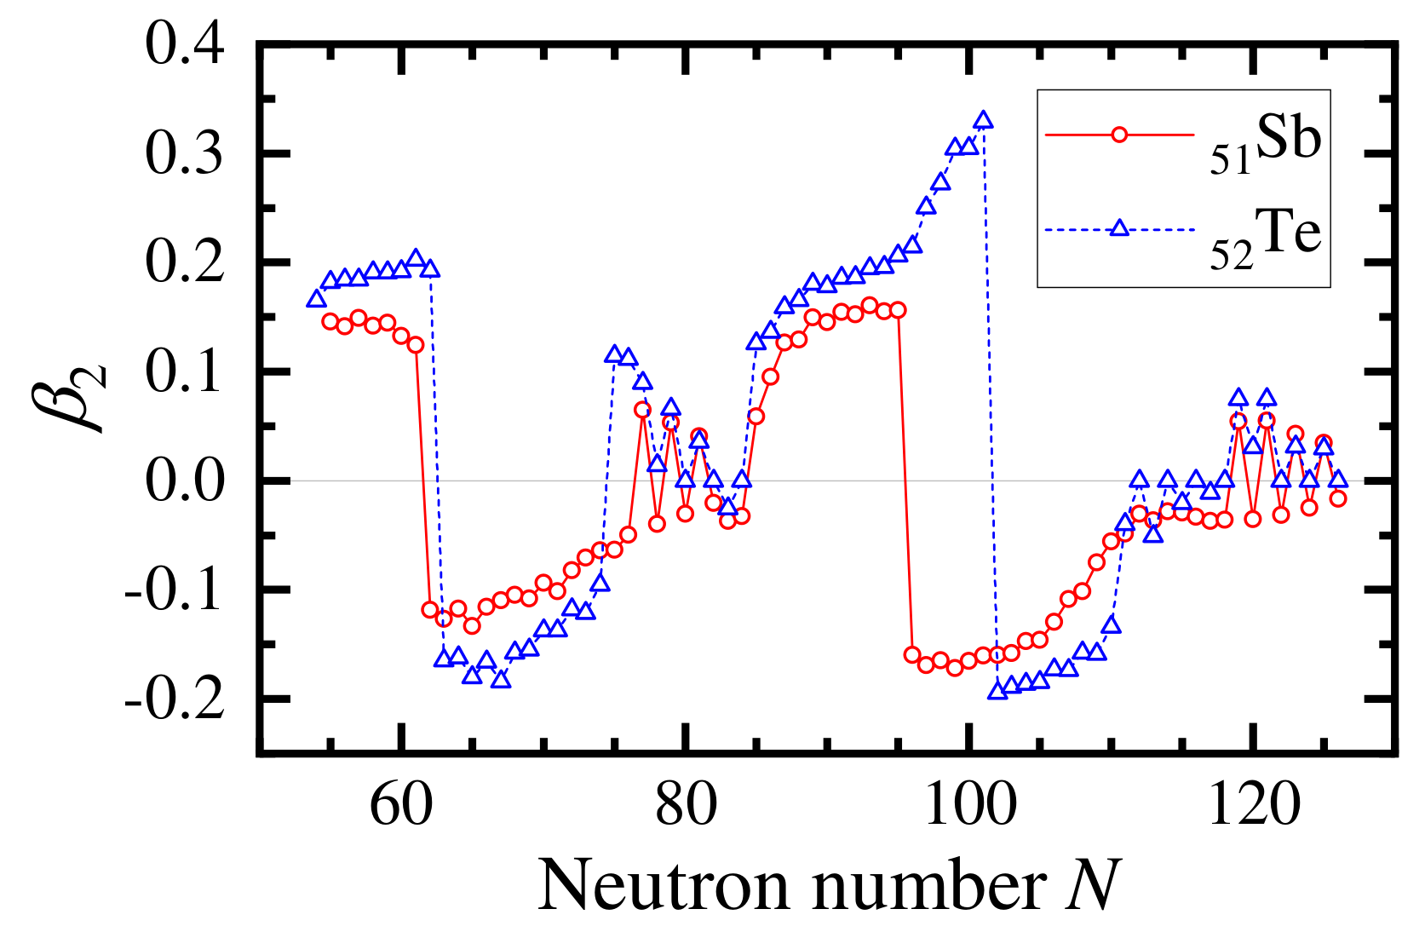
Deformation: ₅₁Sb vs ₅₂Te
The evolutions of deformation β₂ for ₅₁Sb and ₅₂Te are similar.
The β₂ in ₅₂Te is generally slightly larger than that in ₅₁Sb.
The sudden changes from prolate to oblate shape in ₅₁Sb is earlier than those in ₅₂Te.

Slide 13
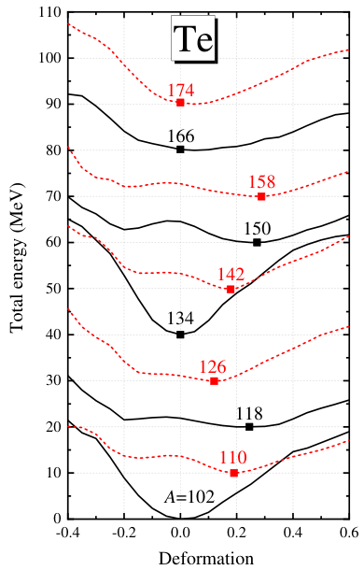
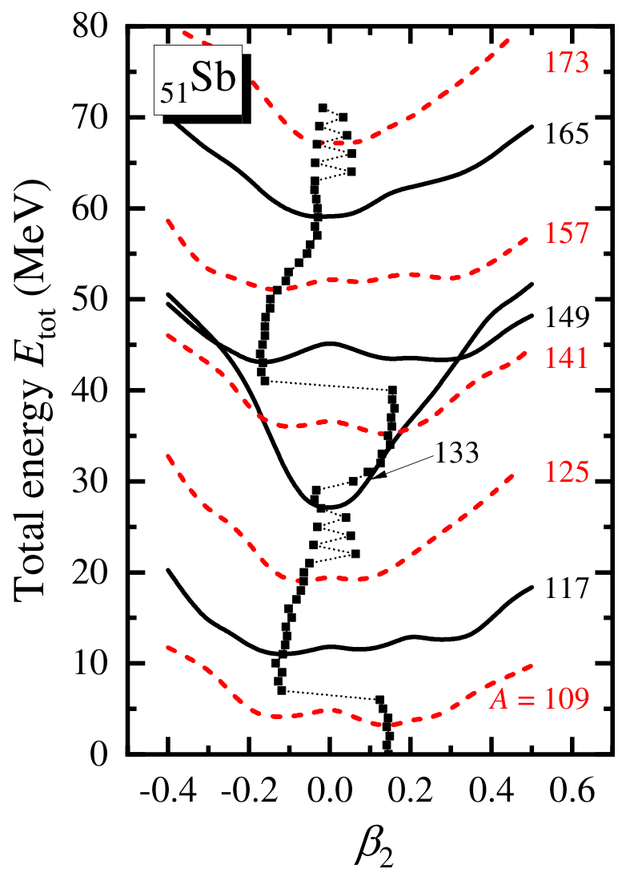
PEC: ₅₁Sb vs ₅₂Te
The evolutions of PECs for ₅₁Sb and ₅₂Te are similar.
Taken from DRHBc Skype meeting, 2019

Slide 14
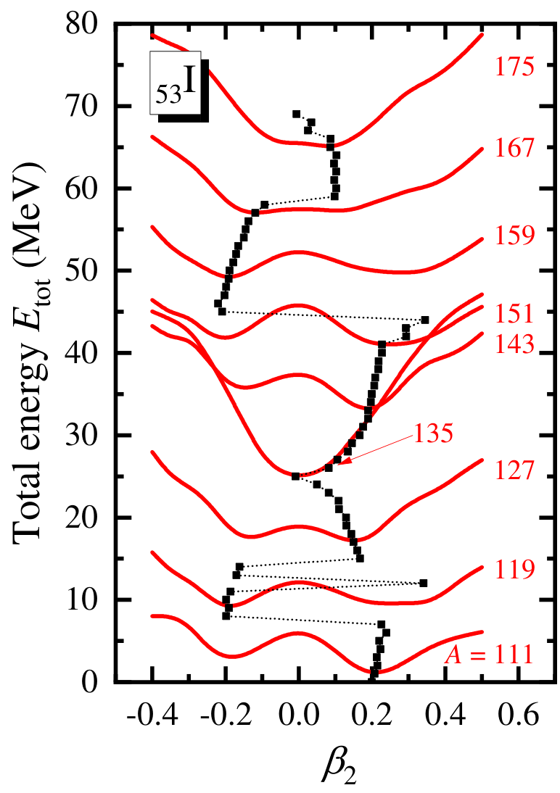
PECs for ₅₃I (Iodine)
The PECs for odd-even ₅₃I isotopes with ΔN = 8 support the evolution of ground-state deformation.
Near a magic number, β₂ is close to zero. At mid shell, significant deformation appears. There is no spherical ₅₃I isotope, due to the blocking effect.
(N=82)

Slide 15
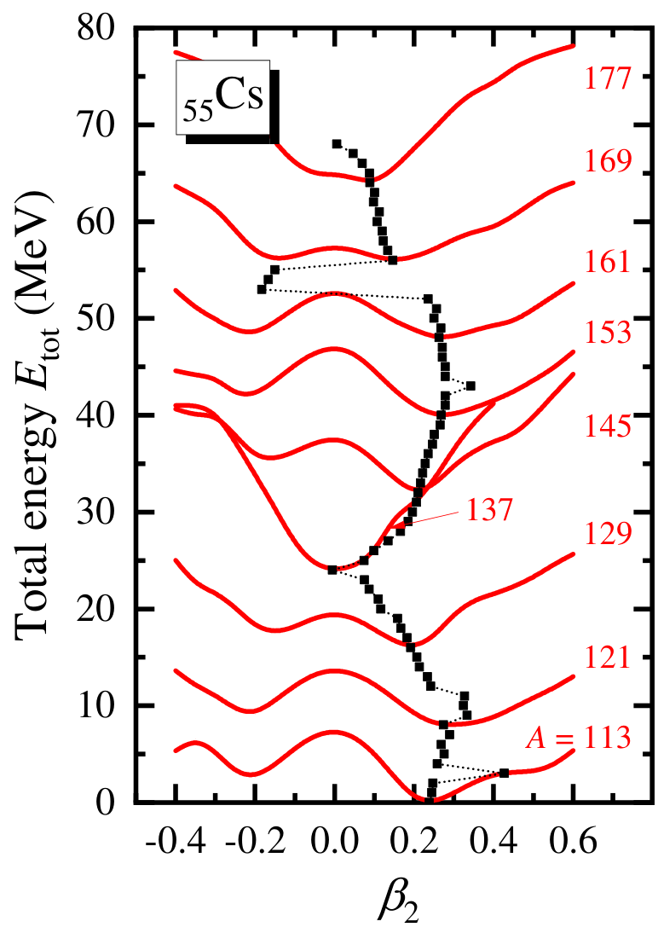
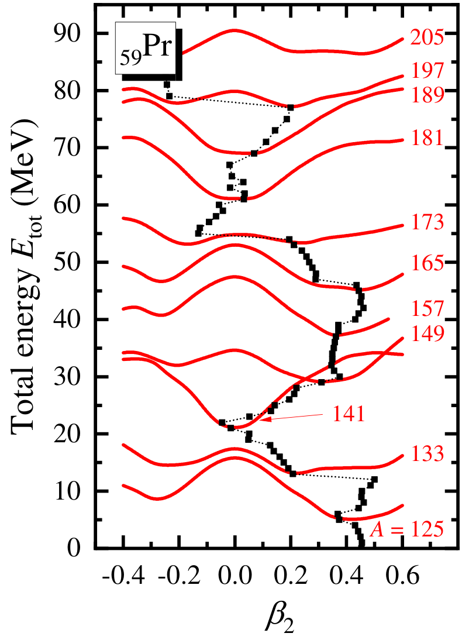
PECs for ₅₅Cs (Cesium) and ₅₉Pr (Praseodymium)
The evolutions of PECs are similar with those of ₅₁Sb and ₅₃I.
(N=82)
(N=82)
(N=82)

Slide 16
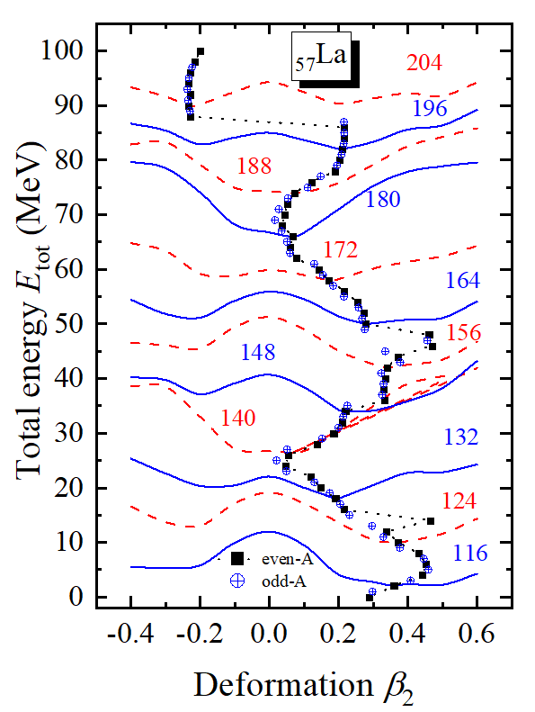
PECs for ₅₇La (Lanthanum)
Results provided by Dr. X.-H. Fan
The PECs for odd-odd ₅₇La isotopes with ΔN = 8 are calculated.
The results support the evolution of ground-state deformation.
The PEC is very useful in examining the ground-state deformations.
(N=83)

Slide 17
Outline
Introduction
Progress in 51 ≤ Z ≤ 60 (G5)
Progress in 124 ≤ Z ≤ 126 (G13)
Numerical details
Ground-state properties
Magic numbers
Summary
Collaborators: Lang Liu (JNU)

Slide 18
Numerical details
Nuclides: ₁₂₆Ubh even-even isotopes
Version: Code_DRHBc_202405
Box size: R_{box} = 20 fm
Mesh size: Δr = 0.1 fm
Energy cutoff: E_{cut} = 300 MeV
Angular momentum cutoff: J_{max} = 23/2 ћ
Legendre expansion order: λ_{max} = 10
Relativistic density functional: PC-PK1
Pairing strength: -325 MeV fm³
DRHBc Mass Table Collaboration, PRC 102, 024314 (2020)
DRHBc Mass Table Collaboration, PRC 106, 014316 (2022)

Slide 19
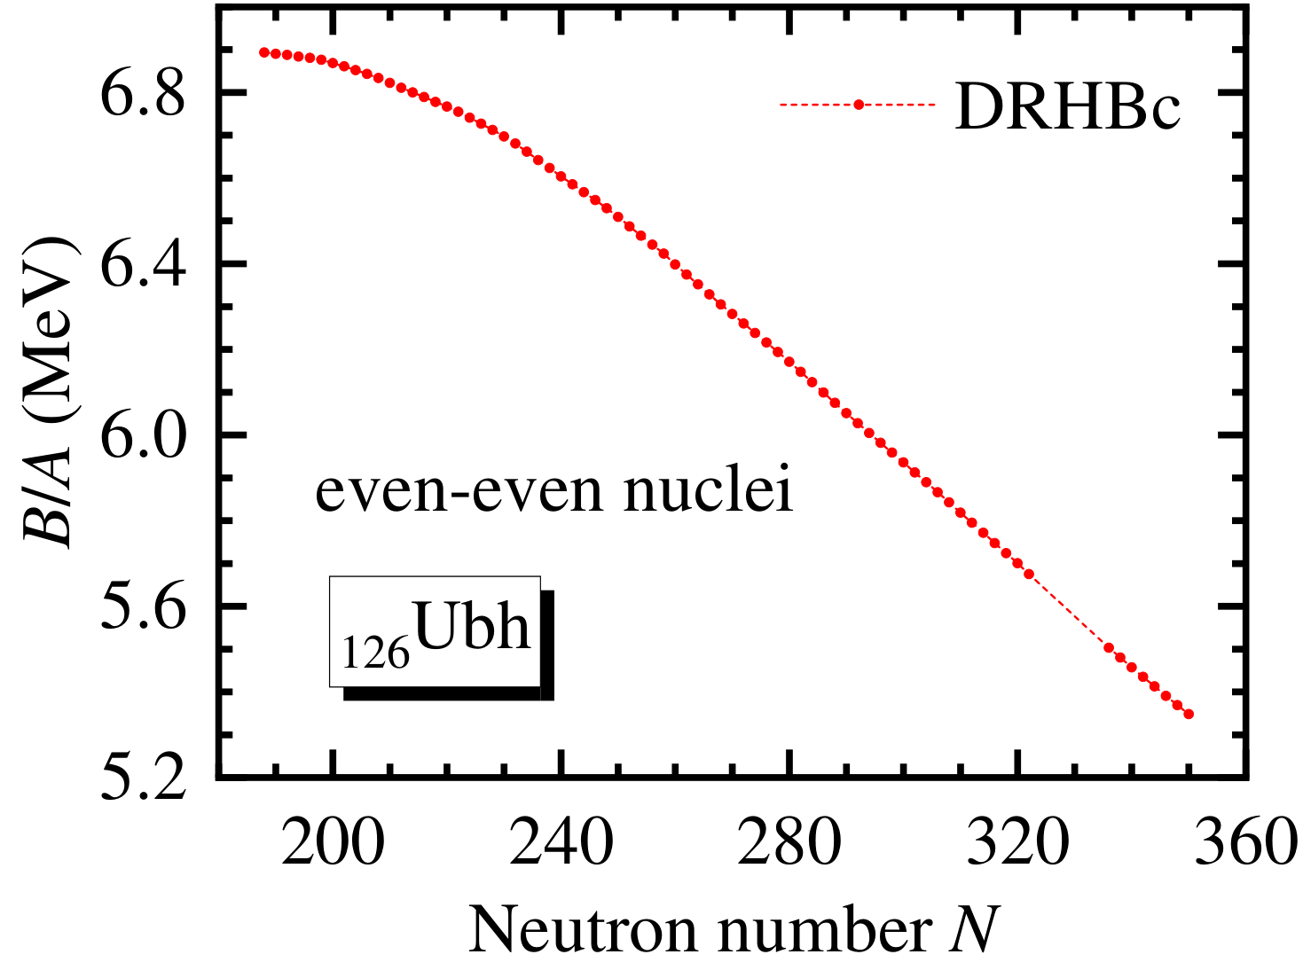
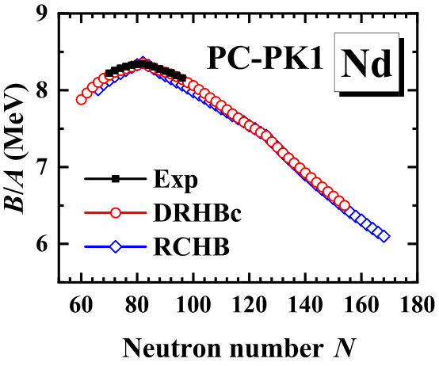
Binding energy
The binding energy per nucleon B/A decreases monotonically.
The largest B/A appears at the proton drip line.
Comparison: B/A for ₆₀Nd
Taken from PRC 102, 024314 (2020)
See Xin-Hui Wu’s talk (G16)

Slide 20
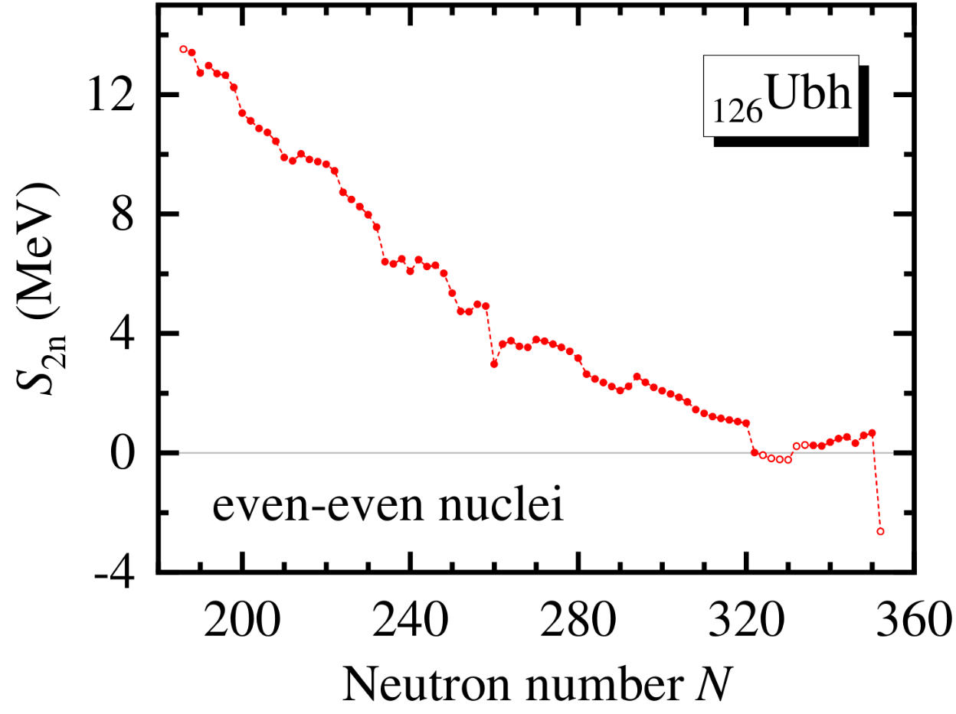
Two-neutron separation energy S_{2n}
The evolution of S_{2n} is generally smooth, with several sudden changes related to the deformation and shell effects.
Beyond the “primary” two-neutron drip line N = 322, some nuclei are bound nuclei or multi-neutron emitters.
PRC 104, L021301 (2021) ; PRC 104, 024331 (2021); CPC 45, 101001 (2021)

Slide 21
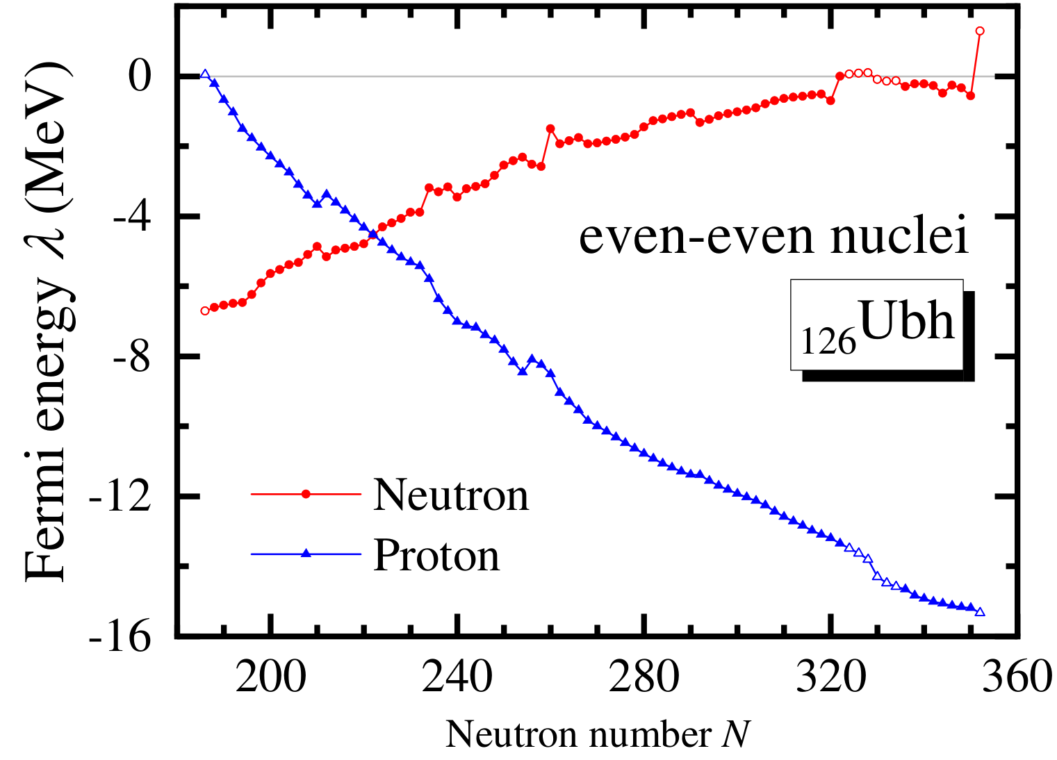
Fermi energies λ
According to S_{2n}, λ_{n} and λ_{p}, the proton and two-neutron drip lines are at N = 188 and 322, respectively. Some bound nuclei are located within N = 336 to 350.

Slide 22
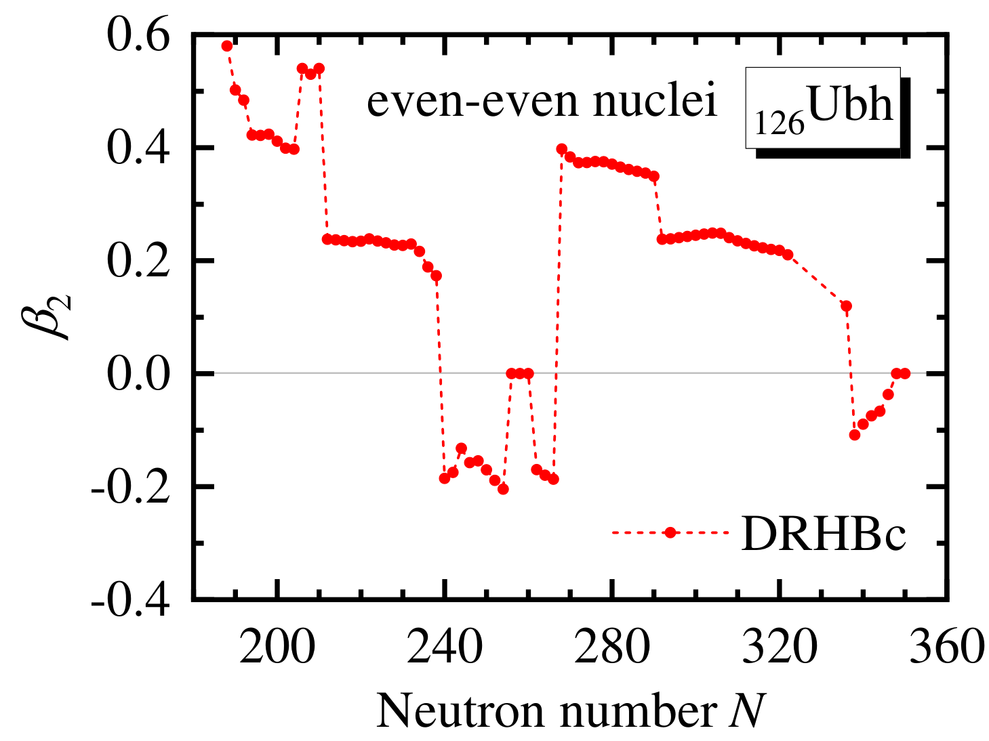
Quadrupole deformation β₂
Sudden changes of β₂ occur near N = 208, 240, 258, 268, 292 and 338.
Outlook: Comparison with the RCHB results, to study the influence of deformation effects on dripline locations.

Slide 23
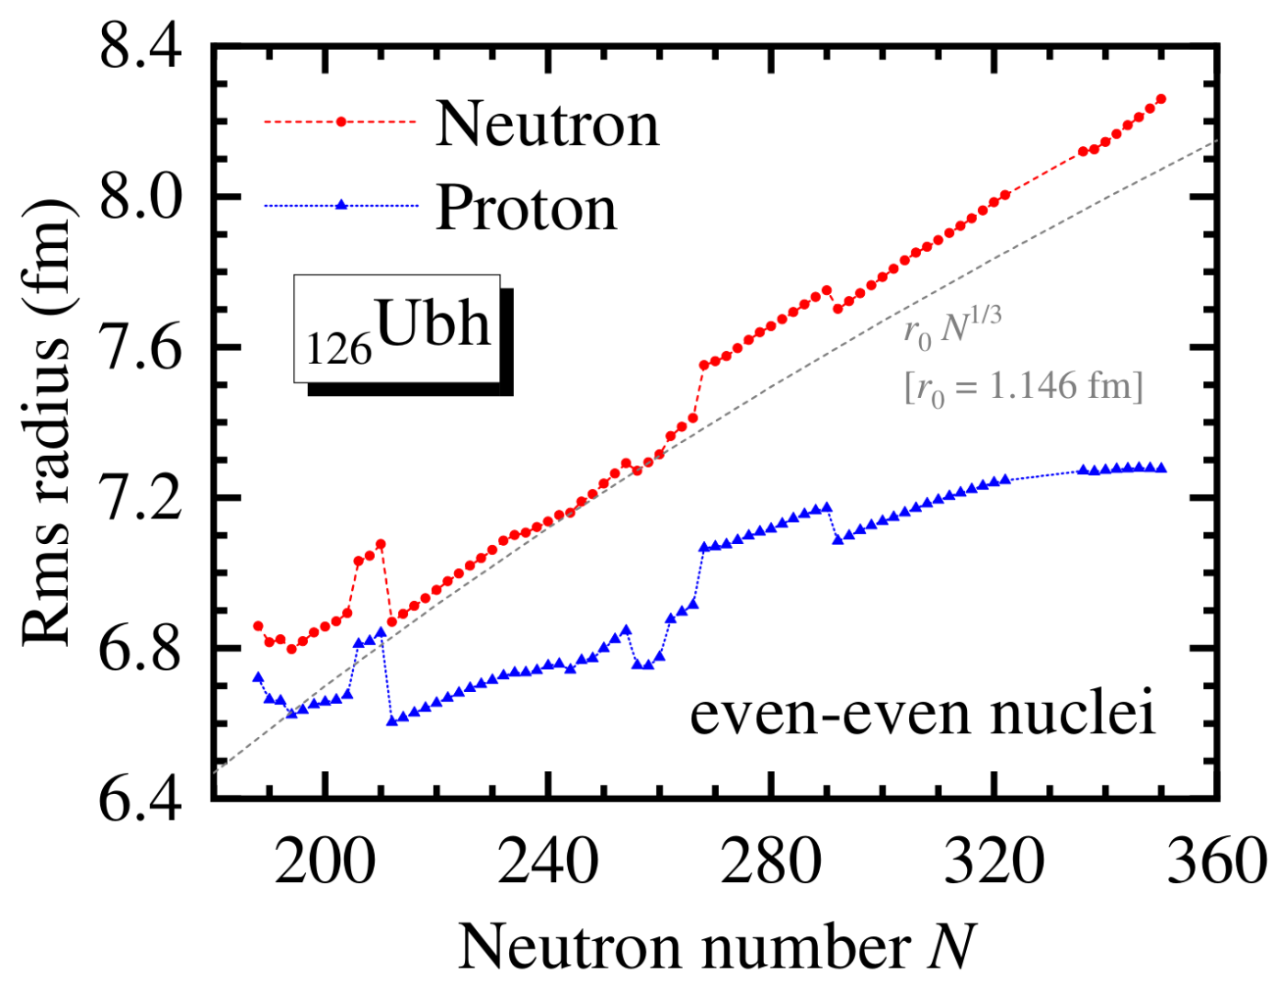
Rms radii
The evolution of neutron rms radius can be roughly described by the empirical formula r₀N^{1/3}.
The deformation plays an important role in the rms radii.

Slide 24
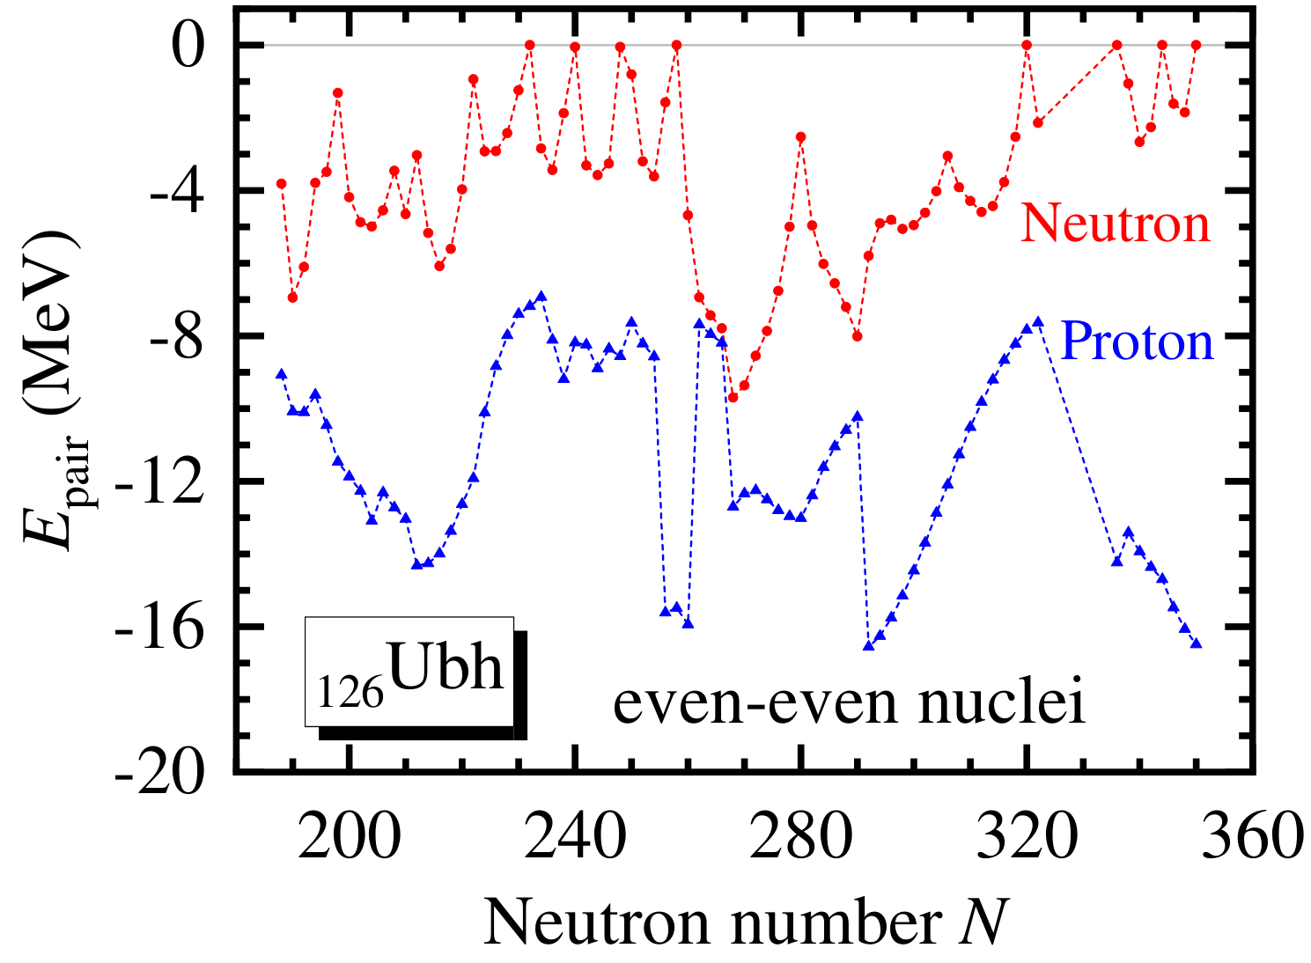
Pairing energies E_{pair}
For even-even ₁₂₆Ubh isotopes, staggering patterns occur, which is a possible indication of shell structure.
E_{pair,n} vanishes at N = 232, 258, 320, 336, 344, 350. —— Possible neutron magic numbers in superheavy region
Zhang, et al., NPA 753, 106 (2005)

Slide 25
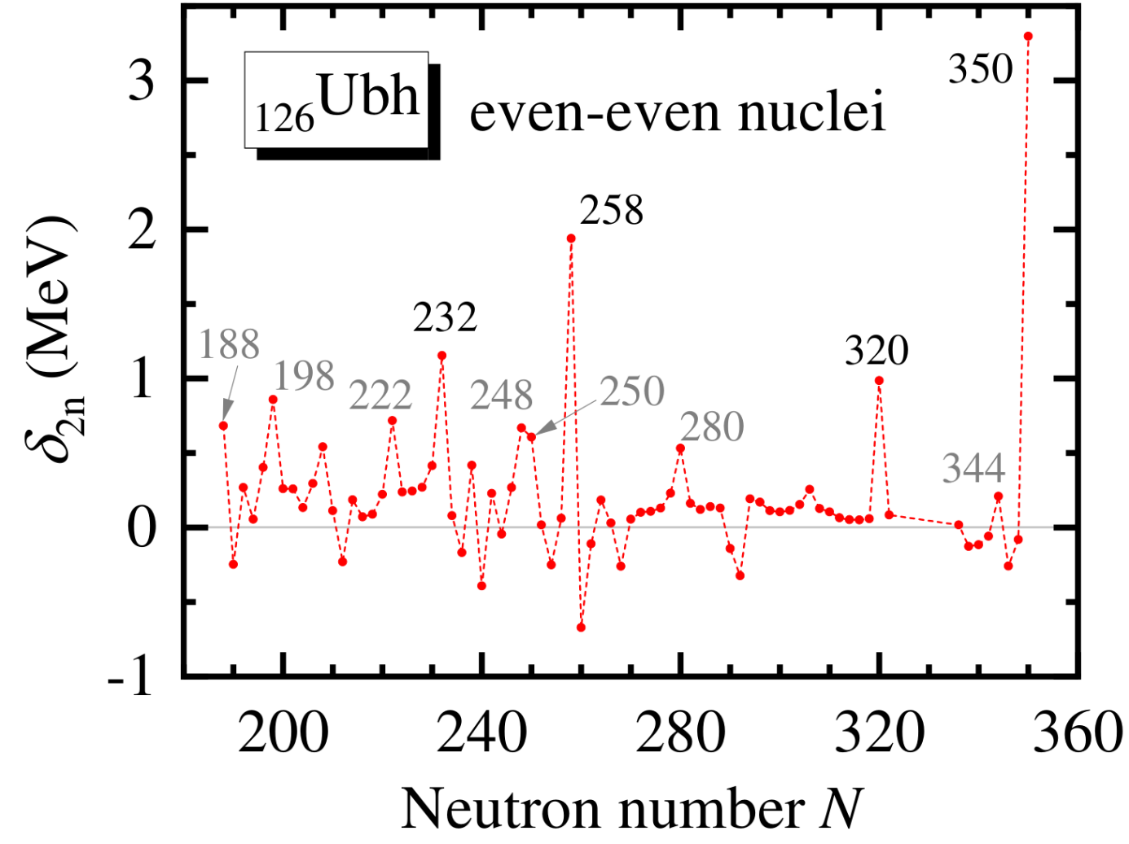
Two-neutron gap
E_{pair,n} vanishes at: N = 232, 258, 320, 336, 344, 350.
Most of them correspond to peaks of δ_{2n}.
N = 336 corresponds to the sudden change of β₂.

Slide 26
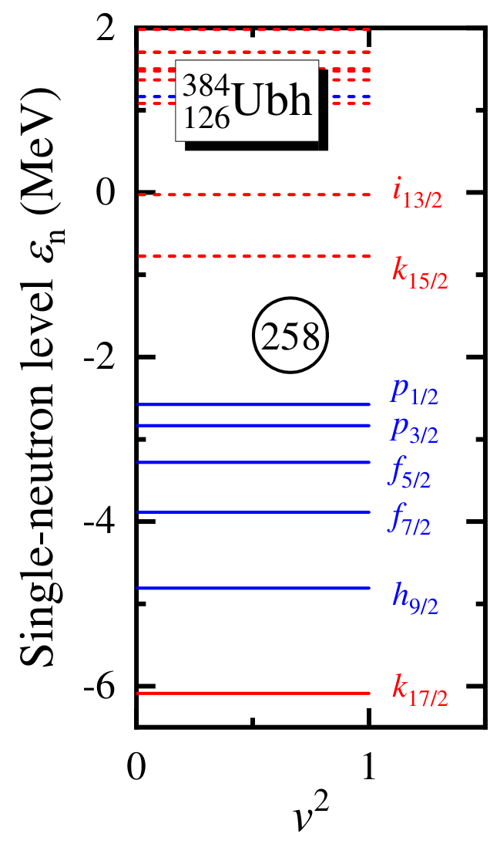
Neutron magic number: N = 258?
A gap appears at N = 258. 258 is still a neutron magic number for ₁₂₆Ubh isotopic chain.
The k_{17/2} level is lower than k_{15/2} for more than 5 MeV, and also lower than many negative-parity levels. —— Strong spin-orbital splitting.
The N = 258 gap is less than 2 MeV, which is not as large as those in lighter regions.
G5-G6: Pan, et al., PRC 104, 024331 (2021)
G9-G10: Zhang, et al., PRC 104, L021301 (2021)

Slide 27
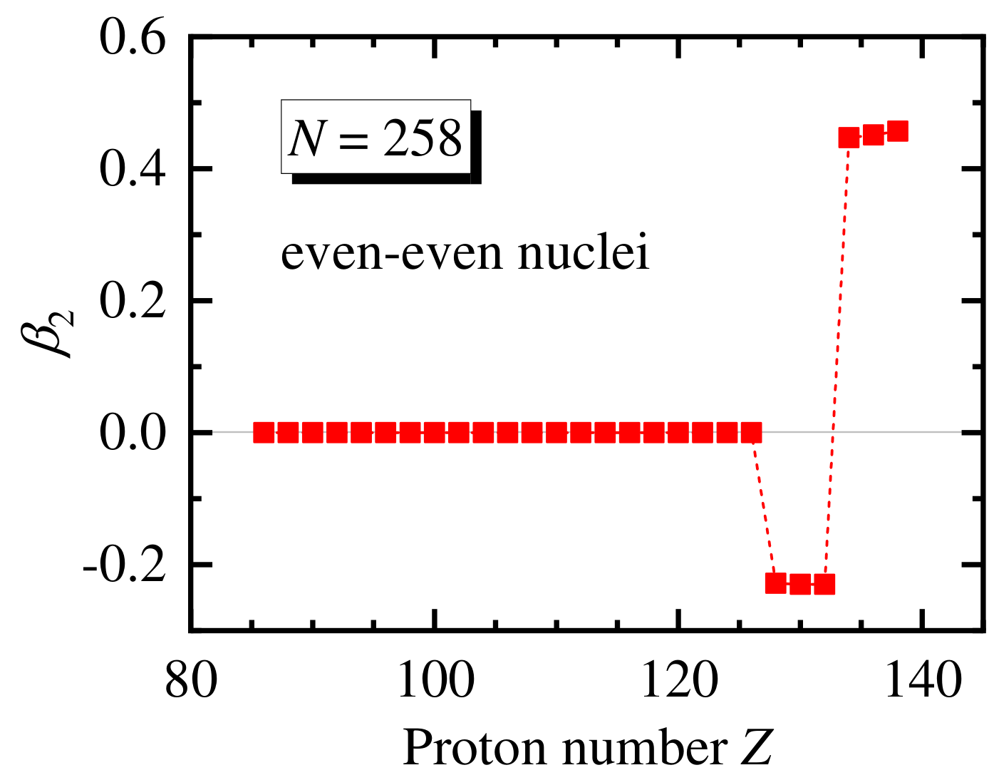
Neutron magic number: N = 258?
For the isotones with Z ≥ 128, N = 258 is no longer spherical. —— Disappearance of magic number 258.
See Xin-Hui Wu’s talk (G16)

Slide 28
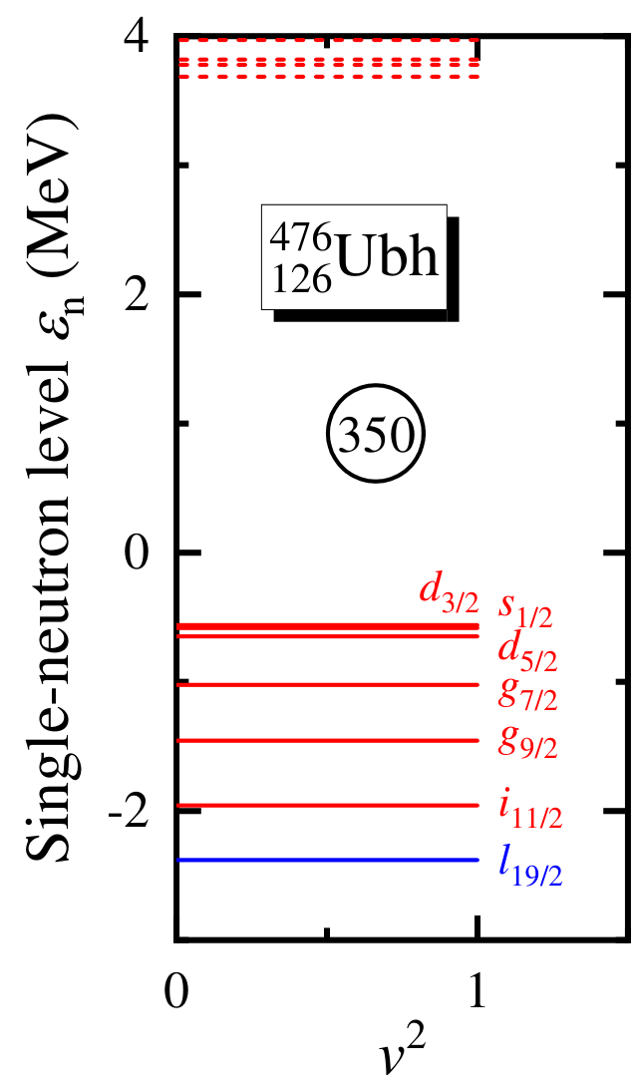
Neutron magic number: N = 350?
According to simple shell structure from a harmonic oscillator potential and spin-orbital splitting, the next magic number is expected to be 350. ⁴⁷⁶Ubh₃₅₀ is the last bound Ubh isotope, with spherical shape and a large δ_{2n}.
A large gap appears at N = 350. (~ 4 MeV)
N = 350 is a neutron magic number, which is also supported by the results in ₁₃₆Uth.
See Xin-Hui Wu’s talk (G16)

Slide 29
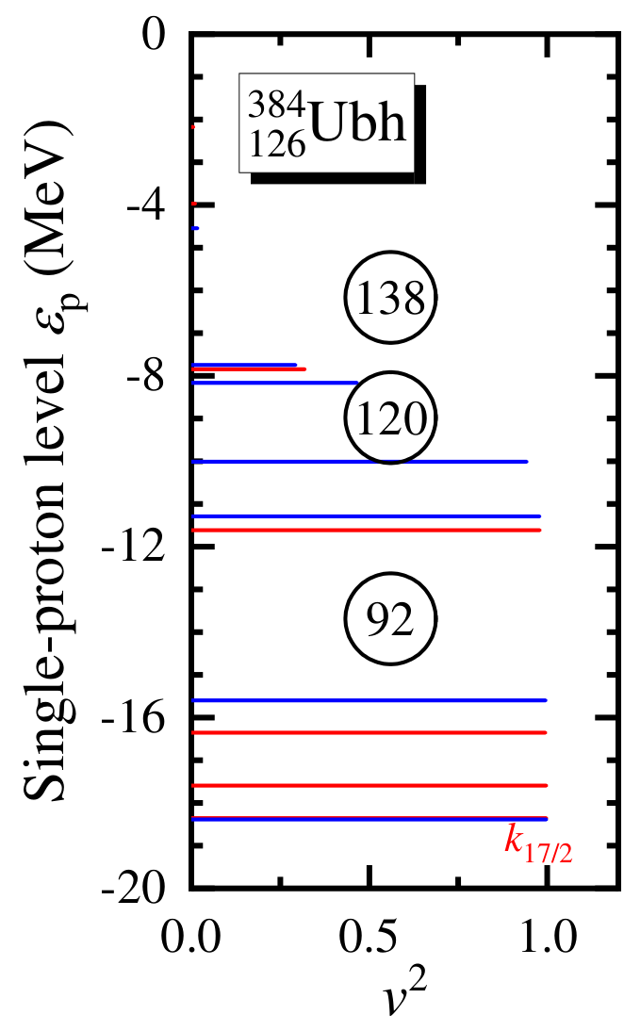
Proton magic number: Z = 126?
126 is a neutron magic number, but not widely accepted as a proton magic number. Based on the RCHB theory, the super- heavy proton magic numbers were predicted as Z = 120, 132, and 138.
In the DRHBc calculations, the proton pairing energy for even-even ₁₂₆Ubh isotopes is never zero.
The single-proton levels show that 126 is not a proton magic number.
Zhang et al., NPA 753, 106 (2005)
Zhang, et al., NPA 753, 106 (2005)

Slide 30
Outline
Introduction
Progress in 51 ≤ Z ≤ 60 (G5)
Progress in 124 ≤ Z ≤ 126 (G13)
Summary

Slide 31
Summary
Constrained DRHBc calculations are performed for the odd-Z nuclei with 51 ≤ Z ≤ 59. The DRHBc mass table results on the evolutions of ground-state deformation are examined.
The ground-state properties of even-even ₁₂₆Ubh nuclei are obtained based on DRHBc calculations .
B/A decreases with N monotonically, showing differences from lighter nuclear region.
The proton and two-neutron drip lines are predicted at N = 188 and 322, respectively, and bound nuclei are found beyond N = 322.
N = 258 and 350 are predicted to be magic numbers in ₁₂₆Ubh. N = 258 is not a magic number in heavier isotopic chains.
Z = 126 is not a proton magic number.

Slide 32
Outlook on superheavy nuclei
Further numerical checks to guarantee convergence, especially for the results at large deformations.
Comparison between the DRHBc and RCHB results, to study the influence of the deformation effect.
Investigation on the evolution of PECs.
Estimation of half lives for α decay, β decay and fissions.
……

Slide 33
Thanks for your attention!

Slide 34
Appendix

Slide 35
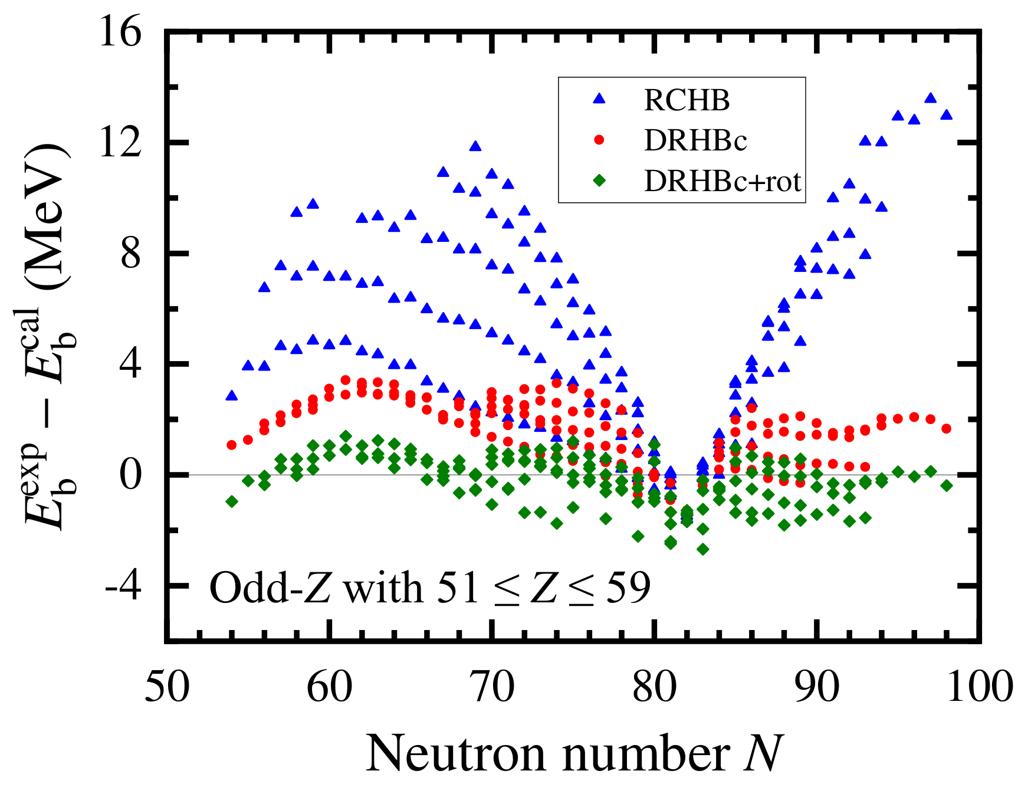
Binding energies E_{b}
Exp: AME2020
The deformation effect can significantly improve the description on binding energy.
 | DRHBc | DRHBc+rot | RCHB
σ(E_{b}) (MeV) | 1.90 | 0.89 | 6.12

Slide 36
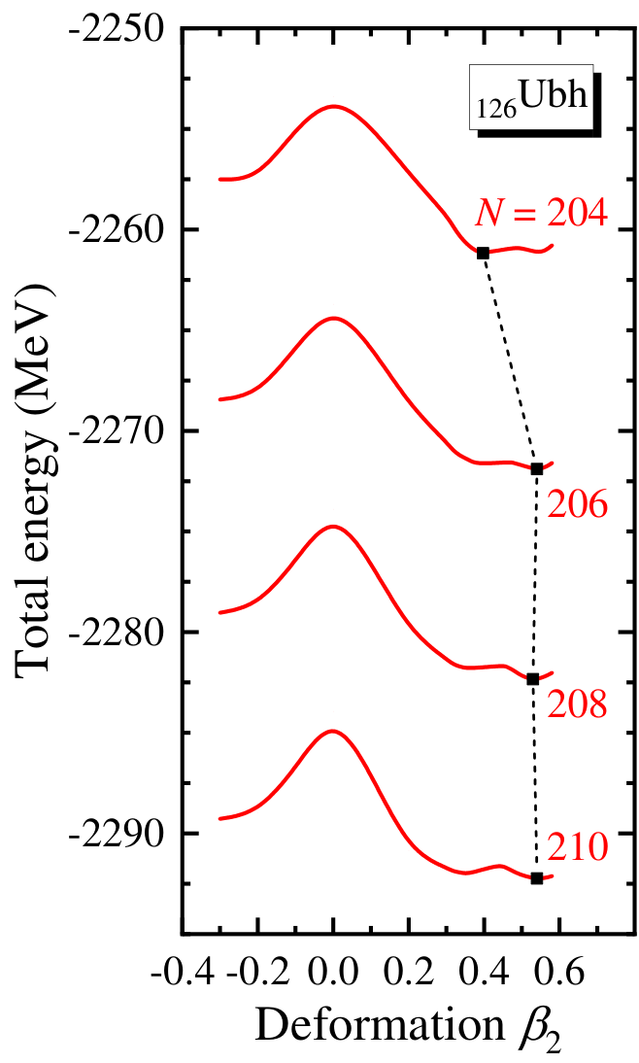
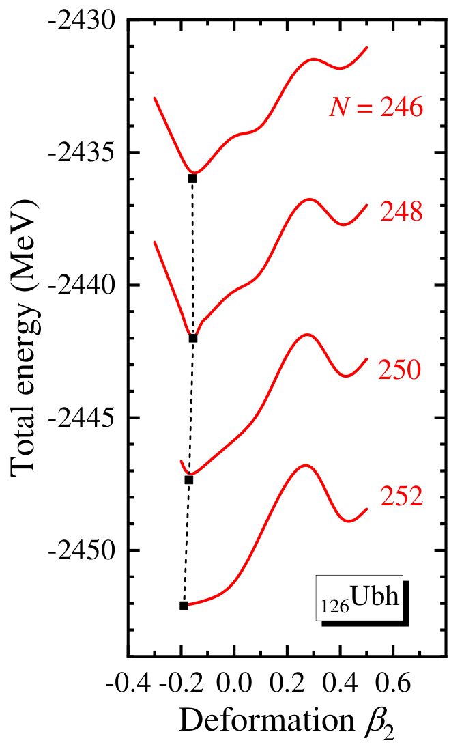
Potential energy curves
The potential energy curves have been constructed to confirm the ground-state deformations.

Slide 37
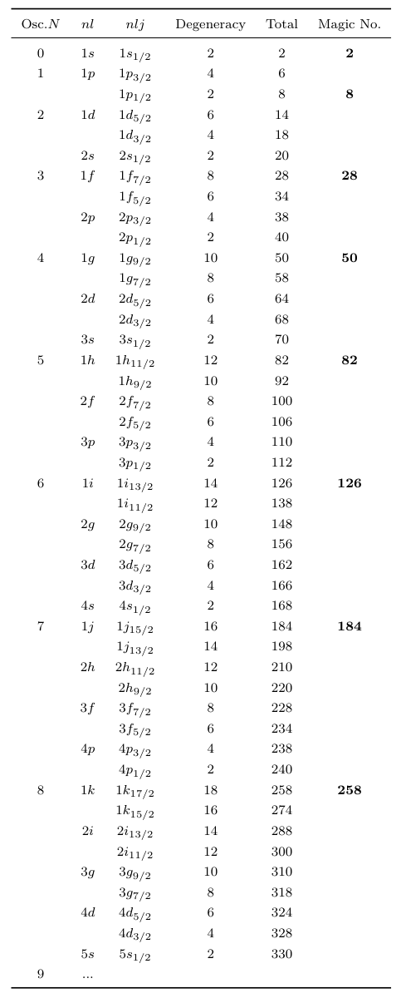
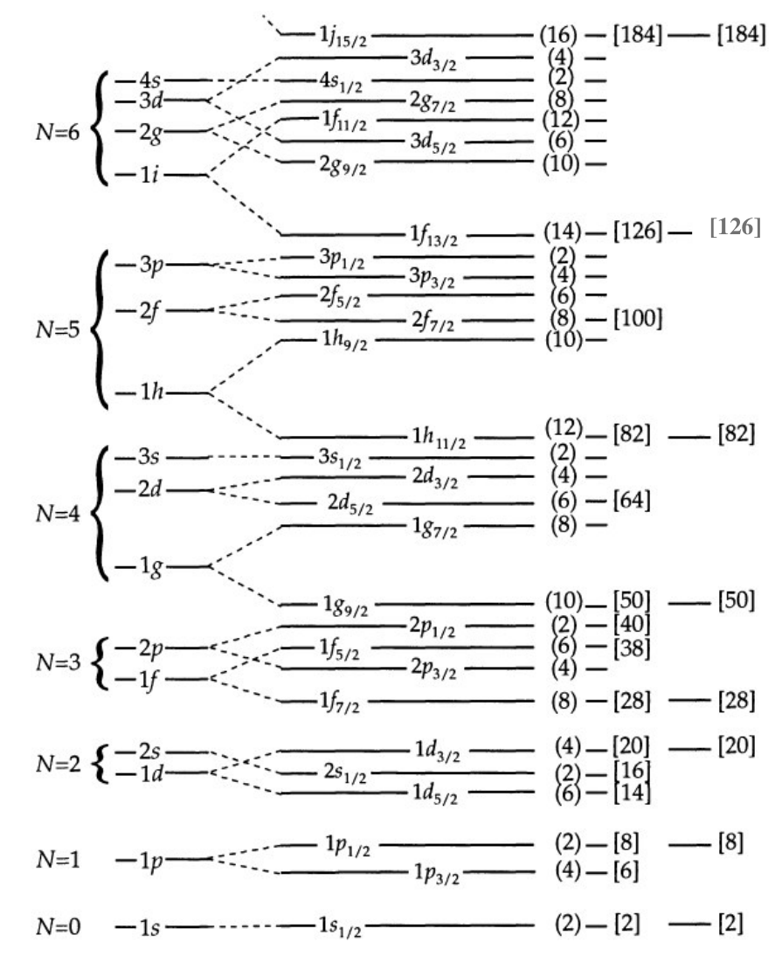
Traditional shell structure
1l 1l_{19/2} 20 350 350

