Slide 1


The 7th workshop on nuclear mass table with DRHBc theory
Progress Report for Mass table with DRHBc for Z = 101 ~ 110
Speaker : Xiao-Tao He
G10: Prof. Cai-Wan Shen, Huzhou Universtiy (HUZU)
Prof. Xiao-Tao He, Nanhang University (NUAA)
Ms. Chen Wang, Nanhang University (NUAA)
Ms. Jia-Wei Wu, Nanhang University (NUAA)
July 1 – 4, 2024, Gangneung Green City Experience Center, Gangneung, Korea

Slide 2

Contents
目 录
Numerical details and progress for Z = 101 ~ 110
Results
- The results of elements Bh (Z = 107) and Mt (Z = 109) isotopes
- Stability peninsula for the superheavy nuclei region
Summary

Slide 3
Contents
目 录
Numerical details and progress for Z = 101 ~ 110
Results
- The results of elements Bh (Z = 107) and Mt (Z = 109) isotopes
- Stability peninsula for the superheavy nuclei region
Summary

Slide 4

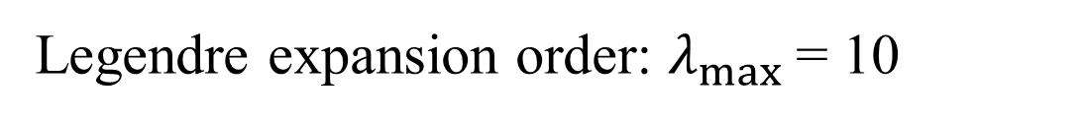
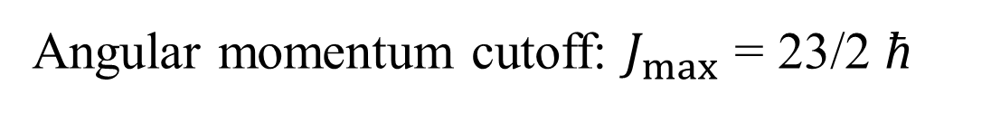
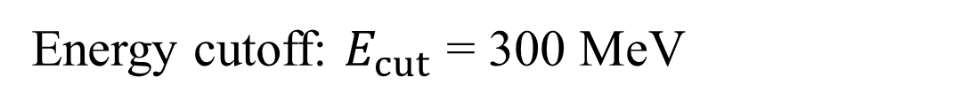
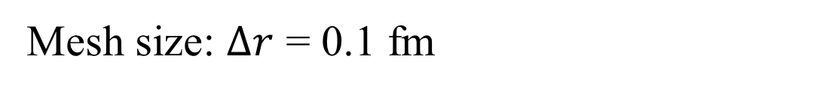
I. Numerical details
目 录
Density functional: PC-PK1
Version: Code_DRHBc_202112
Box size: $R_{box}$ = 20 fm
Mesh size: $Δr$ = 0.1 fm
Energy cutoff: $E_{cut}$ = 300 MeV
Angular momentum cutoff: $J_{max}$ = 23/2 ћ
Pairing strength: -325 MeV·fm³
Legendre expansion order: $λ_{max}$ = 10
Initial deformation β₂ = -0.4, -0.3, -0.2…..0.3, 0.4, 0.5, 0.6
-From Manual for DRHBc_202112

Slide 5
Contents
目 录
Numerical details and progress for Z = 101 ~ 110
Results
- The results of elements Bh (Z = 107) and Mt (Z = 109) isotopes
- Stability peninsula for the superheavy nuclei region
Summary

Slide 6
Ⅱ.1 General progress
 |  | HUZU |  | NUAA
 |  | Even-N | Odd-N | Even-N | Odd-N
Even-Z | 102 |  | √ | √
 | 104 | √ | √
 | 106 | √ |  |  | √
 | 108 |  |  | √ | √
 | 110 | √ |  | √ | √
Odd-Z | 101 | √
 | 103 | √
 | 105 | √
 | 107 |  |  | √
 | 109 |  |  | √
The calculation of odd-Z nuclei are completed (double check is needed for some of them).

Slide 7
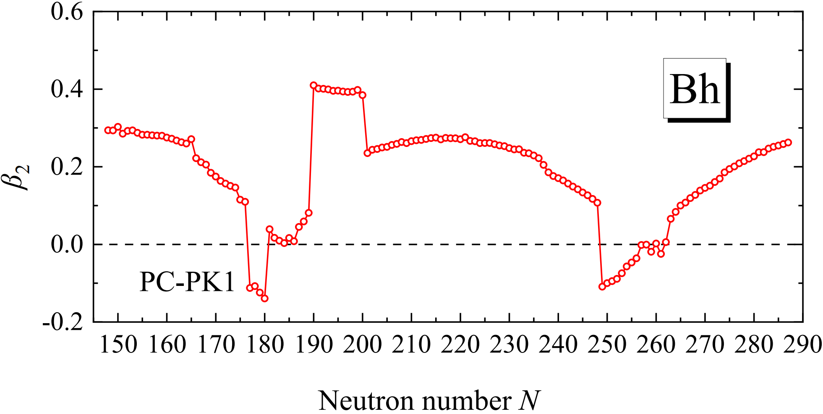
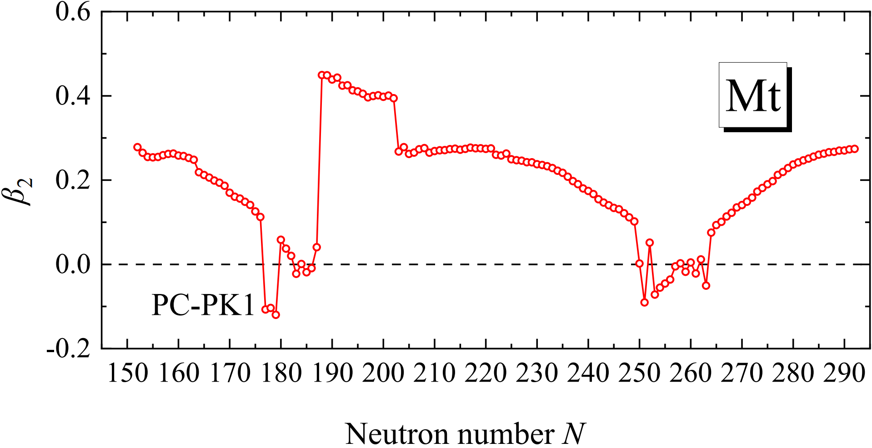
Ⅱ.2 Beta2
目 录
Regions of super deformation
Bh N = 190~200
Mt N = 188~202
Nuclei with sudden change will be checked.
Shape coexistence may exist around these nuclei. (In Progress……)

Slide 8
Ⅱ.2 Beta2
目 录
Regions of super deformation
Bh N = 190~200
Mt N = 188~202
Nuclei with sudden change will be checked.
Shape coexistence may exist around these nuclei. (In Progress……)

Slide 9
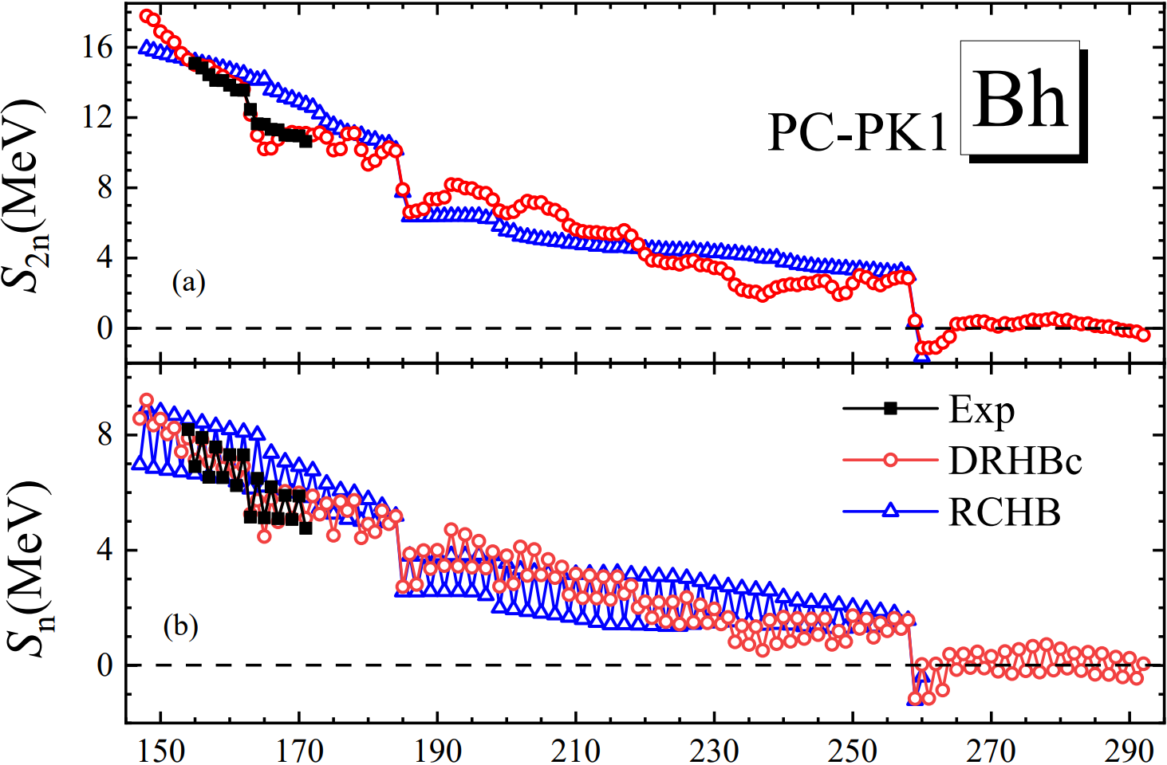
Ⅱ.3 One&Two Neutron Separation Energy
目 录
Experimental values are reproduced
better by DRHBc calculations
Deformed shell gap: N=162
Sepherical shell gap: N=184, 258
One-neutron drip line:
DRHBc N=258
RCHB N=258
For even-N nuclei, bound nuclei exist beyond one neutron drip line.
For odd-N nuclei, no bound nuclei exist beyond one neutron drip line.
Notes:
实验值被DRHBc的计算值很好地重现了
从中子分离能的下降看壳：
Deformed shell gap: N=162
Sepherical shell gap: N=184, 258
单中子滴线
滴线外可能的束缚核

Slide 10
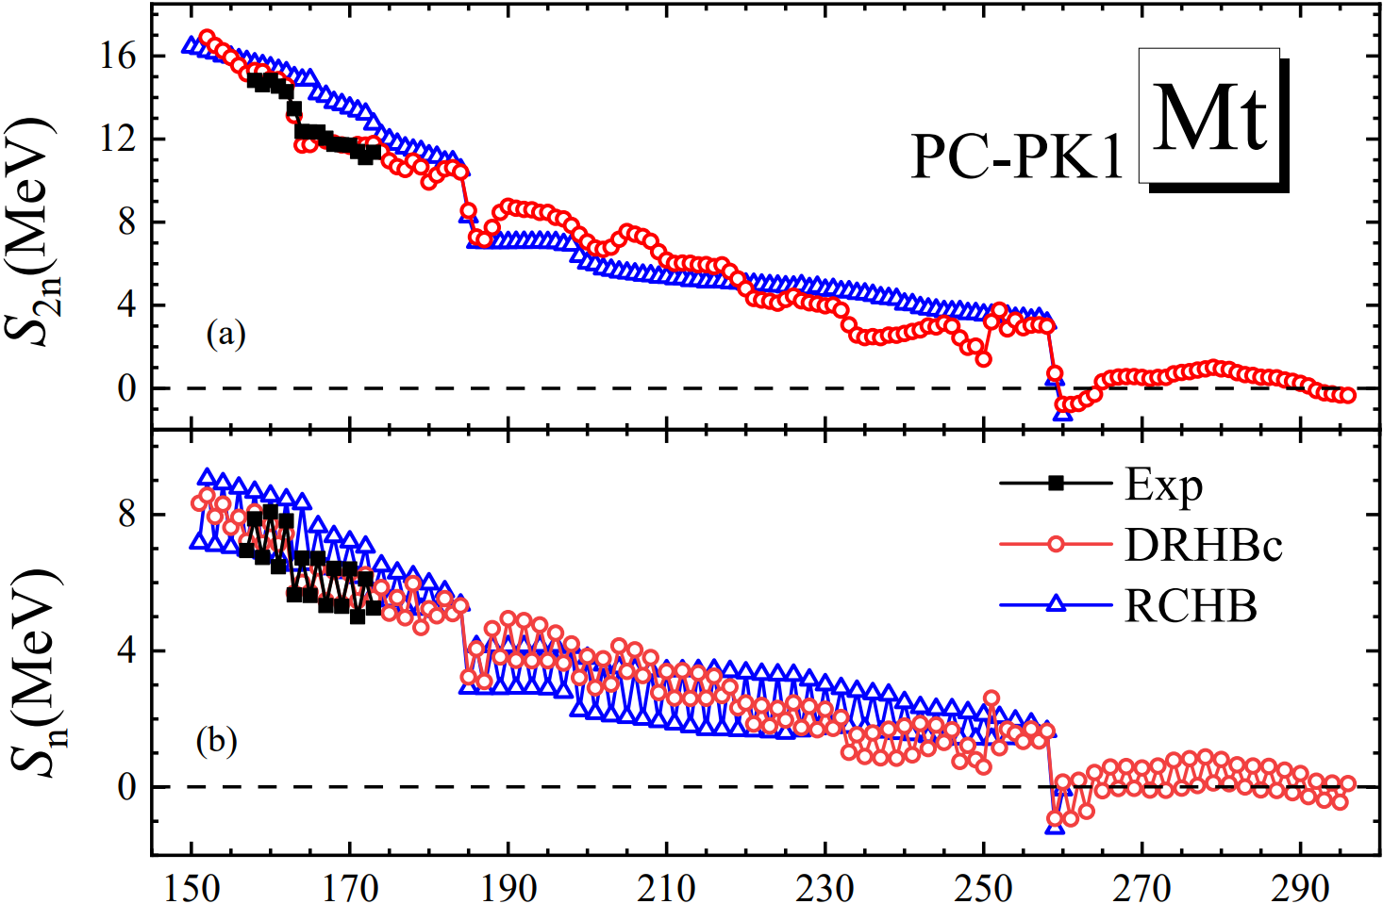
Ⅱ.3 One&Two Neutron Seperation Energy
目 录
Experimental values are reproduced
better by DRHBc calculations
Deformed shell gap: N=162
Sepherical shell gap: N=184, 258
One-neutron drip line:
DRHBc N=258
RCHB N=258
For both even-N and odd- N nuclei, bound nuclei exist beyond one neutron drip line.
Notes:
实验值被DRHBc的计算值很好地重现了
滴线外可能的束缚核
Mt滴线外偶N核与奇N核都存在束缚核，但他们在稳定性以及数目上存在明显差异。
为了研究这种差异，我们对超重核区域滴线外所有可能存在的束缚核进行了研究。

Slide 11
Contents
目 录
Numerical details and progress for Z = 101 ~ 110
Results
- The results of elements Bh (Z = 107) and Mt (Z = 109) isotopes
- Stability peninsula for the superheavy nuclei region
Summary

Slide 12
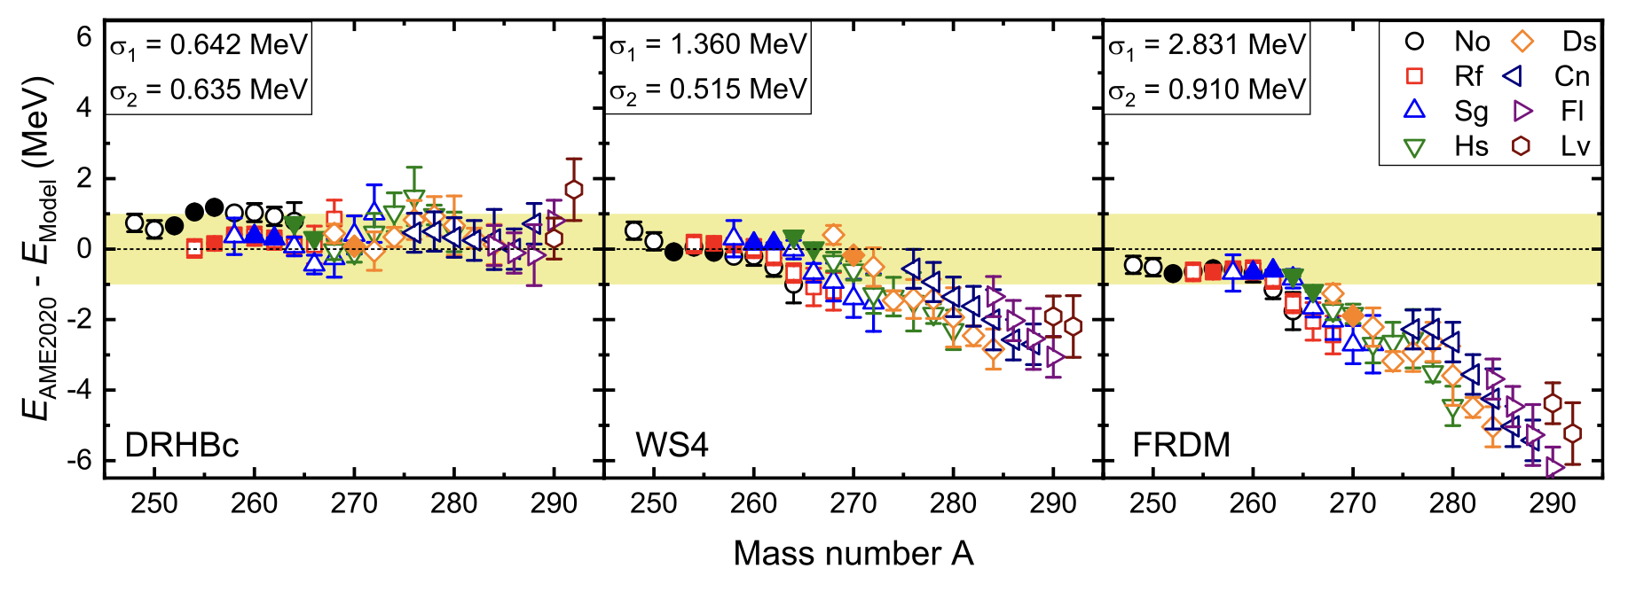
Ⅲ.1 Predictive power for nuclei of 102<Z<116
The DRHBc theory shows improved predictive power for the binding energies of superheavy nuclei compared to WS4 and FRDM models, with smaller deviations from AME2020 data.
The root-mean-square deviation of the DRHBc model is 0.642 MeV for even nuclei, which is better than the WS4 model (1.360 MeV) and significantly better than the FRDM model (2.831 MeV).
The results highlight the superior accuracy of the DRHBc model in predicting the properties of superheavy nuclei, making it a valuable tool for exploring nuclear stability.
K. Y. Zhang, X. T. He, J. Meng, C. Pan, C. W. Shen, C. Wang, S. Q. Zhang, PRC104, L021301 (2021).

Slide 13
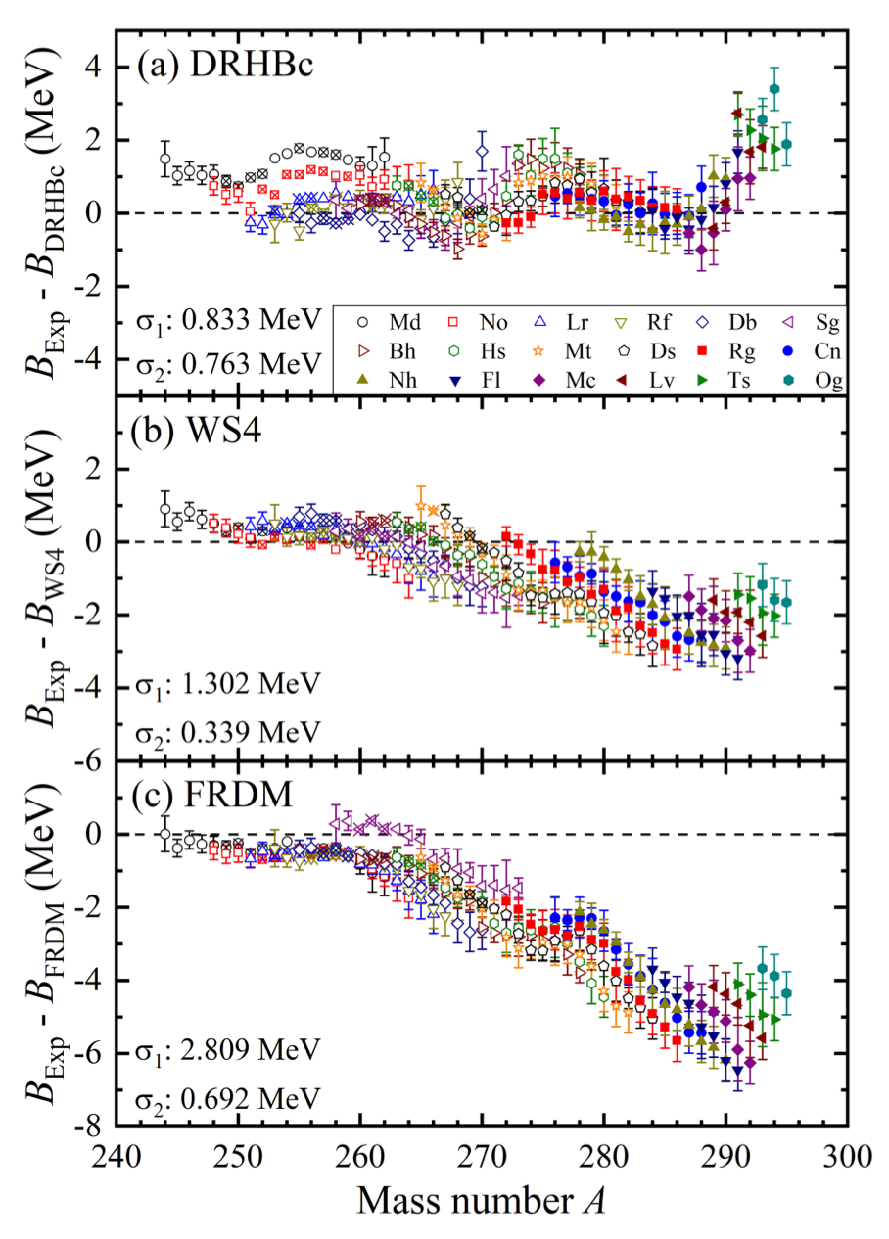
Ⅲ.1 Predictive power for 101<Z<118
The DRHBc theory shows improved predictive power for the binding energies of superheavy nuclei compared to WS4 and FRDM models, with smaller deviations from AME2020 data.
The root-mean-square deviation of the DRHBc model for 240 data points is 0.833 MeV, which is better than the WS4 model (1.302 MeV) and significantly better than the FRDM model (2.809 MeV).
The results highlight the superior accuracy of the DRHBc model in predicting the properties of superheavy nuclei, making it a valuable tool for exploring nuclear stability.
X.T. He, J. W. Wu, K. Y. Zhang, C. W. Shen, PRC110, 014301 (2024).

Slide 14
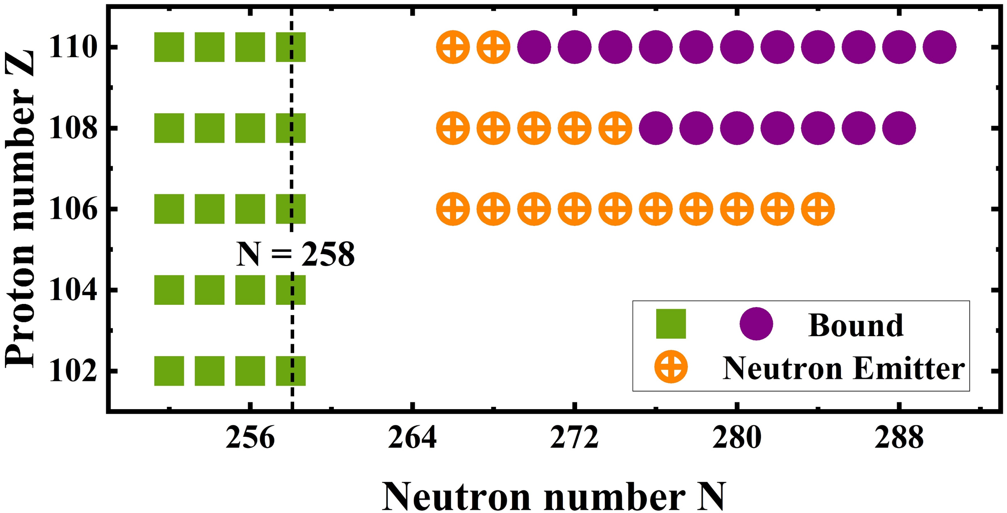
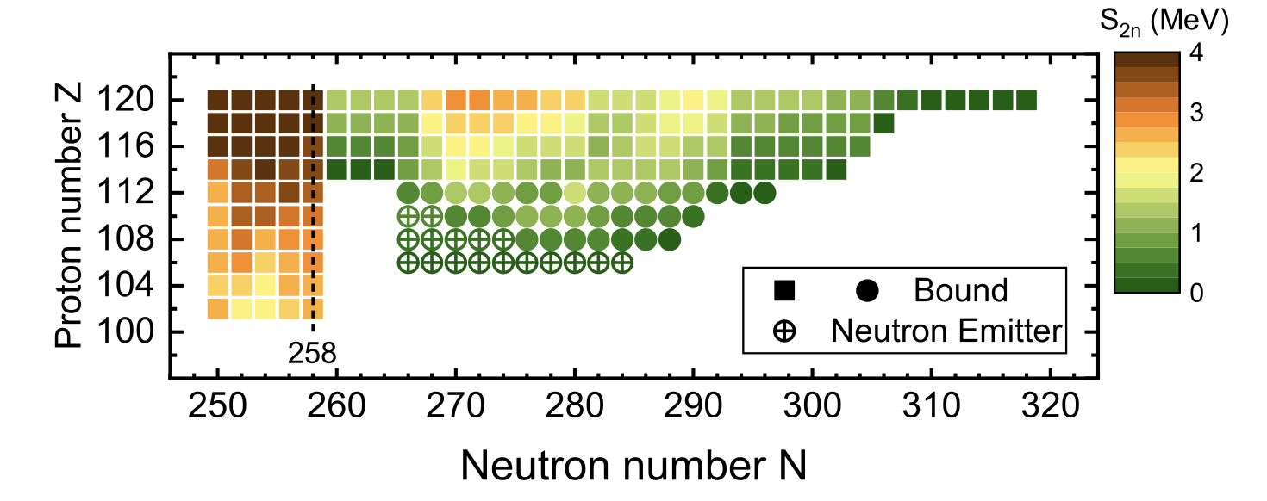

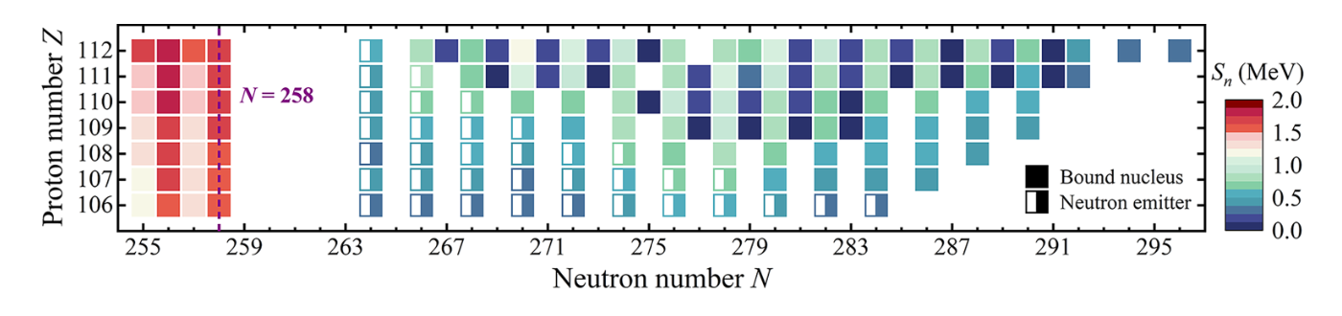
Ⅲ.2 Stability peninsula
目 录
Even-even nuclei
Even-even nuclei
X. T. He, C. Wang, K. Y. Zhang, C. W. Shen, Chin. Phys. C 45, 101001 (2021).
K. Y. Zhang, X. T. He, J. Meng, C. Pan, C. W. Shen, C. Wang, S. Q. Zhang, PRC104, L021301 (2021).
X.T. He, J. W. Wu, K. Y. Zhang, C. W. Shen, PRC110, 014301 (2024).

Slide 15
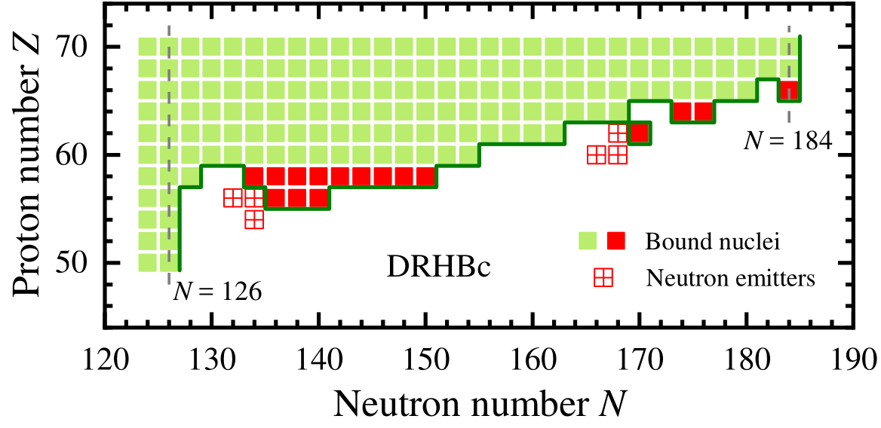
Ⅲ.2 Stability peninsula
(50 ≤ Z ≤ 70)
Taken from Cong Pan’talk 2021ChongQing.
在双中子滴线外, 存在对两中子发射稳定 (S_{2n} > 0), 但对多中子发射不稳定 (S_{xn} < 0) 的核素, 即多中子发射核.
₅₆Ba, ₅₈Ce, ₆₂Sm, ₆₄Gd, ₆₆Dy 在双中子滴线外有束缚的同位素, 它们在核版图中形成“半岛”结构.

Slide 16
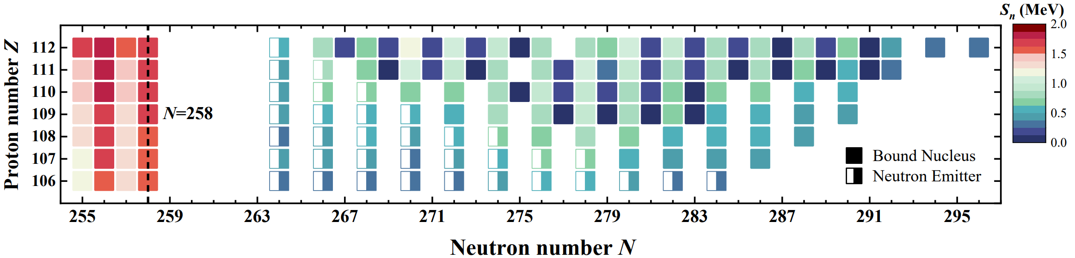
Ⅲ.3 One-Neutron Separation Energy
One-neutron separation energy Sn​ decreases suddenly after N=258, suggesting it as a possible magic number
Bound nuclei beyond the neutron drip line are found in the region of 106 ≤ Z ≤ 112, forming a stability peninsula.
The reentrant stability for odd-N nuclei appears later and ends earlier than for even-N nuclei, indicating significant odd-even differences.
X.T. He, J. W. Wu, K. Y. Zhang & C. W. Shen, (2024) accepted.

Slide 17
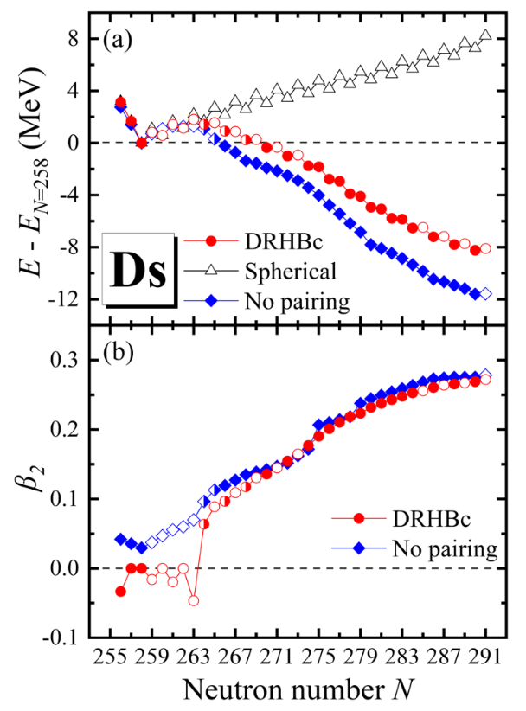
Ⅲ.4 E-E_{N=258}
X.T. He, J. W. Wu, K. Y. Zhang, C. W. Shen, PRC110, 014301 (2024).
The total energy of Ds isotopes exhibits clear odd-even staggering, where odd-N nuclei are generally less stable than even-N nuclei. This odd-even effect is pronounced in the regions 258 ≤ N ≤ 273 and 284 ≤ N ≤ 291.
Deformation effects are essential for achieving stability beyond the neutron drip line. Without deformation, no bound nuclei exist beyond N = 258. Increasing deformation leads to the binding of more neutron-rich nuclei.
Pairing correlations play a significant role in the stability of nuclei, with odd-N nuclei showing suppressed neutron pairing energy due to the blocking effect. This leads to observable odd-even differences in total energy, one-neutron separation energy, and deformation parameters.

Slide 18
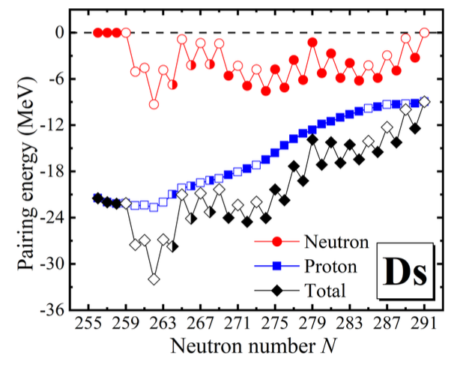
Ⅲ.5 Pairing energy
X.T. He, J. W. Wu, K. Y. Zhang, C. W. Shen, PRC110, 014301 (2024).
Odd-Even Differences
Significant odd-even differences are observed in neutron pairing energy. Odd-N nuclei exhibit lower neutron pairing energy due to blocking effects, resulting in noticeable odd-even differences in total pairing energy, total energy, and stability.
Deformation Influence
Nuclear deformation affects pairing energy, with more deformed nuclei showing reduced pairing energy. This interplay between deformation and pairing correlations significantly impacts the stability and binding of nuclei.
Stability Trends
The overall stability of Ds isotopes near the drip line is influenced by neutron and proton pairing energies. Nuclei that are bound against one-neutron emission but unbound against multi-neutron emission highlight the complex nature of nuclear stability in this region.

Slide 19
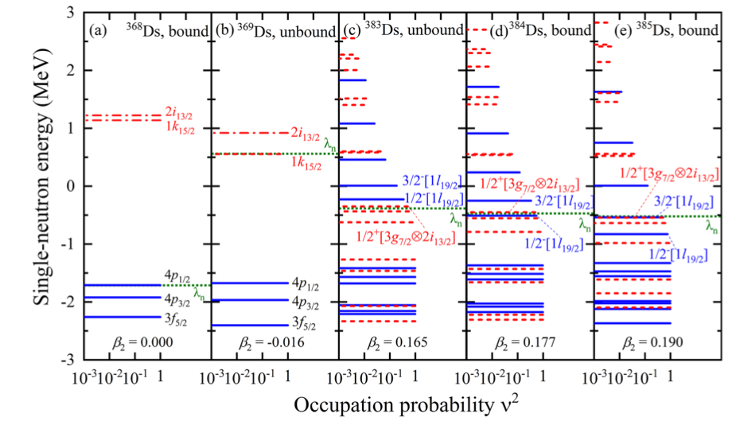
Ⅲ.6 Single neutron energy
X.T. He, J. W. Wu, K. Y. Zhang, C. W. Shen, PRC110, 014301 (2024).
The single-neutron orbitals for Ds isotopes show a clear shell closure at N = 258, with a significant energy gap around the Fermi surface in the spherical nucleus 368Ds.
As more neutrons are added, the nuclei become more deformed, causing previously unbound orbitals to drop below the continuum threshold and become bound, which stabilizes the nucleus against one-neutron emission.
The interplay between deformation and pairing effects is crucial, with deformation significantly lowering the total energy and thus stabilizing the nucleus, while pairing effects lead to observable odd-even differences in stability .

Slide 20
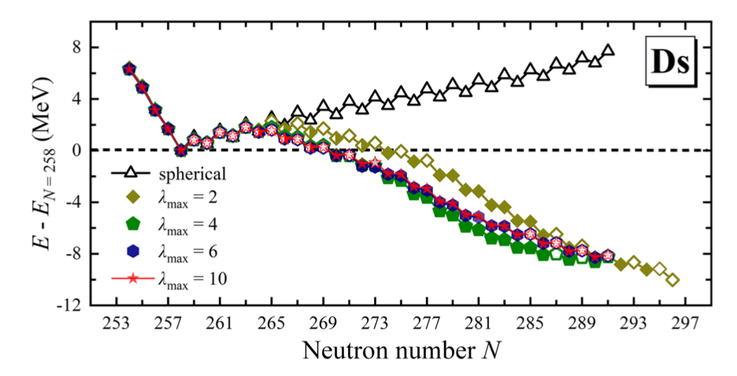
Ⅲ.7 Different orders of deformation
Impact of Deformation on stability Peninsula
Including quadrupole deformation (β₂​) alone introduces reentrant stability, making some nuclei bound.
Odd-Even Differences
Hexadecapole deformation (β₄​) reduces the odd-even energy differences and increases the number of bound odd-N nuclei. Further higher-order deformations (β₆ and β₁₀​) show marginal effects, indicating convergence of results.
X.T. He, J. W. Wu, K. Y. Zhang, C. W. Shen, PRC110, 014301 (2024).

Slide 21
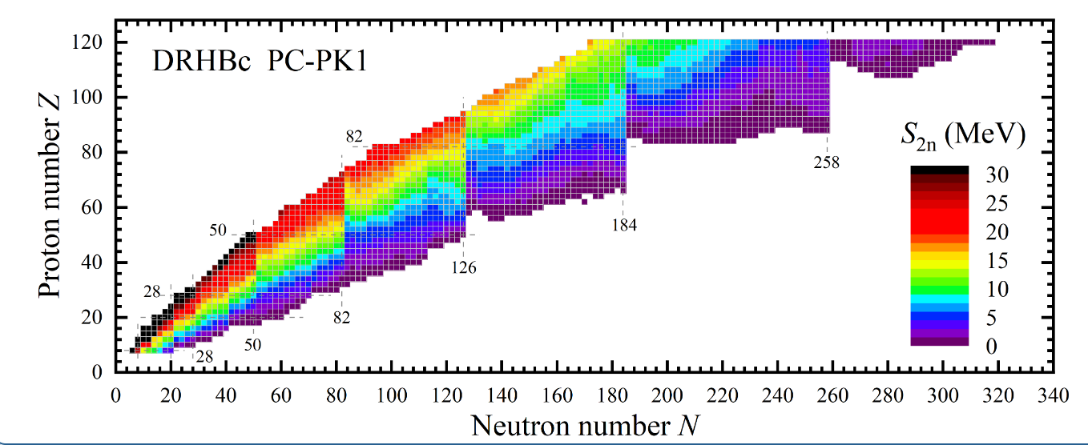
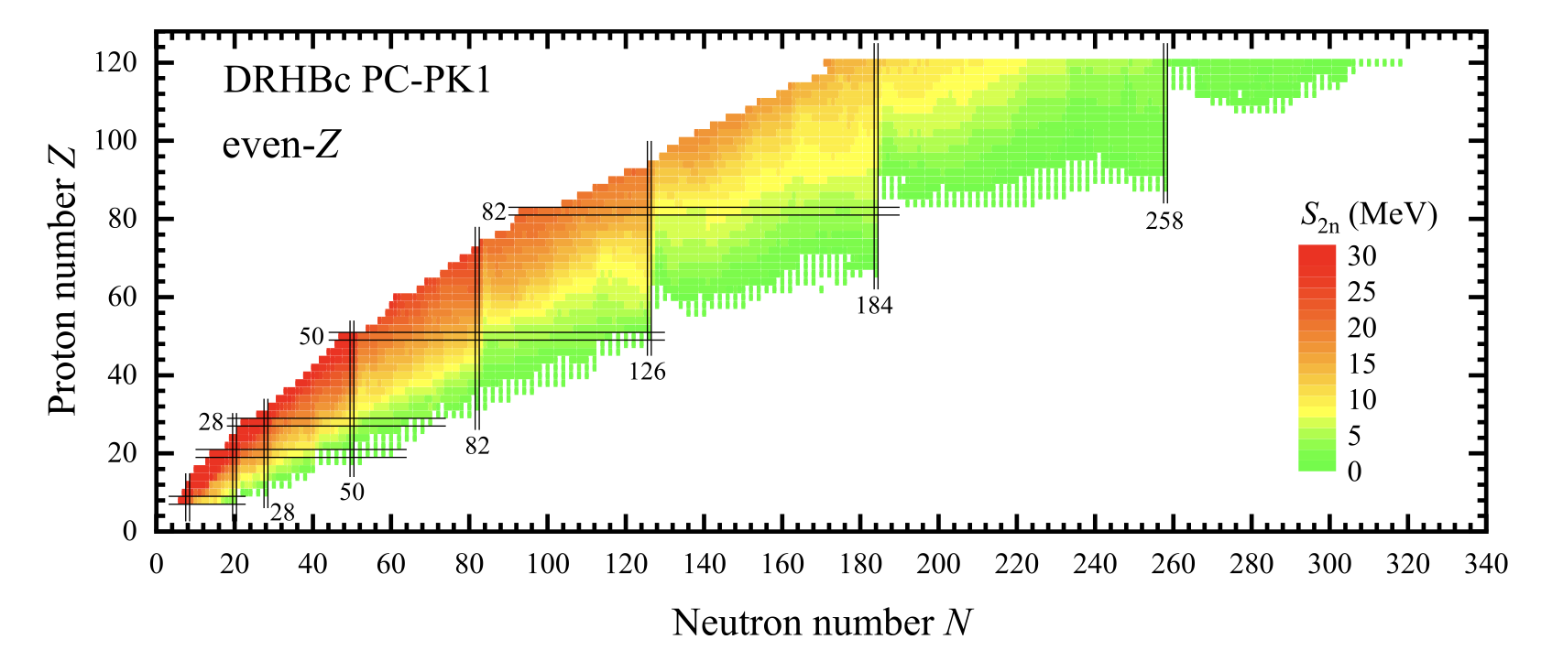
Ⅲ.8 Stability peninsula in nuclear chart of DRHBc
https://drhbctable.jcnp.org/
P. Guo, et al., Atomic Data and Nuclear Data Tables 158, 101661 (2024).

Slide 22
Contents
目 录
Numerical details and progress for Z = 101 ~ 110
Results
- The results of elements Bh (Z = 107) and Mt (Z = 109) isotopes
- Stability peninsula for the superheavy nuclei region
Summary

Slide 23
Ⅳ. Summary
目 录
Results for odd-Z isotopes Z=101~109
- The calculation of odd-Z nuclei are completed (double check is needed for some of them).
- The investigation of possible shape coexistence around this nuclear region is currently in progress.
Stability peninsula for the superheavy nuclei region
Predictive Power
The DRHBc theory predicts superheavy nuclear ground state properties with highly accuracy, highlighting significant odd-even differences in stability.
Reentrant Stability
Bound nuclei are predicted beyond the neutron drip line due to nuclear deformation.
Deformation Impact
Quadrupole and higher-order deformations are crucial for nuclear stability and binding.

Slide 24

The 7th workshop on nuclear mass table with DRHBc theory
Thank you for attention !

Slide 25
Ⅲ.2 Stability peninsula
目 录
X. T. He, et al, Chin. Phys. C 45, 101001 (2021).
The spherical neutron shell closure is predicted at N = 258, consistent with other density functional theories, indicating a significant stability point for heavy nuclei.
Bound nuclei are predicted to exist beyond the neutron drip line for isotopes ranging from No to Ds, influenced significantly by nuclear deformation.
Reentrant binding occurs for certain isotopes such as Sg, Hs, and Ds, where they are bound against two-neutron emission but unbound against multi-neutron emission, highlighting the complex interplay of nuclear forces and deformations.

Slide 26
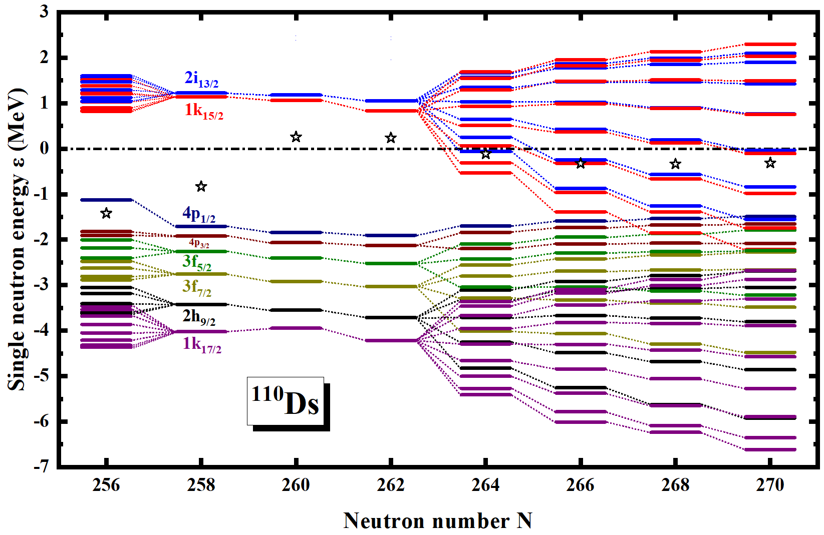
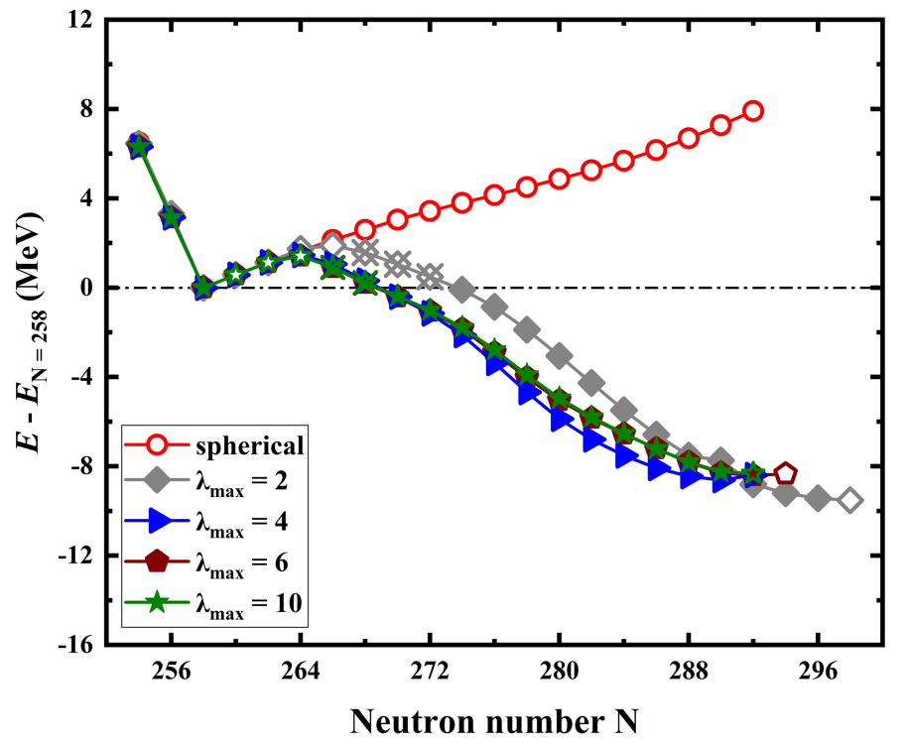
Ⅲ.2 Stability peninsula
目 录
X. T. He, et al, Chin. Phys. C 45, 101001 (2021).
A significant shell gap exists at N = 258, indicating a stable shell closure crucial for the stability of heavy and superheavy nuclei.
Increasing nuclear deformation impacts single-neutron energy levels, causing some levels to drop below the Fermi surface, affecting the binding energy and stability of the nucleus.
Nuclear deformation, including higher-order deformations, is crucial for the existence of bound nuclei beyond the neutron drip lines.
Several isotopes exhibit reentrant binding, being bound against two-neutron emission but unbound against multi-neutron emission.
Detailed calculations highlight the complex interplay between nuclear forces and deformations, impacting the stability of heavy nuclei.

