Slide 1


Report of current status: the region of Z=81,83, 85 and
Z=87 and 89
Myung-Ki Cheoun^{1,2}
Eunja Ha³, Myung-hwan Mun², Seonghyun Kim^{1,2}
¹Department of Physics, Soongsil University(SSU, 崇實大學)
²Origin of Matter and Evolution of Galaxies (OMEG) Institute, Soongsil University
³Department of Physics, Hanyang University
Z=87 (Fr) Gui Zhou Min Zu University (GZMU) PI: Xiaoying Qu
Student: Kangmin Chen, Tianyu Wang
Z=89 (Ac) Tianjin University (TJU)
PI: Ying Zhang
Student: Xiaojie Cao, Yiran Wang, Wentao Zeng
Notes:
Good after noon, all. I’m Seonghyun Kim in Soongsil University. Nice to meet you again.
In this time, I will report progress of our region.

Slide 2
Context
Overview
Calculation Results
Further Discussion
Summary
Notes:
목차, 목차1: overview

Slide 3
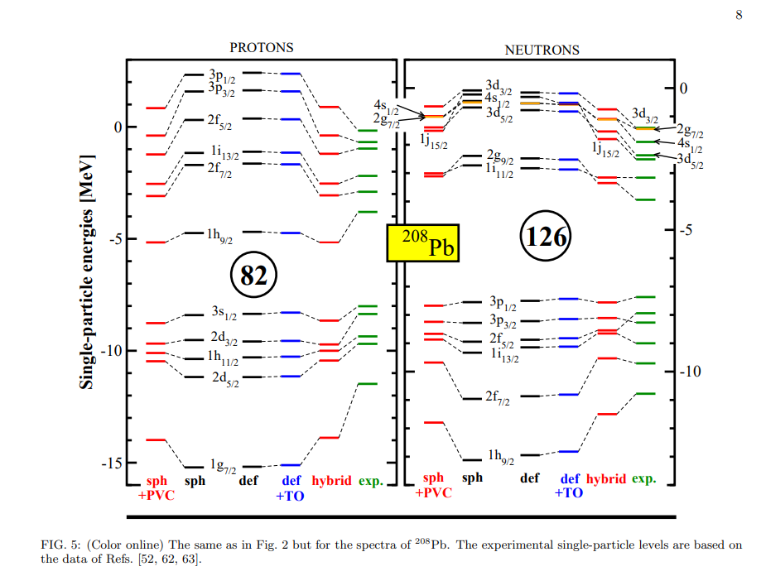

Slide 4
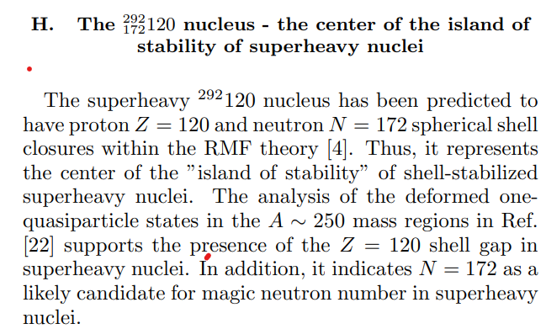
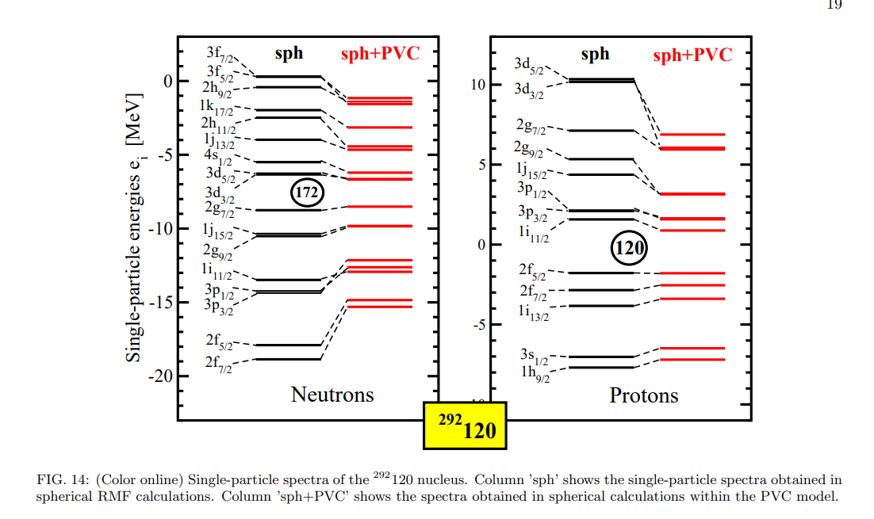
184
126
82

Slide 5
Computer Resources
Used resources for the DRHBc odd-even and odd-odd phase
Computers |  | Spec |  |  | Remarks
Model | Nodes | Cores | Threads | RAM
Type I | 3 | 32 | 64 | 1 TB | Intel® Xeon Scalable Gold 6242 / ~2.80 GHz
Type II | 5 | 56 | 112 | 1 TB | Intel® Xeon Scalable Gold 6258R / ~2.70 GHz
Type III | 3 | 64 | 128 | 512 GB | AMD Ryzen Threadripper Pro 3995WX / ~2.70 GHz
Total threads |  | 1,136
Review: CPUs for calculations of the DRHBc
Each CPU models have a similar clock count
All of calculations are compiled by the Intel FORTRAN compiler (ifort)
AMD CPUs are recommended, because it showed better efficiency than Intel CPU for the DRHBc
Notes:
DRHBc 계산 경험에서, Intel CPU와 AMD CPU를 사용했을 때 AMD CPU가 DRHBc 계산에 대한 더 나은 퍼포먼스를 보였음. 계산에 사용된 두 제작사 CPU가 비슷한 CPU 클럭수를 가지고 있으나, 계산 속도면에서 AMD가 나은 점을 보였음

Slide 6
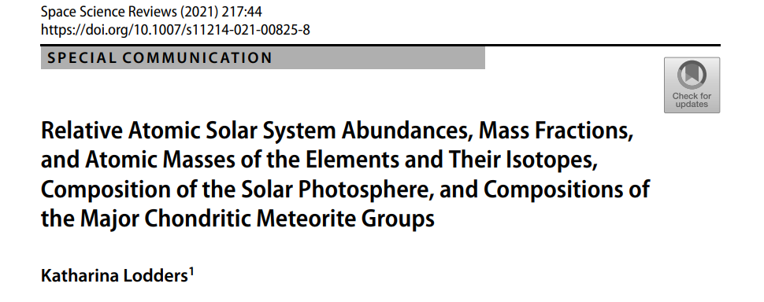
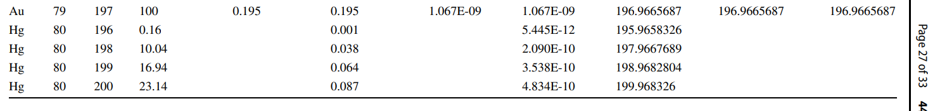
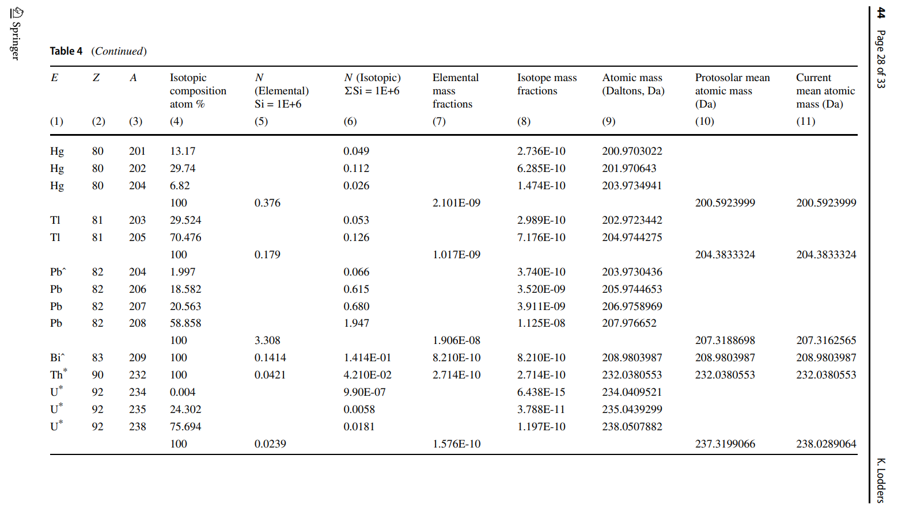

Slide 7
Calculation Region
The number of calculated nuclei in odd-even and odd-odd phase
Odd-Z / Even-N
Odd-Z / Odd-N
Models Isotopes | FRDM2012 |  | KTUY05 M246 (2014) |  | RCHB |  | DRHBc
 | Range | Number | Range | Number | Range | Number | Range | Number
Tl (Z = 81) | 173 ≤ A ≤ 269 | 97 | 166 ≤ A ≤ 281 | 116 | 172 ≤ A ≤ 267 | 96 | 169 ≤ A ≤ 282 | 57
 |  |  |  |  |  |  |  | 57
Bi (Z = 83) | 178 ≤ A ≤ 276 | 99 | 171 ≤ A ≤ 283 | 113 | 179 ≤ A ≤ 269 | 91 | 172 ≤ A ≤ 292 | 61
 |  |  |  |  |  |  |  | 60
At (Z = 85) | 184 ≤ A ≤ 282 | 99 | 177 ≤ A ≤ 285 | 109 | 193 ≤ A ≤ 271 | 79 | 186 ≤ A ≤ 311 | 63
 |  |  |  |  |  |  |  | 63
Number | 295 |  | 338 |  | 266 |  | 361
All calculations of odd-even and odd-odd for Z=81-85 isotope chains are completed
Both driplines of the DRHBc are expanded comparing to the RCHB
We also obtained obviously an expanded neutron dripline comparing to other mass tables
Notes:
우리 영역의 odd-Z even-N isotope chains와 odd-Z even-N isotope chains의 계산이 모두 마무리 되었음.

Slide 8
Context
Overview
Calculation Results
Further Discussion
Summary
Notes:
목차2: 계산결과

Slide 9
Numerical details
Nuclei
Odd-even and odd-odd from Tl to At isotope chain
Box size
R_{box} = 20 fm
Mesh size
Δr = 0.1 fm
Energy cutoff
E_{cut} = 300 MeV
Angular moment cutoff
J_{max} = 23/2 ħ
Legendre expansion order
λ_{max} = 8
Relativistic density functional
PC-PK1
Pairing strength
- 325.0 MeV fm³
Initial β₂
-0.5, -0.4, -0.3, -0.2, -0.1, 0.0, 0.1, 0.2, 0.3, 0.4, 0.5, and 0.6
Automatic blocking process
For odd-Z and odd-N nuclei
Notes:
계산 파라미터들

Slide 10
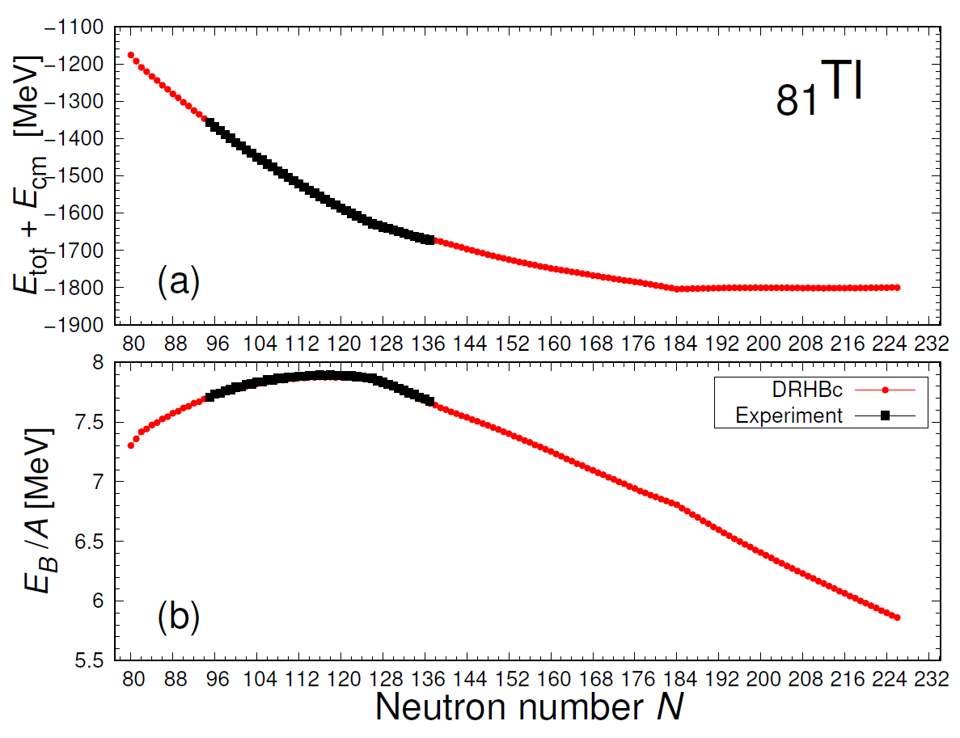
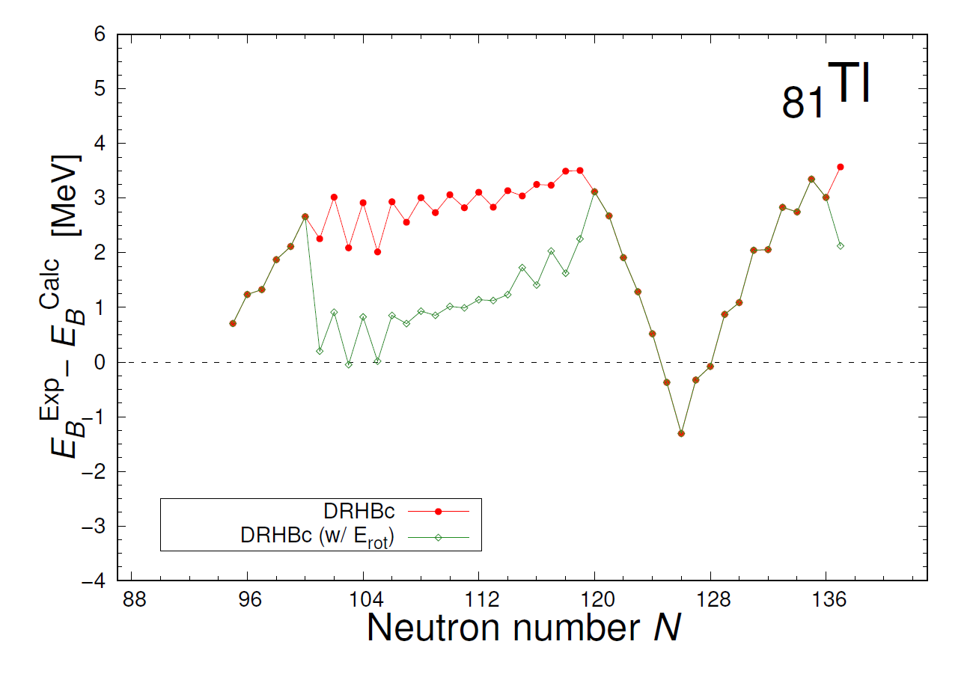
Calculation Results: ₈₁Tl
Total binding energy, binding energy per nucleon, and differences
Experimental data : W. J. Huang et al., 2021 Chinese Phys. C 45 030002 (AME2020)
DRHBc well explains experimentally measured nuclear binding energies for odd-Z nuclei
Rotational energy correction contributes to reduce energy difference with experimental binding energies
Notes:
odd-Z isotope chain에 대한 DRHBc 계산 결과 Binding energy를 잘 구현함

Slide 11
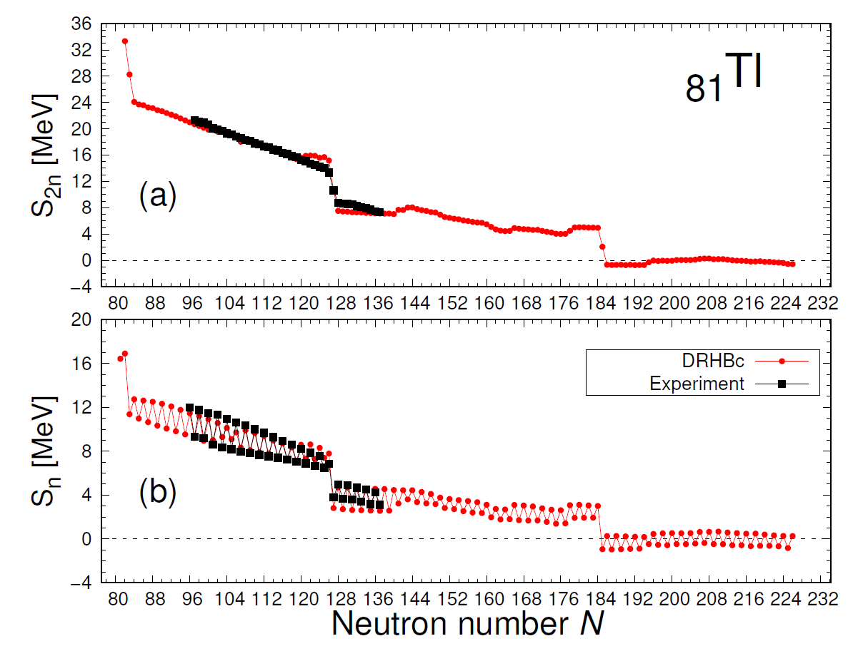
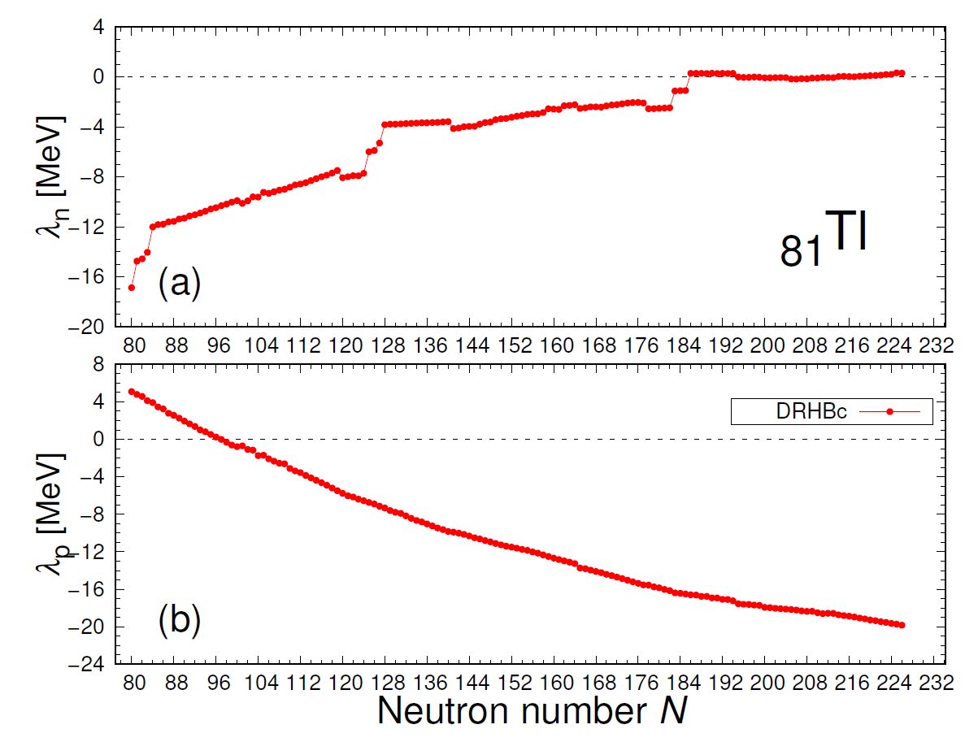
Calculation Results: ₈₁Tl
N=186
Neutron separation energies and nucleon fermi energy levels
Experimental data : W. J. Huang et al., 2021 Chinese Phys. C 45 030002 (AME2020)
Overestimation of separation energies around magic number appears again
Neutron and proton driplines are determined by separation energy and nucleon fermi energy level
Notes:
Separation energy도 잘 구현하였고, separation energies와 nucleon fermi energy level로 neutron dripline과 proton dripline을 결정하였음

Slide 12
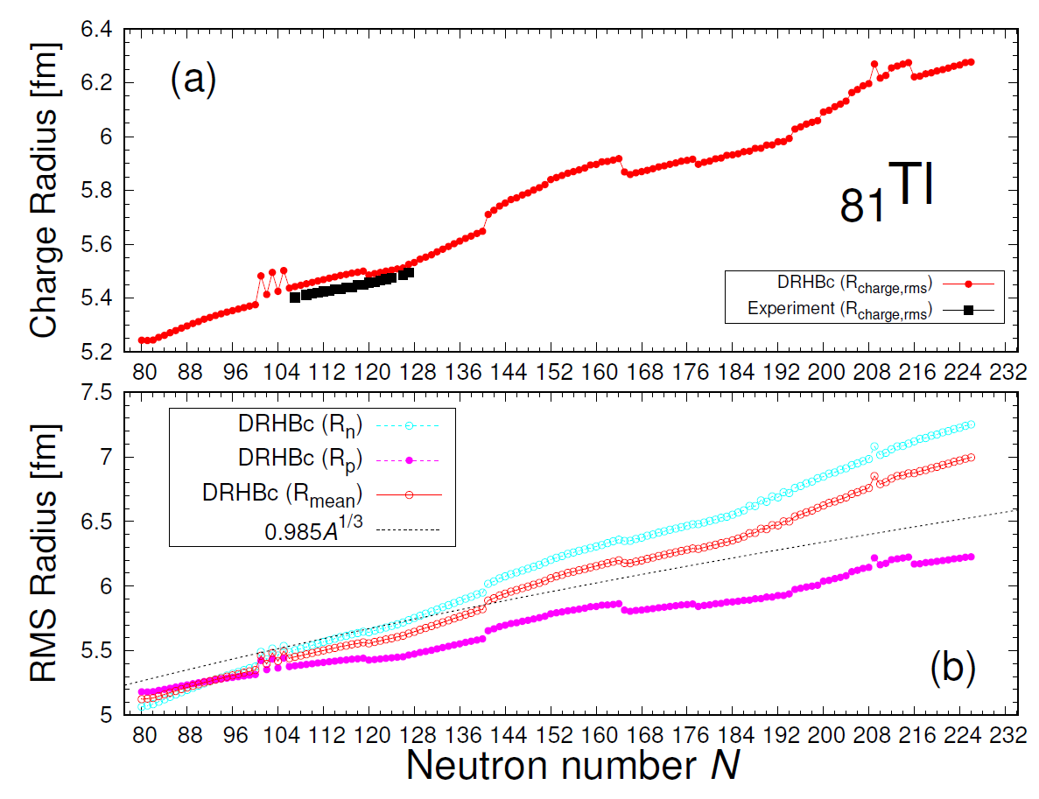
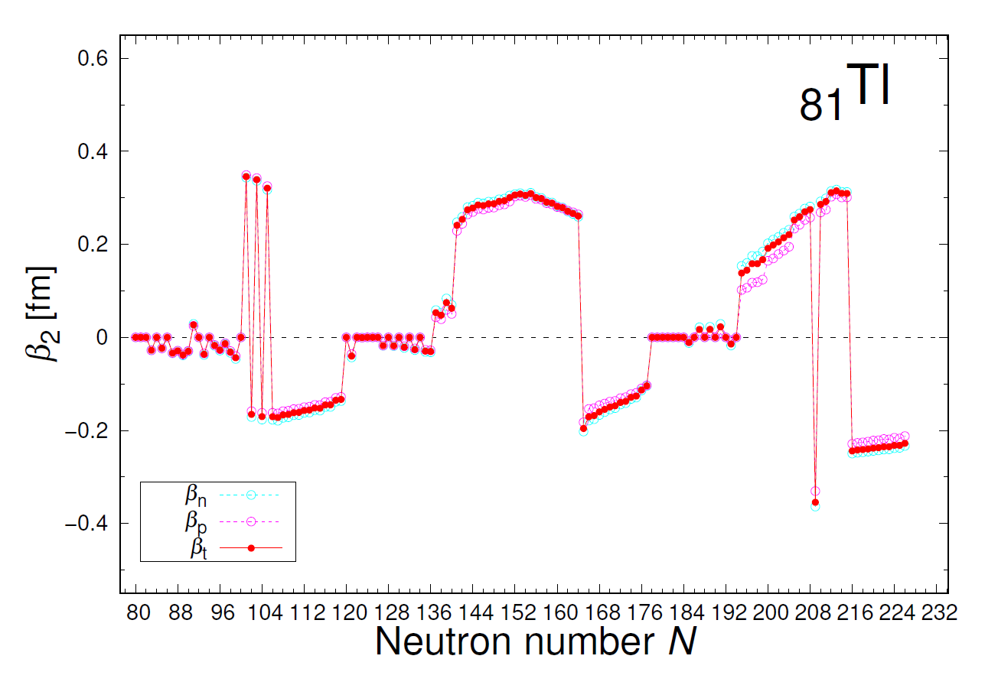
Calculation Results: ₈₁Tl
Nuclear radii and deformation parameter
Experimental data : I. Angelia, K. P. Marinova, ADNDT 99 (2013) 69-95
Nuclear radius has a correlation with nuclear deformation in an isotope chain
Alternate deformation between prolate and oblate shape reveals in N = 101-106 range
N = 101, 103, and 105 show a relatively high deformed parameter
Notes:
Radii도 잘 구현함. 다만, 특정 영역에서 deformation에 따라 radii가 번갈아 나타나는 현상이 있었음

Slide 13
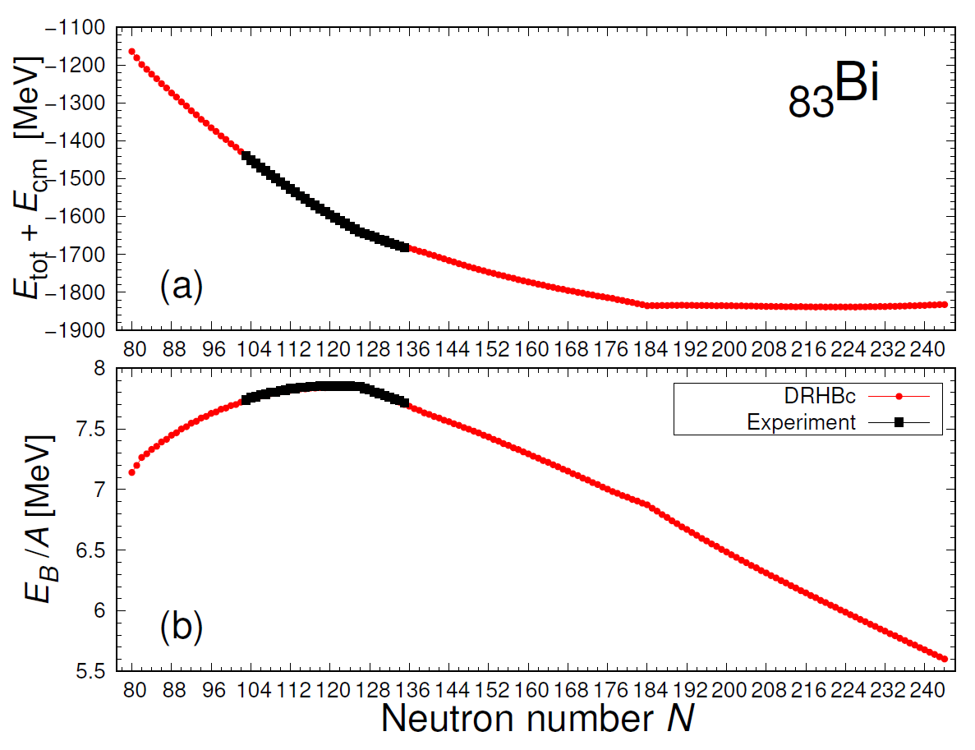
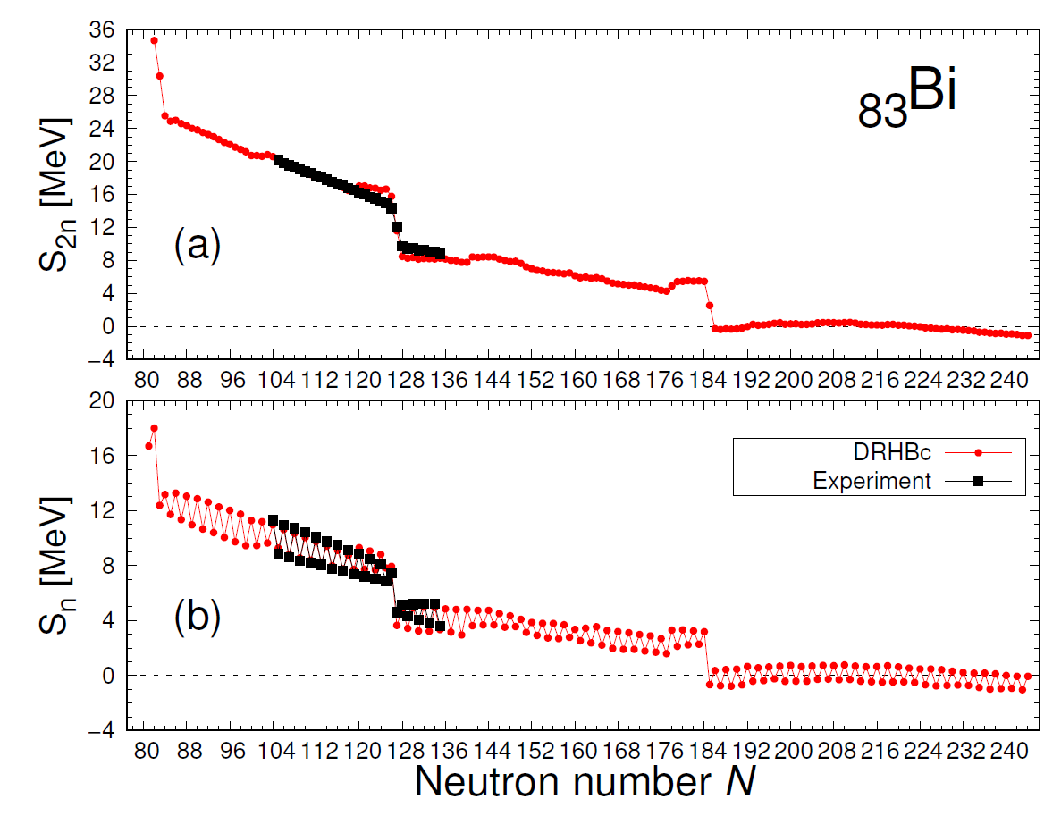
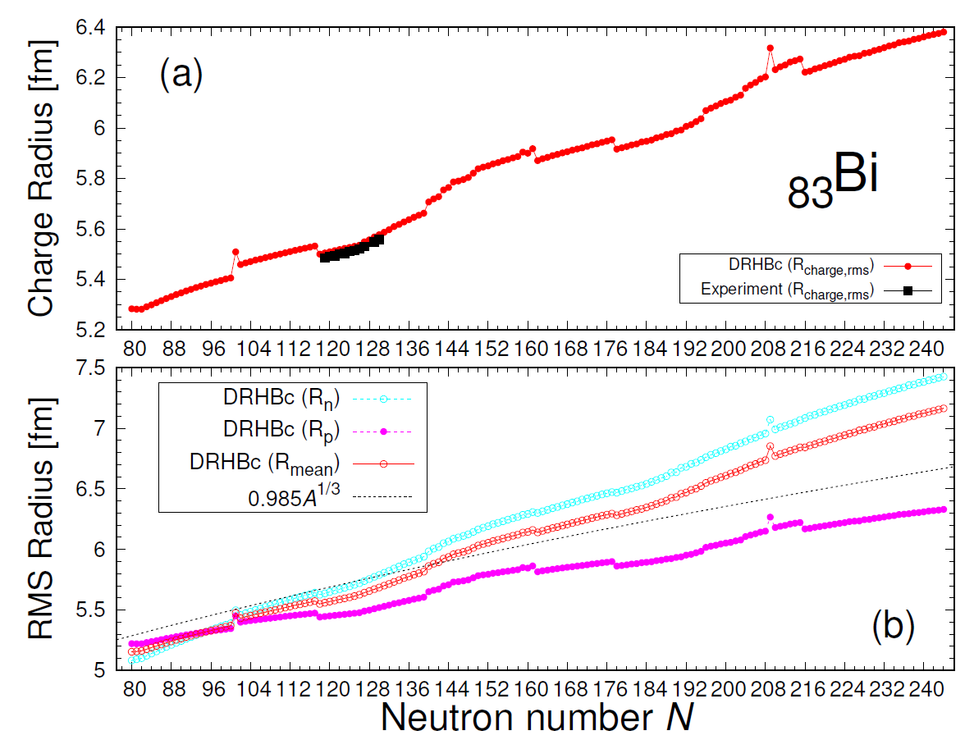
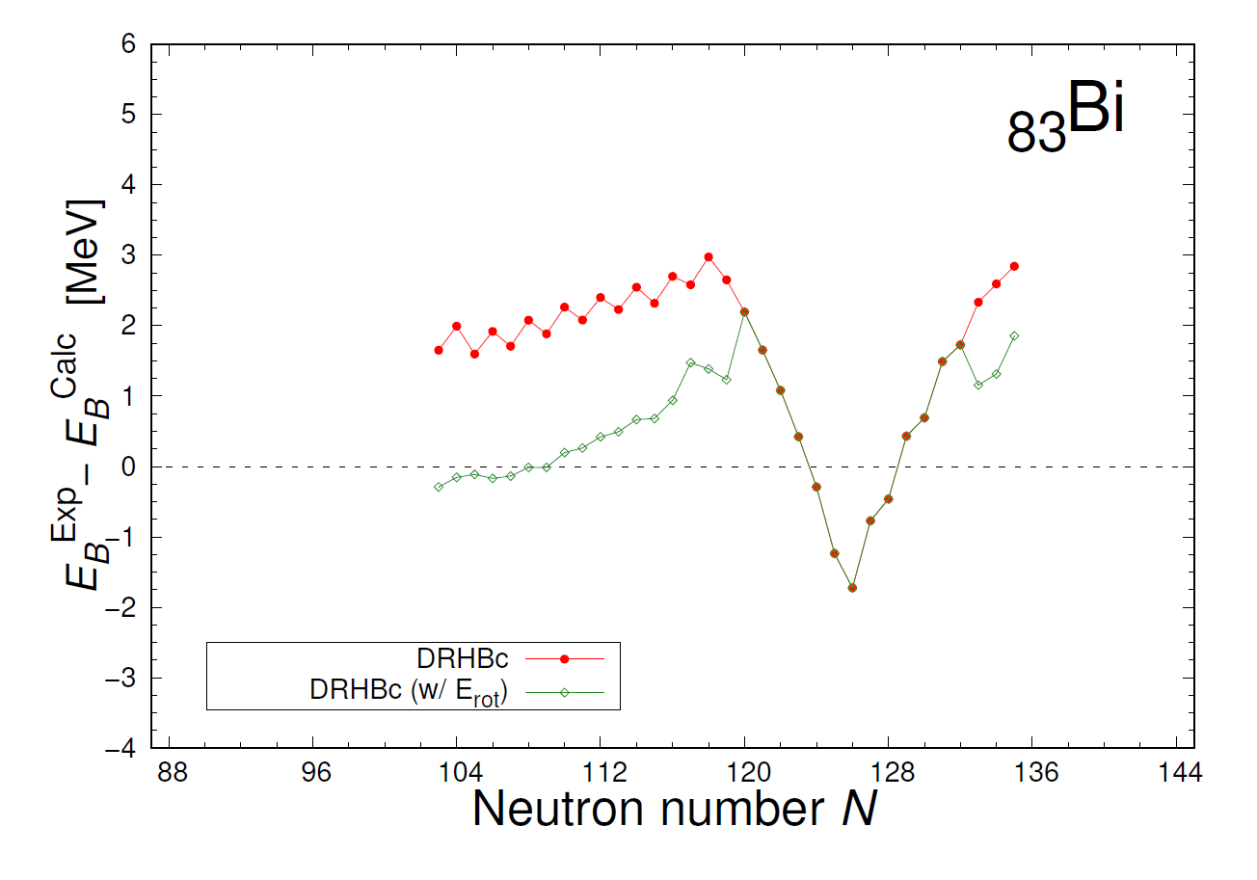
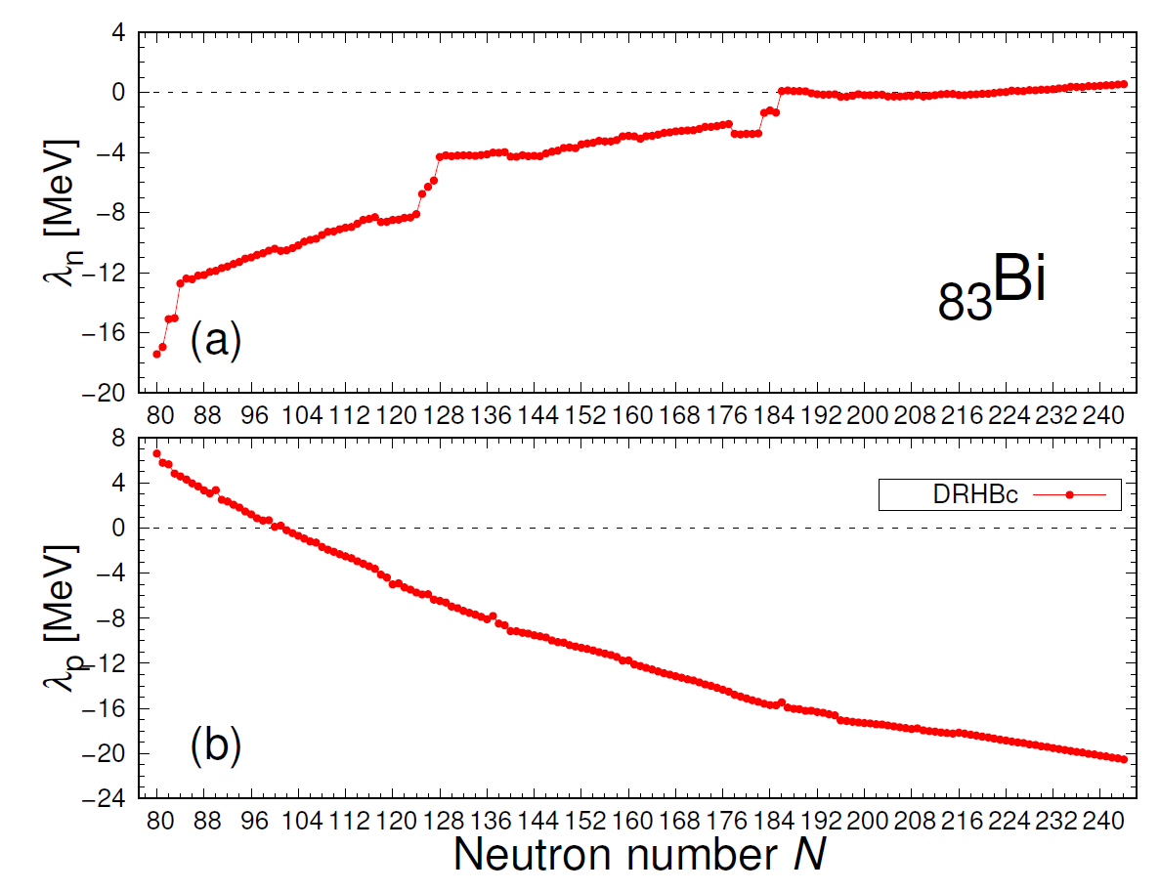
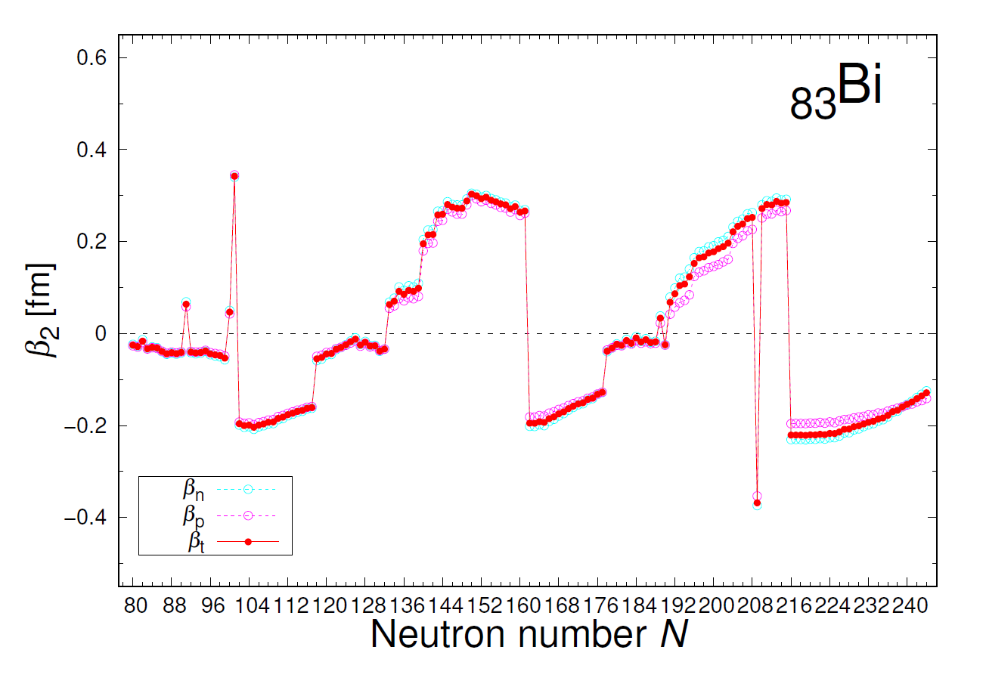
Calculation Results: ₈₃Bi
Experimental data : W.J. Huang et al., 2021 Chinese Phys. C 45 030002 (AME2020) / I.Angelia, K.P.Marinova, ADNDT 99 (2013) 69-95
Notes:
이는 다른 동위원소 계산에서도 마찬가지로 나타남. Radius와 deformation 사이의 상관관계가 있는 것처럼 보임

Slide 14
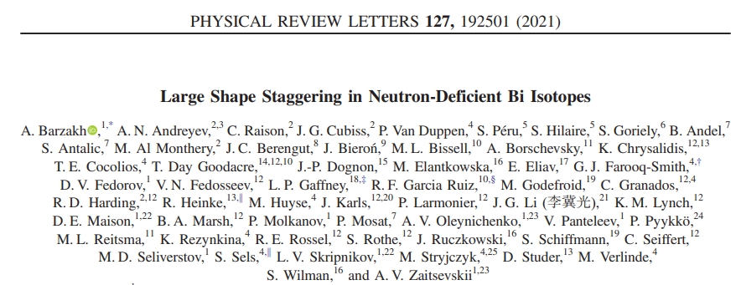
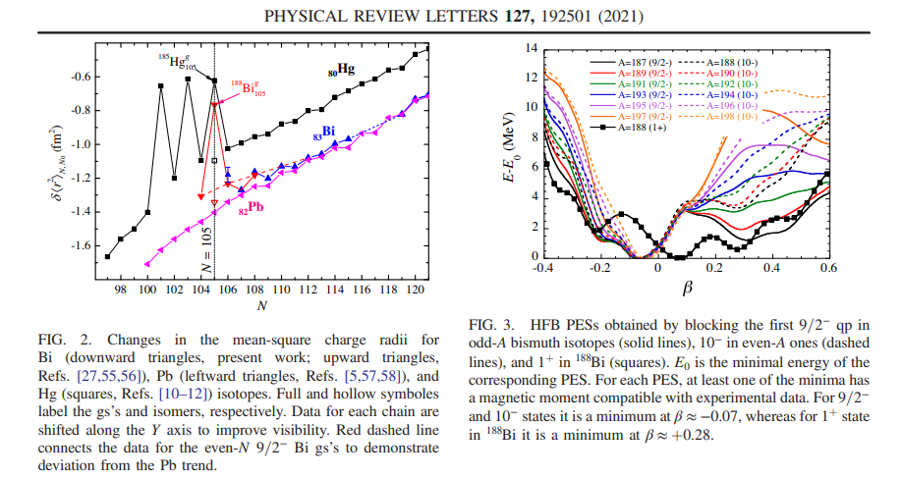

Slide 15
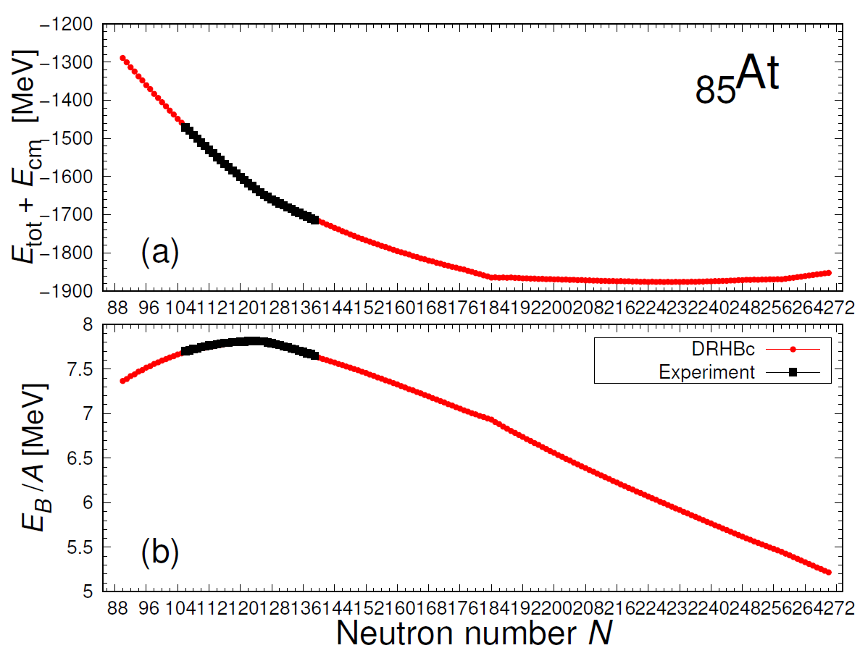
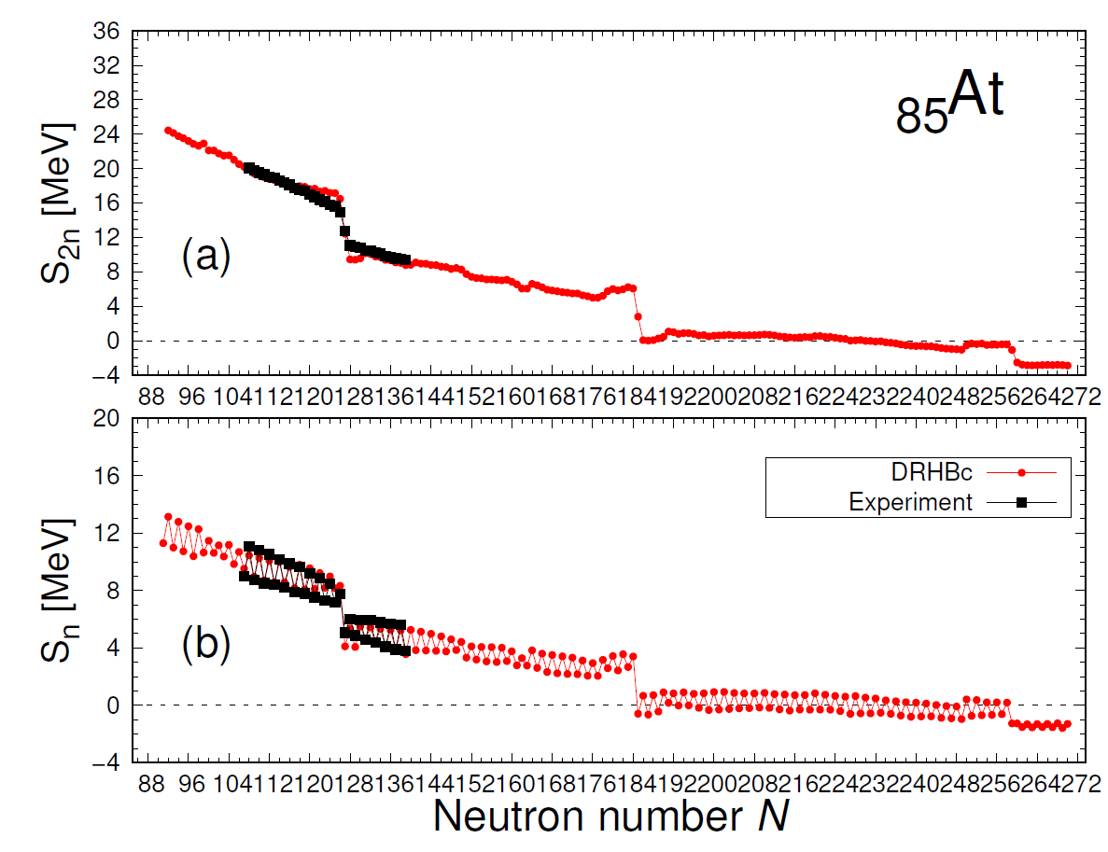
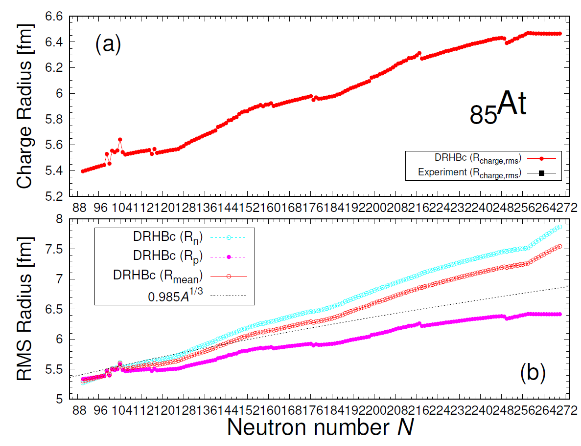
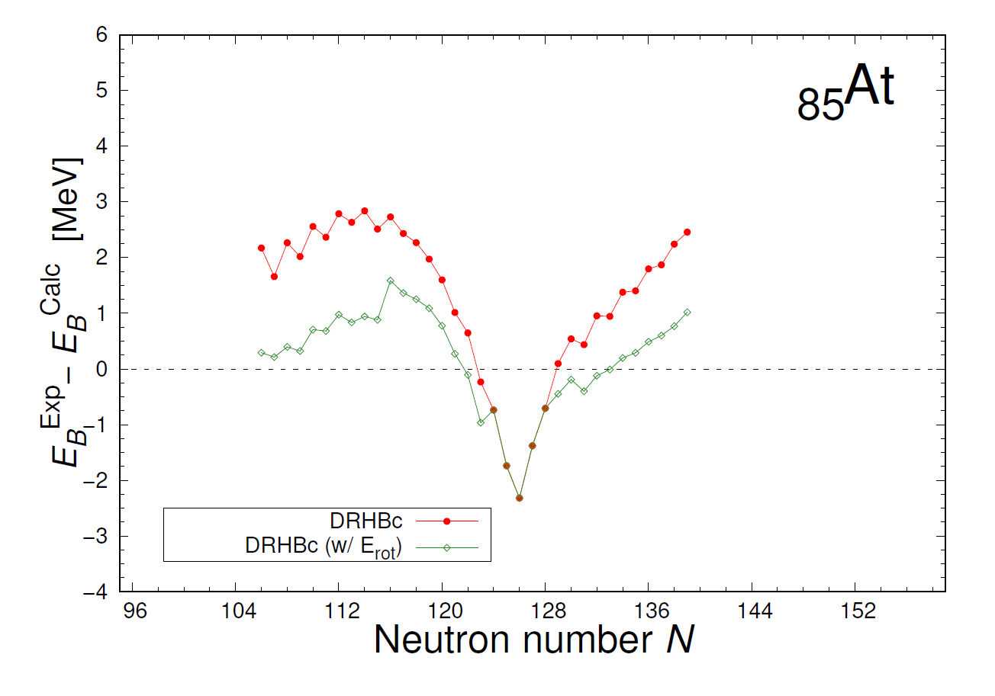
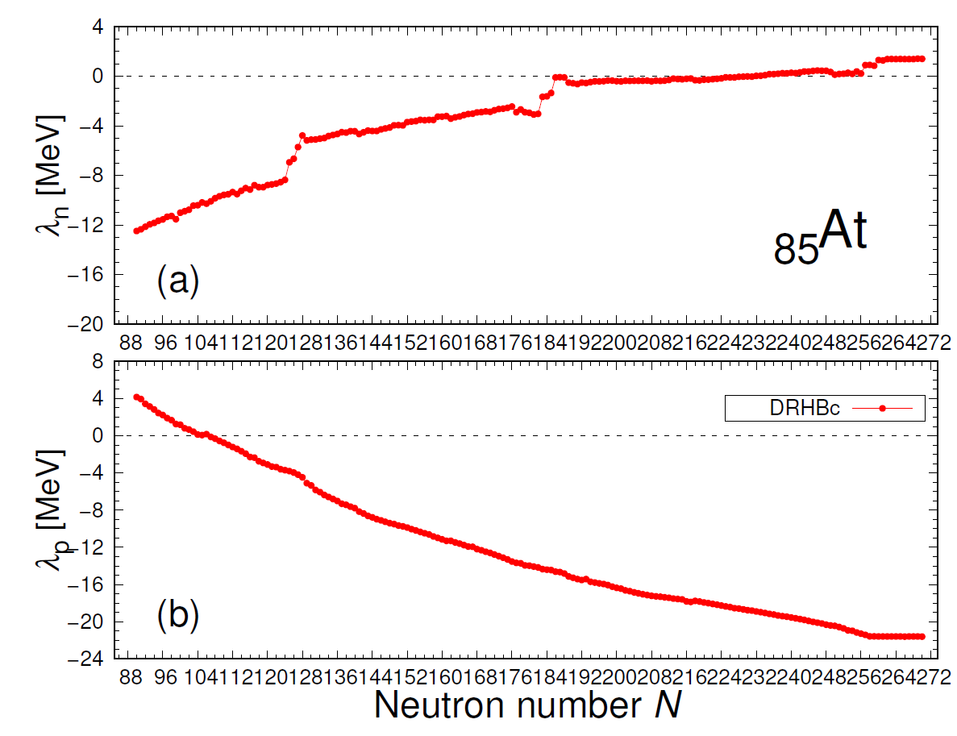
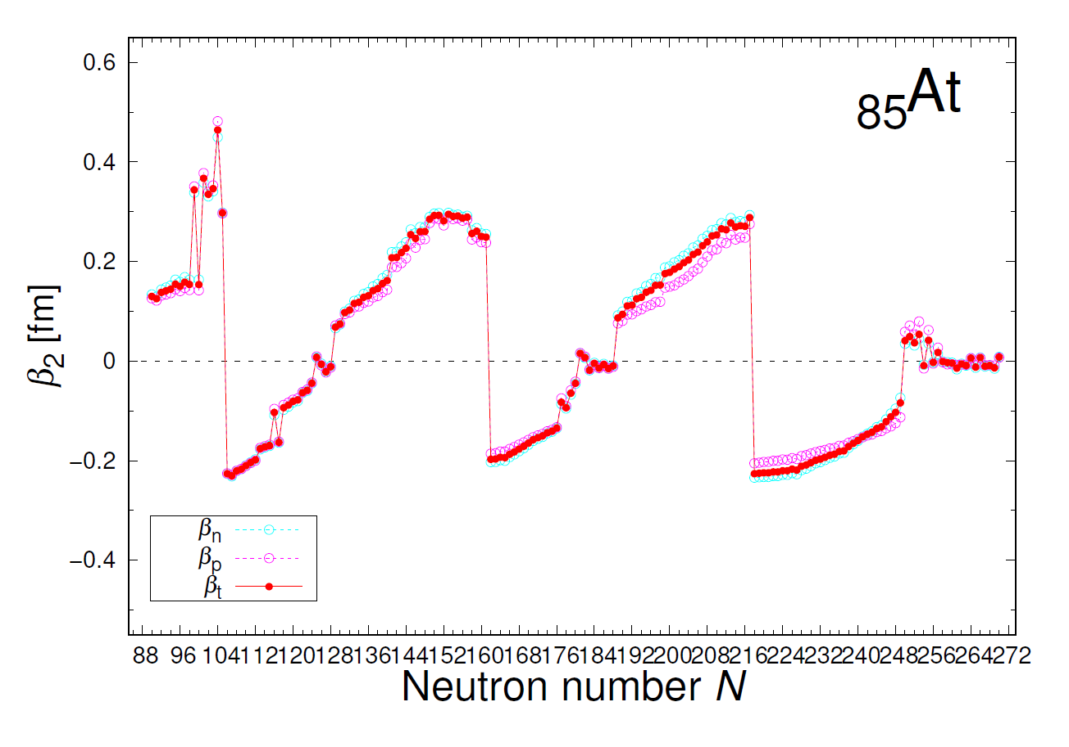
Calculation Results: ₈₅At
Experimental data : W.J. Huang et al., 2021 Chinese Phys. C 45 030002 (AME2020) / I.Angelia, K.P.Marinova, ADNDT 99 (2013) 69-95
Notes:
Prolate shape일 때 radius가 상대적으로 크게 나타남.

Slide 16
Context
Overview
Calculation Results
Further Discussion
Summary
Notes:
목차3: 흥미로운 점, 자세히 살펴볼 점

Slide 17
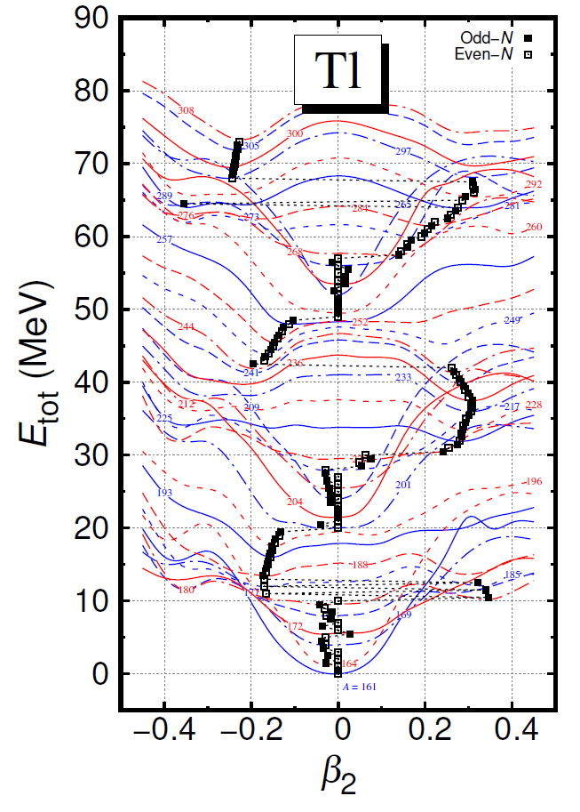
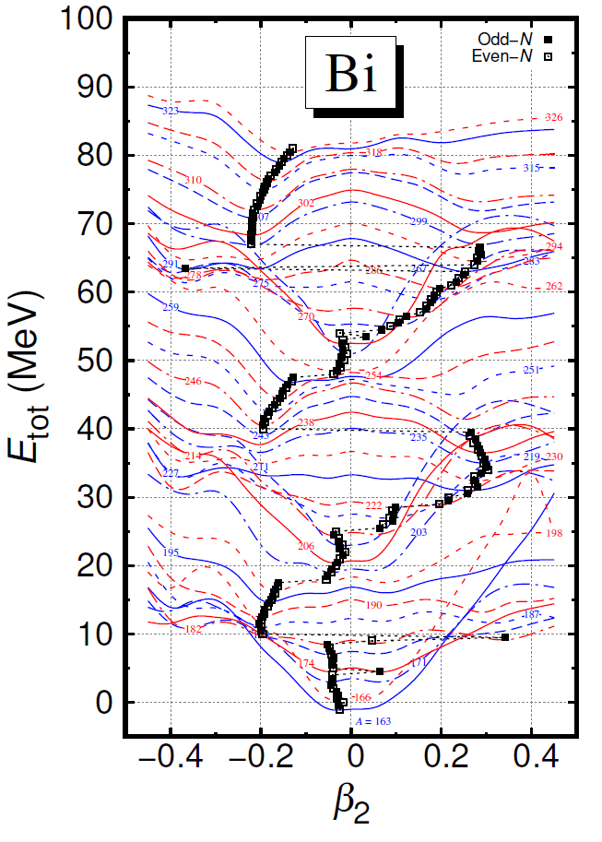
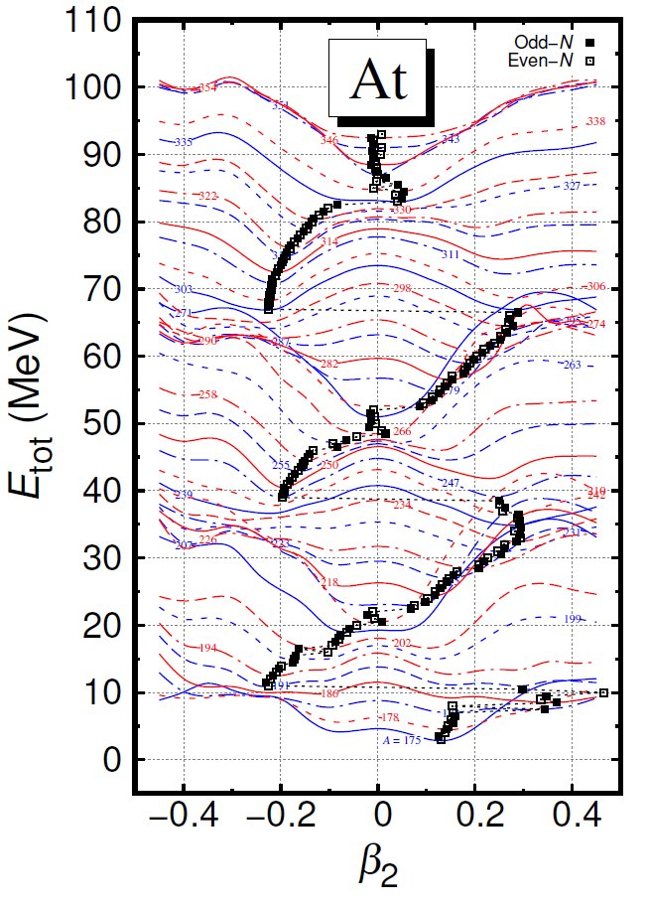
Potential energy curves (PECs)
Potential energy curves (PECs)
Notes:
PEC 커브 그림임. 이 중에서 특기할 점은 앞서 언급한 특정 영역에서 radius와 deformation 상관관계 또는 deformation이 번갈아 나타나는 그 영역임

Slide 18
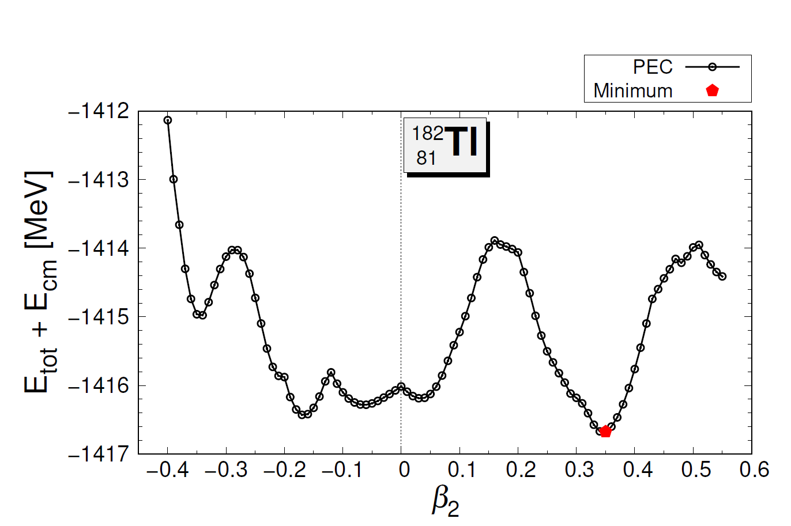
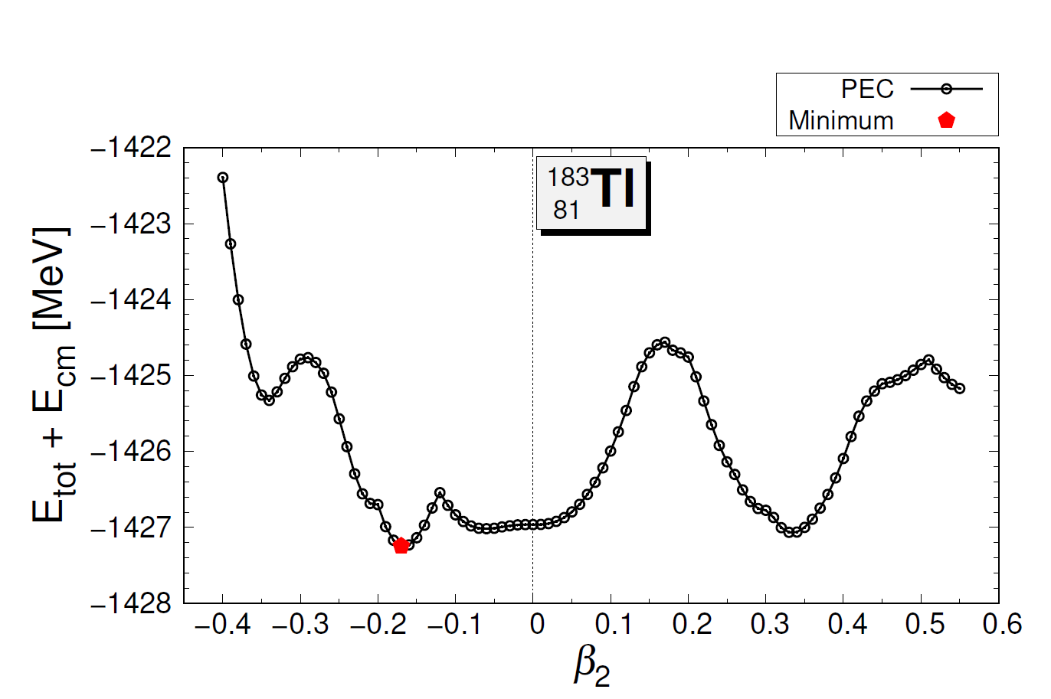
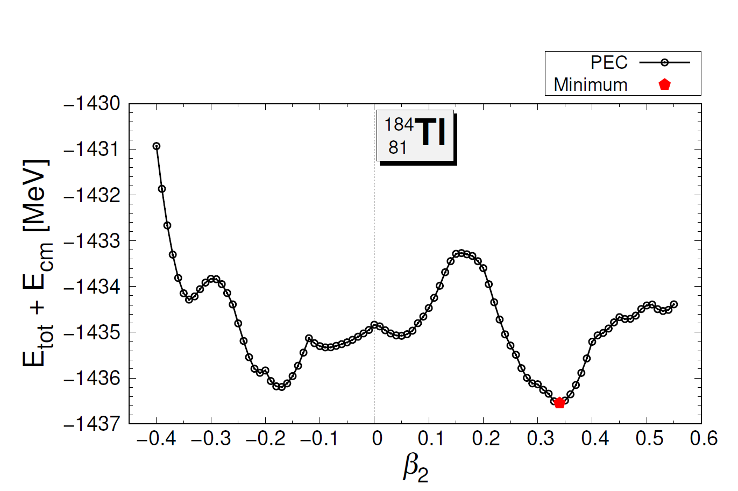
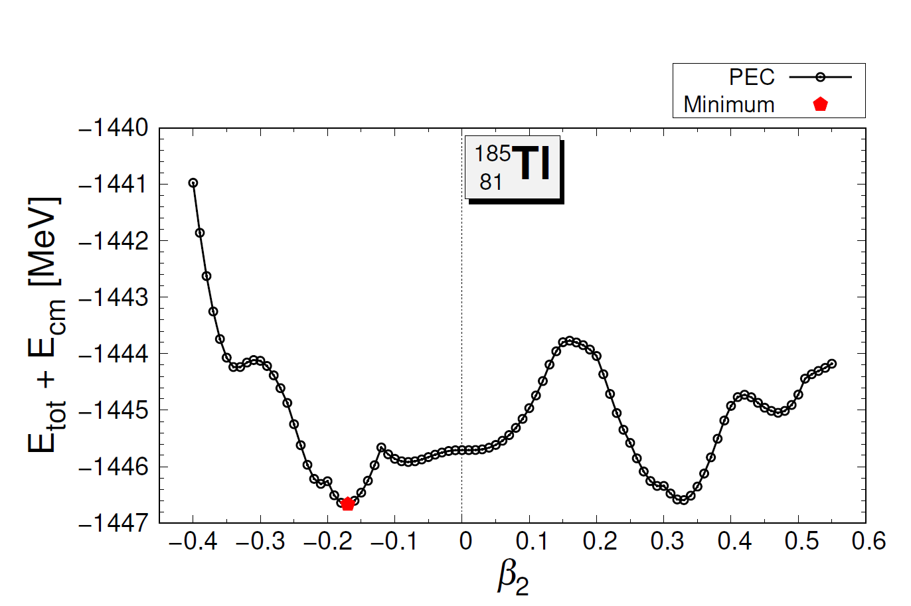
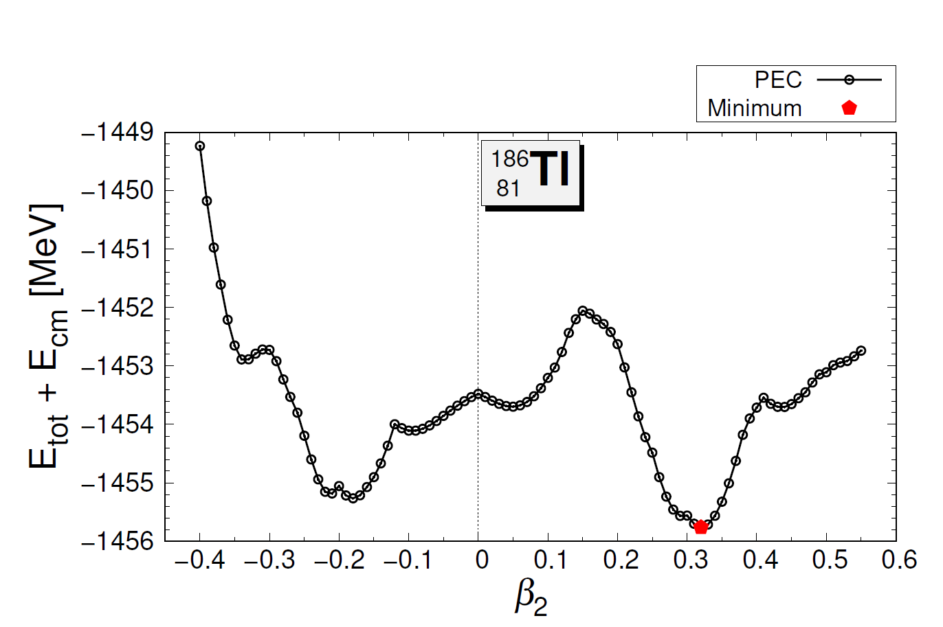
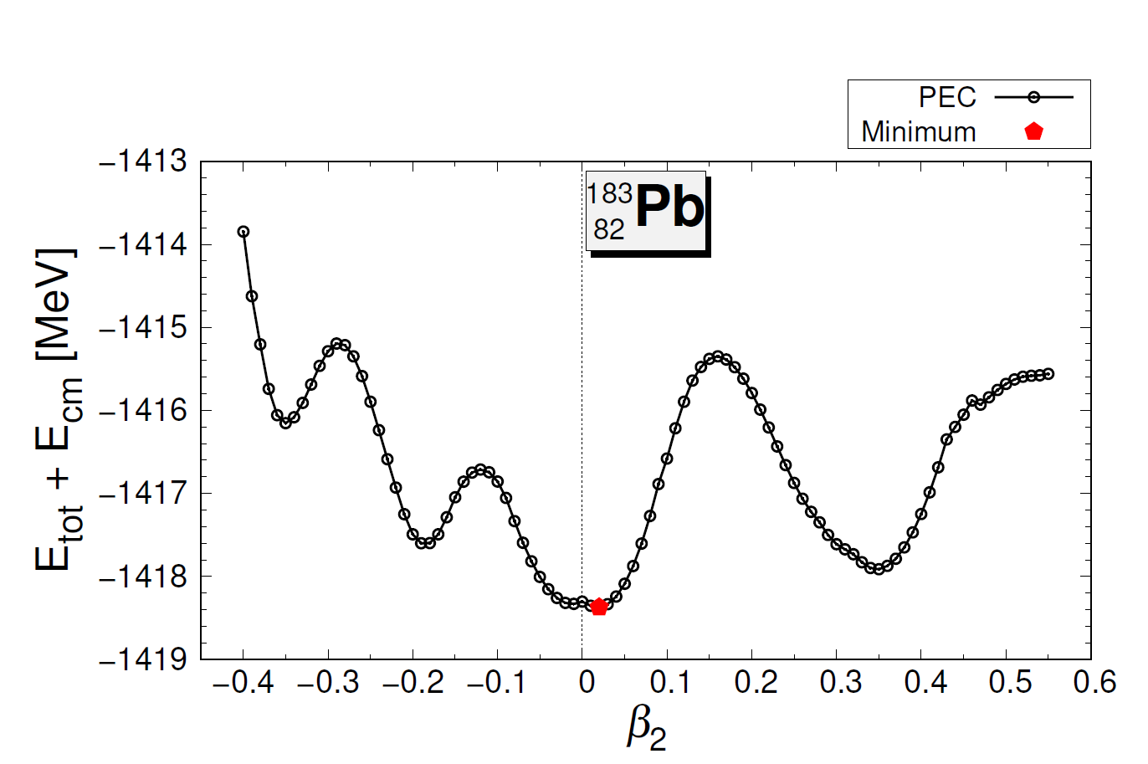
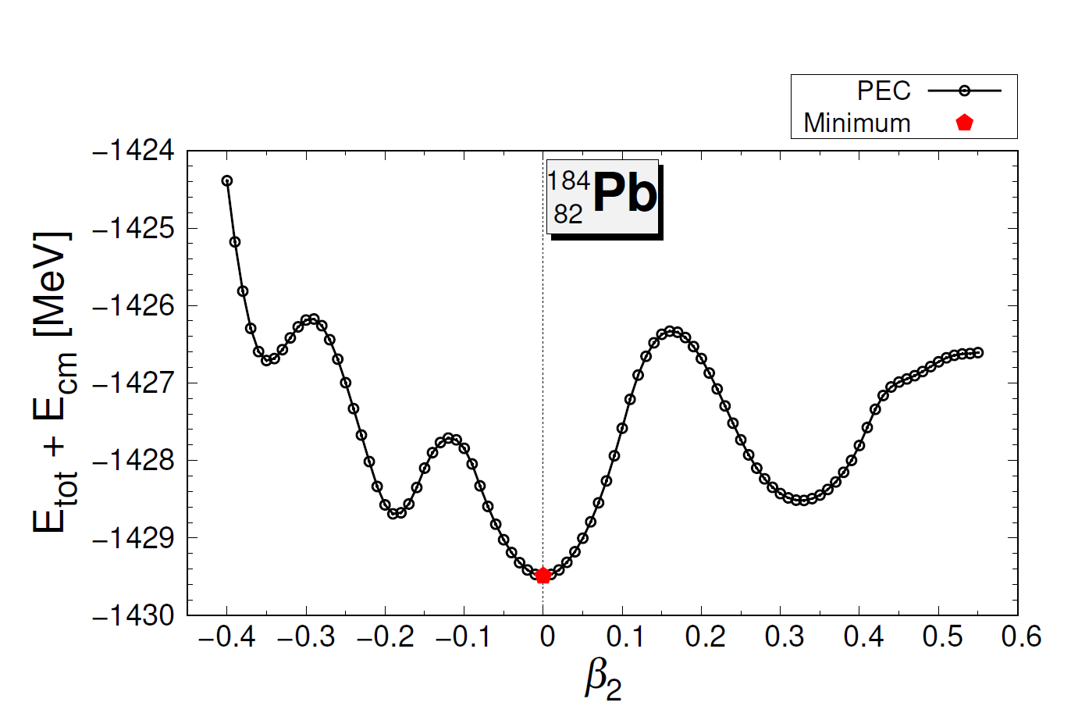
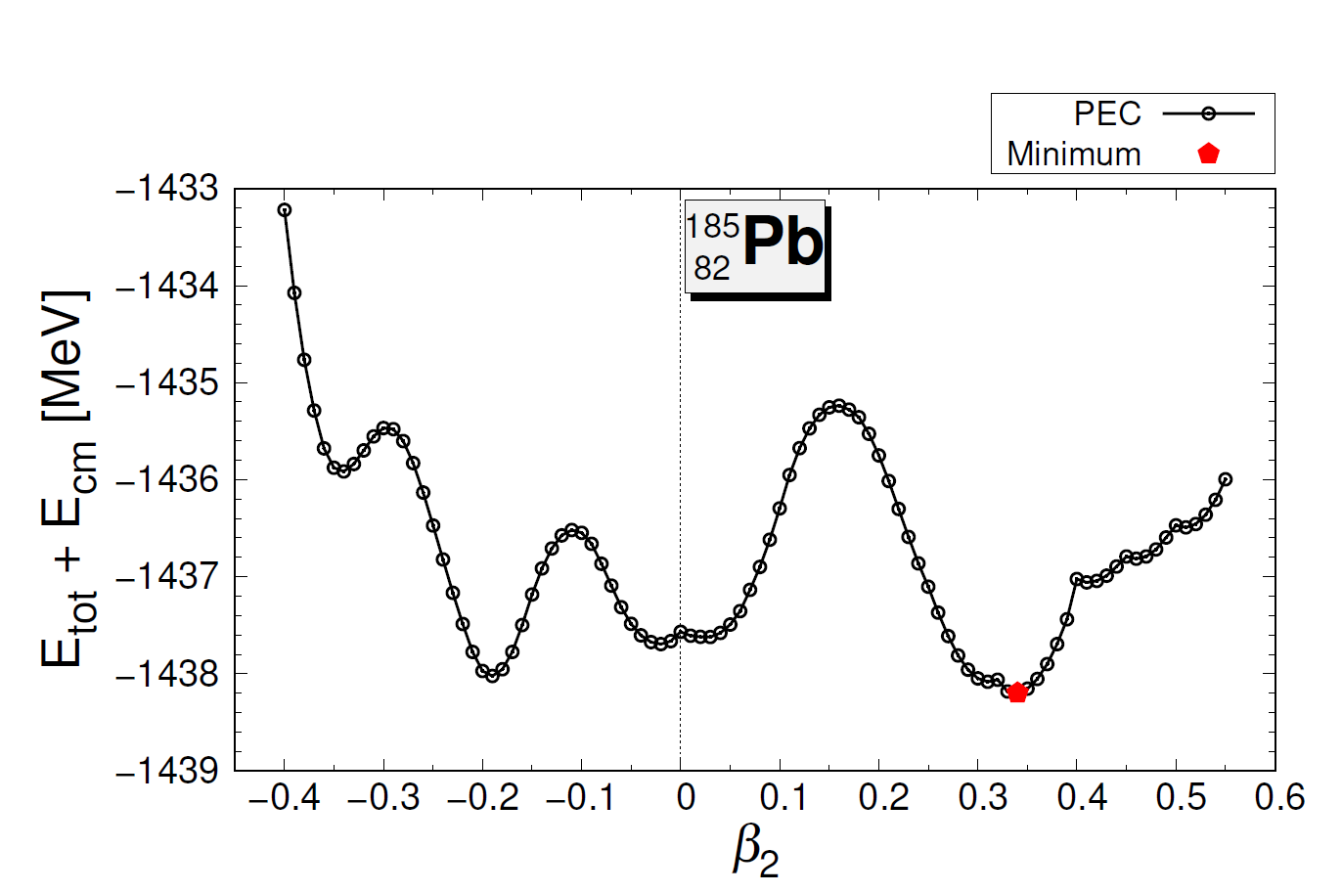
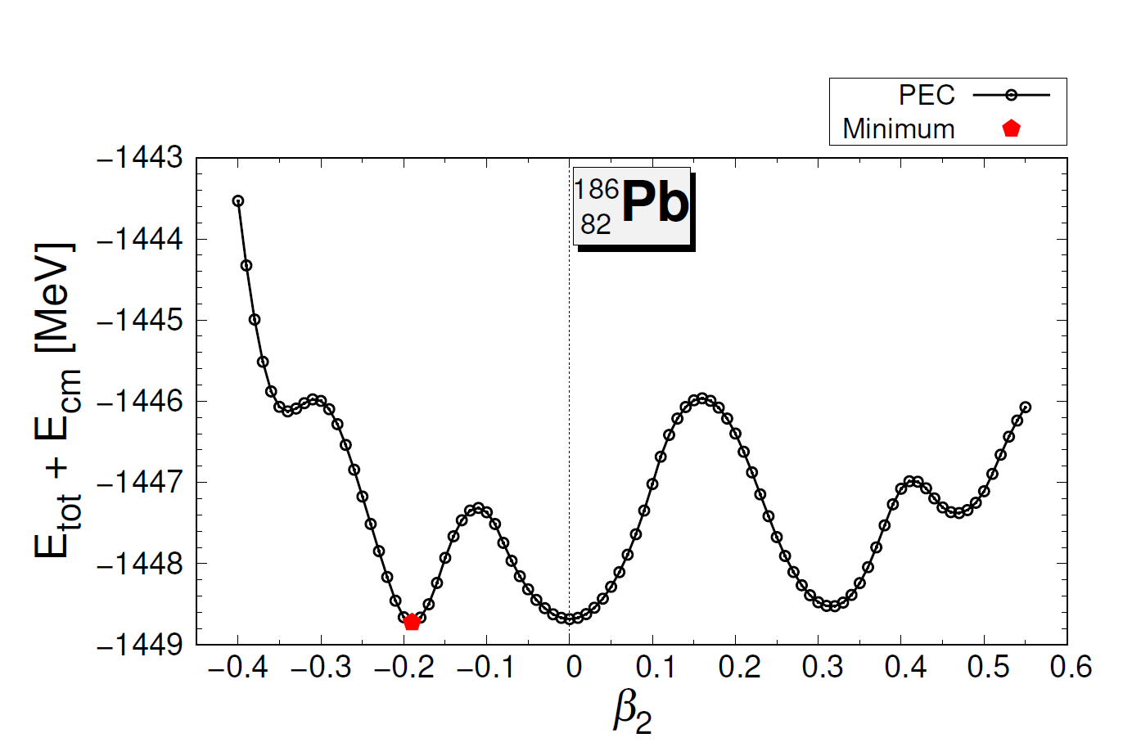
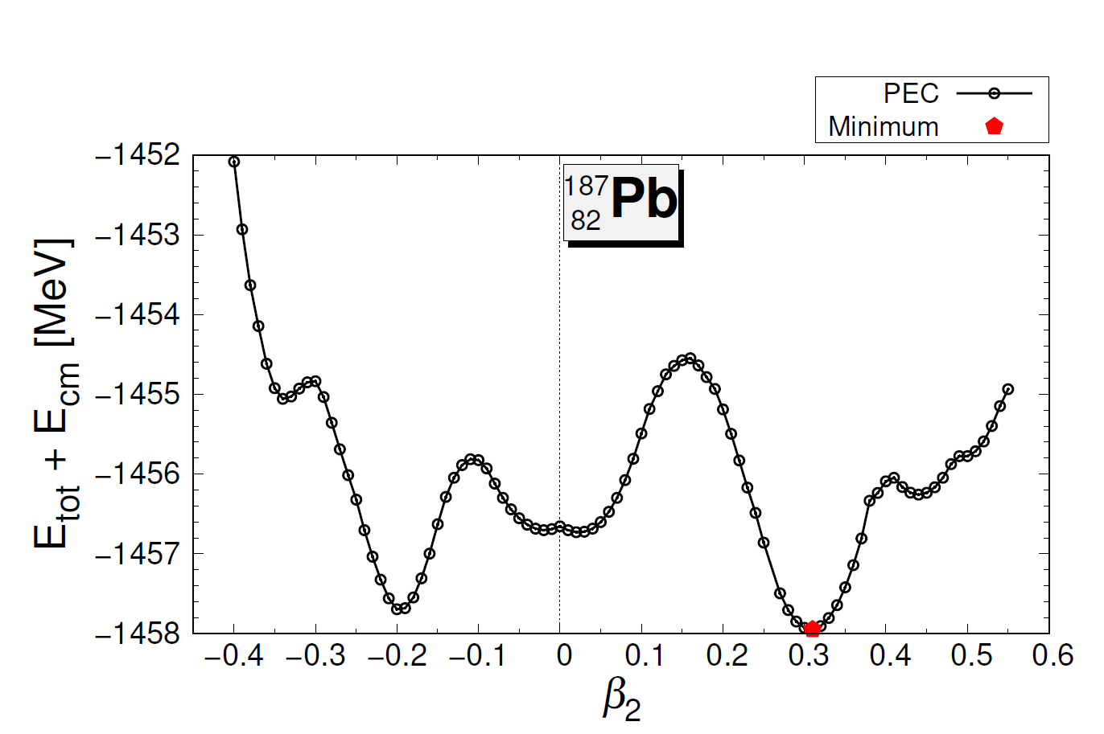
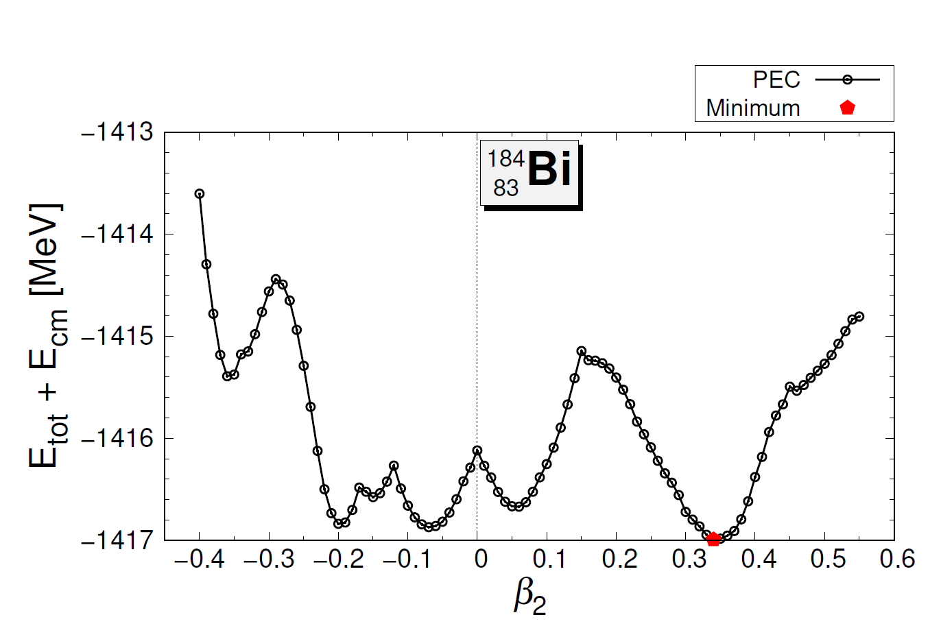
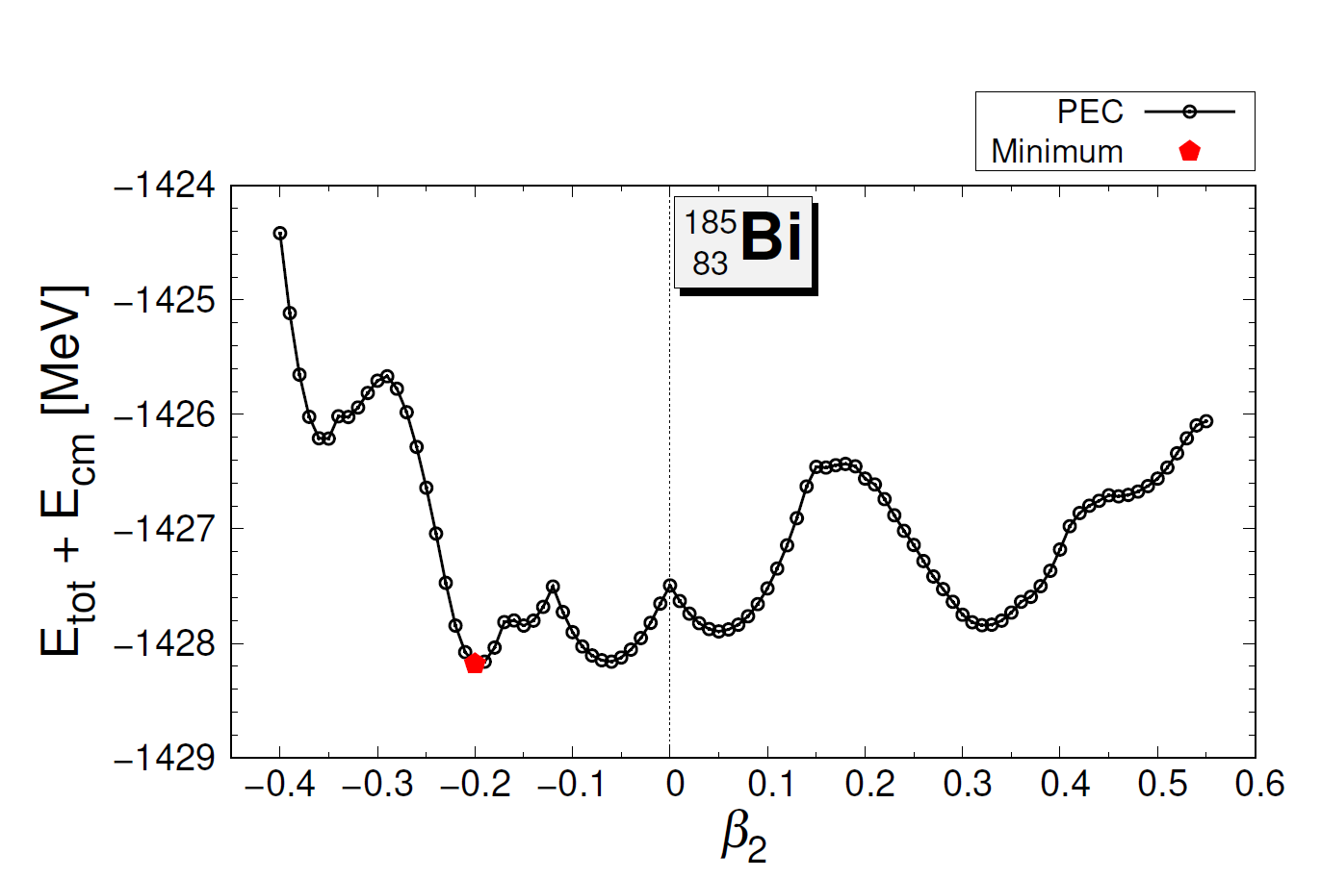
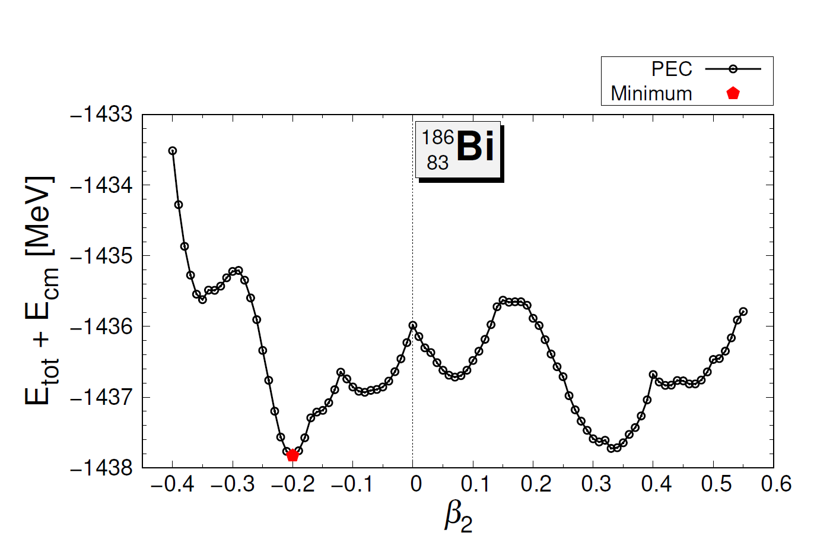
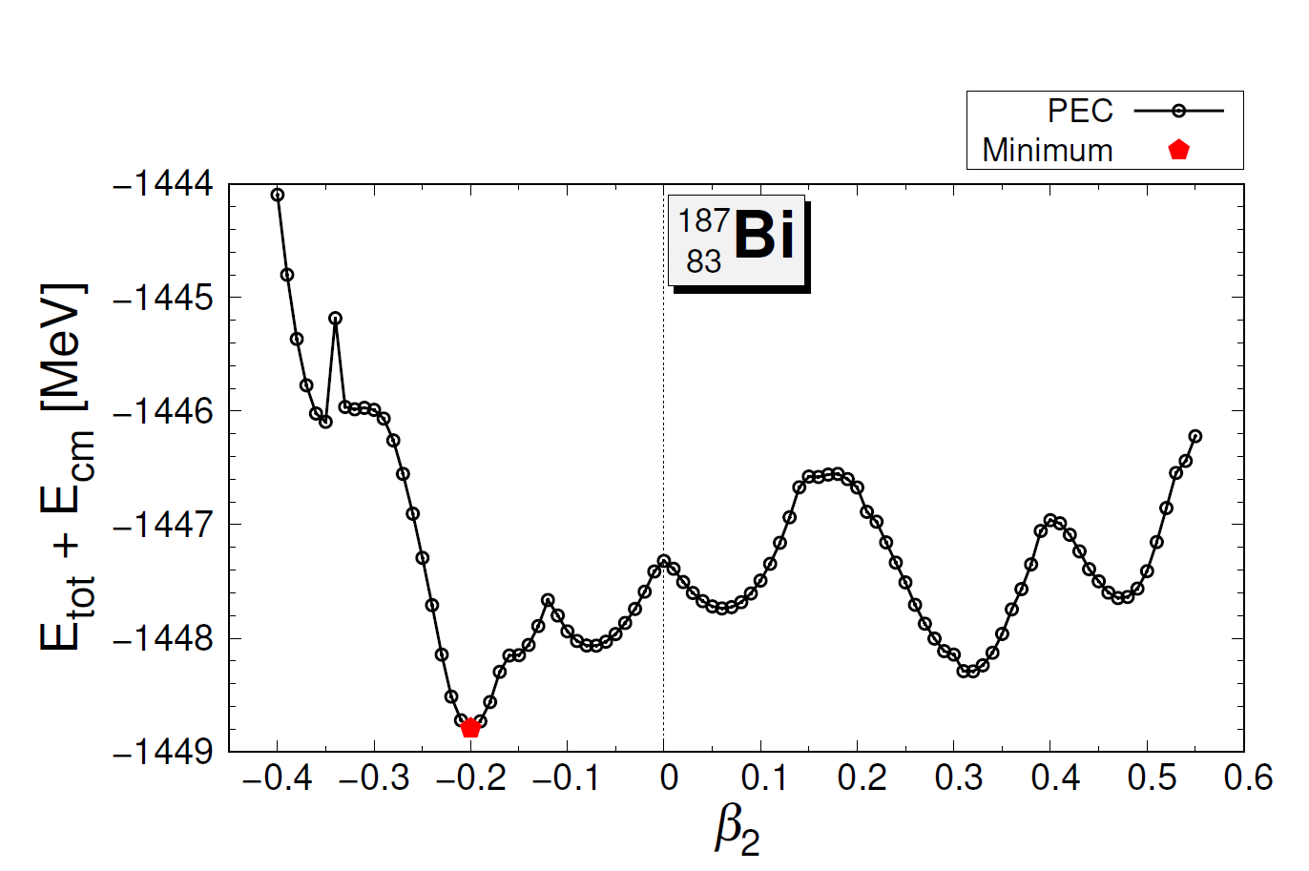
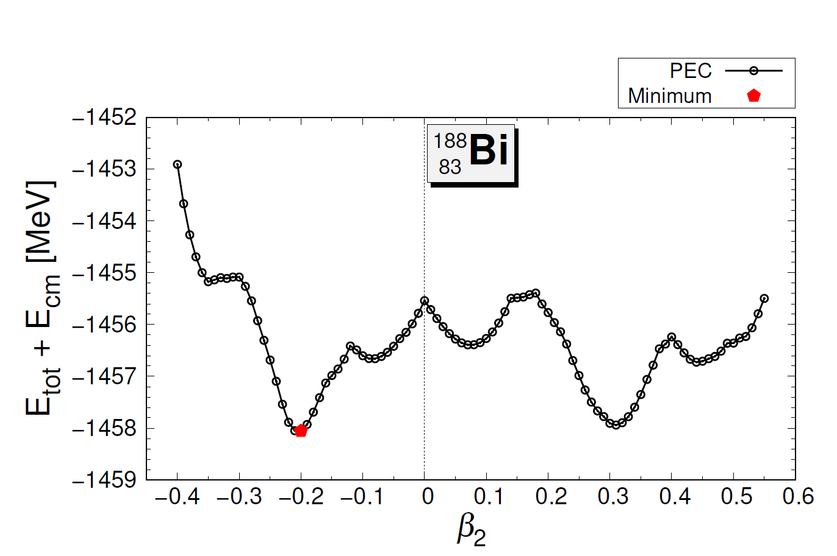
Potential energy curves (PECs)
Multiple minima on PECs in neutron deficient range












N = 101
N = 102
N = 103
N = 104
N = 105
Notes:
개별 PEC를 살펴봄. 그러면 여러 개의 아래쪽 변곡점이 나타남. (multiple local minimums). 또한 이 지점들의 에너지 차이가 매우 작음 (약 1MeV 미만의 차이, Shape coexistence)
빨간색 체크표시가 local minimums 사이의 에너지 차이가 작게 나타나는 것을 의미함

Slide 19
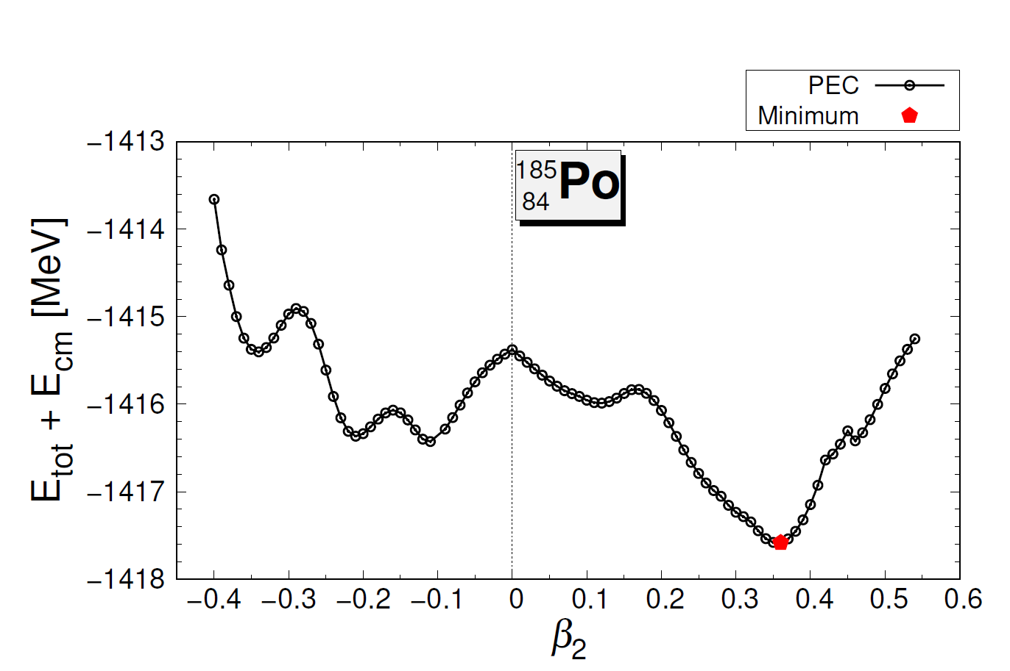
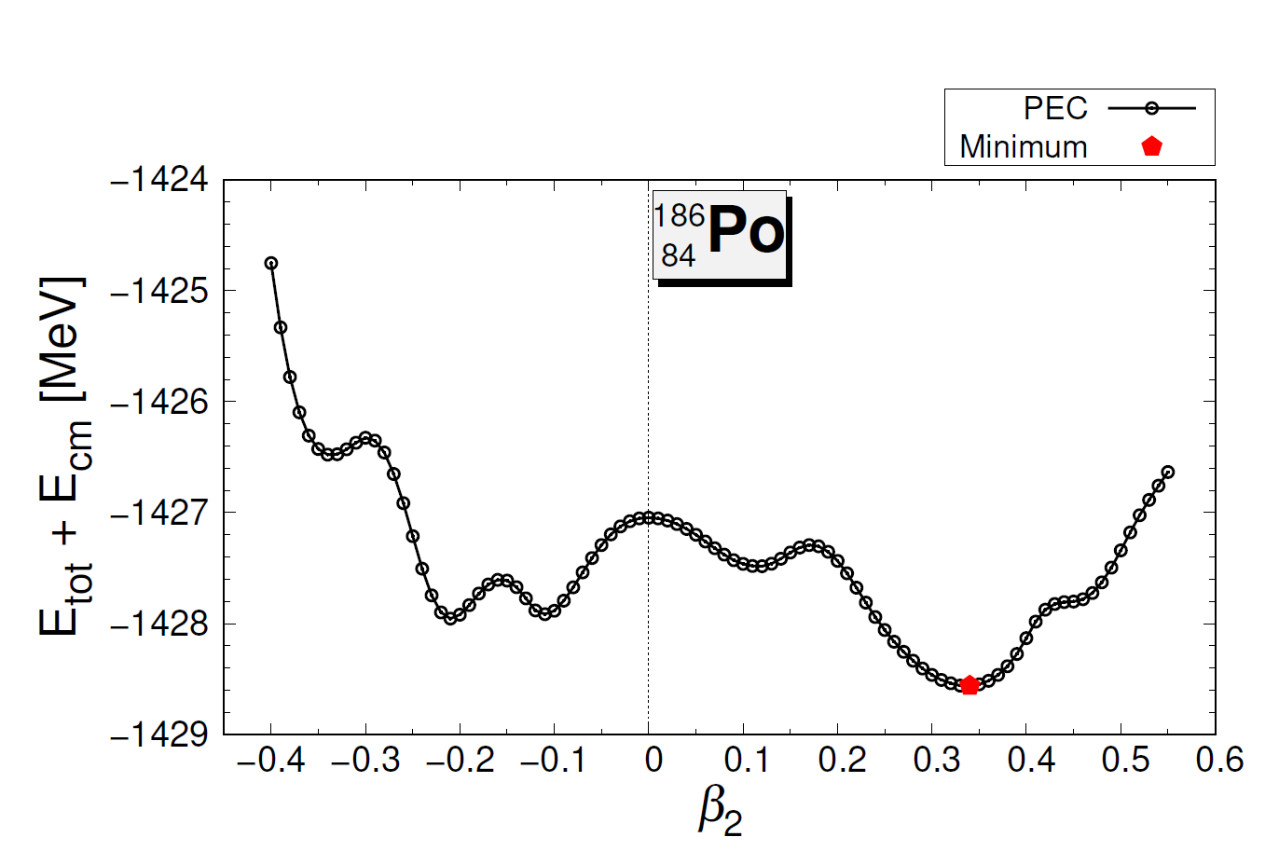
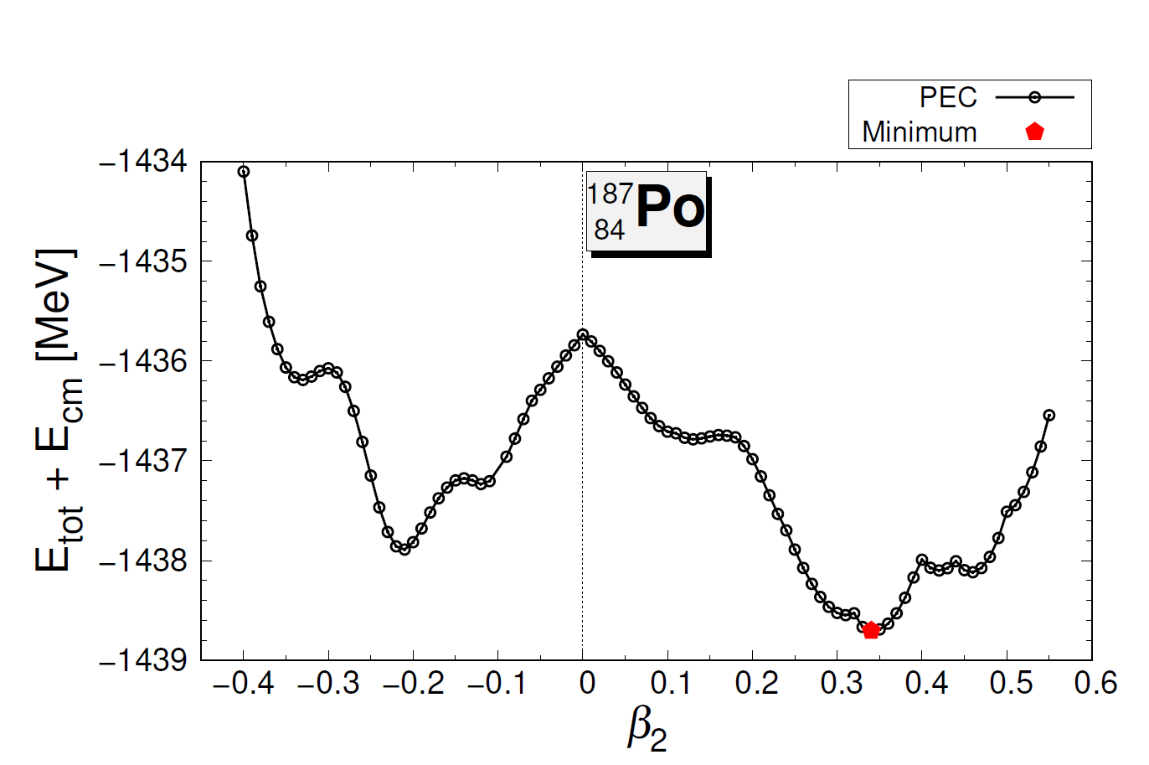
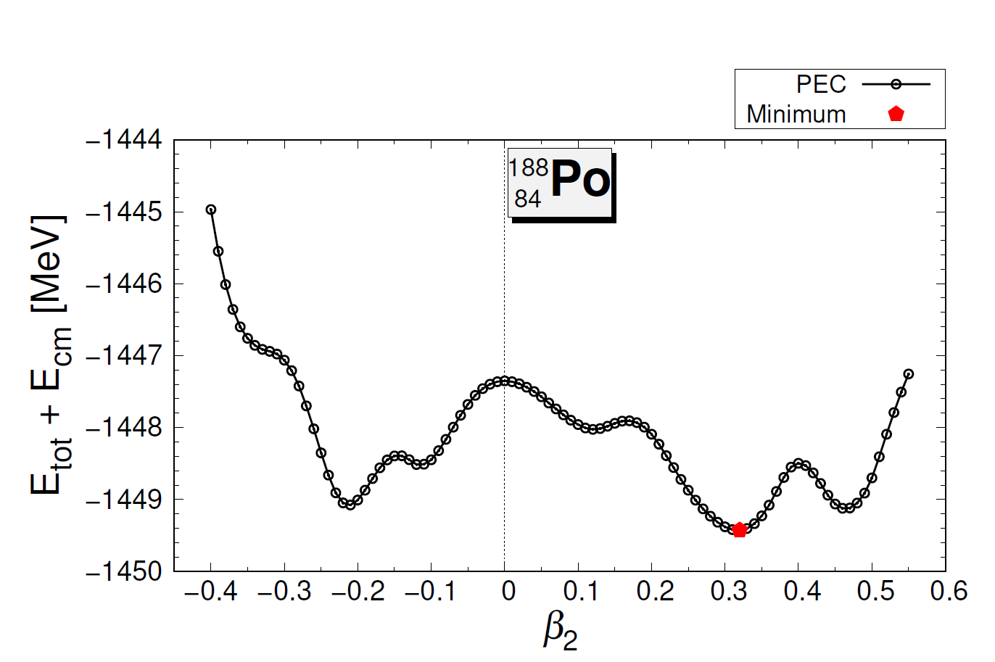
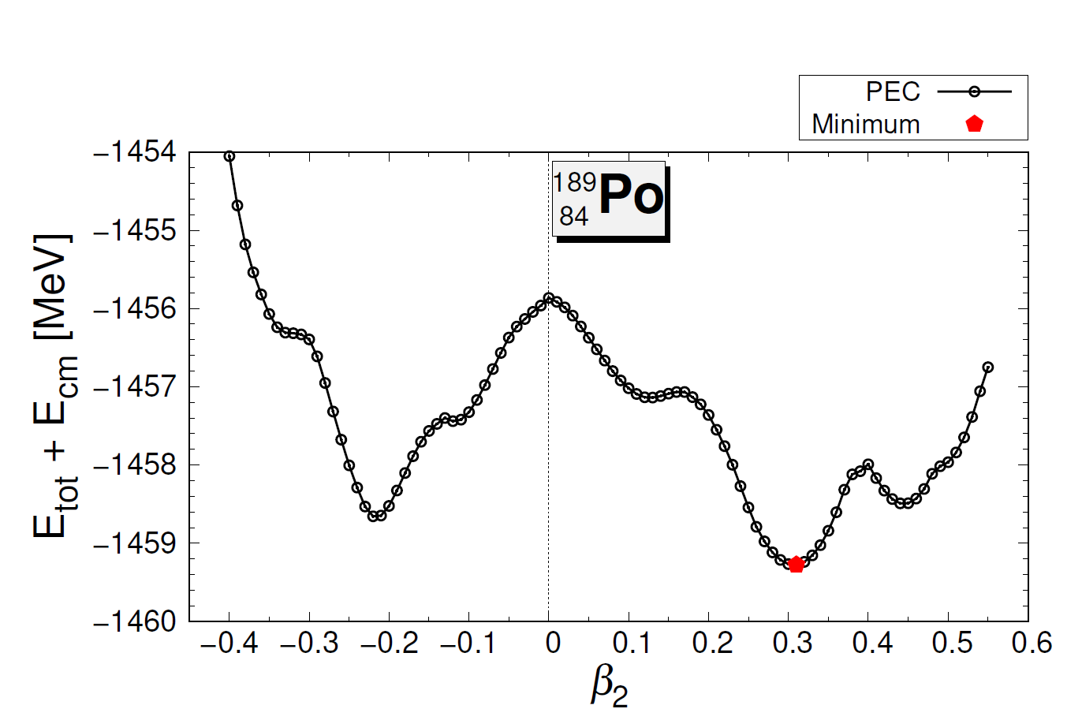
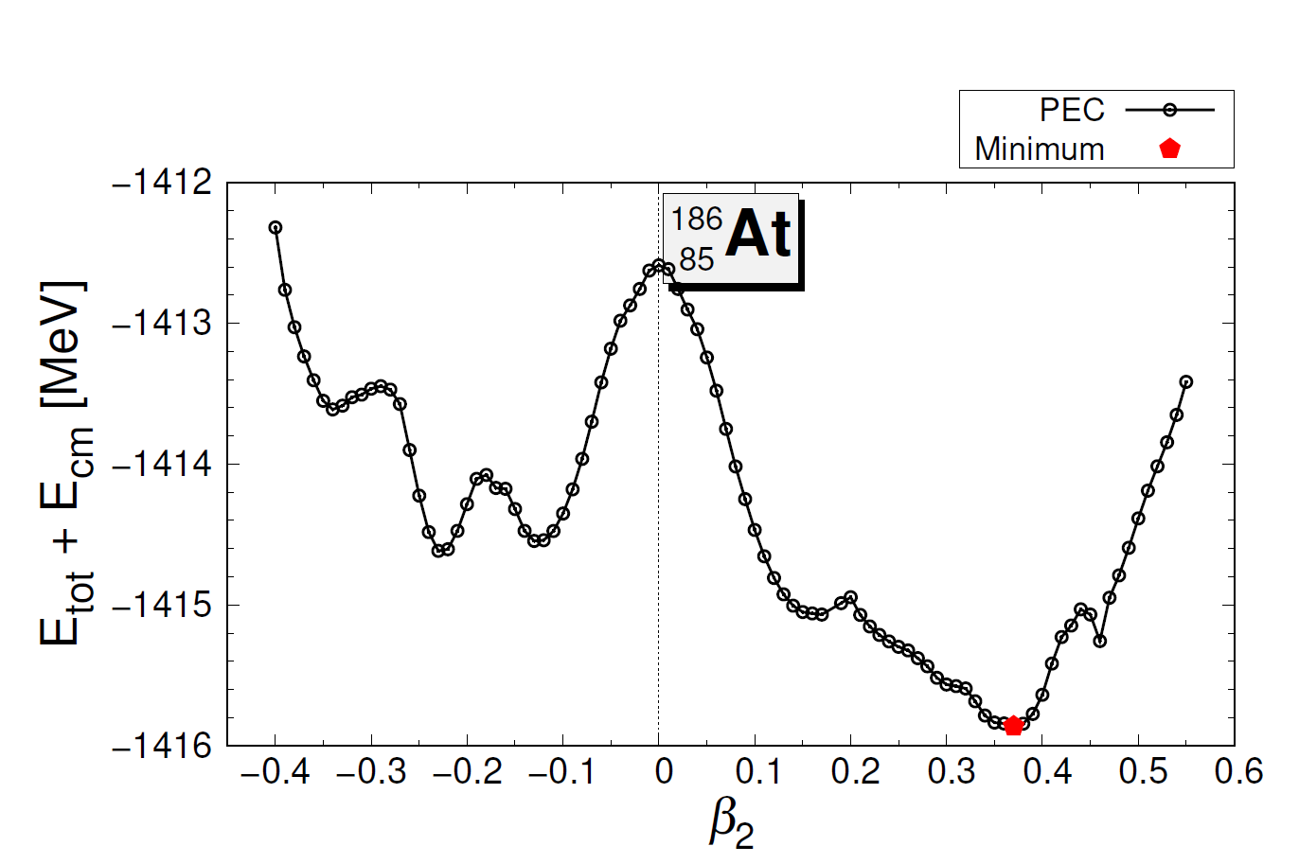









Potential energy curves (PECs)
Multiple minimums on PECs in neutron deficient range




N = 101
N = 102
N = 103
N = 104
N = 105
Notes:
N >105 영역에서는 이러한 현상이 잘 나타나지 않음

Slide 20





Potential energy curves (PECs)
Multiple minimums on PECs in neutron deficient range
In region of N = 101-105 of Tl-At (Z=81-85)
Multiple local minimums appear
Energy difference between local minimums ⪅ 1 MeV
Local minimums on both (prolate and oblate) side
Z = 82 is a magic number
Suspecting reason 1: Microscopic reason
(single particle energy)
Suspecting reason 2: Pairing energy
These are the next objective of investigation
Notes:
나름 흥미롭게 보임. 조사필요

Slide 21
Context
Overview
Calculation Results
Further Discussion
Summary
Notes:
목차4: summary

Slide 22
Summary
Overview of progress
  Odd-Z DRHBc calculations of Z=81-85 region are totally completed
  We perceive that AMD CPU is more suitable than Intel CPU for the DRHBc program
Calculation result of Tl, Bi, and At isotope chains
  Calculation results shows the DRHBc well explains the nuclear binding energy
  Alternate deformed shapes appear in Tl (Z = 81) isotope chain
  The DRHBc calculation has a correlation between nuclear radius and deformation ??
  Its feature is revealed in a region of N = 101-105 of Tl-At (Z = 81-85) isotope chains
Further discussion
  Feature on PEC in a region of N=101-105 of Tl-At (Z = 81-85) isotopes chains
  Multiple local minimums appear on PEC: Shape coexistences
  Next plan: To investigate microscopic properties and its reason
Notes:
정리

Slide 23

Progress report on Z=87 nuclei
The 7th workshop on nuclear mass table with DRHBc theory
July 1 - 4, 2024, Korea
Xiaoying Qu

Slide 24
Outline
Project plan
Numerical details
Results and discussions
Summary

Slide 25

Project Plan

Slide 26
Project Plan
Z=87 (Fr) Gui Zhou Min Zu University (GZMU)
PI: Xiaoying Qu
Student: Kangmin Chen, Tianyu Wang
Z=89 (Ac) Tianjin University (TJU)
PI: Ying Zhang
Student: Xiaojie Cao, Yiran Wang, Wentao Zeng
Notes:
Fr：[ˈfrænsiəm] francium 钫 fang 一声
Ra: 88 [ˈreɪdiəm] radium，镭
Ac: Actinium [ækˈtɪniəm] 锕 a 一声
Th: Thorium [ˈθɔːriəm] 钍

Slide 27
Project Plan
Models Isotopes | FRDM2012 |  | RCHB |  | DRHBc
 | Range | Number | Range | Number | Range | Number
Fr (Z = 87) | 189 ≤ A ≤ 289 | 101 | 198 ≤ A ≤ 345 | 148 | 197 ≤ A ≤ 345 | 112
Ra (Z = 88) | 192 ≤ A ≤ 292 | 101 | 200 ≤ A ≤ 346 | 147 | 198 ≤ A ≤ 348 | 151
Ac (Z = 89) | 195 ≤ A ≤ 295 | 101 | 202 ≤ A ≤ 347 | 146 | 203 ≤ A ≤347
Th (Z = 90) | 198 ≤ A ≤ 299 | 102 | 204 ≤ A ≤ 348 | 145 | 204 ≤ A ≤ 350 | 147
FRDM2012: P. Möller et al. Atomic Data and Nuclear Data Tables 109–110 (2016) 1–204
RCHB: X.W. Xia et al. Atomic Data and Nuclear Data Tables 121–122 (2018) 1–215
DRHBc: P. Guo et al. in preparation
Notes:
Fr：[ˈfrænsiəm] francium 钫 fang 一声
Ra: 88 [ˈreɪdiəm] radium，镭
锕系元素 - 百度翻译

Actinide element
Ac: Actinium [ækˈtɪniəm] 锕 a 一声
Th: Thorium [ˈθɔːriəm] 钍

Slide 28

Numerical details
Box size: $R_{box}=20 fm$
Mesh size: $∆r=0.1 fm$
Energy cutoff: $E_{cut}=300 MeV$
Angular momentum cutoff: $J_{max}=23/2 ℏ$
Legendre expansion order: $λ_{max}=8 (Z=87)$
Relativistic density functional: PC-PK1
Pairing strength: $−325.0 MeV fm^{3}$
Zhang, et al. (DRHBc Mass Table Collaboration), PRC 102, 024314 (2020)

Slide 29

Results of Z= 87
Constrained calculation
The nuclei with A=197~345 are bound, except A=286~322 with odd neutron, and A=324~336, 338, 340~342, 344, i.e. 37 nuclei are not bound.

Slide 30


Results of Z= 87
Total Binding Energy
Root-mean-square (rms) deviations:
  RCHB: 5.283
  DRHBc: 2.023
  DRHBc+rot: 1.254

Slide 31


Results of Z= 87
Drip line

Slide 32


Results of Z= 87
Rms radius and deformation

Slide 33
Summary
For isotopes Z=87
  The unconstrained calculations are finished.
  The constrained calculations are finished.
For Z=87, the g.s. binding energies are improved compared with RCHB results.
The driplines are the same with RCHB results. For Z=87, there are 37 unbound nuclei before the neutron dripline.

Slide 34

The 7th workshop on nuclear mass table with DRHBc theory July 1-4,2024, Gangneung Green City, Korea
Progress report on odd-Z nuclei:
Z=89
Ying Zhang （Tianjin University）

Slide 35
Outline
Project Plan
Numerical details
Overall Progress
Results of Z=87，89
Summary

Slide 36
Project Plan

Slide 37
Project Plan
Z=89 (Ac) Tianjin University (TJU)
PI: Ying Zhang
Student: Xiaojie Cao, Yiran Wang, Wentao Zeng
Notes:
Fr：[ˈfrænsiəm] francium 钫 fang 一声
Ra: 88 [ˈreɪdiəm] radium，镭
Ac: Actinium [ækˈtɪniəm] 锕 a 一声
Th: Thorium [ˈθɔːriəm] 钍

Slide 38

Numerical details
Box size: $R_{box}=20 fm$
Mesh size: $∆r=0.1 fm$
Energy cutoff: $E_{cut}=300 MeV$
Angular momentum cutoff: $J_{max}=23/2 ℏ$
Legendre expansion order: $λ_{max}=8 (Z=87, 89)$
Relativistic density functional: PC-PK1
Pairing strength: $−325.0 MeV fm^{3}$
Zhang, et al. (DRHBc Mass Table Collaboration), PRC 102, 024314 (2020)

Slide 39
Overall Progress
Unconstrained Cal.
Constrained Cal.
Data summary
Z=89
even N
100%
100%
100%
~ 2023.12
odd N
100%
100%
80%
~ 2024.6

Slide 40
Results of Z= 89 even N odd N
Constrained calculation

Slide 41


Results of Z= 89 even N and odd N
Total Binding Energy
Root-mean-square (rms) deviations:
  RCHB 6. 03 MeV
  DRHBc 2.58 MeV
  DRHBc+rot 1.74 MeV
Root-mean-square (rms) deviations:
  RCHB 6. 00 MeV
  DRHBc 2.49 MeV
  DRHBc+rot 1.88 MeV
Notes:
RCHB: X.W. Xia et al. Atomic Data and Nuclear Data Tables 121–122 (2018) 1–215
DRHBc: Etotcom
DRHBC+ rot: Etotcm+Erot
rms: \sqrt{\sum(E_exp-E_cal)^2/N}

Slide 42



Results of Z= 89 even N
Drip line
P: A=203，N=114
N: A=347, N=258
Notes:
S_2n 双中子分离能，Sn(N)= Etotcm(N-2)-Etot(N)

Slide 43



Results of Z= 89 odd N
Drip line
P: A= 204，N= 115
N: A= 344, N= 255
Notes:
S_2n 双中子分离能，Sn(N)= Etotcm(N-2)-Etot(N)

Slide 44



Results of Z= 89 even N
Charge radius and deformation

Slide 45
Results of Z= 89 odd N
Constrained calculation

Slide 46
Results of Z= 89 odd N
Total Binding Energy
Root-mean-square (rms) deviations:
  RCHB 6. 00 MeV
  DRHBc 2.49 MeV
  DRHBc+rot 1.88 MeV
Notes:
RCHB: X.W. Xia et al. Atomic Data and Nuclear Data Tables 121–122 (2018) 1–215
DRHBc: Etotcom
DRHBC+ rot: Etotcm+Erot
rms: \sqrt{\sum(E_exp-E_cal)^2/N}

Slide 47



Results of Z= 89 odd N
Charge radius and deformation

Slide 48
Summary and next step
For isotopes Z=89，N is even
  The unconstrained calculations are finished.
  The constrained calculations are finished.
For isotopes Z=89，N is odd
  The unconstrained calculations are finished.
  The constrained calculations are finished.
  The data summary is on going.
For Z=89 the g.s. binding energies are improved compared with RCHB results.
The driplines are almost the same with RCHB results.

Slide 49
Thanks for
your attention!

Slide 50






Potential energy curves (PECs)
Potential energy curves (PECs) for neutron deficient range
Z = 81
Z = 83
Z = 85
Z = 82
Z = 84
Z = 86

