Slide 1
Correlation between alpha-decay half-lives and the symmetry energy
In collaboration with Yong-Beom Choi, Hana Gil, Chang-Hwan Lee
Chang Ho Hyun

Slide 2
Contents
KIDS formalism
Model: KIDS-A, B, C, D
Formulas for the alpha-decay half-lives
Results
Correlation between alpha-decay half-lives and the symmetry energy
Summary

Slide 3
KIDS (Korea-IBS-Daegu-SKKU) formalism
Expansion rule
Energy density of many-nucleon system expanded in the power of the Fermi momentum
Fitting rule
For the self-bound strongly interacting system, first principle calculation is not available: Coefficients in the energy density must be constrained from experiment
Find the optimal number of terms to describe infinite nuclear matter
Step1: Determine the coefficients to reproduce the nuclear matter EoS
Step2: Fit the additional coefficients to reproduce nuclear properties
Step3: Terms can be added to satisfy specific properties or conditions without changing properties determined in prior steps

Slide 4
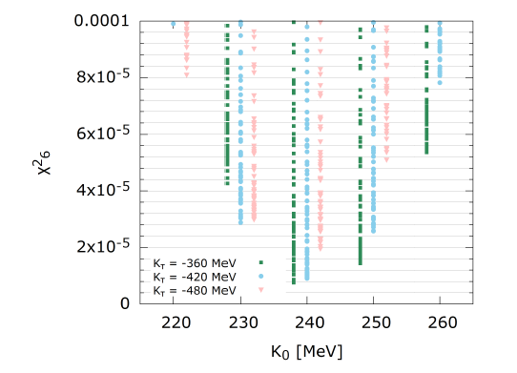
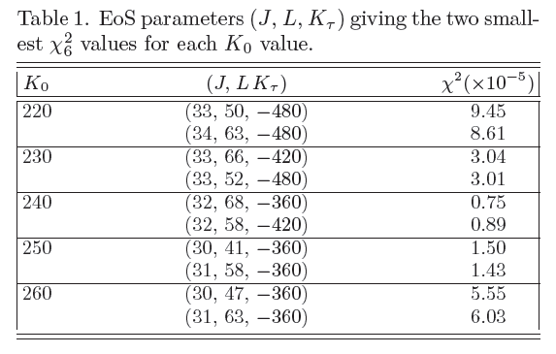
Model: KIDS-A, B, C, D
Nuclear matter: determine 7 model constants
Vary K₀ (220-260:10), J (30-34:1), L (40-70:1), Kτ (-360,-420,-480)
2250 models
Nuclear properties: determine 2 model constants
Binding energy and charge radius of ⁴⁰Ca, ⁴⁸Ca and ²⁰⁸Pb

Slide 5
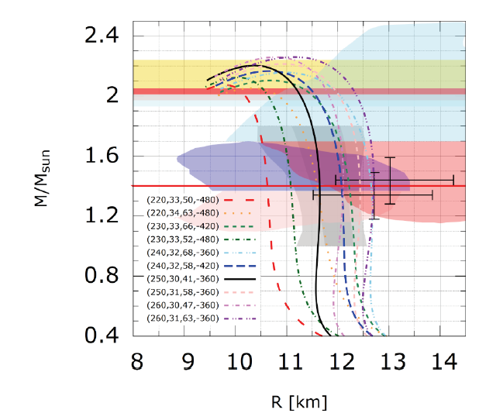
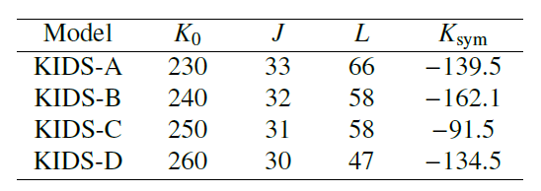
Neutron star
Final selection
11.8 ≤ R_{1.4} ≤ 12.5 km

Slide 6
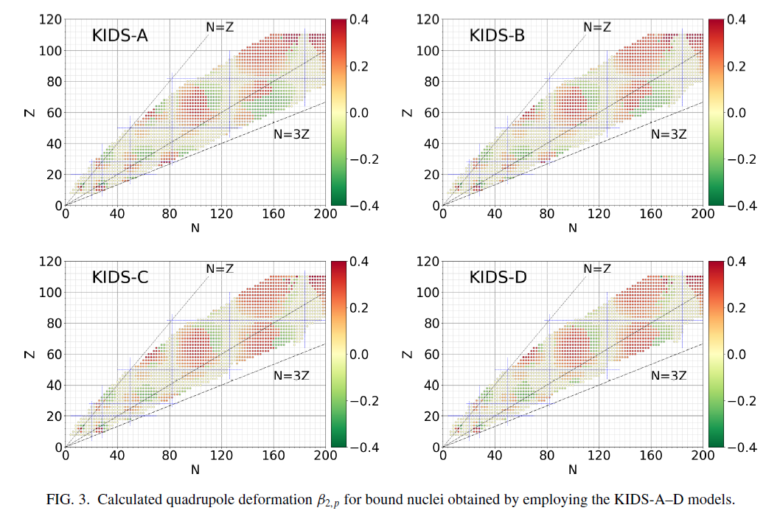
Example of application

Slide 7
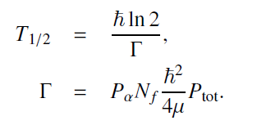
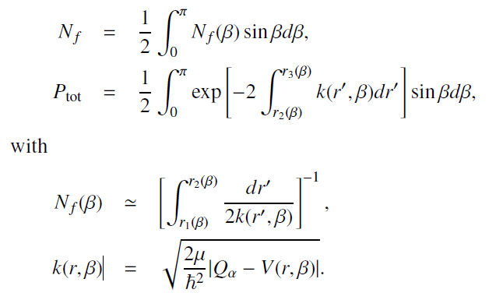
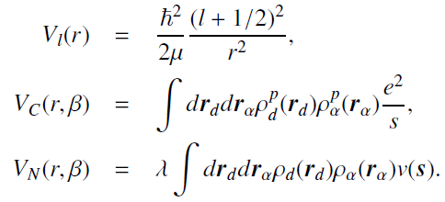
Formulas for alpha-decay half-lives
Basic ingredients
WKB approximation
Cluster-formation model
Folding potential
P_{α} and Q_{α} from AME2020

Slide 8
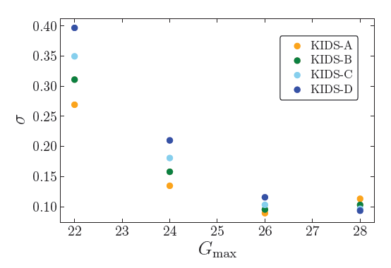
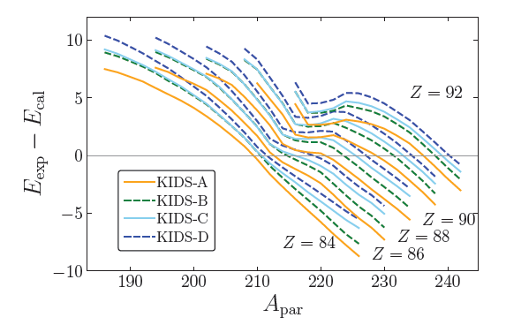
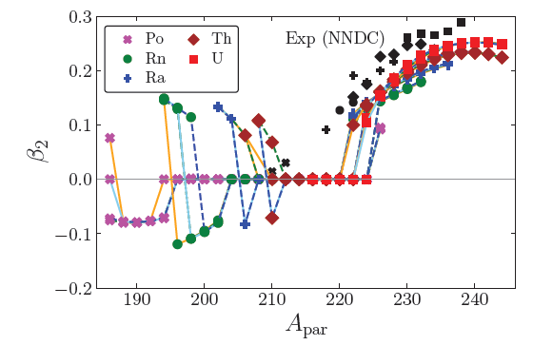
Results
Nuclei
Z_{par} | 84 (Po) | 86 (Rn) | 88 (Ra) | 90 (Th) | 92 (U)
A_{par} | 186-224 | 194-230 | 202-234 | 208-238 | 216-242
Adjusting G value
Accuracy of the model

Slide 9
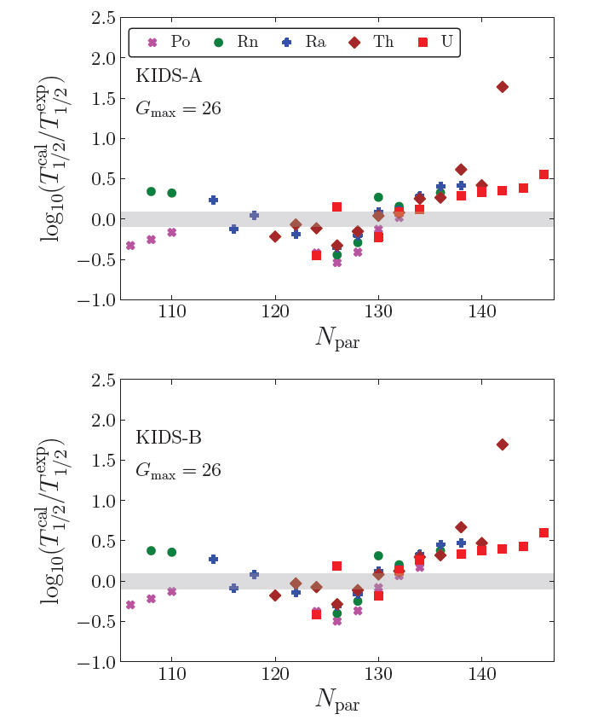
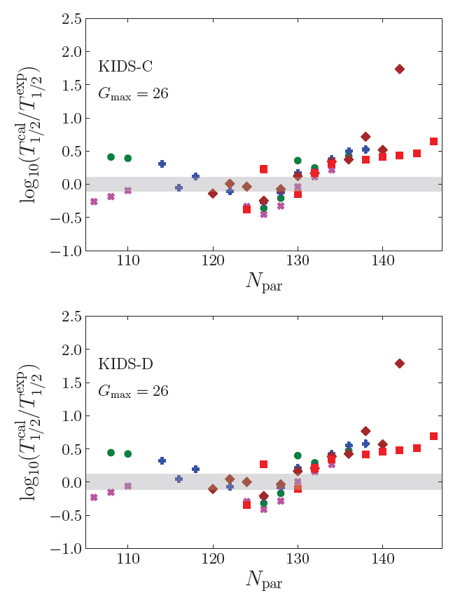
Results
Half-life as a function of N_{par}
Results are mostly in [-0.5:0.5]
Minima at N=126
Tend to increase with large N
Shortest in KIDS-A, longest in KIDS-D

Slide 10
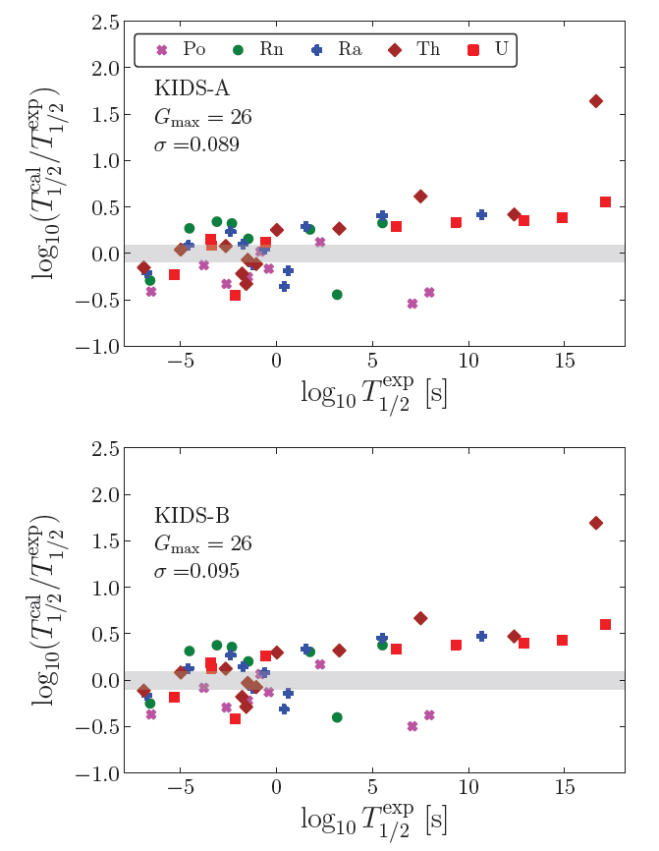
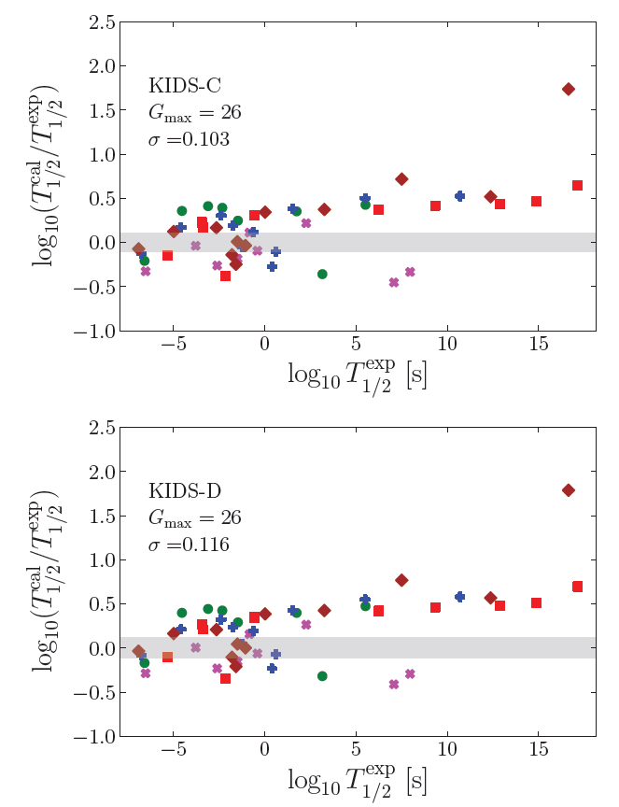
Results
Half-life as a function of T^{exp}_{1/2}
1 day = 86,400 seconds (~10⁵)
T < 1 day: random distribution
T > 1 day: overshoots the experiment
Small uncertainty in Γ gives large difference

Slide 11
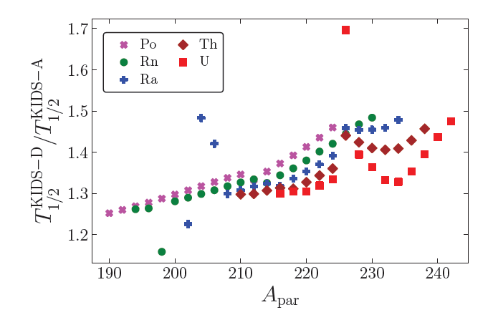
Correlation between alpha-decay half-lives and the symmetry energy
T^{D}_{1/2}/T^{A}_{1/2} as a function of A_{par}
The ratios are in the range 1.25-1.5
For A_{par} ≤ 224, ratio increases monotonically
Above 224, there are minima at A_{par}=230, 232, 234 for Ra, Th, U, for which N_{par} is identically 142: Is there any special meaning?
Is the ratio 1.25-1.5 big enough?
Neutron skin thickness of 208Pb: ΔR_{np}(KIDS-D)/ΔR_{np}(KIDS-A) = 1.40
Correlation is clear and prominent

Slide 12
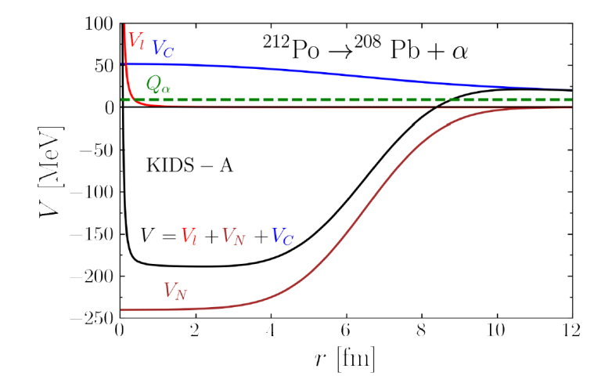
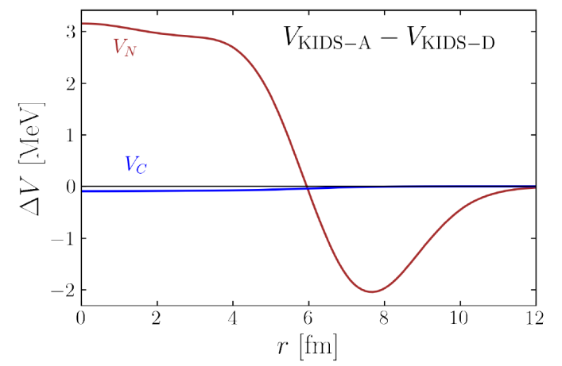
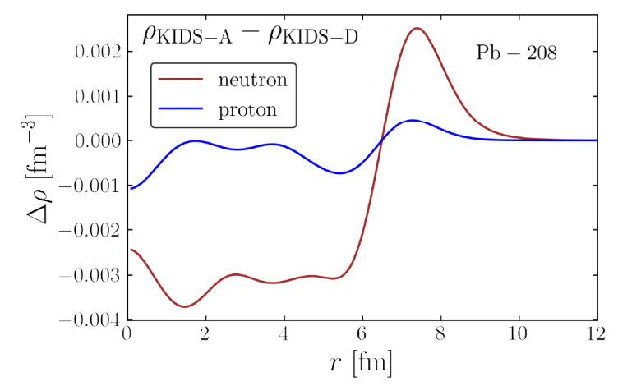
Diagnose the origin of the correlation
Tunneling barrier is determined by V_{C} and V_{N}
Barrier builds up at r~8.5 fm
Density in the surface region is critical
V_{C} is identical in the two models
In r≤6 fm, potential of KIDS-A is shallower
In 6-10 fm, KIDS-A is smaller: more cancellation with V_{C}
Stronger cancellation makes barrier lower: shorter half-life
Less density in the core with KIDS-A
Depletion in the core compensated in 6-10 fm
Symmetry energy → Different density → Different potential → Different half-life

Slide 13
Summary
KIDS formalism provides a unified description of finite nuclei and infinite nuclear matter.
Models are constrained by nuclear properties and neutron star data.
Alpha-decay half-lives are reproduced with the factor 1/3 – 3
Soft symmetry energy gives longer half-lives.
Dependence on the symmetry energy is as clear as the neutron skin thickness of ²⁰⁸Pb.
Interesting behavior happens at N=142.

