Slide 1


The 7th International Workshop on DRHBc Mass Table · Gangneung
Study of β-decay half-lives by relativistic quasiparticle random-phase approximation with localized exchange terms
LIANG GUO
Supervisor: YIFEI NIU
School of Nuclear Science and Technology, Lanzhou University, China
Notes:
Good afternoon, everyone, I am Liang Guo, coming from Lanzhou University in China. My topic today is about the study of beta-decay half-lives by relativistic quasiparticle random-phase approximation with localized exchange terms.

Slide 2
Introduction
Theoretical framework
Results and Discussions
Summary and Perspective
Notes:
My report has four parts

Slide 3
Introduction
Theoretical framework
Results and Discussions
Summary and Perspective
Notes:
The first part is introduction

Slide 4
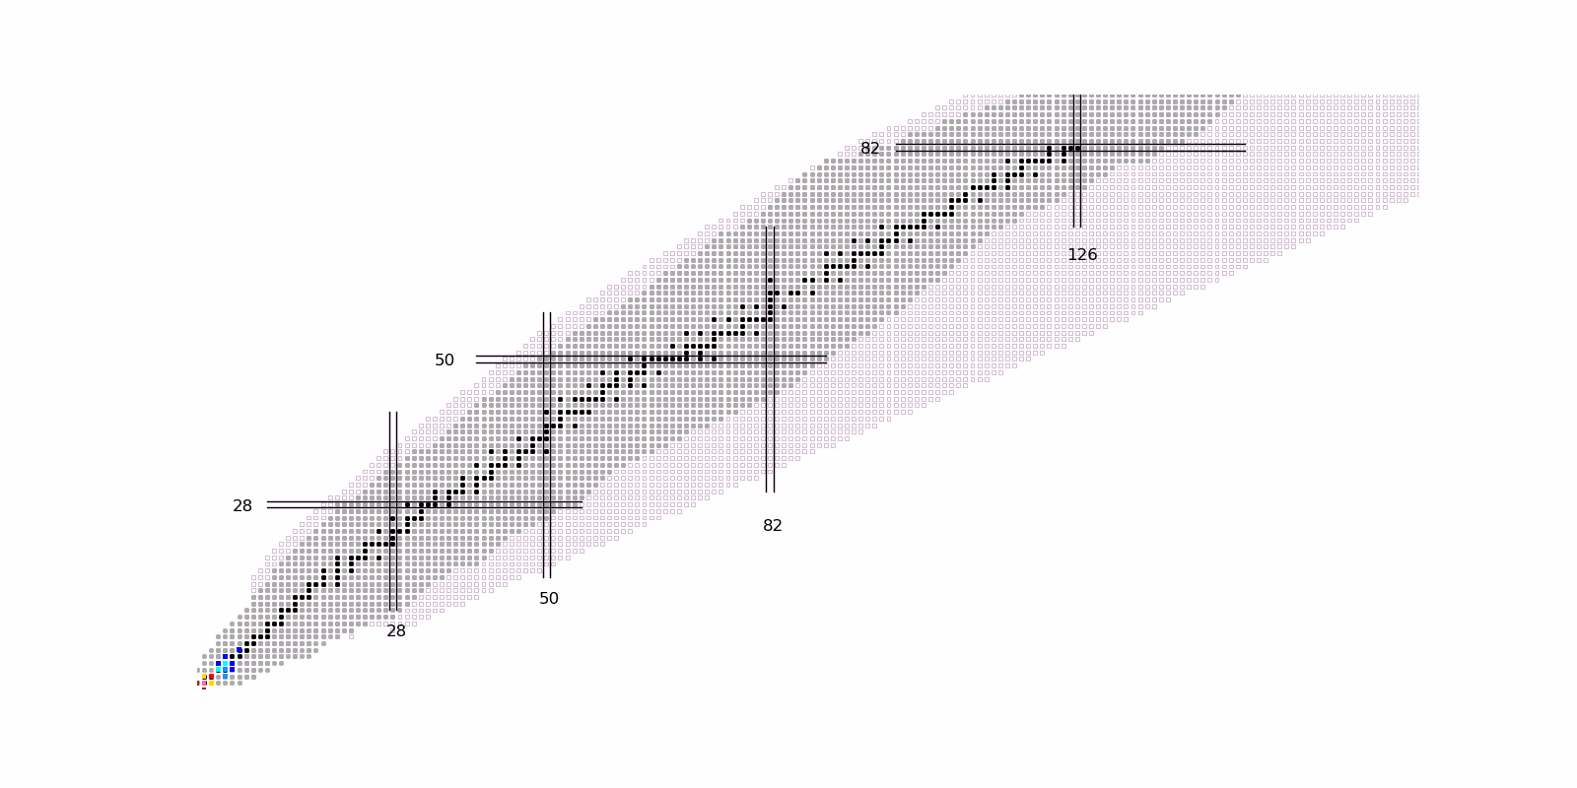
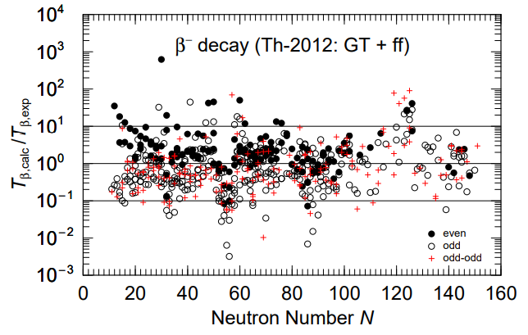
β-decay half-lives
How were the heavy elements from iron to uranium made ？
Rapid neutron-capture process (r-process)
β-decay
r-process
Key nuclear physics input: β-decay half-lives
Neutron capture
  set the time scale of r-process
1 order of
magnitude
Motivation
  Involving over 6000 nuclei: only 1000+ measured experimentally
  Large deviation between theory and experiment: up to 1 order of magnitude
P. Möller et al., At. Data Nucl. Data Tables , 125, 1 (2019)
β-decay half-lives: reliable nuclear theoretical model
Notes:
“How were the heavy elements from iron to uranium made in the universe”is seen as one of greatest mysteries of astrophysics in 21st century. At present, it is generally believed that the rapid neutron-capture process, known as r-process, can produce about half of the elements heaver than iron in the universe.
In r-process, neutron-capture rate is much larger than beta-decay rate. Thus, beta-decay half-lives are the key nuclear physics input, and it sets the time scale of r-process. In beta-decay, a neutron becomes a proton and also emits an electron and antielectron neutrino. The right figure shows the r-process. This process occurs in neutron-rich area. Starting from the seed nuclei, the neutron-rich nuclei far from the stability can be generated by continuously rapid neutron-capture. Finaly, through beta-decay, these neutron-rich nuclei become elements heaver than iron.
r-process simulation involves beta-decay half-lives of more than 6000 nuclei. However, only 1000 of them have been measured experimentally. Theoretical research is needed. Moreover, for beta-decay half-lives, there is a large deviation between the theoretical and experimental values. As shown in this figure, this deviation can be up to 1 order of magnitude.
Therefore, for study of beta-decay half-lives, the key point is to develop a reliable nuclear theoretical model.

Slide 5
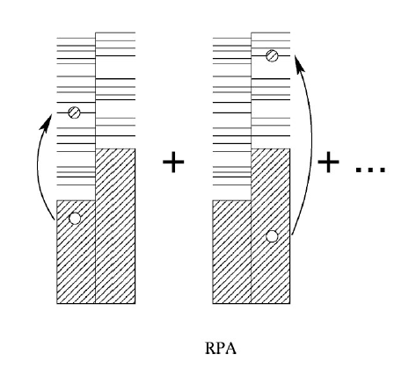
Theoretical methods
Shell Model：including N-particle N-hole correlations; but difficult to extend to heavy nuclei far away from magical number
E. Caurier et al., Rev. Mod. Phys. 77, 427 (2005);
B. R. Barrett et al., Prog. Part. Nucl. Phys. 69, 131 (2013)
Quasiparticle Random Phase Approximation(QRPA)：providing a unified description of all nuclei except for a few light nuclei
Non-self-consistent QRPA: applied to calculate the β-decay half-lives
P. Möller et al., At. Data Nucl. Data Tables 66, 131 (1997); 125, 1 (2019); Phys. Rev. C 67, 055802 (2003)
Self-consistent QRPA：single-particle basis and residual interaction are given by the same Hamiltonian
RPA
sensitive
Langanke et al., RMP 75, 819 (2003)
introducing isoscalar(T=0) pairing force
β-decay half-lives
Non-relativistic：proton-neutron QRPA (PNQRPA) based on Hartree-Fock-Bogoliubov(HFB) theory
Relativistic: PNQRPA based on Relativistic-Hartree-Bogoliubov(RHB) and Relativistic HFB (RHFB) theory
J. Engel et al., Phys. Rev. C 60, 014302(1999)
F. Minato et al., Phys. Rev. C 106, 024306(2022)
T. Niksic et al., Phys. Rev. C 71, 014308(2005)
T. Marketin et al., Phys. Rev. C 75, 024304(2007)
Z. M. Niu et al., Phys. Lett. B 723, 172 (2013)
Notes:
At present, in study of beta-decay, the main theoretical models include shell model and QRPA model. For shell model, it includes N-particle N-hole many-body correlations and can agree well with experiment, but it is difficult to extend to heavy nuclei far away from magical number due to the large of configuration space.
For Quasi-particle random-phase approximation model, the most important 1-particle 1-hole correlation are included, and it can provide a unified description of all nuclei except for a few light nuclei. In QRPA model, it can be divided into non-self-consistent QRPA and self-consistent QRPA. For non-self-consistent QRPA, it has been applied to the study of beta-decay half-lives. For self-consistent QRPA, the single-particle basis and residual interaction are given by same Hamiltonian. This is important for the description of long isotopic chains extending towards the drip lines. Moreover, it it necessary to introduce isoscalar pairing force in self-consistent QRPA because beta-decay half-life is very sensitive to isoscalar pairing.
According to the form of Hamiltonian, there are non-relativistic QRPA and relativistic QRPA. For the case of non-relativistic, proton-neutron QRPA based on Hartree-Fock-Bogoliubov theory has been developed, such as Skyrme-QRPA. It is found that the isoscalar pairing is important for the description of beta-decay half-life of nuclei involving r-process. On the relativistic side, PNQRPA based on RHB and RHFB model has also been developed to study beta-decay.

Slide 6
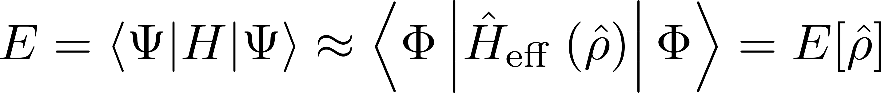
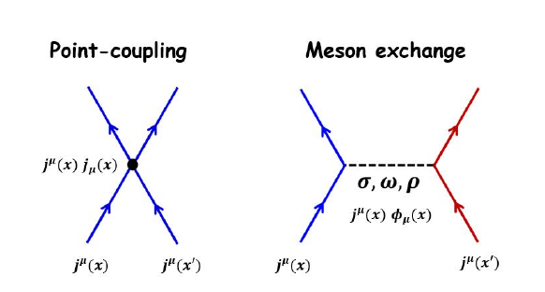
QRPA based on CDFT
  Covariant density function theory (CDFT)
Covariance: natural explanation of spin-orbit splitting and pseudospin symmetry
Jing Geng et al., Phys. Rev. C 100, 051301(R)(2019)
Providing a good description of the ground and excited state of nuclei
P. Ring, Prog. Part. Nucl. Phys. 37, 193(1996);
J. Meng et al., Prog. Part. Nucl. Phys. 57, 470 (2006)
  PNQRPA based on CDFT
PNQRPA based on RHB: without exchange term
Contribution from pion is important: additional parameters
Low Landau mass in most RHB models:
longer β-decay half-lives
N. Paar et al., Phys. Rev. C 69, 054303(2004); T. Niksic et al., Phys. Rev. C 71, 014308(2005)
PNQRPA based on RHFB: self-consistent introduction of pion through exchange terms, without additional parameters
Time cost of calculation is high: exchange terms
Z. M. Niu et al., Phys. Lett. B 723, 172 (2013); Phys. Rev. C 95, 044301 (2017)
Notes:
Covariant density function theory has been achieved great success in nuclear physics. Its covariance can give a natural explanation of spin-orbit splitting and pseudospin symmetry. CDFT provides a good description of the ground and excited state of nuclei. In general, there are two kinds of CDFT according to the form of interaction, that is, point coupling and meson exchange.
For self-consistent QRPA, it can be based on different CDFT, such as RHB or RHFB model. For QRPA based on RHB, there is no contribution from exchange terms, so the time cost of calculation is low. However, the contributions from pion are important for the description of spin-isospin excitation and it is not included in RHB model. So we need to introduce additional parameter in QRPA for including pion. Moreover, for most RHB models, they give a low Landau mass due to the limitation of spin-orbit splitting. Their Landau mass ranges from 0.64 to 0.67 bare nucleon mass. In corresponding QRPA calculation, it will give a longer beta-decay half-lives compared with experiment.
For QRPA based on RHFB model, contribution from pion is included self-consistently through exchange terms. So there are no additional parameters in residual interaction. However, time cost of calculation is high for this model due to the inclusion of exchange terms.

Slide 7
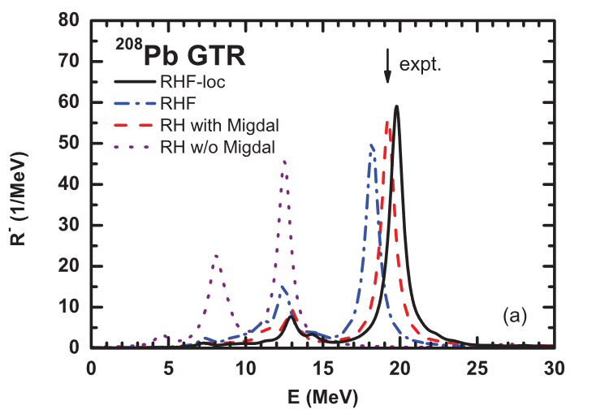

Fierz transformation and tensor coupling
Including exchange terms
Increasing Landau mass in RHB
Fierz transformation: exchange terms can be expressed as direct terms for point-coupling interaction
Momentum dependent self-energy term
Tensor coupling
T. Marketin et al., Phys. Rev. C 75, 024304(2007)
T. Niksic et al., Phys. Rev. C 71, 014308(2005)
A. Sulaksono et al., Ann. Phys. (NY) 306, 36 (2003).
Fierz transformation
Haozhao Liang et al., Phys. Rev. C 86, 021302(R) (2012)
RHB model：PCF-PK1 interaction
RPA
Without additional parameters, RPA with the localized exchange terms provides a fully self-consistent description of the GTR energy of ²⁰⁸Pb.
Large Landau mass induced by tensor coupling：
High computational efficiency
Qiang Zhao et al., Phys. Rev. C 106, 034315(2022)
In this work
Based on CDFT including exchange terms via Fierz transformation and tensor coupling, we will develop a fully self-consistent PNQRPA theory to improve the description of β-decay half-lives.
Notes:
It is found that the exchange terms can be expressed as direct terms through Fierz transformation for point-coupling interaction. Therefore, the localized exchange terms can be included in the RHB framework and the complicated calculation is avoided. However, as discussed before, the Landau mass in most RHB models is low. In order to increase Landau mass in RHB model, we can introduce momentum dependent self-energy or tensor coupling. These two methods give a large Landau mass while ensuring that the spin-orbit splitting is consistent with experiment.
At present, RHB and RPA models including localized exchange terms through Fierz transformation have been developed. For RHB model, PCF-PK1 interaction gives a large Landau mass due to the inclusion of tensor coupling. The Landau mass is 0.85 bare nucleon mass. This model has the high computational efficiency because the contribution from exchange term is expressed by direct term. For RPA model, the right figure shows the Gamow-Teller strength function of 208Pb. As shown in back line, without additional parameters, RPA with localized exchange term provides a fully self-consistent description of GT energy.
Therefore, the aim of this work is to based on CDFT including exchange term via Fierz transformation and tensor coupling, developing a fully self-consistent relativistic PNQRPA theory to improve the description of beta-decay half-lives.

Slide 8
Introduction
Theoretical framework
Results and Discussions
Summary and Perspective
Notes:
The second part is theoretical framework.

Slide 9
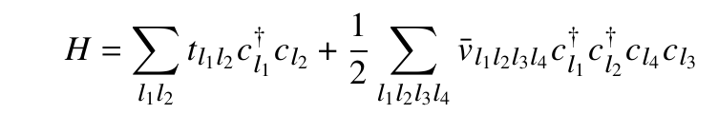
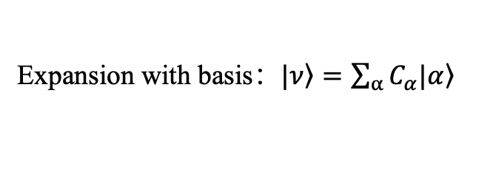
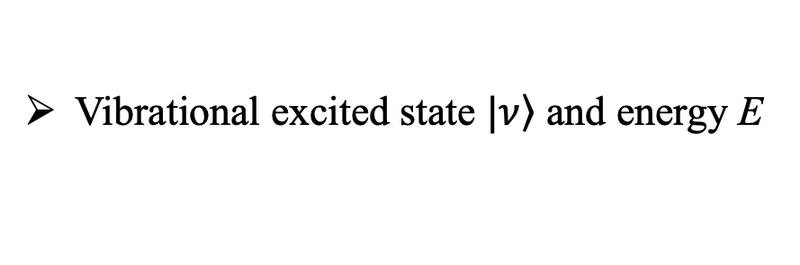
QRPA based on RHB
Eigenvalue equation
Hamiltonian：
Point-coupling relativistic interaction
Vibrational excited state $|\left.ν\right\rangle$ and energy E
Expansion with basis：$|\left.ν\right\rangle =\sum_{α}{C_{α}|\left.α\right\rangle }$
Configuration space: all 2-quasiparticle (2-qp) excitation
Y. Tian et al., Phys. Lett. B 676, 44(2009)
Pairing force：separable form
2-qp excitation state basis
Spherical RHB equation: localized exchange term and tensor coupling
Qiang Zhao et al., Phys. Rev. C 106, 034315(2022)
Spherical QRPA equation
Isoscalar pairing force:
separable form
Notes:
Firstly, I would give a brief introduction about QRPA theory. The start point is the eigenvalue equation of nuclear system. Here the Hamiltonian is composed of kinetic term and two-body interaction term. For interaction part, we employ point-coupling relativistic interaction. nu is vibrational excited state and corresponding energy is E. In order to solve this equation, we can expand it with a complete basis. Starting from RHB ground state, this basis should include 2-qp excitation, 4-qp excitation, and so on.
However, the configuration space composed of all possible quasi-particle excitation on RHB ground state is too large and it is impossible to solve the equation in this basis. As an approximation, we only consider the most important part. It is all possible 2-quasi-particle excitation. In PNQRPA, all possible 2-quasi-particle excitation should be 1 proton 1 neutron state. Here the single particles states are obtained by solving spherical RHB equation with localized exchange term via Fierz transformation and tensor coupling. The Hamiltonian in RHB and energy eigen equation are same, and this ensures self-consistency. In RHB equation, we employ the separable pairing force.
If we expand the excited state nu with the 2-quasi-particle excitation state, energy eigen equation can be written as the matrix form. Matrix elements A and B represent the interaction between different 2-quasi-particle excitation states. Where the isoscalar pairing force is also separable form.

Slide 10
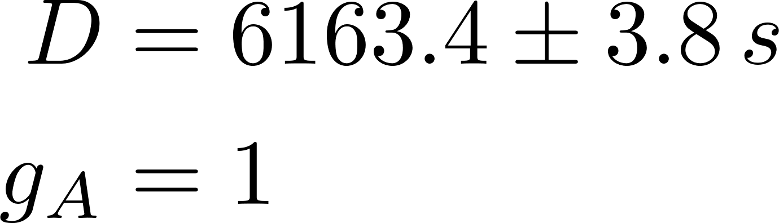
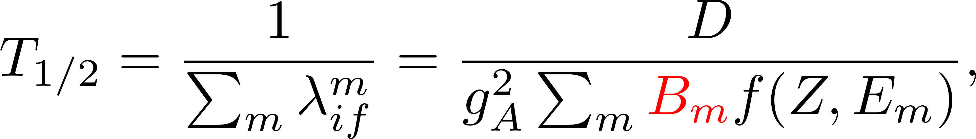
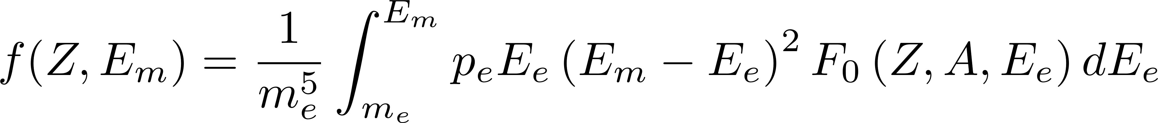
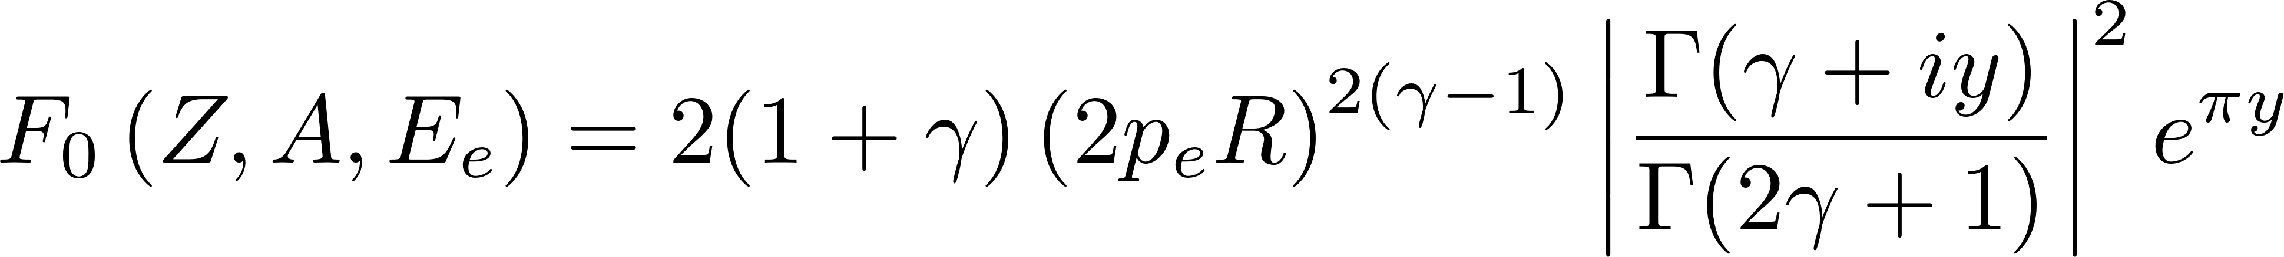

β-decay half-lives
Transition strength in QRPA
β-decay half-lives
Calculated by QRPA
Allowed Gamow-Teller（GT）approximation:
Integrated phase volume
Energy difference $E_{m}$：
QRPA amplitude：
Fermi function：
K. Langanke et al., At. Data Nucl. Data Tables 79, 1 (2001)
Notes:
With QRPA amplitude X and Y, we can get the transition strength induced by operator TJ in beta- direction. In allowed Gamow-Teller approximation, the operator has the simple form. The corresponding spin-parity is 1+, and the change in spin and orbital angular momentum are 1 and 0.
With the transition strength in beta- direction, the beta-decay half-life can be calculated by this formula. Here function f is the integrated phase volume. It represents the density of final state of emitted electron. Em is the energy difference between the initial and final state. F0 is the Fermi function. It is the correction for emitted electron and coming from Coulomb field.

Slide 11
Introduction
Theoretical framework
Results and Discussions
Summary and Perspective
Notes:
The following part is results and discussions.

Slide 12
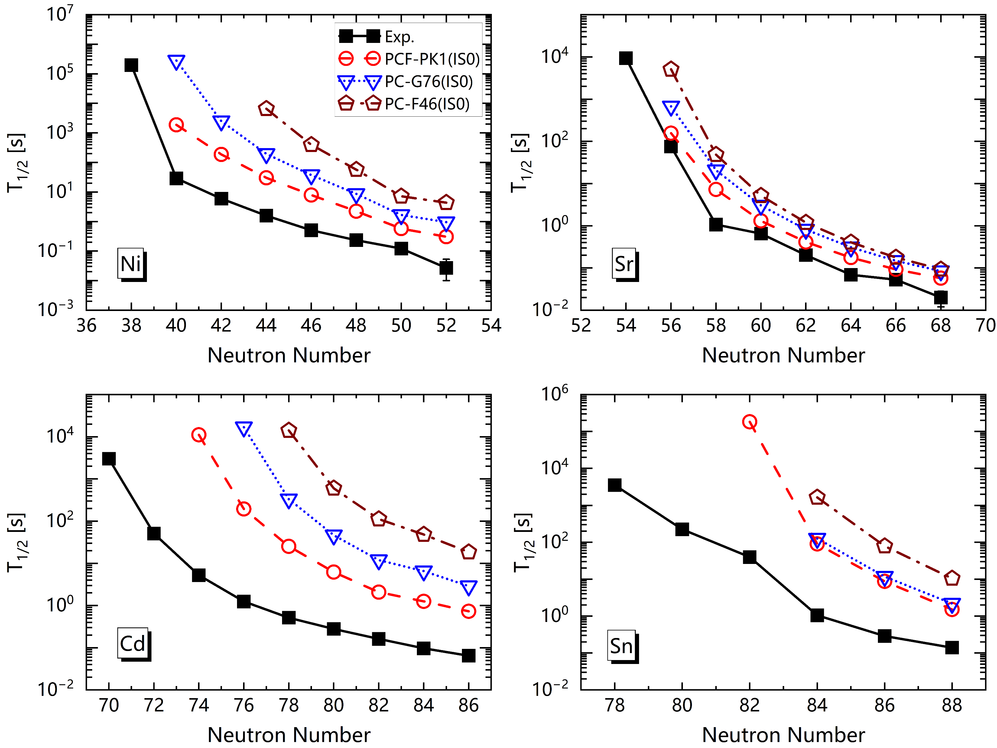
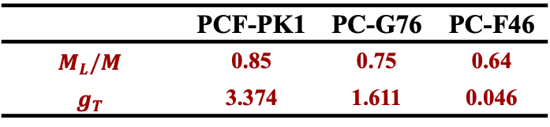
Landau mass
Ni，Sr，Cd and Sn isotopes
 | PCF-PK1 | PC-G76 | PC-F46
$$M_{L}/M$$ | 0.85 | 0.75 | 0.64
$$g_{T}$$ | 3.374 | 1.611 | 0.046
For PCF-PK1 with higher Landau mass (0.85M), its results are closer to the experimental values
Large Landau mass
Higher energy density at the Fermi surface of neutrons and protons
Higher β-decay transition energy and shorter half-lives
Notes:
Firstly, we investigate the influence of Landau mass on beta-decay half-lives. To reduce the interference of other physical quantities, we select three interactions with same coupling form but different strength of tensor coupling. Here strength of tensor coupling is strongest for PCF-PK1 interaction, and weakest for PC-F46 interaction. As a result, Landau mass is large for PCF-PK1 and small for PC-F46.
With these three interactions, we calculate the beta-decay half-lives of Ni, Sr, Cd and Sn isotopes. Here the strength of isoscalar pairing is zero and the black line is experimental value. As shown in figure, we can find that for PCF-PK1 interaction with higher Landau mass, its results are closer to the experimental value. Because for the interaction with large Landau mass, nuclear system will have higher energy density at the Fermi surface. Therefore, the beta-decay transition energy will become large, and this leads to a shorter half-lives.

Slide 13
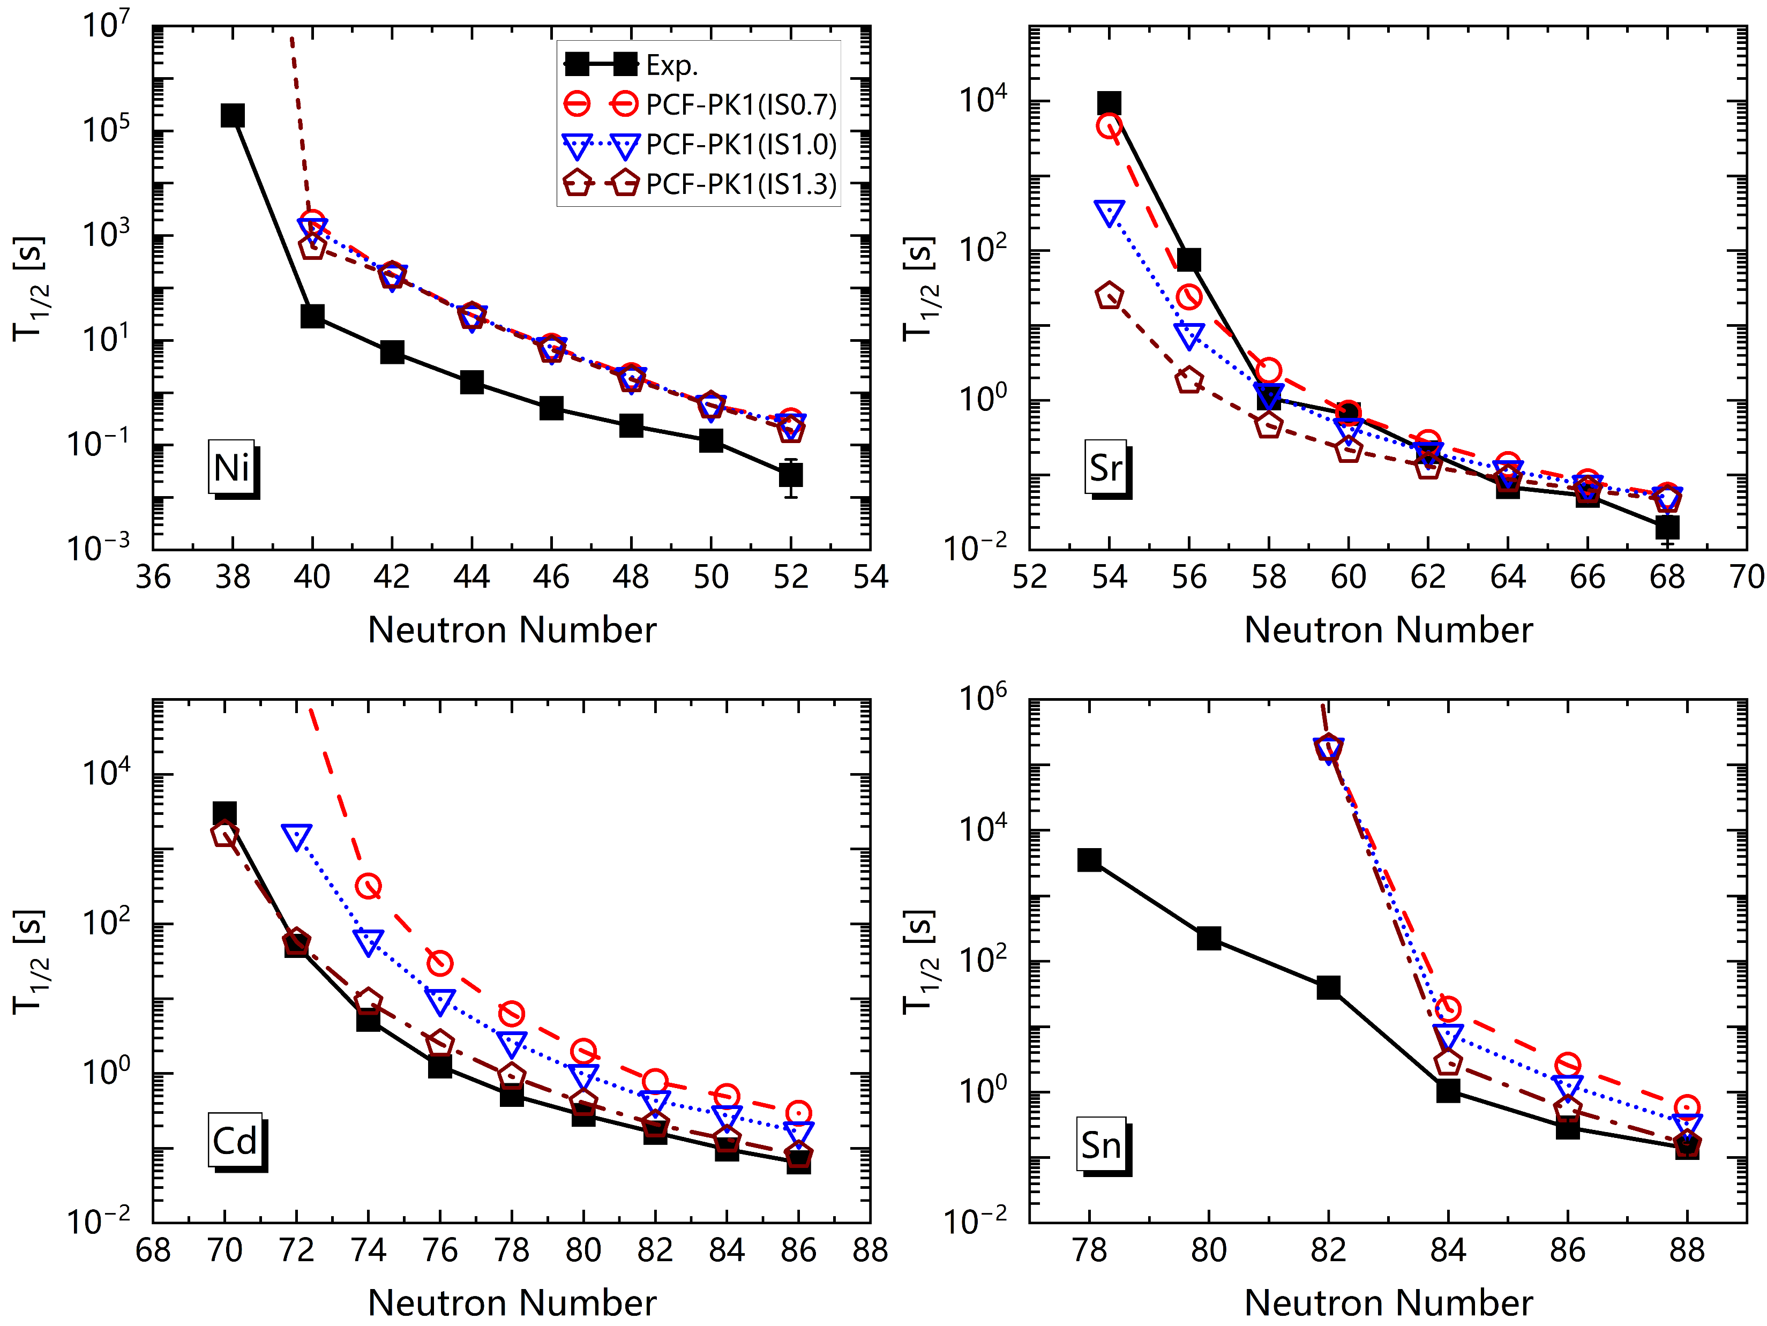
Isoscalar pairing force
β-decay half-lives at different isoscalar pairing
Isoscalar pairing interaction in QRPA
Z=28
Z=38
hole-hole
particle-particle pn pair
large
hole-hole pn pair
particle-hole pn pair
small
p: hole
n: particle
For Sr and Cd isotopes, PCF-PK1 can agree well with the experimental values by uniformly adjusting the strength of isoscalar pairing
hole-hole
p: hole
n: particle
For Ni and Sn isotopes, the sensitivity of isoscalar pairing is weak because they mainly have pn pair with particle-hole nature.
Z=48
Z=50
Notes:
For isoscalar pairing, it will affect the beta-decay half-lives significantly. With PCF-PK1 interaction, the half-lives of these four isotopes are calculated at different isoscalar pairing, as indicated in the brackets. From the figures, we can find for Sr and Cd isotopes, PCF-PK1 interaction can agree well with the experiment by uniformly adjusting the strength of isoscalar pairing. However, for Ni and Sn isotopes, half-lives are overestimated by PCF-PK1.
This is related to the property of isoscalar pairing in QRPA. In QRPA equation, isoscalar pairing is large for proton-neutron pair having particle-particle or hole-hole nature and is small for pn pair having particle-hole nature. As a result, isoscalar pairing will significantly affect beta-decay half-life of nuclei with particle-particle or hole-hole pn pair. For nuclei with particle-hole pn pair, the sensitivity of isoscalar pairing is weak. So, for Sr and Cd isotopes, they have pn pairs with hole-hole nature and they are sensitive to isoscalar pairing. Therefore, by adjusting isoscalar pairing, we can get a good results compared with experiment. However, for Ni and Sn isotopes, they mainly have pn pair with particle-hole nature. So they are not sensitive to isoscalar pairing and we can’t get results that agree well with the experiment.

Slide 14
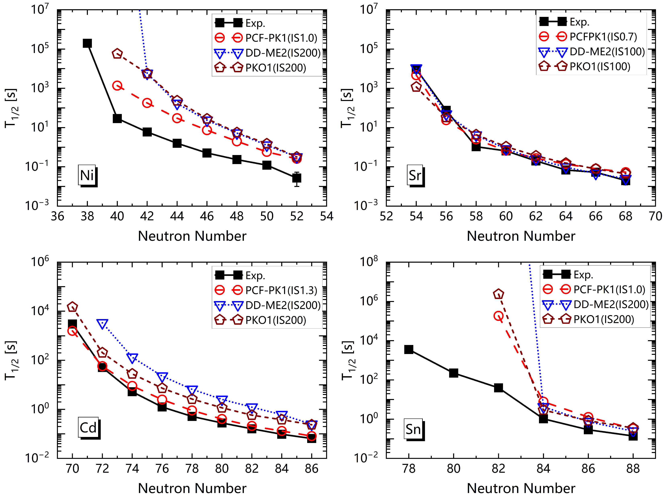
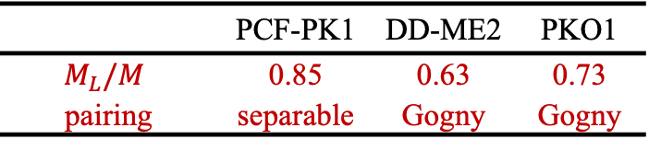
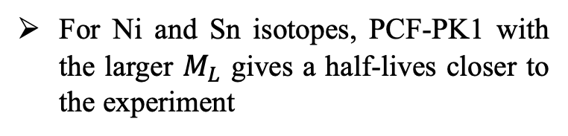
Landau mass and isoscalar pairing
PCF-PK1、DD-ME2 and PKO1
 | PCF-PK1 | DD-ME2 | PKO1
$$M_{L}/M$$ | 0.85 | 0.63 | 0.73
pairing | separable | Gogny | Gogny
Z=28
Z=38
hole-hole
particle-particle
For Ni and Sn isotopes, PCF-PK1 with the larger $M_{L}$ gives a half-lives closer to the experiment
p: hole
n: particle
For the Cd isotope, there are only 𝑝𝑛 pairs with hole-hole nature, and the influence of Landau mass on half-life is greater than isoscalar pairing.
Z=48
Z=50
only hole-hole
p: hole
n: particle
For Sr isotope, there are 𝑝𝑛 pairs with both hole-hole and particle-particle nature, the influence of Landau mass on half-life is less than isoscalar pairing.
Notes:
This slide shows the results of PCF-PK1 compared with DD-ME2 and PKO1 interactions. For DD-ME2 and PKO1, their Landau mass are 0.63 and 0.73. Thee values are small compared with PCF-PK1. And the pairing interaction is Gogny force.
As shown in figure, for Ni and Sn isotopes, as discussed before, they are not sensitive to isoscalar pairing and the interaction PCF-PK1 with larger Landau mass will give more better results than DD-ME2 and PKO1.
For Cd isotopic chain, because they only have pn pairs with hole-hole nature, the influence of Landau mass on half-life is greater than isoscalar pairing. Therefore, interaction with larger Landau mass will give a better results, that is, PCF-PK1 interaction. For Sr isotopic chain, they have pn pairs with both hole-hole and particle-particle nature. So the influence of Landau mass on bete-decay half-life is less than isoscalar pairing because they are more sensitive to isoscalar pairing. As a result, by adjusting the strength of isoscalar pairing, the results calculated by these three interactions can agree well with experiment.

Slide 15
Introduction
Theoretical framework
Results and Discussions
Summary and Perspective
Notes:
The last is the summary and perspective.

Slide 16
Summary and Perspective
Summary
Based on CDFT, a fully self-consistent PNQRPA including tensor coupling and localized exchange terms via Fierz transformation is developed to study β-decay half-life.
Due to the higher Landau mass (0.85M) achieved by introducing tensor coupling in PCF-PK1, it provides a better description of β-decay half-lives compared to other relativistic interactions.
For Cd and Sr isotopes, adjusting isoscalar pairing strength uniformly allows PCF-PK1 to agree well with experiment. For Ni and Sn isotopes, PCF-PK1 can’t provide a good description of β-decay half-lives due to the weak sensitivity to isoscalar pairing force.
Perspective
Based on CDFT including exchange terms via Fierz transformation, we are developing quasiparticle vibration coupling (QPVC) model with higher order correlation to study β-decay half-lives.
Notes:
Baed on CDFT, a fully self-consistent PNQRPA including tensor coupling and localized exchange terms via Fierz transformation is developed to study beta-decay half-life.
Because PCF-PK1 interaction has a higher Landau mass (0.85M) achieved by introducing tensor coupling, it provides a better description of beta-decay half-lives compared to other relativistic interactions, such as DD-ME2 and PKO1.
For Cd and Sr isotopes, by adjusting isoscalar pairing uniformly, PCF-PK1 can agree well with experiment. But for Ni and Sn isotopes, PCF-PK1 can’t provide a good description of beta-decay half-lives due to the weak sensitivity to isoscalar pairing force. Therefore, for nucleus near the magical number, higher order correlations, such as 2particle-2hole excitation, are important.
In order to describe the beta-decay half-life of nucleus near magical number, based on same CDFT, we are developing quasiparticle vibration coupling model with higher order correlation to study β-decay half-lives.

Slide 17
Thank you for your attentions!

Slide 18
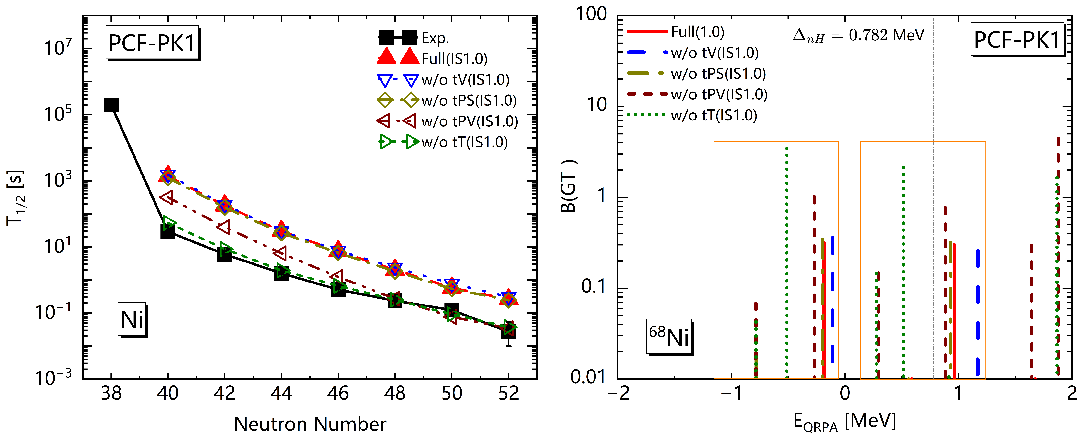
Contribution of each coupling channel
Ni isotope
Contribution from isovector-pseudovector (tPV) and isovector-tensor (tT) coupling channels are dominant, which significantly affect the β-decay half-lives.
tPV and tT coupling channels increase the excitation energy of GT transition, resulting in a longer β-decay half-life.
Notes:
For PCF-PK1 interaction, we investigate the contribution from different coupling channels for beta-decay half-life. Take Ni isotopes as an example, the left figure shows the results of beta-decay half-life. Here the red line represents the results contributed from all coupling channels. And other colors are results calculated without one coupling channel. For example, here w/o tV represent without isovector-vecotor channel. The strength of isoscalar pairing are set to one. We can find that the contribution from isovector-pseudovector (tPV) and isovector-tensor (tT) coupling channels is the dominant, and they significantly affect beta-decay half-lives.
Taken Ni68 as an example, we plot the corresponding Gamow-Teller distribution in the right figure. As shown in brown and green lines, tPV and tT channels will increase the excitation energy of GT transition, resulting in a longer β-decay half-life.

Slide 19
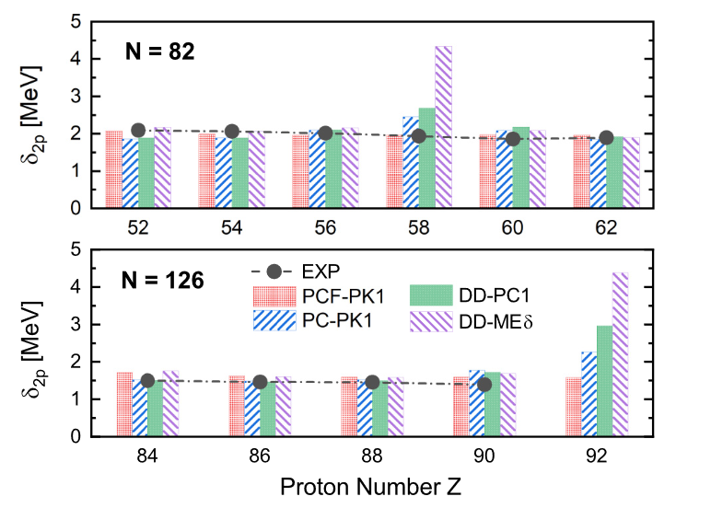
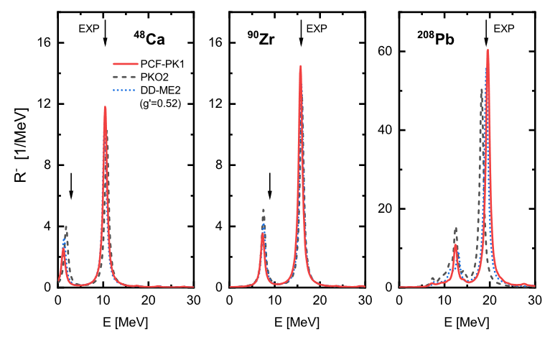

Fierz变换考虑局域化交换项
$N=82$和$126$双质子壳隙
⁴⁸Ca、⁹⁰Zr和²⁰⁸Pb的Gamow-Teller共振(GTR)强度分布
Qiang Zhao et al., Phys. Rev. C 106, 034315(2022)
PCF-PK1可以消除多数RHB理论中存在的假壳结构$Z=58$和$Z=92$
无需额外调节参数，PCF-PK1能够完全自洽描述⁴⁸Ca、⁹⁰Zr和²⁰⁸Pb的GTR能量
Notes:
赵强等人发展了通过Fierz变换考虑交换项效应的RHB理论和RPA理论，如图中PCF-PK1参数所示，其可以消除原子核基态中Z=58和92的假壳结构；对于Gamow-Teller共振，无需额外调节参数，PCF-PK1可以完全自洽的给出这些核的激发能。

Slide 20
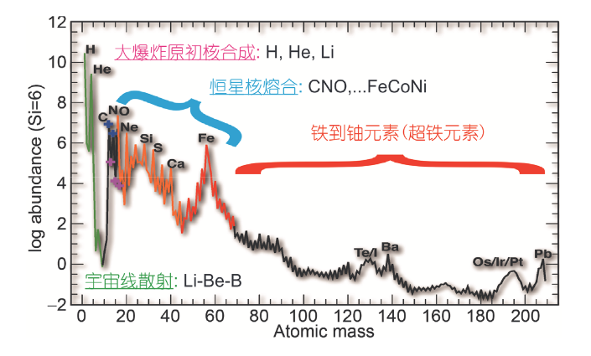
附录
太阳系元素丰度及可能的核合成起源
何建军, 郭冰, 柳卫平, 等. 宇宙中铁以上的重核是如何合成的? 科学通报, 2018, 63: 2429–2439
Notes:
以80Zn为例，其零温和有限温度下的结果如图所示，可以发现：原子核的热激发无法使得较强的GT+激发出现；此外，SD+跃迁对温度并不敏感。

Slide 21
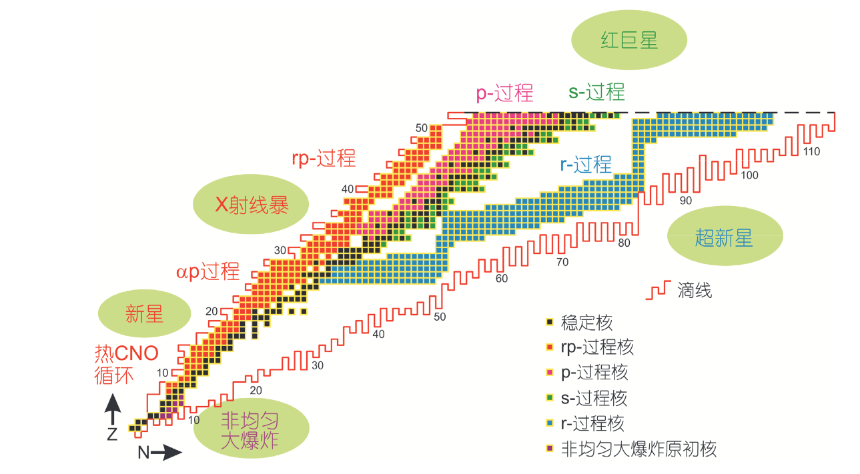
附录
典型天体环境中的核合成路径
何建军, 郭冰, 柳卫平, 等. 宇宙中铁以上的重核是如何合成的? 科学通报, 2018, 63: 2429–2439
Notes:
以80Zn为例，其零温和有限温度下的结果如图所示，可以发现：原子核的热激发无法使得较强的GT+激发出现；此外，SD+跃迁对温度并不敏感。

Slide 22
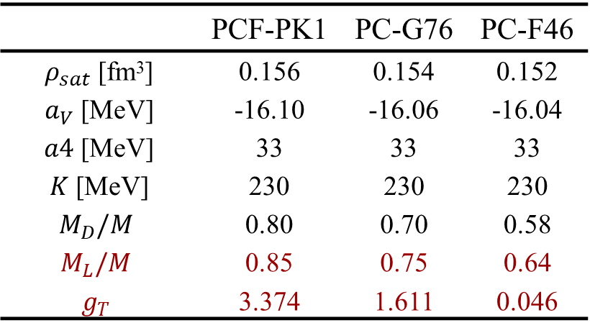
包含局域化交换项与张量耦合效应的参数组
对称核物质性质
费米面处单粒子能级
 | PCF-PK1 | PC-G76 | PC-F46
$ρ_{sat}$ [fm³] | 0.156 | 0.154 | 0.152
$a_{V}$ [MeV] | -16.10 | -16.06 | -16.04
$a4$ [MeV] | 33 | 33 | 33
$K$ [MeV] | 230 | 230 | 230
$$M_{D}/M$$ | 0.80 | 0.70 | 0.58
$$M_{L}/M$$ | 0.85 | 0.75 | 0.64
$$g_{T}$$ | 3.374 | 1.611 | 0.046
Qiang Zhao et al., Phys. Rev. C 106, 034315(2022)
强
张量耦合
弱
PCF-PK1
PC-G76
PC-F46
courtesy of Yanan Huang
Notes:
接下来是初步的计算结果展示，这里给出了包含交换项与张量耦合效应的电荷交换QRPA理论对β-衰变寿命的描述，如图中PCF-PK1所示，可以看出，对于不包含幻数的Cd和Sr同位素链，包含交换项、张量耦合效应的PCF-PK1和PKA1能够较好的符合实验值；而对于含幻数的Ni和Sn同位素链，QRPA并不能很好的描述，这表明理论中需要考虑更高阶的关联效应。

Slide 23
附录
单粒子轨道跃迁能量
hole | particle | PCF-PK1 | PC-G76 | PC-F46
N2p1/2 | P2p1/2 | 3.945 | 2.810 | 1.452
N2p1/2 | P2p3/2 | 5.300 | 4.099 | 2.757
N2p3/2 | P2p3/2 | 3.907 | 2.755 | 1.364
N2p3/2 | P1f5/2 | 3.006 | 2.604 | 2.258
N1f5/2 | P1f5/2 | 4.357 | 3.244 | 1.816
N1f5/2 | P2p3/2 | 5.394 | 3.394 | 0.921
N1g9/2 | P1g9/2 | 4.550 | 3.445 | 2.014
Notes:
接下来是初步的计算结果展示，这里给出了包含交换项与张量耦合效应的电荷交换QRPA理论对β-衰变寿命的描述，如图中PCF-PK1所示，可以看出，对于不包含幻数的Cd和Sr同位素链，包含交换项、张量耦合效应的PCF-PK1和PKA1能够较好的符合实验值；而对于含幻数的Ni和Sn同位素链，QRPA并不能很好的描述，这表明理论中需要考虑更高阶的关联效应。

Slide 24
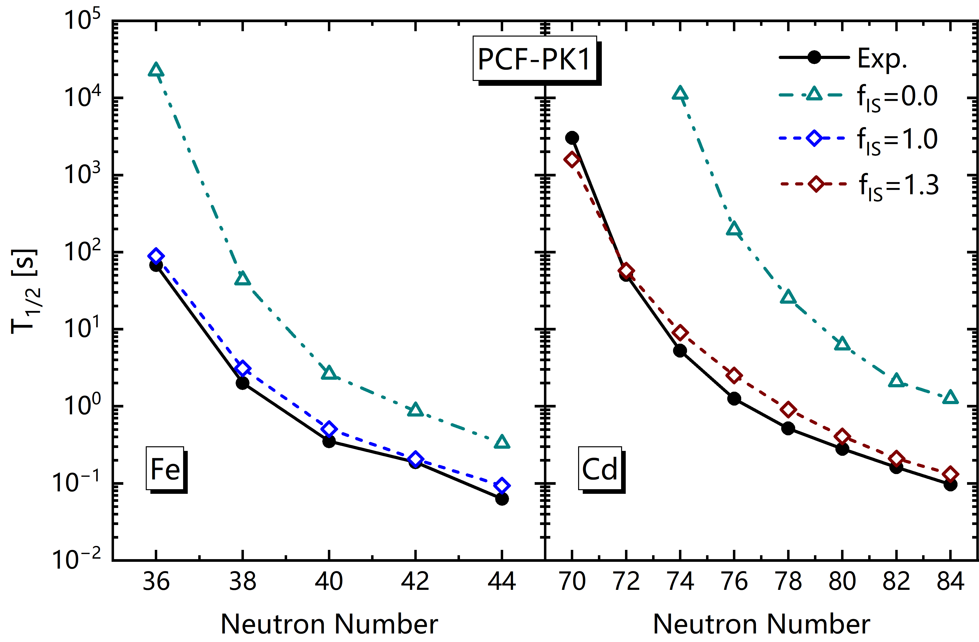
初步结果
电荷交换QRPA理论
Notes:
（1）基于目前的研究现状，本工作将基于通过菲尔兹变换考虑交换项效应的RHB密度泛函，发展RQPVC模型，改善β-衰变寿命描述。发展RQPVC模型需要基于RHB理论独立发展三个模型，即发展电荷交换和非电荷交换的相对论QRPA模型，然后在此基础上，发展相对论准粒子耦合模型，目前这两个模型已经发展完成，正在进行最后一个模型的发展。

Slide 25
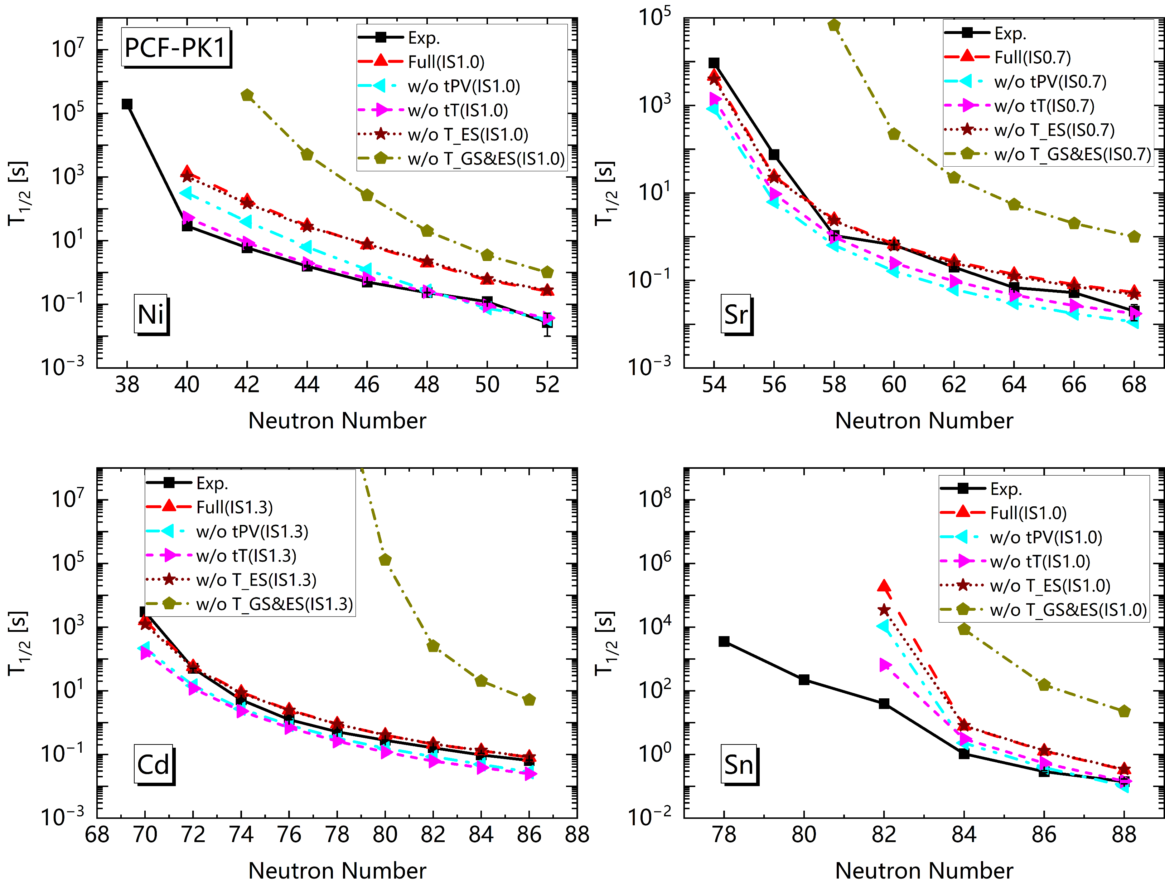
结果与讨论
PCF-PK1剩余相互作用中各耦合道的贡献
Notes:
接下来是初步的计算结果展示，这里给出了包含交换项与张量耦合效应的电荷交换QRPA理论对β-衰变寿命的描述，如图中PCF-PK1所示，可以看出，对于不包含幻数的Cd和Sr同位素链，包含交换项、张量耦合效应的PCF-PK1和PKA1能够较好的符合实验值；而对于含幻数的Ni和Sn同位素链，QRPA并不能很好的描述，这表明理论中需要考虑更高阶的关联效应。

Slide 26


初步结果
RPA理论的提出
D. Bohm, D. Pines, Pysical Review, 82 625 (1951)
We distinguish between two kinds of response of the electrons to a wave. One of these is in phase with the wave, so that the phase difference between the-particle response and the wave producing it is independent of the position of the particle. This is the response which contributes to the organized behavior of the system. The other response has a phase difference with the wave producing it which depends on the position of the particle. Because of the general random location of the particles, this second response tends to average out to zero when we consider a large number of electrons, and we shall neglect the contributions arising from this. This procedure we call the random phase approximation. "
电子和波的相位差与电子位置无关
对系统的整体响应有贡献
与波的相位相同
电子对波的响应
与波的相位不同
电子和波的相位差与电子位置有关
对系统的整体响应无贡献
RPA
Notes:
（1）基于目前的研究现状，本工作将基于通过菲尔兹变换考虑交换项效应的RHB密度泛函，发展RQPVC模型，改善β-衰变寿命描述。发展RQPVC模型需要基于RHB理论独立发展三个模型，即发展电荷交换和非电荷交换的相对论QRPA模型，然后在此基础上，发展相对论准粒子耦合模型，目前这两个模型已经发展完成，正在进行最后一个模型的发展。

Slide 27
Summary and Perspective
Summary
Based on CDFT, a fully self-consistent PNQRPA including tensor coupling and localized exchange terms via Fierz transformation is developed to study β-decay half-life.
Due to the higher Landau mass (0.85M) achieved by introducing tensor coupling in PCF-PK1, it provides a better description of β-decay half-lives compared to other relativistic interactions.
For Cd and Sr isotopes, adjusting isoscalar pairing strength uniformly allows PCF-PK1 to agree well with experiment. For Ni and Sn isotopes, PCF-PK1 can’t provide a good description of β-decay half-lives due to the weak sensitivity to isoscalar pairing force.
tPV and tT coupling channels will increase the excitation energy of GT transition, resulting in a longer β-decay half-life.
Perspective
Based on CDFT including exchange terms via Fierz transformation, developing quasiparticle vibration coupling (QPVC) model with higher order correlation to study β-decay half-lives.
Notes:
Baed on CDFT, a fully self-consistent PNQRPA including tensor coupling and localized exchange terms via Fierz transformation is developed to study beta-decay half-life.
Because PCF-PK1 interaction has a higher Landau mass (0.85M) achieved by introducing tensor coupling, it provides a better description of beta-decay half-lives compared to other relativistic interactions, such as DD-ME2 and PKO1.
For Cd and Sr isotopes, by adjusting isoscalar pairing uniformly, PCF-PK1 can agree well with experiment. But for Ni and Sn isotopes, PCF-PK1 can’t provide a good description of beta-decay half-lives due to the weak sensitivity to isoscalar pairing force. Therefore, for nucleus near the magical number, many-body correlations, such as 2particle-2hole excitation, are important.
Moreover, in PCF-PK1 interaction, tPV and tT coupling channels will increase the excitation energy of GT transition, resulting in a longer β-decay half-life.
As the perspective, in order to describe the beta-decay half-life of nucleus near magical number, we will based on same CDFT, develop quasiparticle vibration coupling model with higher order correlation to study β-decay half-lives.

Slide 28

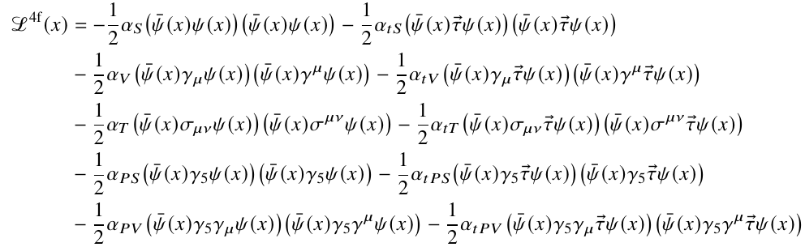


Relativistic point-coupling model
Lagrangian density
free-nucleon term
four-fermion point-coupling term
derivative term and electromagnetic term
Notes:
1. 这里给出了采用QPVC理论计算β-衰变寿命的流程，首先我们需要求解点耦合的RHB方程，得到正则单粒子基矢，然后求解相应的QRPA方程，从而得到相应的声子态基矢，然后再构建求解QPVC方程，计算强度函数S(E)，最终利用该公式计算β-衰变寿命。

Slide 29
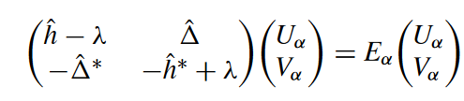

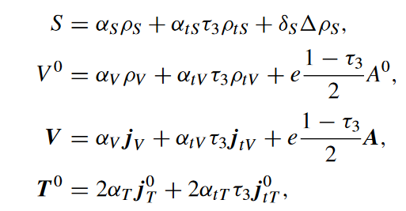
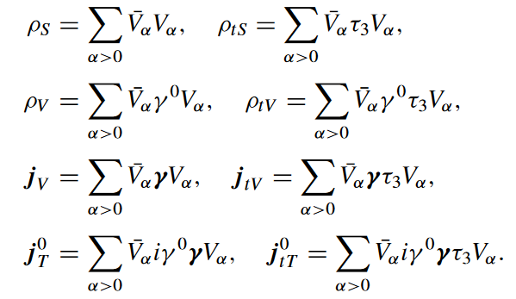
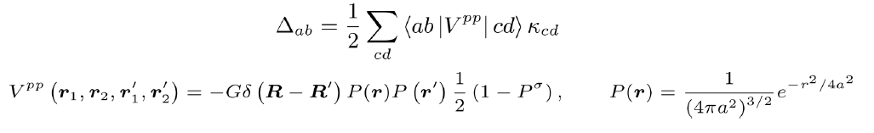
Relativistic Hartree-Bogoliubov equation
Relativistic Hartree-Bogoliubov (RHB) equation
single-particle Dirac Hamiltonian
potentials
densities
Pairing filed
Notes:
1. 接下来是理论框架的介绍，首先我们需要求解的是原子核激发态所满足的能量本征方程，其中哈密顿量采用的是相对论点耦合形式，原子核振动激发态以及相应的激发能可通过基展开方法进行求解；
2. 我们的基矢空间包含Q1和Q2两部分，其中Q1包括RHB基态以及所有两准粒子的激发，这里的两准粒子态通过求解束缚边界条件的RHB方程得到，其包含了交换项以及张量耦合效应；
3. 为了考虑更高阶的关联效应，我们考虑了包含两准粒子激发与声子态的耦合子空间Q2，即准粒子振动耦合效应。

Slide 30
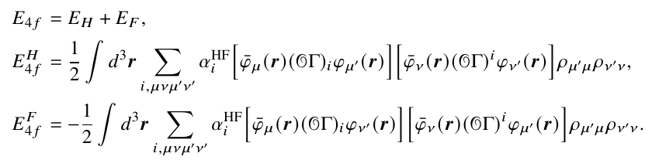
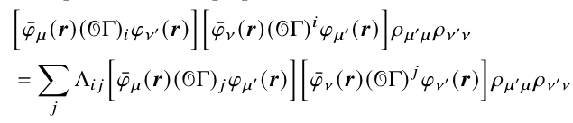

Relativistic point-coupling model
Energy density functional
Hartree term
Fock term
Fierz transformation
E_{4f} in energy density functional
where
Notes:
1. 这里给出了采用QPVC理论计算β-衰变寿命的流程，首先我们需要求解点耦合的RHB方程，得到正则单粒子基矢，然后求解相应的QRPA方程，从而得到相应的声子态基矢，然后再构建求解QPVC方程，计算强度函数S(E)，最终利用该公式计算β-衰变寿命。

Slide 31
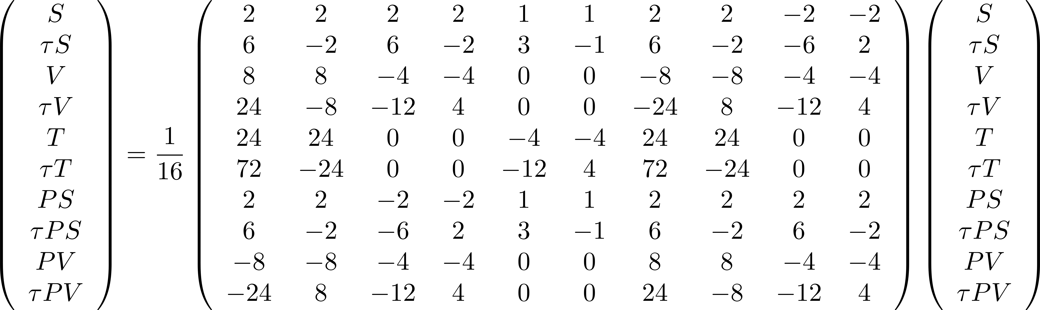
附录
Fierz重排
RMF中各耦合道的变换关系
Notes:
以80Zn为例，其零温和有限温度下的结果如图所示，可以发现：原子核的热激发无法使得较强的GT+激发出现；此外，SD+跃迁对温度并不敏感。

Slide 32

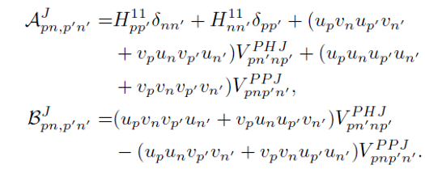
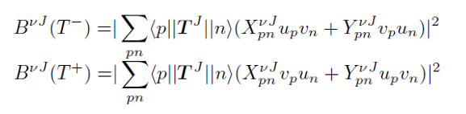
Random Phase Approximation (RPA)
Quasi-particle RPA based on relativistic density functional
QRPA equation
A and B matrix read
Transition strength for spin-isospin operator $T^{J}$
Notes:
1. 为了减少基矢维度，降低计算量，我们可以将能量本征方程投影到子空间Q1，此时方程变为能量依赖的本征方程，其中花体的哈密顿量会出现能量依赖的第二项，称为展宽项，其为准粒子振动耦合效应的贡献；
2. 如果将投影后的激发态采用Q1空间的完备基矢声子态进行展开，我们即可以得到矩阵形式的准粒子振动耦合方程。

Slide 33
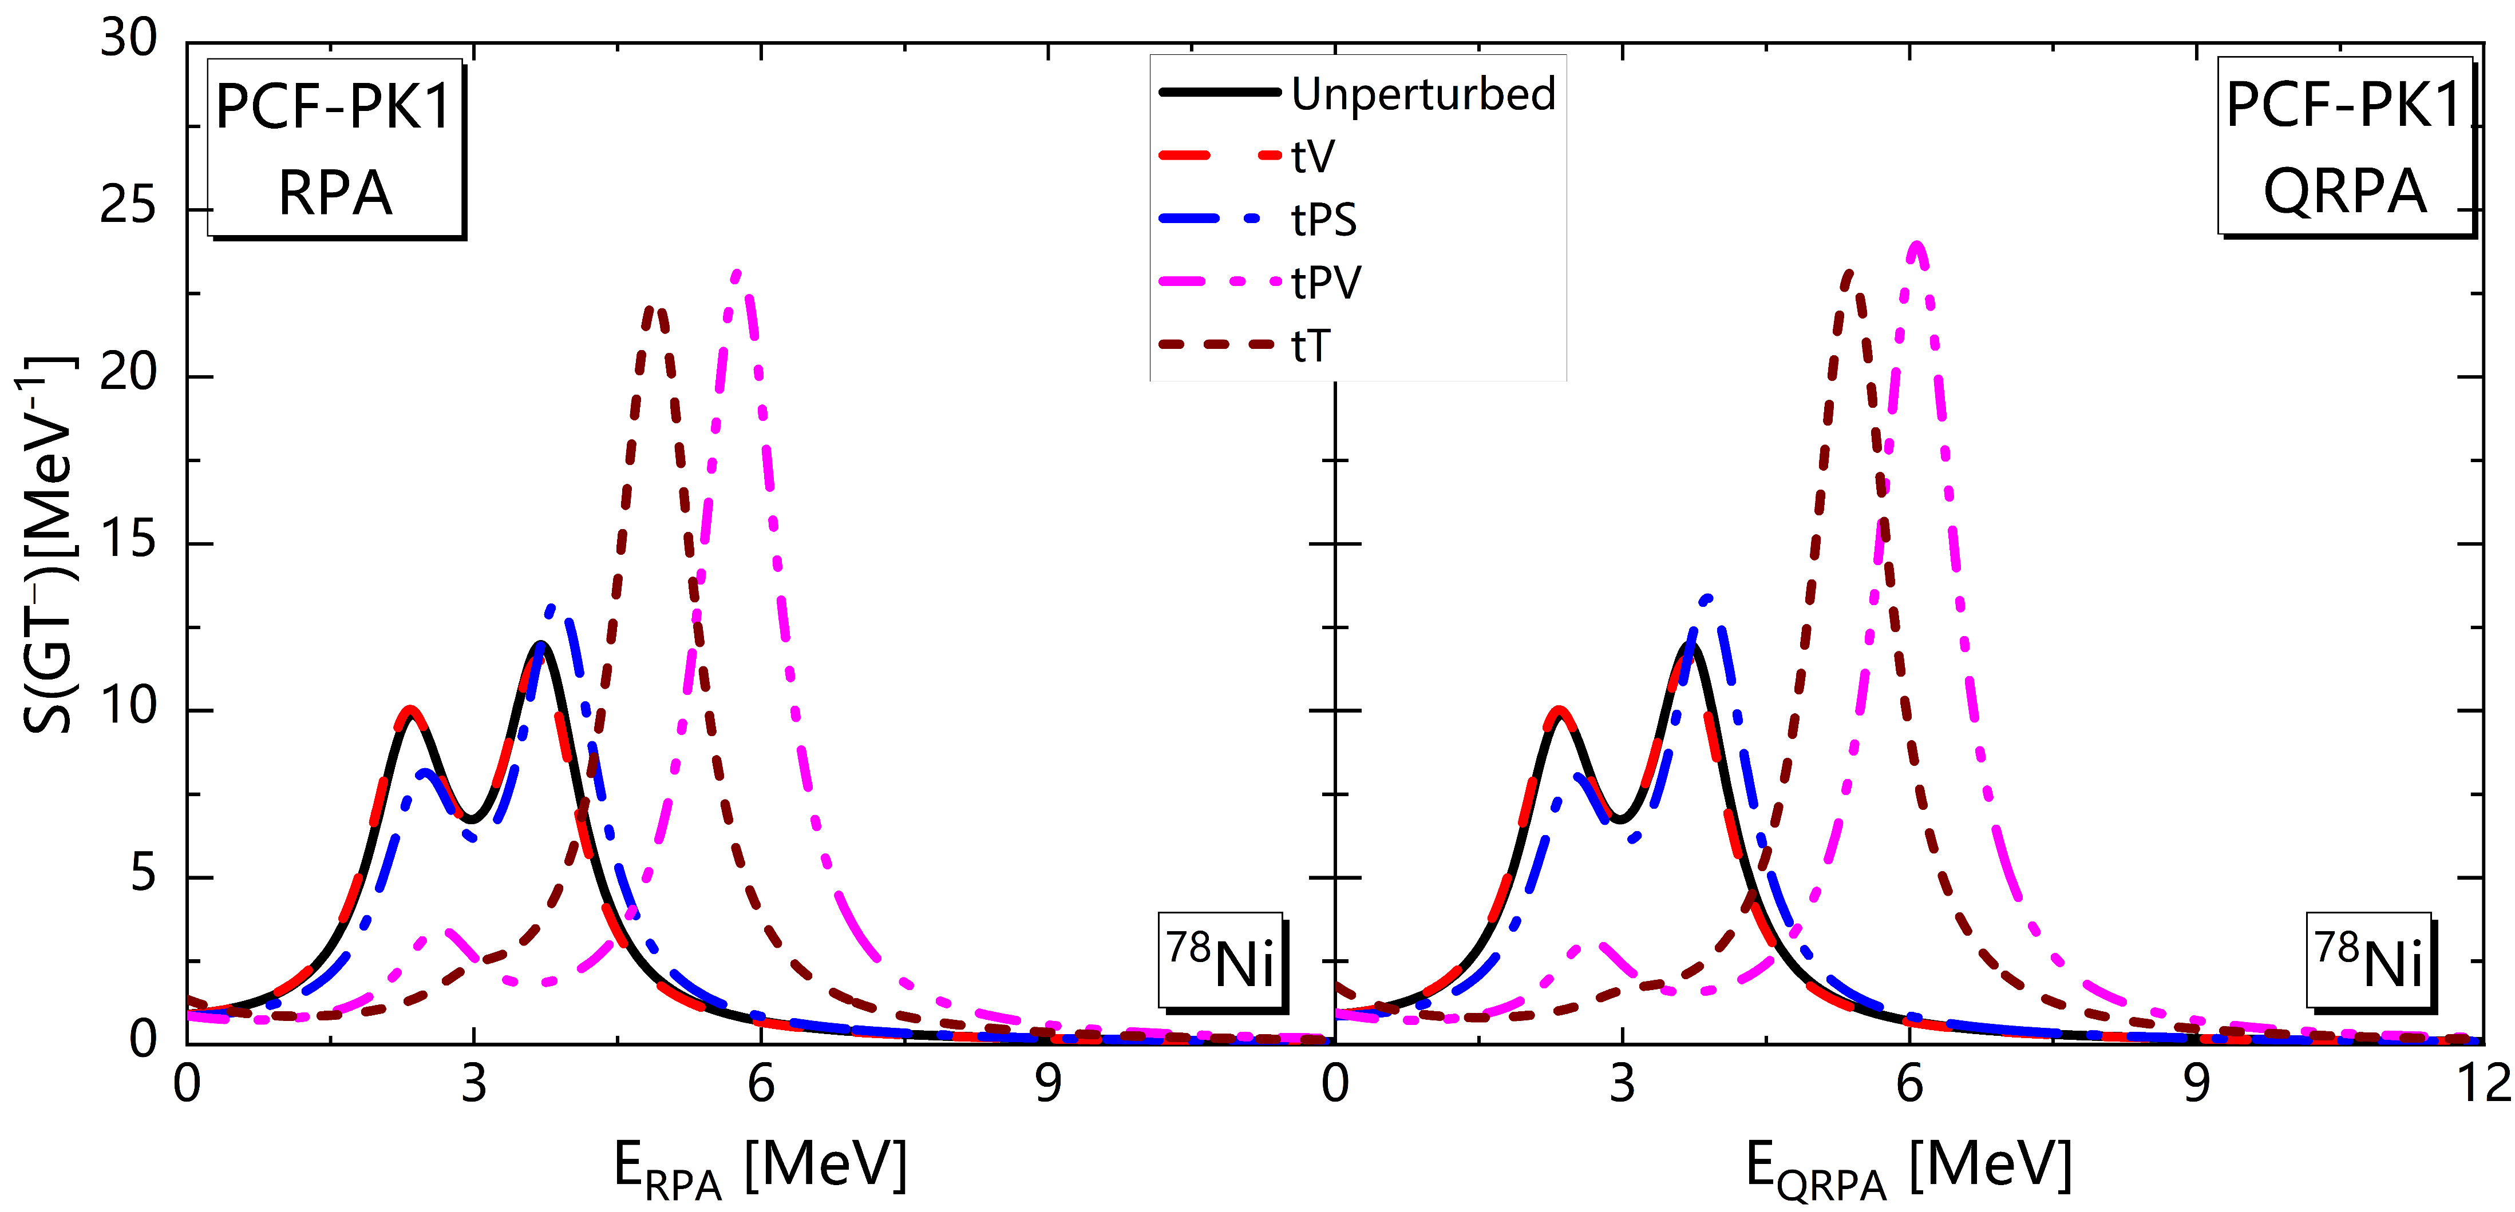
附录
Notes:
赵强等人发展了通过Fierz变换考虑交换项效应的RHB理论和RPA理论，如图中PCF-PK1参数所示，其可以消除原子核基态中Z=58和92的假壳结构；对于Gamow-Teller共振，无需额外调节参数，PCF-PK1可以完全自洽的给出这些核的激发能。

