Slide 1
The 7th International Workshop on DRHBc Mass Table
July 1-4, 2024, Gangneung
Halo nuclei in DRHBc theory with
Lipkin-Nogami correction
Chang Zhou
School of Physics, Peking University
Collaborators: P. Guo, X.-F. Jiang, J. Meng
Email: c.zhou@pku.edu.cn

Slide 2
Outline
Introduction
Theoretical Framework
Results
Summary and Perspectives
Notes:
My presentation includes four parts:

Slide 3
Exotic nuclei
The study of exotic nuclei is one of the frontiers of nuclear physics.
Pairing correlation and continuum play crucial roles in exotic nuclei.
Based on relativistic density functional theory and with the pairing correlation and continuum treated appropriately, the relativistic continuum Hartree-Bogoliubov (RCHB) theory successfully described the halo in ¹¹Li.
Taking deformation into account, the deformed relativistic Hartree-Bogoliubov theory in continuum (DRHBc theory) has achieved success in the study of deformed exotic nuclei.
Tanihata, et. al., PRL 55 (1985) 2676
Dobaczewski, Flocard and Treiner, NPA 422 (1984) 103
Meng and Ring, PRL 77 (1996) 3963
Zhou, Meng, Ring and Zhao, PRC 82 (2010) 011301(R)
Li, Meng, Ring, Zhao and Zhou, PRC 85 (2012) 024312
Notes:
The motivation starts from the exotic nuclei, whose …
Otsuka, Gade, Sorlin, Suzuki and Utsuno, Rev. Mod. Phys. 92 (2020) 015022

Slide 4
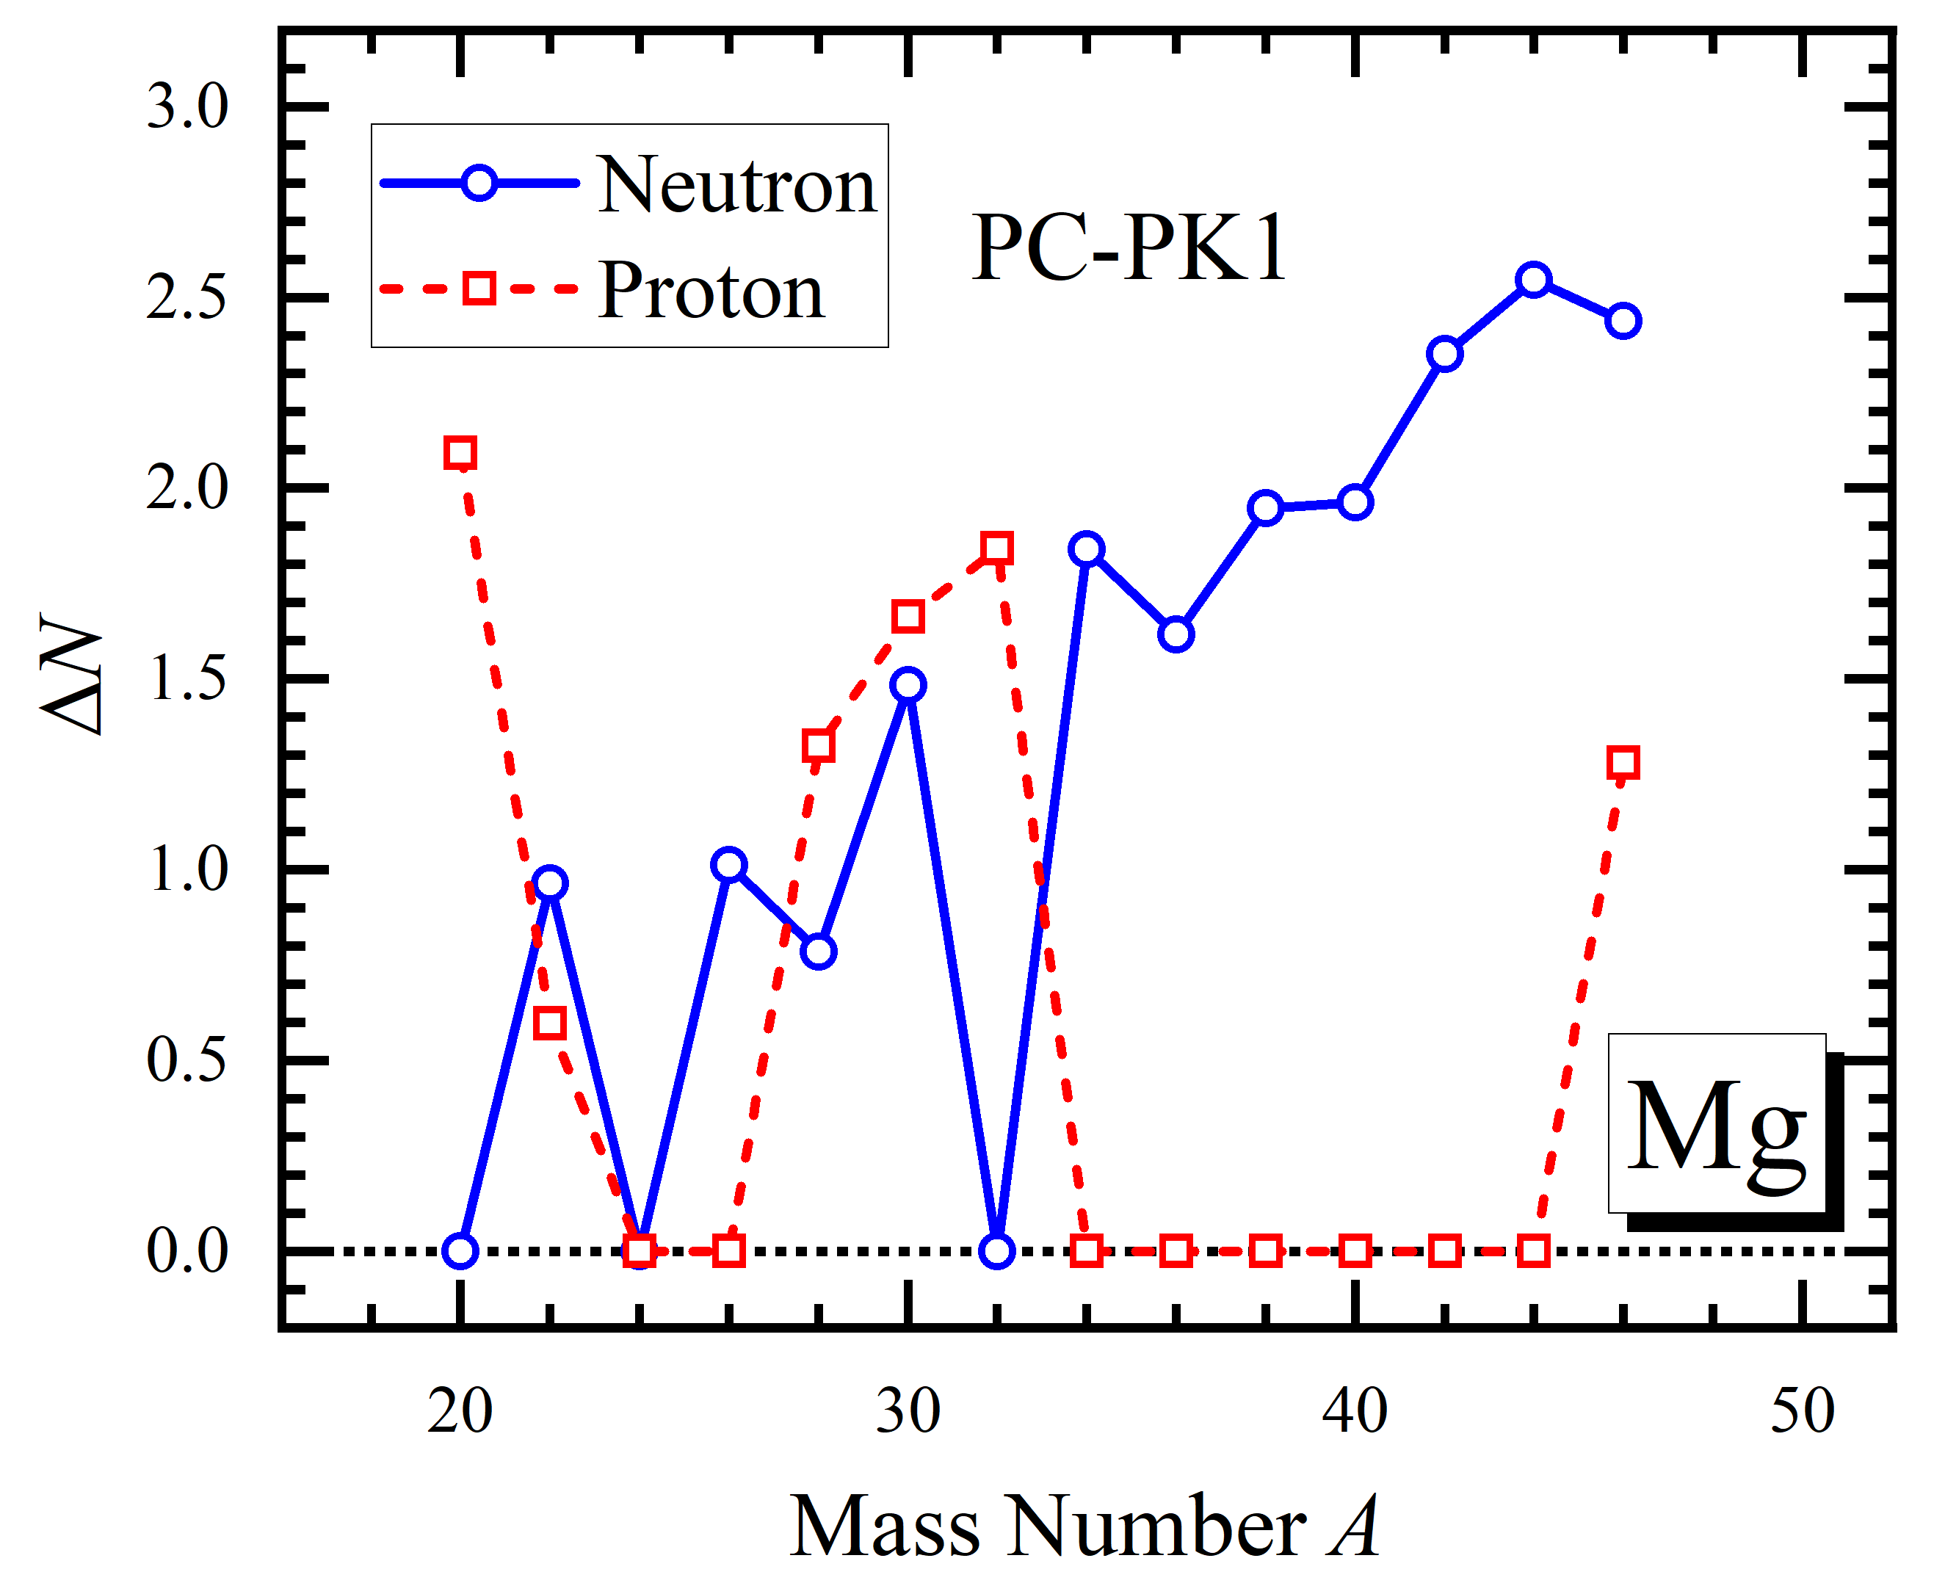
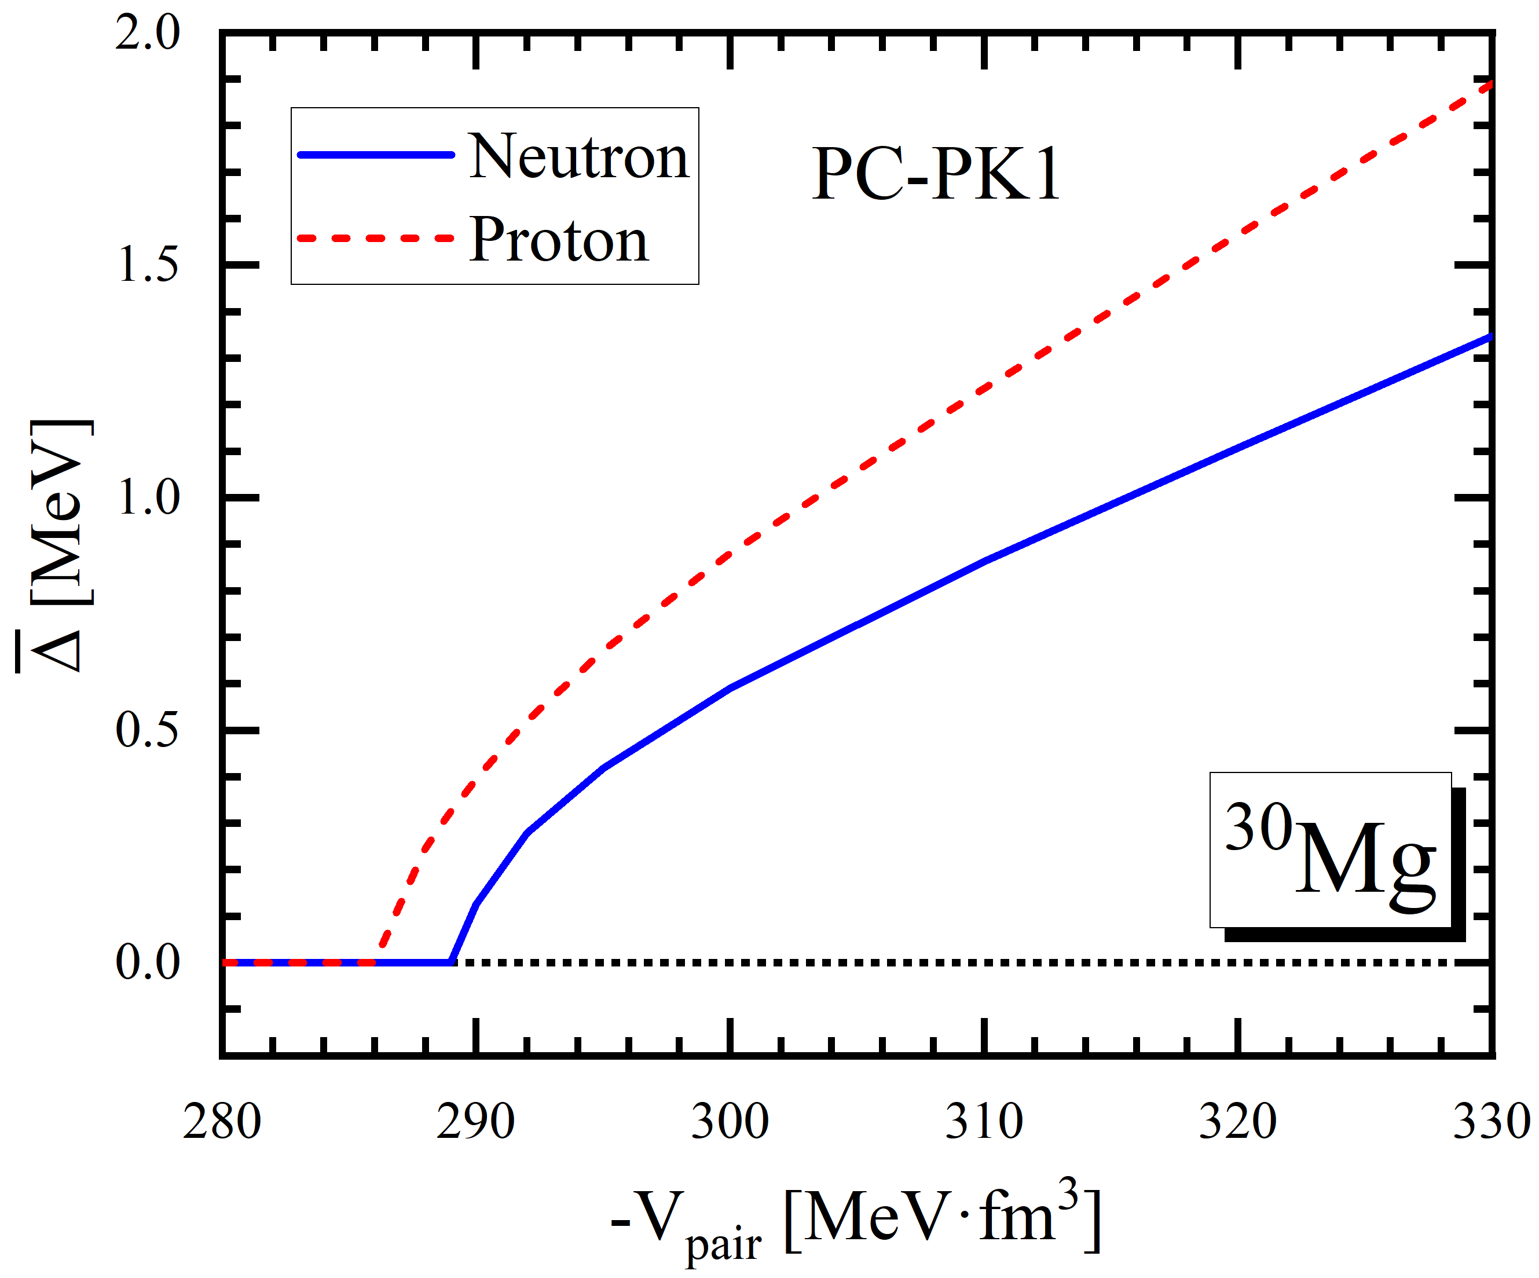
Bogoliubov transformation
Bogoliubov transformation is one of the effective approaches for pairing correlation, but it has disadvantages as follows:
The wave function is not the eigenfunction of particle number, i.e. it breaks the particle number symmetry.
Sharp transition of pairing can be seen, however, such “phase transition” is spurious.
Ring and Schuck, The Nuclear Many-Body Problem (Springer, 1980)
Notes:
The theories mentioned above both treat pairing correlation in the framework of Bogoliubov transformation.
As depicted in the figure on the left, the particle number fluctuations for magnesium isotopes can be over 2.5, indicating the strong symmetry breaking of particle number.
As shown in the figure on the right, for ³⁰Mg, the pairing collapse can be seen when the pairing strength is lower than 290 MeV·fm³. Such sharp transition can also be seen in the rotational and thermal properties of nuclei with pairing correlation treated in the framework of Bogoliubov transformation.
Rho and Rasmussen, PR 135 (1964) B1295
Egido, Ring, Iwasaki and Mang, PLB 154 (1985) 1
Mang, Poggenburg and Rasmussen, NP 64 (1965) 353
Kaneko and Hasegawa, PRC 72 (2005) 024307

Slide 5
Lipkin-Nogami method
To overcome such disadvantages, particle number projection method can be adopted.
Projection after variation: not variationally optimal
Variation after projection: time consuming
Lipkin-Nogami (LN) method, which is an approximation to variation after particle number projection method, can largely reduce the calculation time.
Sheikh, Dobaczewski, Ring, Robledo and Yannouleas, JPG 48 (2021) 123001
Lipkin, Ann. Phys. 9 (1960) 272
Nogami, PR 134 (1964) B313
Pradhan, Nogami and Law, NPA 201 (1973) 357
Notes:
There are two kinds of projection method. One is the “projection after variation”. The problem is that this method does not give a variationally optimal result. Another is the “variation after projection”. This method treats the variation strictly, but it’s too time-consuming.

Slide 6
Applications of LN method
LN method has been applied in the studies on:
Nuclear charge distribution
Rotational properties of nuclei
Thermal properties of nuclei
…
Bennour, et. al., PRC 40 (1989) 2834
Terasaki, et. al., NPA 593 (1995) 1
Afanasjev, König and Ring, PRC 60 (1999) 051303
Hung and Dang, PRC 81 (2010) 057302
In this work
LN correction is applied to DRHBc theory.
Taking deformed halo nucleus ⁴²Mg as an example, the impact of LN correction on halo is studied.
Notes:
原子核裂变 Wang, et. al., PRC 108 (2023) 034306

Slide 7
Lipkin-Nogami method
Starting from variation after particle number projection, the projected energy reads
$$E_{proj}^{N}=\frac{\left\langle Ψ^{N} | \hat{H} | Ψ^{N}\right\rangle }{\left\langle Ψ^{N} | Ψ^{N}\right\rangle }=\frac{\left\langle Φ | \hat{H}{\hat{P}}^{N} | Φ\right\rangle }{\left\langle Φ | {\hat{P}}^{N} | Φ\right\rangle }=\frac{\int_{0}^{2π}{dφ e^{−iφN}\left\langle Φ | \hat{H}e^{iφ\hat{N}} | Φ\right\rangle }}{\int_{0}^{2π}{dφ e^{−iφN}\left\langle Φ | e^{iφ\hat{N}} | Φ\right\rangle }}.$$
Introducing the Lipkin operator $\hat{K}$ which satisfies $E_{proj}^{N}−K_{proj}^{N}\text{=}\text{const}\text{.}$ and building $\hat{K}$ as
$$\hat{K}=\sum_{m=1}^{∞}{λ_{m}{\left(\hat{N}−N_{0}\right)}^{m}},$$
with $N_{0}$ the particle number of the system, the Lipkin formula reads
$$E_{proj}^{N_{0}}=\left\langle Φ | \hat{H}−\hat{K} | Φ\right\rangle .$$
Lipkin, Ann. Phys. 9 (1960) 272
Sheikh, Dobaczewski, Ring, Robledo and Yannouleas, JPG 48 (2021) 123001
Notes:
${\hat{P}}^{N}$ the particle number projection operator, $|Φ⟩$ ($\left|Ψ^{N}\right\rangle$) the wave function before (after) projection.

Slide 8
Lipkin-Nogami method
Defining $λ_{0}=E_{proj}^{N_{0}}$ and taking $M$-order truncation, the parameters $λ_{m}$ can be determined by
$$\left\langle Φ | \left[\hat{H}−\sum_{m=0}^{M}{λ_{m}{\left(Δ\hat{N}\right)}^{m}}\right]{\left(Δ\hat{N}\right)}^{k} | Φ\right\rangle =0, k=0,1,⋯,M,$$
where $Δ\hat{N}=\hat{N}−N_{0}=\hat{N}−\left\langle Φ | \hat{N} | Φ\right\rangle$ .
Lipkin-Nogami (LN) method takes the 2nd order truncation case.
The variational equation given by LN method reads
$$δ\left\langle \hat{H}\right\rangle −λ_{1}δ\left\langle \hat{N}\right\rangle −λ_{2}δ\left\langle {\left(Δ\hat{N}\right)}^{2}\right\rangle =0,$$
where $λ_{1}=λ$ representing the Fermi surface.
Nogami, PR 134 (1964) B313
Pradhan, Nogami and Law, NPA 201 (1973) 357
Sheikh, Dobaczewski, Ring, Robledo and Yannouleas, JPG 48 (2021) 123001

Slide 9
RHB+LN equation
From the variational equation above, the RHB+LN equation reads
$$\left[\begin{matrix}h_{D}−λ−2λ_{2}\left(1−2ρ\right) & Δ \\ −Δ^{∗} & −h_{D}^{∗}+λ+2λ_{2}\left(1−2ρ^{∗}\right)\end{matrix}\right]\left[\begin{matrix}U_{k} \\ V_{k}\end{matrix}\right]=\left(E_{k}−λ_{2}\right)\left[\begin{matrix}U_{k} \\ V_{k}\end{matrix}\right],$$
where $λ_{2}$ satisfies
$$λ_{2}=−\frac{1}{4}\frac{{Tr}_{2}{Tr}_{2}\left(\left(κ^{∗}ρ\right)\overline{V}\left(σκ\right)\right)}{{\left[Tr\left(κκ^{†}\right)\right]}^{2}−2Tr\left(κκ^{†}κκ^{†}\right)},$$
with $σ=1−ρ$ , and ${Tr}_{2}$ the summation in particle-particle channel.
Afanasjev, Ring and König, NPA 676 (2000) 196
Notes:
where the terms colored in red are the correction terms brought by LN correction.
All these terms are related to the parameter $λ_{2}$ ,
The calculation of these terms does not take much time, and the numerical cost of DRHBc+LN is of the same order to DRHBc.

Slide 10
DRHBc+LN
As in DRHBc, for an axially deformed nucleus with spatial reflection symmetry, the densities $ρ\left(r\right), κ\left(r\right)$ and potentials $V\left(r\right), S\left(r\right)$ are expanded in terms of even-order Legendre polynomials
$$f\left(r\right)=\sum_{λ}{f_{λ}\left(r\right)P_{λ}\left(\cos{θ}\right)}, λ=0,2,4,⋯$$
The deformed RHB+LN equation is also solved in a spherical Dirac Woods-Saxon (DWS) basis, in which the radial wave functions have a proper asymptotic behavior for large $r$.
Notes:
Because except for the correction terms in RHB+LN equation, the theoretical framework of DRHBc+LN is the same as DRHBc: the densities and potentials are still expanded in terms of even-order Legendre polynomials, and the equation is still solved in a spherical Dirac Woods-Saxon basis.

Slide 11
Numerical details
The numerical details are listed as follows:
Box size: $R_{box}=20.00 fm$
Step size: $Δr=0.10 fm$
Energy cutoff: $E_{cut}=300 MeV$
Angular momentum cutoff: ${23}/2 ℏ$
Legendre expansion truncation: $λ_{cut}=6$
Density functional: PC-PK1
Pairing strength: $V_{0}=−325.0 MeV⋅{fm}^{3}$
Zhao, et. al., PRC 82 (2010) 054319
Zhang, et. al. (DRHBc Mass Table Collaboration), PRC 102 (2020) 024314
Notes:
The numerical details are listed as follows, which are the same as DRHBc mass table, including the box size, the step size, the truncations, the density functional and the pairing strength.

Slide 12
Mg isotopes: specific binding energies
^{*24,26}Mg are calculated with PC-F1.
DRHBc+LN gives a larger specific binding energy.
Notes:
Firstly, take magnesium isotopes as examples to see the impact of LN correction on the ground state properties. This figure shows the specific binding energies of Mg isotopes. Note that ^{24,26}Mg are calculated with the density functional PC-F1, for PC-PK1 encounters the high-density instability when calculating these two nuclides. From the figure, it turns out that DRHBc+LN gives a larger specific binding energy.
Experimental data from: Wang, et. al., Chin. Phys. C 45 (2021) 030003

Slide 13
Mg isotopes: $S_{2n}$
^{*24,26}Mg are calculated with PC-F1.
Without $E_{rot}$ , the $S_{2n}$ of ⁴²Mg in DRHBc and DRHBc+LN are 1.217 and 1.516 MeV, respectively.
Notes:
As to two neutron separation energies, the results of DRHBc and DRHBc+LN are similar. This means LN correction has no drastic impact on two neutron separation energies. Especially, for our interested nucleus ⁴²Mg, the two neutron separation energies in DRHBc and DRHBc+LN are 1.217 and 1.516 MeV, respectively, i.e. ⁴²Mg is weakly bound in both DRHBc and DRHBc+LN calculations.
Experimental data from: Wang, et. al., Chin. Phys. C 45 (2021) 030003

Slide 14
Mg isotopes: $E_{pair,n}$ vs $β$
With the same pairing strength, DRHBc+LN gives a smaller deformation and a larger neutron pairing energy in comparison with DRHBc.
For ³²Mg, the neutron pairing vanishes in DRHBc but not in DRHBc+LN.
Notes:
This figure shows the changes of neutron pairing energies and quadrupole deformations of four Mg isotopes after applying LN correction.
This indicates that LN correction gives an enhanced pairing correlation.
This shows the pairing doesn’t collapse within LN method.

Slide 15
Mg isotopes: density distribution
In the direction perpendicular to the symmetric axis, the neutron density distribution of ⁴²Mg extends vary far away from the center, indicating the halo structure in ⁴²Mg.
Notes:
This figure shows the neutron density distributions of several Mg isotopes in the direction perpendicular to the symmetric axis. It can be seen that the neutron density distribution of ⁴²Mg extends vary far away from the center in both DRHBc and DRHBc+LN calculations, indicating the halo structure in ⁴²Mg.

Slide 16
Single neutron levels of ⁴²Mg
Neutron levels with $ε>−1 MeV$, e.g. ${1/2}_{5}^{−},{3/2}_{3}^{−},{7/2}_{1}^{−},{1/2}_{6}^{−}, {3/2}_{4}^{−}$, are corresponding to the “halo” part, while others are corresponding to the “core” part.
Notes:
Here comes to the isotope we focused on, ⁴²Mg. This figure shows its single neutron levels. Noticing that there’s a considerable gap between the first 5/2⁻ level and the fifth 1/2⁻ level, so we can divide the levels into two parts: Neutron levels with $ε>−1 MeV$ are corresponding to the “halo” part, while others are corresponding to the “core” part.

Slide 17
Density distribution of ⁴²Mg
In the tail part, the halo components domain.
Notes:
This figure shows the density distribution of ⁴²Mg in the direction perpendicular to the symmetric axis, as well as that of the core and the halo.
for both DRHBc and DRHBc+LN, further indicating the halo structure in ⁴²Mg.

Slide 18
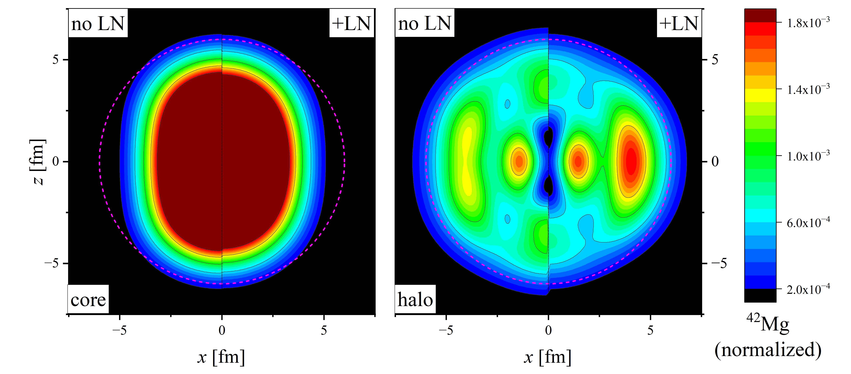
Density distribution of ⁴²Mg
 | Core |  | Halo
 | DRHBc | DRHBc+LN | DRHBc | DRHBc+LN
Radius $R$ (fm) | 3.899 | 3.858 | 5.373 | 5.181
Deformation $β$ | 0.447 | 0.370 | -0.225 | -0.465
Notes:
And this figure shows the density distribution of the core and the halo on the x-z plane, where z-axis refers to the symmetric axis. The left halves are the results of DRHBc calculation and the right halves are those of DRHBc+LN. The core is prolate and the halo is oblate for both DRHBc and DRHBc+LN, presenting the deformation decoupling in ⁴²Mg. And compared with DRHBc, the deformation of the core in DRHBc+LN is slightly smaller, while that of the halo is much larger, as shown in the table above. This can be seen more clearly through the normalized density distribution with linear scale. Such a result shows the strengthen of deformation decoupling effect in ⁴²Mg due to the LN correction.

Slide 19
Deformation contributions
The enlargement of the halo’s deformation is mostly attributed to the deformation change in the ${1/2}_{5}^{−}$ neutron level.
Notes:
What’s the reason is the enlargement of the halo deformation? Here shows the occupation probabilities and quadrupole deformations of the main single neutron levels of the halo part. With LN correction taking into account, the fifth 1/2⁻ neutron level, which is previously a prolate one, turns oblate, and the deformation of the sixth 1/2⁻ neutron level changes in the opposite direction, while others do not change much. Because the occupation probability of the fifth 1/2⁻ neutron level is much larger than that of the sixth one, the enlargement of the halo’s deformation is mostly attributed to the deformation change in the ${1/2}_{5}^{−}$ neutron level.

Slide 20
Components of single neutron levels
more $2p_{1/2}$ and less $1f_{5/2}$ components in $ν{1/2}_{5}^{−}$ level
more $1f_{5/2}$ and less $2p_{1/2}$, $2p_{3/2}$ components in $ν{1/2}_{6}^{−}$ level
Notes:
This figure shows the components of the main single neutron levels of the halo part. For the fifth 1/2⁻ neutron level, there are more $2p_{1/2}$ and less $1f_{5/2}$ components; for the sixth one, there are more $1f_{5/2}$ and less $2p_{1/2}$ and $2p_{3/2}$ components. Others do not change much. This indicates the reason of the deformation change may be related to the change of the components of the single particle level.

Slide 21
Density distribution of $ν{1/2}_{5}^{−}$ level
With LN correction taking into account:
The oblate $Y_{1}^{±1}\left(θ,φ\right)$ component increases and the prolate $Y_{1}^{0}\left(θ,φ\right)$ component decreases, which is consistent with the increase of the $2p_{1/2}$ component
The prolate $Y_{3}^{0}\left(θ,φ\right)$ component decreases, which is consistent with the decrease of the $1f_{5/2}$ component
Notes:
This figure shows the normalized density distribution of the fifth 1/2⁻ neutron level. The left half is the result of DRHBc calculation while the right half is that of DRHBc+LN. It can be seen that with LN correction taking into consideration:
1) In the direction perpendicular to the symmetric axis, here the normalized density becomes larger, this means the oblate $Y_{1}^{±1}\left(θ,φ\right)$* component increases; in the direction along the symmetric axis, here the normalized density becomes smaller, this means prolate $Y_{1}^{0}\left(θ,φ\right)$ component decreases. This is consistent with the increase of the $2p_{1/2}$ component.
2) Also, here the normalized density, which corresponding to the prolate $Y_{3}^{0}\left(θ,φ\right)$ component, becomes smaller. This is consistent with the decrease of the $1f_{5/2}$ component.

Slide 22
Core and halo deformations of ⁴²Mg
By increasing pairing strength, the deformations of core and halo in DRHBc and DRHBc+LN both decrease in general.
With the same pairing strength, LN correction decreases the core deformation but increases the halo deformation.
The effect of LN correction to halo is different from simply increasing the pairing strength.
Notes:
As shown before, the LN correction gives a larger pairing. So here comes the question that whether increasing the pairing strength gives a similar result. Here the picture shows the core and halo deformations of ⁴²Mg under different pairing strength for DRHBc and DRHBc+LN calculations. From the figure, it can be seen that by increasing pairing strength, the deformations of core and halo in DRHBc and DRHBc+LN both decrease in general. And with the same pairing strength, LN correction decreases the core deformation but increases the halo deformation. So, the effect of LN correction to halo is different from simply increasing the pairing strength.

Slide 23
Summary and Perspectives
Summary
Lipkin-Nogami (LN) correction is applied to DRHBc theory.
The ground state properties of Mg isotopes are calculated with DRHBc+LN and the results are compared with DRHBc, indicating LN correction gives an enhanced pairing correlation.
LN correction enhances the shape decoupling effect in ⁴²Mg, this cannot be reproduced by simply increasing the pairing strength.
Perspectives
Extend DRHBc+LN theory to odd-$A$ and odd-odd nuclei.
Calculate other halo nuclei, e.g. ²²C and ¹⁹B, with DRHBc+LN and systematically study the influence of LN correction on halo nuclei.
Notes:
For the prospective, presently the calculations are only constrained to even-even nuclei. In the future, the calculation will be extended to odd-A and odd-odd nuclei. And to see whether LN correction also has such influence on other deformed halo nuclei, e.g. ²²C and ¹⁹B, systematically study will be performed.

Slide 24
Thank you!

Slide 25
Appendix

Slide 26
DRHBc theory: RHB equation
Treating the mean field and pairing correlation self-consistently, the relativistic Hartree-Bogoliubov (RHB) equation reads:
$$\left[\begin{matrix}h_{D}−λ & Δ \\ −Δ^{∗} & −h_{D}^{∗}+λ\end{matrix}\right]\left[\begin{matrix}U_{k} \\ V_{k}\end{matrix}\right]=E_{k}\left[\begin{matrix}U_{k} \\ V_{k}\end{matrix}\right],$$
with $λ$ the Fermi surface, $E_{k}$ the quasiparticle energy, ${\left(U_{k}, V_{k}\right)}^{T}$ the quasiparticle wave function. $h_{D}$ is the Dirac Hamiltonian
$$h_{D}\left(r\right)=α⋅\left[p−V\left(r\right)\right]+V^{0}\left(r\right)+β\left[M+S\left(r\right)\right],$$
with $V^{μ}(r)$ and $S(r)$ the vector and scalar potentials, respectively.
$Δ$ is the pairing potential with
$$Δ\left(r_{1},r_{2}\right)=V^{pp}\left(r_{1},r_{2}\right)κ\left(r_{1},r_{2}\right).$$
In this work, $V^{pp}$ is the density-dependent force of zero range
$$V^{pp}\left(r_{1},r_{2}\right)=V_{0}\frac{1}{2}\left(1−P^{σ}\right)δ\left(r_{1}−r_{2}\right)\left(1−\frac{ρ\left(r_{1}\right)}{ρ_{sat}}\right).$$
Meng (Ed.), Relativistic Density Functional for Nuclear Structure (2016)
Notes:
下面是理论框架。首先，在DRHBc理论中，通过 RHB 方程自洽地……

Slide 27
DRHBc theory: Legendre expansion
For an axially deformed nucleus，potentials $V\left(r\right), S\left(r\right)$ and densities $ρ\left(r\right), κ\left(r\right)$ can be expanded in terms of Legendre polynomials
$$f\left(r\right)=\sum_{λ}{f_{λ}\left(r\right)P_{λ}\left(\cos{θ}\right)}.$$
With the spatial reflection symmetry taking into account, $λ$ should be even.
$$f\left(r\right)=\hat{P}f\left(r\right)=\hat{P}\sum_{λ}{f_{λ}\left(r\right)P_{λ}\left(\cos{θ}\right)}=\sum_{λ}{f_{λ}\left(r\right)P_{λ}\left(\cos\left(π−θ\right)\right)}=\sum_{λ}{{\left(−1\right)}^{λ}f_{λ}\left(r\right)P_{λ}\left(\cos{θ}\right)}.$$
Notes:
DRHBc 理论仅考虑有着空间反射对称性的轴对称形变

Slide 28
DRHBc theory: Dirac Woods-Saxon basis
In DRHBc theory，the deformed RHB equation is solved in a spherical Dirac Woods-Saxon (DWS) basis, in which the radial wave functions have a proper asymptotic behavior for large $r$.
DWS basis is derived through solving the Dirac equation with Woods-Saxon potentials
$$\left[α⋅p+V\left(r\right)+β\left(M+S\left(r\right)\right)\right]ψ_{i}\left(r\right)=ε_{i}ψ_{i}\left(r\right), V±S=\frac{V_{0,±}}{1+e^{{\left(r−R_{±}\right)}/{a_{±}}} },$$
DWS basis can be written as
$$ψ_{nκm}\left(r\right)=\frac{1}{r}\left[\begin{matrix}iG_{nκ}\left(r\right)Y_{jm}^{l}\left(Ω\right) \\ −F_{nκ}\left(r\right)Y_{jm}^{\tilde{l}}\left(Ω\right)\end{matrix}\right], κ={\left(−1\right)}^{j+l+1/2}\left(j+1/2\right).$$
Zhou, Meng, and Ring, PRC 68 (2003) 034323

Slide 29
Lipkin method
Starting from variation after particle number projection, the particle projected energy reads
$$E_{proj}^{N}=\frac{\left\langle Ψ^{N} | \hat{H} | Ψ^{N}\right\rangle }{\left\langle Ψ^{N} | Ψ^{N}\right\rangle }=\frac{\left\langle Φ | \hat{H}{\hat{P}}^{N} | Φ\right\rangle }{\left\langle Φ | {\hat{P}}^{N} | Φ\right\rangle }=\frac{\int_{0}^{2π}{dφ e^{−iφN}\left\langle Φ | \hat{H}e^{iφ\hat{N}} | Φ\right\rangle }}{\int_{0}^{2π}{dφ e^{−iφN}\left\langle Φ | e^{iφ\hat{N}} | Φ\right\rangle }}.$$
Introduce the Lipkin operator $\hat{K}$ which satisfies
$$E_{proj}^{N}−K_{proj}^{N}=\frac{\int_{0}^{2π}{dφ e^{−iφN}\left\langle Φ | \left(\hat{H}−\hat{K}\right)e^{iφ\hat{N}} | Φ\right\rangle }}{\int_{0}^{2π}{dφ e^{−iφN}\left\langle Φ | e^{iφ\hat{N}} | Φ\right\rangle }}\text{=}\text{const}\text{.}.$$
For the constant doesn’t depend on $N$ , it gives
$$\frac{\left\langle Φ | \left(\hat{H}−\hat{K}\right)e^{iφ\hat{N}} | Φ\right\rangle }{\left\langle Φ | e^{iφ\hat{N}} | Φ\right\rangle }=\text{const}\text{.,} \text{for} \text{all} φ$$
Lipkin, Ann. Phys. 9 (1960) 272
Sheikh, Dobaczewski, Ring, Robledo and Yannouleas, JPG 48 (2021) 123001
Notes:
${\hat{P}}^{N}$ the particle number projection operator，$|Φ⟩$ ($\left|Ψ^{N}\right\rangle$) the wave function before (after) projection.

Slide 30
Lipkin method
$\hat{K}$ can be built as
$$\hat{K}=\sum_{m=1}^{∞}{λ_{m}{\left(\hat{N}−N_{0}\right)}^{m}},$$
with $N_{0}$ the particle number of the system. This means that $K_{proj}^{N_{0}}=0$ , so the constant equals to $E_{proj}^{N_{0}}$ . Applying $φ=0$ , the Lipkin formula reads
$$E_{proj}^{N_{0}}=\left\langle Φ | \hat{H}−\hat{K} | Φ\right\rangle .$$
Defining $λ_{0}=E_{proj}^{N_{0}}$ and taking $M$-order truncation, the Lipkin parameters $λ_{m}$ can be derived by solving a set of linear equations given by $M+1$ different $φ_{i}$ ($φ_{0}=0$) :
$$\sum_{m=0}^{M}{A_{im}λ_{m}}=h_{i}, A_{im}=\frac{\left\langle Φ | {\left(\hat{N}−N_{0}\right)}^{m}e^{iφ_{i}\hat{N}} | Φ\right\rangle }{\left\langle Φ | e^{iφ_{i}\hat{N}} | Φ\right\rangle }, h_{i}=\frac{\left\langle Φ | \hat{H}e^{iφ_{i}\hat{N}} | Φ\right\rangle }{\left\langle Φ | e^{iφ_{i}\hat{N}} | Φ\right\rangle }.$$

Slide 31
Lipkin-Nogami method
Lipkin-Nogami (LN) method equivalently gives
$$\left\langle Φ | \left[\hat{H}−\sum_{m=0}^{M}{λ_{m}{\left(Δ\hat{N}\right)}^{m}}\right]e^{iφ\hat{N}} | Φ\right\rangle =0, Δ\hat{N}\text{=}\hat{N}−N_{0}, \text{for} \text{all} φ.$$
Because choosing different $φ_{i}$ near $φ=0$ is equivalent to applying a series of differentials operators at $φ=0$, the parameters $λ_{m}$ can be determined by
$$\left\langle Φ | \left[\hat{H}−\sum_{m=0}^{M}{λ_{m}{\left(Δ\hat{N}\right)}^{m}}\right]{\left(Δ\hat{N}\right)}^{k} | Φ\right\rangle =0, k=0,1,⋯,M.$$
Lipkin-Nogami (LN) method also especially refers to the 2nd order truncation case for particle number symmetry.
The variational equation given by LN method reads
$$δ\left\langle \hat{H}\right\rangle −λ_{1}δ\left\langle \hat{N}\right\rangle −λ_{2}δ\left\langle {\left(Δ\hat{N}\right)}^{2}\right\rangle =0,$$
where $λ_{1}=λ$ represents the Fermi surface.
Nogami, PR 134 (1964) B313; Pradhan, Nogami and Law, NPA 201 (1973) 357
Sheikh, Dobaczewski, Ring, Robledo and Yannouleas, JPG 48 (2021) 123001

Slide 32
Projected energy
Based on the mean-field wave function $\left|Φ\right\rangle$ , the projected wave function with particle number $N$ reads
$$\left|Ψ^{N}\right\rangle ={\hat{P}}^{N}\left|Φ\right\rangle =\frac{1}{2π}\int_{0}^{2π}{dφ e^{iφ\left(\hat{N}−N\right)}}\left|Φ\right\rangle ,$$
It is the eigenstate of particle number.
The projected energy reads
$$E_{proj}^{N}=\frac{\left\langle Ψ^{N} | \hat{H} | Ψ^{N}\right\rangle }{\left\langle Ψ^{N} | Ψ^{N}\right\rangle }=\frac{\left\langle Φ | \hat{H}{\hat{P}}^{N} | Φ\right\rangle }{\left\langle Φ | {\hat{P}}^{N} | Φ\right\rangle }=\frac{\int_{0}^{2π}{dφ e^{−iφN}h\left(φ\right)}}{\int_{0}^{2π}{dφ e^{−iφN}n\left(φ\right)}},$$
where
$$h\left(φ\right)=\left\langle Φ | \hat{H}e^{iφ\hat{N}} | Φ\right\rangle , n\left(φ\right)=\left\langle Φ | e^{iφ\hat{N}} | Φ\right\rangle .$$

Slide 33
Kamlah expansion
When $h\left(φ\right), n\left(φ\right)$ peak at $φ=0$ and are very small elsewhere, and $h(φ)/n\left(φ\right)$ behaves smoothly, we can expand $h\left(φ\right)$ in terms of $n\left(φ\right)$ in the following way
$$h\left(φ\right)=\sum_{m=0}^{∞}{λ_{m}{\hat{𝒩}}^{m}n\left(φ\right)},$$
where $\hat{𝒩}=\frac{1}{i}\frac{∂}{∂φ}−\left\langle Φ | \hat{N} | Φ\right\rangle$.
Taking $M$-order truncation, the truncation error when taking $φ→0$ is $𝒪\left(φ^{M+1}\right)$ , this gives
$$\lim_{φ→0}{{\hat{𝒩}}^{k}\left[h\left(φ\right)−\sum_{m=0}^{M}{λ_{m}{\hat{𝒩}}^{m}n\left(φ\right)}\right]}=0, k=0,1,⋯,M,$$
i.e.
$$\left\langle Φ | \left[\hat{H}−\sum_{m=0}^{M}{λ_{m}{\left(\hat{N}−\left\langle \hat{N}\right\rangle \right)}^{m}}\right]{\left(\hat{N}−\left\langle \hat{N}\right\rangle \right)}^{k} | Φ\right\rangle =0, k=0,1,⋯,M.$$
Kamlah, Z. Phys. A 216 (1968) 52

Slide 34
The approximations
With Kamlah expansion to second order, the projected energy reads
$$E_{proj}^{N}≈\left\langle \hat{H}\right\rangle −λ_{2}\left\langle {\left(Δ\hat{N}\right)}^{2}\right\rangle ,$$
where
$$λ_{2}=\frac{\left\langle \hat{H}{\left(Δ\hat{N}\right)}^{2}\right\rangle −\left\langle \hat{H}\right\rangle \left\langle {\left(Δ\hat{N}\right)}^{2}\right\rangle −{\left\langle \hat{H}Δ\hat{N}\right\rangle \left\langle {\left(Δ\hat{N}\right)}^{3}\right\rangle }/{\left\langle {\left(Δ\hat{N}\right)}^{2}\right\rangle }}{\left\langle {\left(Δ\hat{N}\right)}^{4}\right\rangle −{\left\langle {\left(Δ\hat{N}\right)}^{2}\right\rangle }^{2}−{{\left\langle {\left(Δ\hat{N}\right)}^{3}\right\rangle }^{2}}/{\left\langle {\left(Δ\hat{N}\right)}^{2}\right\rangle }}.$$
In Lipkin-Nogami method, $λ_{2}$ is regard as a constant during the variation, i.e. the variational equation reads
$$δ\left\langle \hat{H}\right\rangle −λ_{2}δ\left\langle {\left(Δ\hat{N}\right)}^{2}\right\rangle −λδ\left\langle \hat{N}\right\rangle =0,$$
with the constraint condition $\left\langle \hat{N}\right\rangle =N$ .
Valor, Egido and Robledo, PRC 53 (1996) 172
Notes:
同理，对于任何一个与粒子数算符对易的算符 $\hat{Q}$ ，其投影期望值 $Q_{proj}^{N}≈\left\langle \hat{Q}\right\rangle −q_{2}\left\langle {\left(Δ\hat{N}\right)}^{2}\right\rangle$ ，其中
$$q_{2}=\frac{\left\langle \hat{Q}{\left(Δ\hat{N}\right)}^{2}\right\rangle −\left\langle \hat{Q}\right\rangle \left\langle {\left(Δ\hat{N}\right)}^{2}\right\rangle −{\left\langle \hat{Q}Δ\hat{N}\right\rangle \left\langle {\left(Δ\hat{N}\right)}^{3}\right\rangle }/{\left\langle {\left(Δ\hat{N}\right)}^{2}\right\rangle }}{\left\langle {\left(Δ\hat{N}\right)}^{4}\right\rangle −{\left\langle {\left(Δ\hat{N}\right)}^{2}\right\rangle }^{2}−{{\left\langle {\left(Δ\hat{N}\right)}^{3}\right\rangle }^{2}}/{\left\langle {\left(Δ\hat{N}\right)}^{2}\right\rangle }}$$

Slide 35
The equivalent forms of RHB+LN equation
From the variational equation
$$δ\frac{\left\langle Φ | \hat{H}−\left(λ−2λ_{2}N\right)\hat{N}−λ_{2}{\hat{N}}^{2} | Φ\right\rangle }{\left\langle Φ | Φ\right\rangle }=0$$
the RHB+LN reads
$$\left[\begin{matrix}h_{D}−λ−λ_{2}\left(1−2ρ\right) & Δ−2λ_{2}κ \\ −Δ^{∗}+2λ_{2}κ^{∗} & −h_{D}^{∗}+λ+λ_{2}\left(1−2ρ^{∗}\right)\end{matrix}\right]\left[\begin{matrix}U_{k} \\ V_{k}\end{matrix}\right]=E_{k}\left[\begin{matrix}U_{k} \\ V_{k}\end{matrix}\right].$$
For the matrix above is commute with $\left[\begin{matrix}ρ & κ \\ −κ^{∗} & 1−ρ^{∗}\end{matrix}\right]$ , considering the matrix
$$\left[\begin{matrix}h_{D}−λ−λ_{2}\left(1−2ρ\right) & Δ−2λ_{2}κ \\ −Δ^{∗}+2λ_{2}κ^{∗} & −h_{D}^{∗}+λ+λ_{2}\left(1−2ρ^{∗}\right)\end{matrix}\right]+ηλ_{2}\left(2\left[\begin{matrix}ρ & κ \\ −κ^{∗} & 1−ρ^{∗}\end{matrix}\right]−𝕀\right),$$
where $η$ is an arbitary constant. Obviously, this matrix has the same eigenvectors as the previous RHB+LN equation.
Notes:
对应于以下替换
$$h_{D}→h_{D}−λ_{2}\left(1−2ρ\right), Δ→Δ−2λ_{2}κ$$
Gall, Bonche, Dobaczewski, Flocard, and Heenen, Z. Phys. A 384 (1994) 183

Slide 36
The equivalent forms of RHB+LN equation
So we get the equivalent forms of RHB+LN equation which read
$$\left[\begin{matrix}h_{D}−λ−\left(1+η\right)λ_{2}\left(1−2ρ\right) & Δ−2\left(1−η\right)λ_{2}κ \\ −Δ^{∗}+2\left(1−η\right)λ_{2}κ^{∗} & −h_{D}^{∗}+λ+\left(1+η\right)λ_{2}\left(1−2ρ^{∗}\right)\end{matrix}\right]\left[\begin{matrix}U_{k} \\ V_{k}\end{matrix}\right]=\left(E_{k}−ηλ_{2}\right)\left[\begin{matrix}U_{k} \\ V_{k}\end{matrix}\right].$$
In this work, $η=1$ ; when $η=−1$ , it gives
$$\left[\begin{matrix}h_{D}−λ & Δ−4λ_{2}κ \\ −Δ^{∗}+4λ_{2}κ^{∗} & −h_{D}^{∗}+λ\end{matrix}\right]\left[\begin{matrix}U_{k} \\ V_{k}\end{matrix}\right]=\left(E_{k}+λ_{2}\right)\left[\begin{matrix}U_{k} \\ V_{k}\end{matrix}\right].$$

Slide 37
The expectation value
For any operator $\hat{Q}$ , using the VAPNP and expand to the second order, similarly we get
$$\left\langle Φ | \left[\hat{Q}−q_{0}−q_{1}Δ\hat{N}−q_{2}{\left(Δ\hat{N}\right)}^{2}\right]{\left(Δ\hat{N}\right)}^{k} | Φ\right\rangle =0, k=0,1,2,$$
The solution is
$$q_{2}=\frac{\left\langle \hat{Q}{\left(Δ\hat{N}\right)}^{2}\right\rangle −\left\langle \hat{Q}\right\rangle \left\langle {\left(Δ\hat{N}\right)}^{2}\right\rangle −{\left\langle \hat{Q}Δ\hat{N}\right\rangle \left\langle {\left(Δ\hat{N}\right)}^{3}\right\rangle }/{\left\langle {\left(Δ\hat{N}\right)}^{2}\right\rangle }}{\left\langle {\left(Δ\hat{N}\right)}^{4}\right\rangle −\left\langle {\left(Δ\hat{N}\right)}^{2}\right\rangle −{{\left\langle {\left(Δ\hat{N}\right)}^{3}\right\rangle }^{2}}/{\left\langle {\left(Δ\hat{N}\right)}^{2}\right\rangle }},$$
where $Δ\hat{N}=\hat{N}−\left\langle \hat{N}\right\rangle$
The projected expectation value reads
$$Q_{proj}^{N}≈\left\langle \hat{Q}\right\rangle −q_{2}\left\langle {\left(Δ\hat{N}\right)}^{2}\right\rangle ,$$
i.e. the correction term is $−q_{2}\left\langle {\left(Δ\hat{N}\right)}^{2}\right\rangle$ .

Slide 38
Trivial check：⁴²Mg with λ₂=0
 | DRHBc | DRHBc+LN
Binding energy $E_{B}$ (MeV) | 274.789938 | 274.789967
Quadrupole deformation $β$ | 0.384235 | 0.384235
Neutron radius $R_{n}$ (fm) | 4.056411 | 4.056411
Proton radius $R_{p}$ (fm) | 3.201231 | 3.201231
Matter radius $R_{m}$ (fm) | 3.831600 | 3.831600
Charge radius $Rc$ (fm) | 3.299678 | 3.299678
Neutron pairing energy $E_{pair,n}$ (MeV) | -15.189261 | -15.189262
Proton pairing energy $E_{pair,p}$ (MeV) | 0.000000 | 0.000000
When constraining $λ_{2,n}=λ_{2,p}=0$ , the results of DRHBc+LN go back to those of DRHBc.
Notes:
这里，我做了一个trivial的检验：令$λ_{2}=0$。可以看出，DRHBc+LN给出的结果与DRHBc的结果相吻合。这与令$λ_{2}=0$时RHB+LN方程会退回到RHB方程相吻合。

Slide 39
Comparison with RCHB(+LN) under DWS basis
⁷²Zn | DWS-RCHB | DRHBc($λ_{cut}=0$) | DRHBc($λ_{cut}=6$)
$$β$$ | 0 | 0.000000 | 0.000000
$E_{tot}$ (MeV) | -618.404337 | -618.404357 | -618.404357
$E_{pair,n}$ (MeV) | -11.126239 | -11.126237 | -11.126237
$E_{pair,p}$ (MeV) | -10.673701 | -10.673702 | -10.673702
$Rn$ (fm) | 4.100621 | 4.100621 | 4.100621
$Rp$ (fm) | 3.887858 | 3.887858 | 3.887858
 | DWS-RCHB+LN | DRHBc+LN($λ_{cut}=0$) | DRHBc+LN($λ_{cut}=6$)
$$β$$ | 0 | 0.000000 | 0.000000
$E_{tot}$ (MeV) | -622.365470 | -622.365543 | -622.365541
$E_{pair,n}$ (MeV) | -16.945645 | -16.945613 | -16.945612
$E_{pair,p}$ (MeV) | -14.766247 | -14.766218 | -14.766218
$Rn$ (fm) | 4.101989 | 4.101989 | 4.101989
$Rp$ (fm) | 3.890469 | 3.890469 | 3.890469
$λ_{2n}$ (MeV) | 0.365610 | 0.365610 | 0.365610
$λ_{2p}$ (MeV) | 0.425115 | 0.425115 | 0.425115
Notes:
首先比较 DWS 基 RCHB 和 DRHBc 的结果（这里只给出平均场的结果）。两者总能量的差异在 10⁻⁵ MeV 量级，其他物理量，包括对能、半径、对势、粒子数、粒子数涨落和费米面的差异均在小数点后第 6 位甚至更小。这说明两者的结果是吻合的。

Slide 40
Mg isotopes: deformations
In general, with LN correction taking into account, the quadrupole deformations of Mg isotopes decrease.
^{22,28,30,34,46}Mg become spherical nuclei.

Slide 41
Mg isotopes: $E_{pair,n}$
With LN correction correction taking into account，the neutron pairing energy of Mg isotopes increase.

Slide 42
Mg isotopes: $E_{pair,p}$
With LN correction correction taking into account，the proton pairing energy of Mg isotopes increase.

Slide 43
Mg isotopes: specific binding energies
*it encounters high density instability in ^{24,26}Mg in DRHBc calculation.
In general, DRHBc+LN gives a larger specific binding energy.
Notes:
首先以Mg 同位素为例，看看加了 LN 修正后一些基态性质的改变
Experimental data from: Wang, et. al., Chin. Phys. C 45 (2021) 030003

Slide 44
Mg isotopes: $S_{2n}$
Without $E_{rot}$ , the $S_{2n}$ of ⁴²Mg in DRHBc and DRHBc+LN are 1.217 and 1.516 MeV, respectively.
Notes:
Experimental data from: Wang, et. al., Chin. Phys. C 45 (2021) 030003

Slide 45
Mg isotopes: $S_{2n}$
*it encounters high density instability in ^{24,26}Mg in DRHBc calculation.
With $E_{rot}$ , the $S_{2n}$ of ⁴²Mg in DRHBc and DRHBc+LN are 1.226 MeV and 1.486 MeV, respectively.
Notes:
Experimental data from: Wang, et. al., Chin. Phys. C 45 (2021) 030003

Slide 46
Mg isotopes: $E_{pair,n}$ vs $β$
With the same pairing strength, DRHBc+LN gives a smaller deformation and a larger neutron pairing energy in comparison with DRHBc.
For ³²Mg, the neutron pairing vanishes in DRHBc but not in DRHBc+LN.
Notes:
This figure shows the changes of neutron pairing energies and quadrupole deformations of four Mg isotopes after applying LN correction.
This indicates that LN correction gives an enhanced pairing correlation.
This shows the pairing doesn’t collapse within LN method.

Slide 47
Mg isotopes: Neutron radii
Starting from ³⁶Mg , the neutron radii deviate from the empirical formula, indicating possible exotic structure in neutron-rich Mg isotopes.
Notes:
……为了进一步看丰中子 Mg 同位素是否存在一些奇特结构，于是看看 Mg 同位素链的密度分布

Slide 48
Mg isotopes: charge radii
Experimental data from:
Angeli, Marinova, ADNDT 99 (2013) 69
Li, Luo, Wang, ADNDT 140 (2021) 101440

Slide 49
Mg isotopes: matter radii
Experimental data from:
Suzuki, et. al., NPA 630 (1998) 661
Kanungo, et. al., PRC 83 (2011) 021302(R)

Slide 50
The ground state properties of ⁴²Mg
 | DRHBc | DRHBc+LN
Binding energy $E_{B}$ (MeV) | 274.790 | 278.061
Quadrupole deformation $β$ | 0.384 | 0.271
Neutron radius $R_{n}$ (fm) | 4.056 | 4.034
Proton radius $R_{p}$ (fm) | 3.201 | 3.178
Matter radius $R_{m}$ (fm) | 3.832 | 3.809
Charge radius $Rc$ (fm) | 3.300 | 3.277
Neutron pairing energy $E_{pair,n}$ (MeV) | -15.189 | -24.716
Proton pairing energy $E_{pair,p}$ (MeV) | 0.000 | -9.431
Notes:
以下是结果讨论部分。这是⁴²Mg的基态性质的计算结果。（照着讲）

Slide 51
⁴²Mg density distribution
The neutron ${1/2}_{5}^{−}$ and ${3/2}_{3}^{−}$ levels contribute most to the halo，which is consistent with the results in Li, Meng, Ring, Zhao and Zhou, PRC 85 (2012) 024312

Slide 52
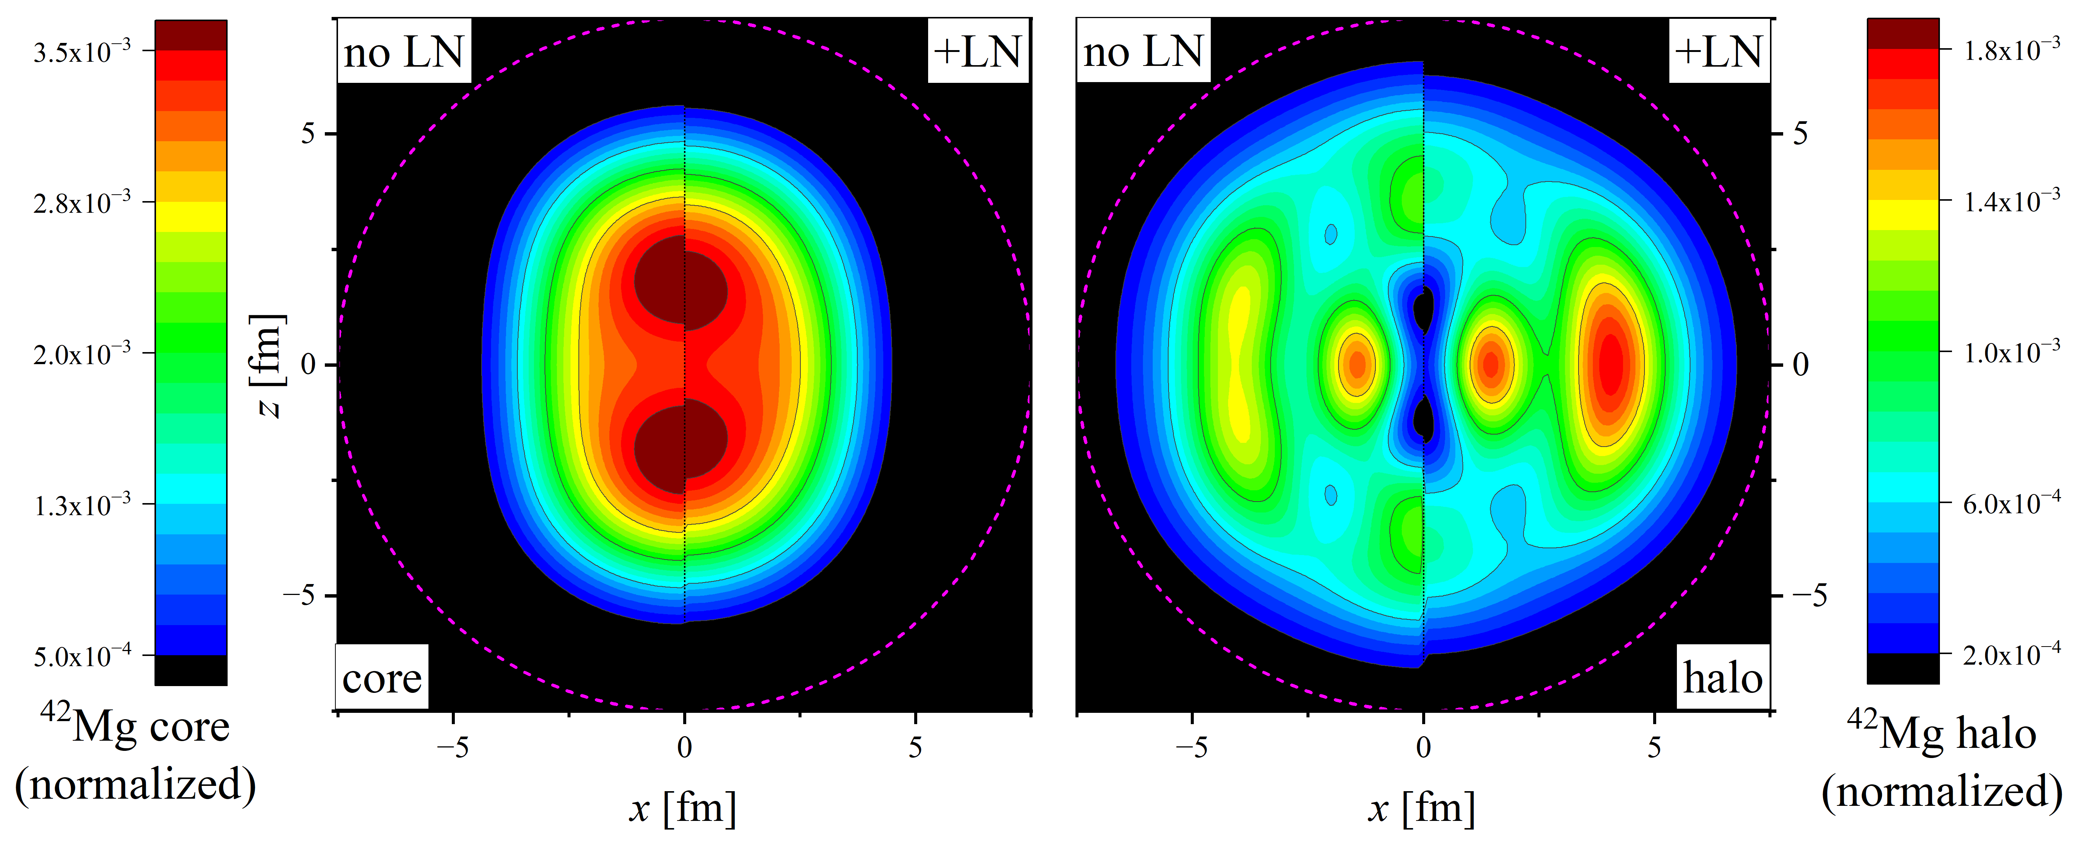
Density distribution of ⁴²Mg
 | Core |  | Halo
 | DRHBc | DRHBc+LN | DRHBc | DRHBc+LN
Radius $R$ (fm) | 3.899 | 3.858 | 5.373 | 5.181
Deformation $β$ | 0.447 | 0.370 | -0.225 | -0.465
Notes:
这样分别计算核芯和晕这两部分的密度分布。下面这幅图的两幅子图的左半边为~的结果，右半边为~的结果。一方面，对比核芯和晕的密度分布，可以看出核芯呈长椭形变而晕呈扁椭形变，即⁴²Mg的核芯和晕存在形状解耦。另一方面，对比DRHBc和DRHBc+LN的结果，可以看出加LN修正会导致⁴²Mg长椭的核芯形变略有减小而扁椭的晕形变显著增大。也就是说，LN修正显著增强了⁴²Mg的形状解耦效应
晕密度分布集中在垂直对称轴的平面上

Slide 53
Deformation contributions of SPLs
Neu. level | method | $$v^{2}$$ | $$β$$
$${1/2}_{5}^{−}$$ | DRHBc | 0.4062 | 0.3002
 | DRHBc+LN | 0.3863 | -0.1502
$${3/2}_{3}^{−}$$ | DRHBc | 0.3347 | -1.2120
 | DRHBc+LN | 0.4210 | -1.2067
$${7/2}_{1}^{−}$$ | DRHBc | 0.1853 | -0.9111
 | DRHBc+LN | 0.3636 | -0.9520
$${1/2}_{6}^{−}$$ | DRHBc | 0.0895 | -0.7416
 | DRHBc+LN | 0.1268 | -0.2495
$${3/2}_{4}^{−}$$ | DRHBc | 0.0763 | 0.1778
 | DRHBc+LN | 0.0992 | 0.1549
The enlarge of the halo’s deformation when applying LN correction is mostly attributed to the deformation change in $ν{1/2}_{5}^{−}$ level.

Slide 54
Deformation contributions of SPLs
 | $${1/2}_{5}^{−}$$ |  | $${3/2}_{3}^{−}$$ |  | $${7/2}_{1}^{−}$$
 | DRHBc | DRHBc+LN | DRHBc | DRHBc+LN | DRHBc | DRHBc+LN
$$v^{2}$$ | 0.4062 | 0.3863 | 0.3347 | 0.4210 | 0.1853 | 0.3636
$$β$$ | 0.3002 | -0.1502 | -1.2120 | -1.2067 | -0.9111 | -0.9520
 | $${1/2}_{6}^{−}$$ |  | $${3/2}_{4}^{−}$$
 | DRHBc | DRHBc+LN | DRHBc | DRHBc+LN
$$v^{2}$$ | 0.0895 | 0.1268 | 0.0763 | 0.0992
$$β$$ | -0.7416 | -0.2495 | 0.1778 | 0.1549
The enlarge of the halo’s deformation when applying LN correction is mostly attributed to the deformation change in $ν{1/2}_{5}^{−}$ level.

