Slide 1
Parity doublet model for finite nuclei
Youngman Kim
CENS, IBS

Slide 2
Motivations
Does QCD chiral symmetry is of use for finite nuclei? (too old question):
in principle yes!, but in practice???
Can finite nuclei help us to understand the origin of nucleon mass?
What will be (true) ground state of nuclear matter and finite nuclei beyond the MFA?

Slide 3
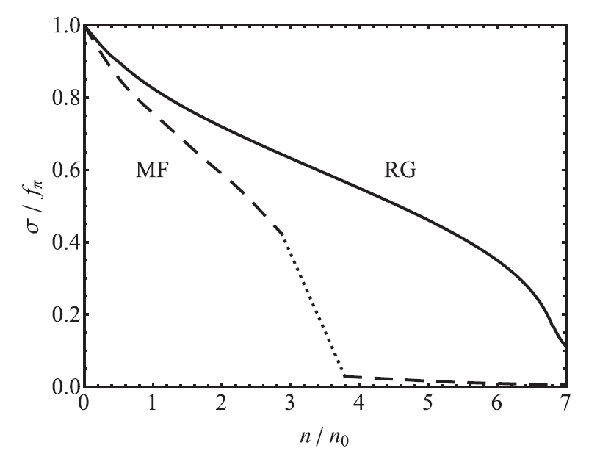
nuclei
Chiral symmetry may do some role.
Also, we may study fluctuations effects in finite nuclei,
as the chiral condensate changes as the density varies.

Slide 4
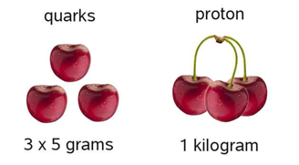

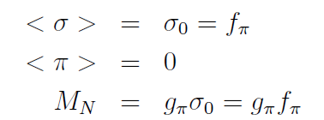
A reminder
Origin of nucleon mass?
Can nuclear matter and nuclei do anything for this?
Nucleon mass (in the chiral limit) in the linear sigma model

Slide 5
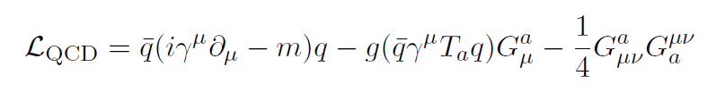

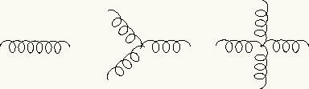
Chiral symmetry
After all, QCD (quantum chromodynamics) is here to
describe busy things: quarks, baryons, nuclei.

Slide 6
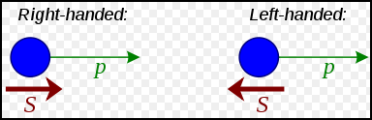
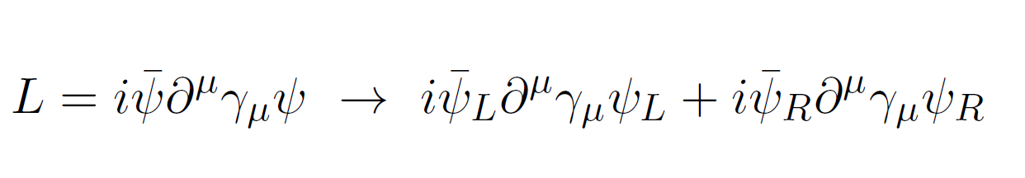
wikipedia
Let’s ignore the light quark mass here.
However, no L, R nucleons
V-L=A
V+L=V
No parity partner
Chiral symmetry breaking

Slide 7
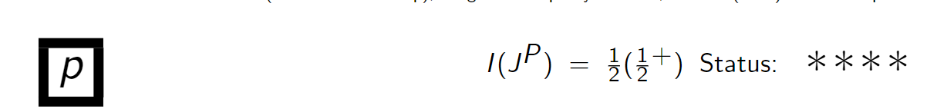
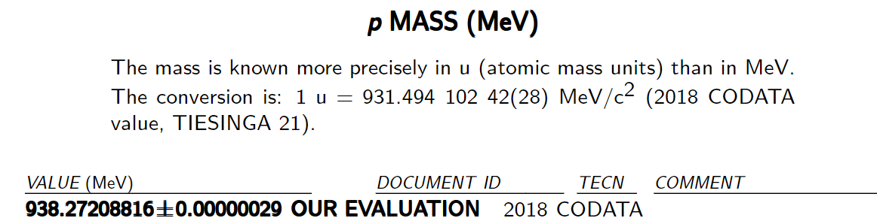
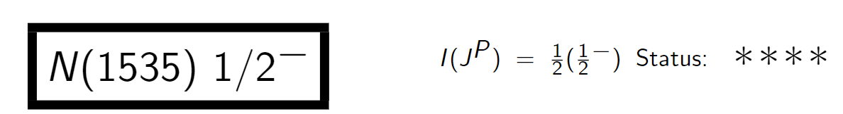
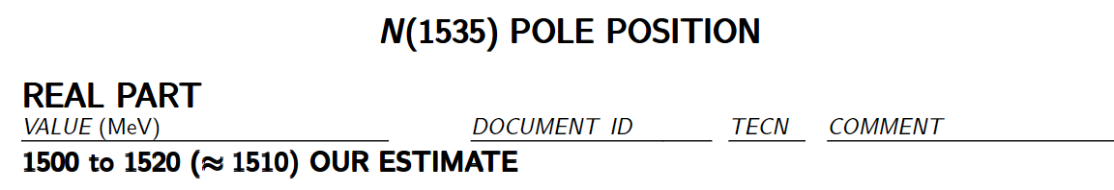
P, N* are chiral partner to each other?
In many cases, NO
Also, pion mass

Slide 8
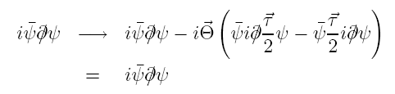





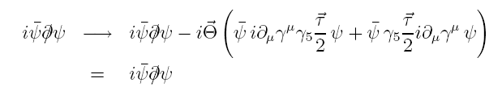
Chiral symmetry
: vector transform
: axial-vector transform

Slide 9




Chiral symmetry breaking
Gluons are flavor-blind!
→ Explicit chiral symmetry breaking
→ chiral limit: m=0
→ SSB of chiral symmetry

Slide 10


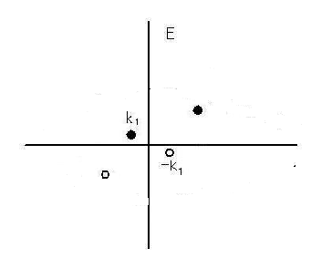
A BCS-like trial ground state --> true vacuum contains chiral (quark-antiquark) condensates in free space [Finger & Mandula, NPB 199, 168 (1982)]
E
In dense nuclear matter, chiral condensates will be reduced as low energy phase space is already occupied by the fermions in Fermi sea.

Slide 11





Mesons and chiral symmetry
→

Slide 12






Linear sigma-model
* SSB →

Slide 13
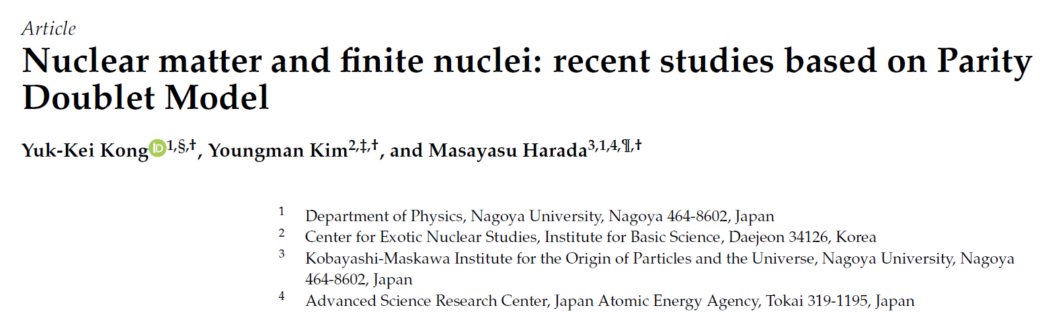
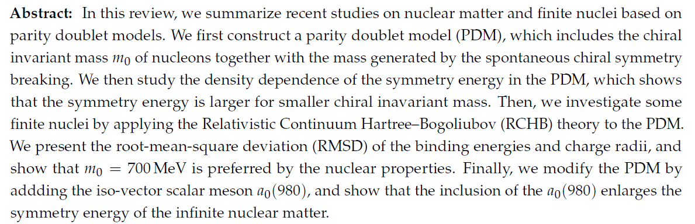
Submitted to a special issue of “SYMMETRY”

Slide 14




Parity doublet model
Introduce two nucleon fields that transform in a mirror way under chiral transformations:
Mirror assignment
c.f. Naïve assignment:

Slide 15
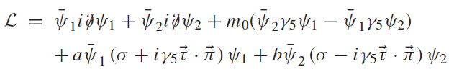


The state N+ is the nucleon N(938). while N- is its parity partner conventionally identified with N(1500).
“Linear sigma model with parity doubling,” C. E. DeTar and T. Kunihiro, Phys. Rev. D 39, 2805 (1989)

Slide 16
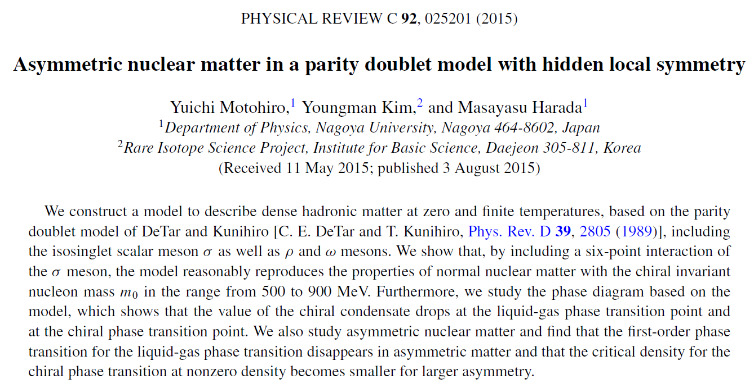
Y. Motohiro, M. Harada, YK, Erratum: Phys.Rev. C95 (2017) 059903

Slide 17
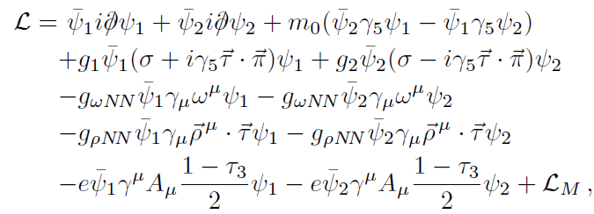
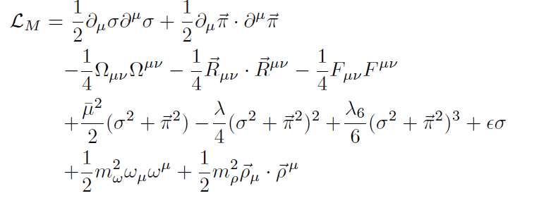

Slide 18
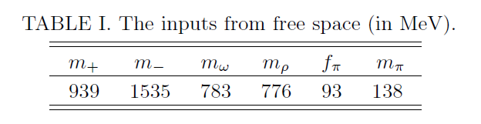
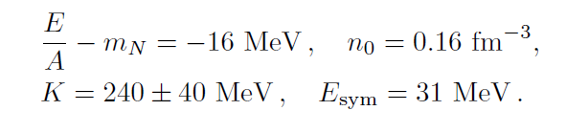
To fix the parameters in our model with fixed m₀

Slide 19
Delta matter in a parity doublet model (within MFA)
Yusuke Takeda, YK, Masayasu Harada, Phys. Rev. C97 (2018) 065202
* In symmetric matter, Delta enters into matter at (1-4) times the saturation density.
The stable Δ-nucleon matter is realized around 4 times the saturation density, and the phase transition from nuclear matter to Δ-nucleon matter is of first order in the wide parameter region.
* In asymmetric matter, the phase transition from the nuclear matter to the stable Δ-nucleon matter can be of the second order for most parameter region. The onset density is smaller than that in symmetric matter.
* In symmetric dense matter, larger chiral invariant nucleon mass tends to lower the transition density to the stable N-Δ phase.
* Partial restoration of chiral symmetry is enhanced by Delta matter.

Slide 20
Parity doublet model in finite nuclei
Spherical code (RCHB) was provided by Prof. Meng (Peking U.).
Main difference is the behavior of sigma mean field.
The code was revised to incorporate the difference.
With no Delta baryons in matter
With no a₀(980) mesons (now we are working on it)
Can we pin down the value of the chiral invariant mass?
Myeong-Hwan Mun, Ik Jae Shin, Won-Gi Paeng, Masayasu Harada, YK, EPJA 2023

Slide 21
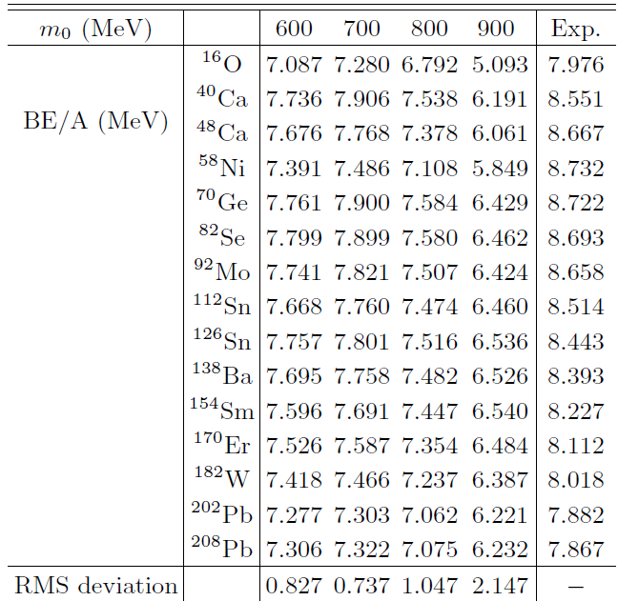

Slide 22
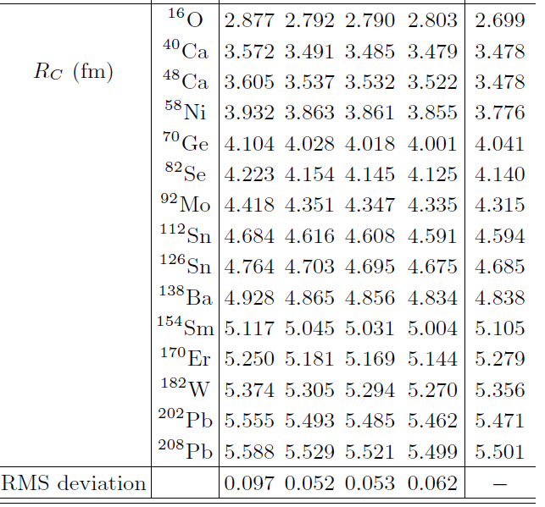

Slide 23
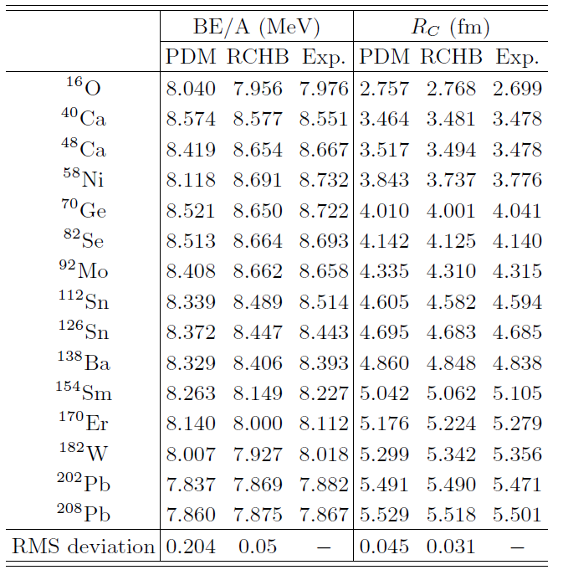

Slide 24
Fluctuations
Nucleons, though massive, can fluctuate near the Fermi surface as p-h excitations.
The pion and sigma mesons can fluctuate.
Vector mesons such as omega mesons may not fluctuate because they are massive. Only as mean field.

Slide 25
Beyond the mean field approximation: FRG
The FRG combines functional approach with the renormalization group idea and deals with the fluctuations not all at once but successively from scale to scale or shell by shell.
FRG is a good way to handle the fluctuations and a handy tool for those who are familiar with relativistic formalism.
My goal is to use the FRG method for exotic nuclei, neutron stars and heavy ion collisions!

Slide 26
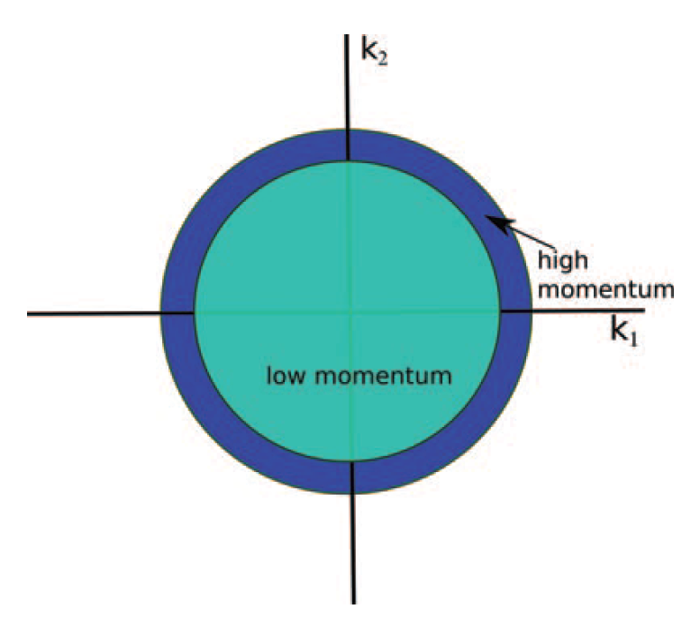
Wilsonian (effective action) approach
It is about how a theory changes as we scale down the momentum scale.

Slide 27
The first term in the derivative expansion of the effective action is effective potential (or energy)

Slide 28
To make sure that our FRG code is ok, we have reproduced the results in the paper below.

Slide 29
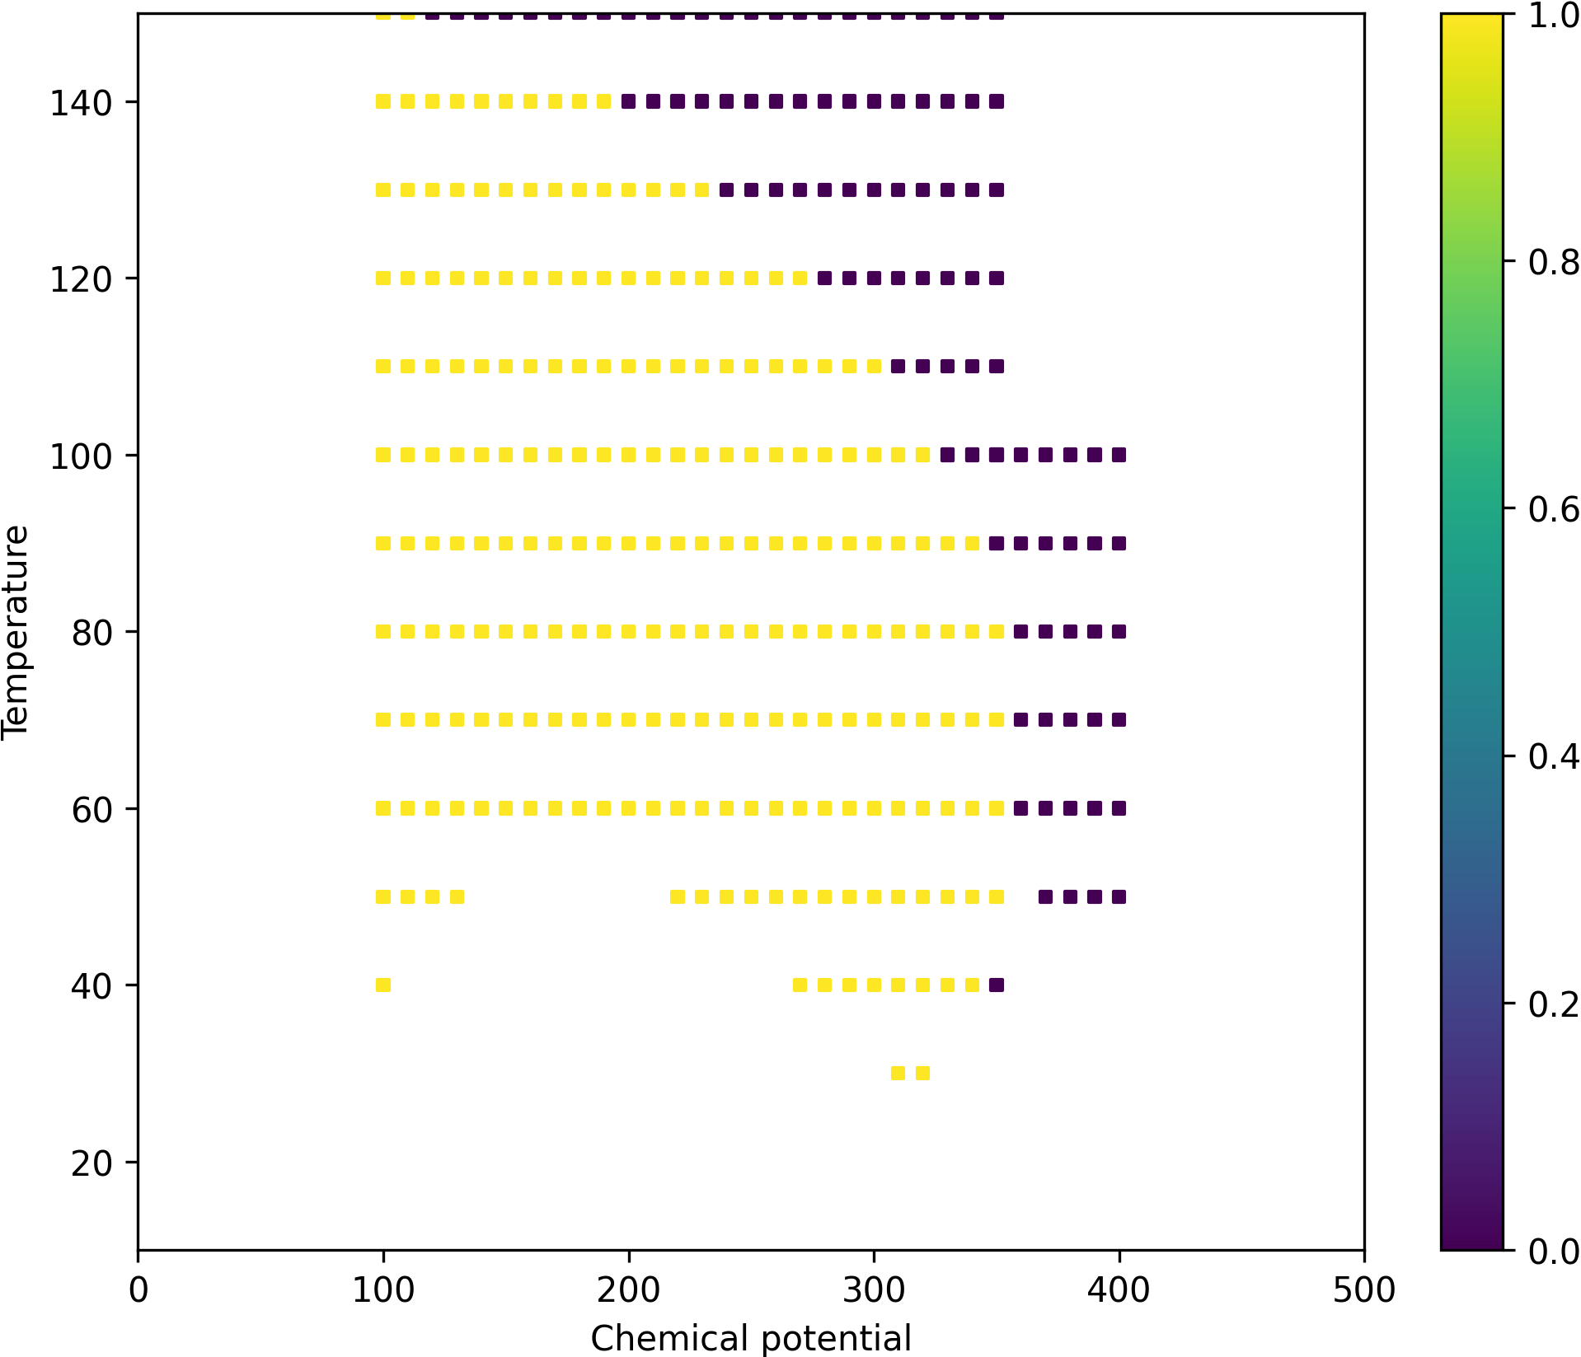
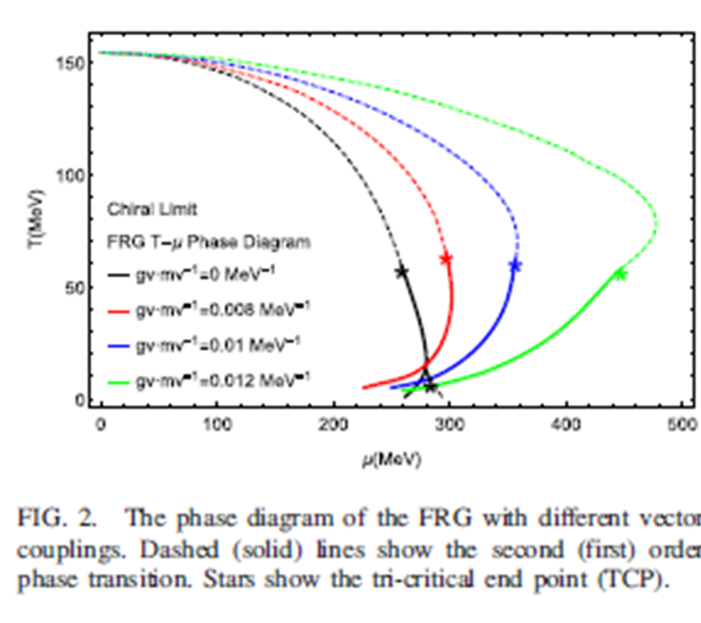
Soonchul Choi (CENS, IBS)

Slide 30
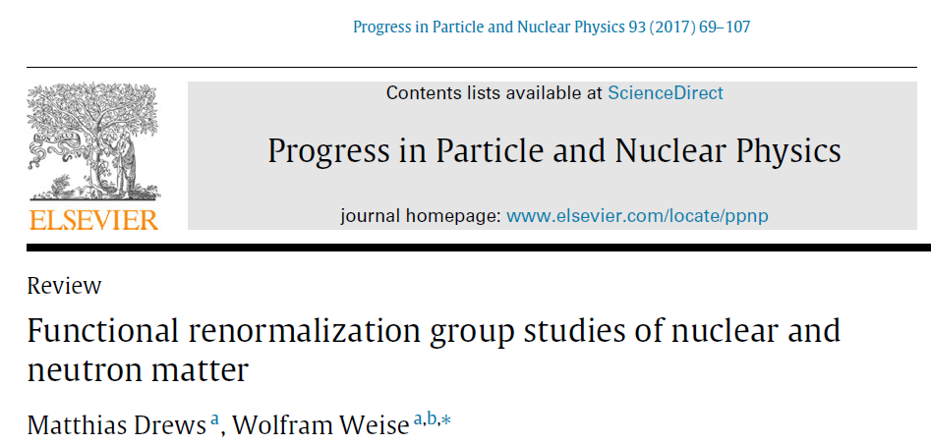

Chiral nucleon-meson model for finite nuclei will be done.

Slide 31
What about RMF models with no chiral symmetry?
In general more parameters and much more tough to constrain them!
Any helping hands from a cleaver and hard working student?

